Slide 1
CSP Foundational Technical Documentation

Slide 2
Agenda
Hybrid Azure Foundational
  Azure Reference Architecture Overview
  Azure Reference Architecture API Models
  Azure Hybrid Identity and Admin On Behalf Of (AOBO)
  Azure Hybrid Networking
Azure Resource Manager
  Azure Resource Manager Templates
  Provisioning Resources

Slide 3
Azure Reference Architecture Overview

Slide 4
The world of IT is changing
Evolving Business Models
Moving away from Infrastructure builds
Evolving IP Models
Building new on-demand services, rather than focusing on infrastructure support
Startup Agility, Enterprise Mentality
Stakeholders expecting better results, faster

Slide 5
Why are customers considering the cloud?
Public Cloud Platform
$30
Speed
Scale
Economics
$25
$20
Market Share (in Billions)
$15
$10
$5
2008
2009
2010
2011
2012
2013
2014
2015
2016
2017
2018
2019
2020
Notes:
In the last few years, we have seen an explosive growth in the use of the public cloud. While most of the initial adoption was seen by startups and smaller orgs, most of the new growth will come from larger organizations adopting the public cloud.
Now you might ask what’s causing cloud adoption at such a fierce rate. There are 3 fundamentals business drivers at play here:
SPEED: With minutes instead of days/weeks to procure & provision servers, the pace of innovation has dramatically increased. Reduced ‘time to develop’ & ‘time to market’ means your IT can be much more agile in servicing needs of the business units or developers. Embrace & Enable Innovation. Help your business move forward against the competition. In fact, it is the speed and agility that IT hasn’t been able to provide has resulted in what many call “Shadow IT” where business units are resorting to using credit cards to procure computing resources outside of the purview of the IT.
SCALE: Cloud gives you an almost infinite set of computing resources. Your applications will enjoy massive global scale, and can easily scale up or down depending on the demand. That means, you never have to worry about running out of capacity or worry about overprovisioning. You use just enough resources for your needs - nothing more, nothing less.
ECONOMICS: And of course, you’re paying only for what you use in the Cloud. This in itself saves you money for any app that has variable computing needs. For some organizations, there is also an additional benefit of changing CapEX to OpEX, which frees up capital from infrastructure investments so it can be put to other uses.

Slide 6
Microsoft Azure
Integration
Heterogeneity
Security
On-premises
AND cloud
Open, Broad, Flexible
Trustworthy
On-premises
and Cloud
Broad
and flexible
Secure
and reliable
Ready by design.

Slide 7





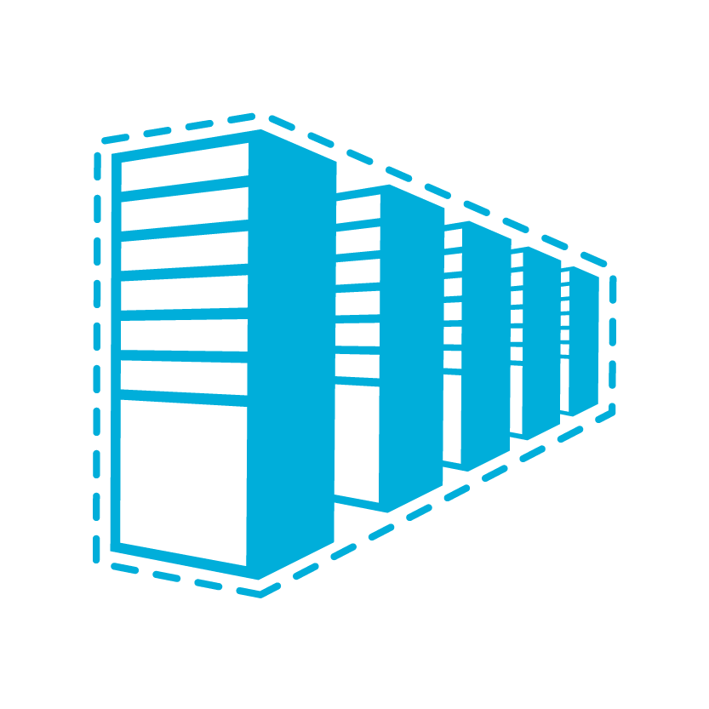

















Microsoft Azure
^{app}
^{services}
cloud services
caching
identity
service bus
media
mobile services
web sites
integration
hpc
analytics
^{data}
^{services}
SQL database
HDInsight
table
blob storage
^{infrastructure}
^{services}
virtual machines
virtual network
vpn
traffic manager
cdn
Notes:
Windows Azure is a broad stack of services that runs in our datacenters globally.
Think of the different services as building blocks. These services can be categorized into three classes –
Infrastructure services which are lower level building blocks,
Data services that provide storage and data management capabilities to apps, and
App services which provide different capabilities to rapidly develop apps, scale and run apps at a global scale.

Slide 8
Microsoft Azure
^{app}
^{services}
cloud services
caching
identity
service bus
media
Apps
mobile services
web sites
integration
hpc
analytics
^{data}
^{services}
SQL database
HDInsight
table
blob storage
caching
identity
cloud
services
table
^{infrastructure}
^{services}
virtual
network
virtual machines
virtual network
vpn
traffic manager
cdn
Notes:
You can use these blocks or puzzle pieces to rapidly build apps, and then choose an Azure datacenter to run the app. Windows Azure takes care of the underlying management, and provides your app the scale it needs.
This approach is what industry experts call a Platform as a Service.

Slide 9

Microsoft Azure
Azure datacenters,
your datacenters.
^{app}
^{services}
cloud services
caching
identity
service bus
media
web sites
integration
hpc
analytics
virtual machines
virtual network
mobile services
vpn
^{data}
^{services}
SQL database
HDInsight
table
blob storage
^{infrastructure}
^{services}
virtual
network
virtual machines
virtual network
vpn
traffic manager
cdn
vpn
Notes:
But that is not all that you can do with Azure. Windows Azure also provides infrastructure services which allow for more hands on configuration and management similar the servers you have today. However, they’re hosted in Microsoft datacenters letting you use Azure as if you were operating your own datacenter in the Cloud. For example, you can provision VMs, give them private IP addresses, and connect to them using a VPN from your on-premises environment. Most importantly, this lets Windows Azure mimic your on-premises datacenter and run your current apps with little or no change without the expense of having to own servers of racks, cooling and building costs. Furthermore, you can connect the “datacenter” you build in the Cloud to your on-premises datacenter so the datacenter in the Cloud becomes an extension to your on-premises infrastructure.
These “building blocks” lets Windows Azure to be used as an Infrastructure-a- a-service.
So, you see Windows Azure offers IaaS +PaaS in one platform. IaaS provides flexibility, PaaS eliminates complexity. Use PaaS where you can, use IaaS where you need. With Azure, you can use both together or independently, and build apps of the future. That uniquely differentiates us.

Slide 10
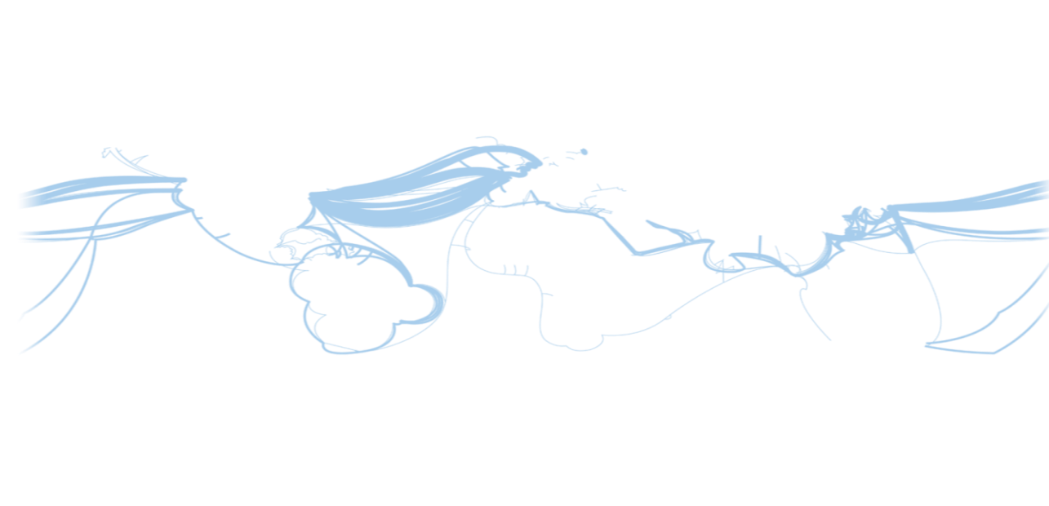
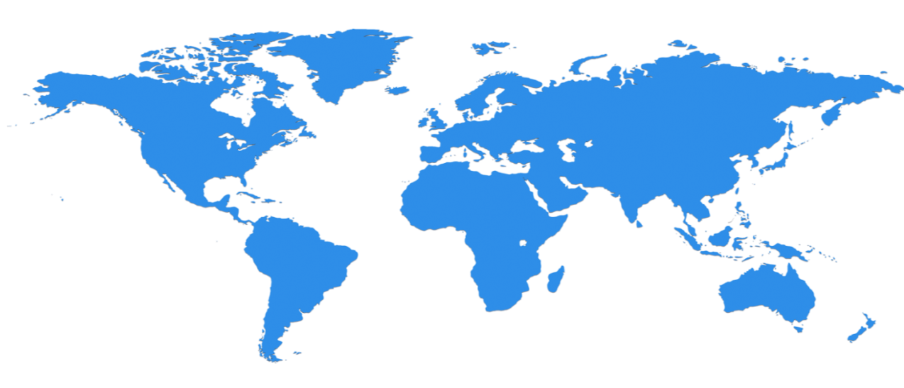

Huge infrastructure scale is the enabler
19 Regions ONLINE…huge datacenter capacity around the world…and we’re growing
North Europe
Ireland
West Europe
Netherlands
Central US
Iowa
North Central US
Illinois
US Gov
Iowa
China North *
Beijing
East US
Virginia
Japan East
Saitama
West US
California
China South *
Shanghai
East US 2
Virginia
Japan West
Osaka
India West
TBD
India East
TBD
South Central US
Texas
US Gov
Virginia
East Asia
Hong Kong
SE Asia
Singapore
Australia East
Sydney
Brazil South
Sao Paulo
  100+ datacenters
  One of the top 3 networks in the world (coverage, speed, connections)
  2 x AWS and 6x Google number of offered regions
  G Series – Largest VM available in the market – 32 cores, 448GB Ram, SSD…
Australia West
Melbourne
Operational
Announced
  * Operated by 21Vianet
Notes:
Over the last few years we’ve truly delivered a huge infrastructure to enable us to grow our services at scale around the globe. Whether it’s our flagship facilities in Quincy, Washington or Boydton, Virginia, or some of the newly announced facilities in Shanghai, Australia and Brazil, it really is key for us to make smart investments around the world to deliver services in a resilient and reliable fashion.
A lot of people ask, what goes into site selection at Microsoft and how do we decide where to place our datacenter investments? There are over thirty-five factors in our site selection criteria. But really, the top elements are around proximity to customers and energy and fiber infrastructure, insuring that we have the capacity and the growth platforms to be able to grow our services.
Another key element is about skilled workforce. We need to insure that we have the right people to run and operate our datacenters on a day to day basis.

Slide 11





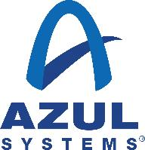





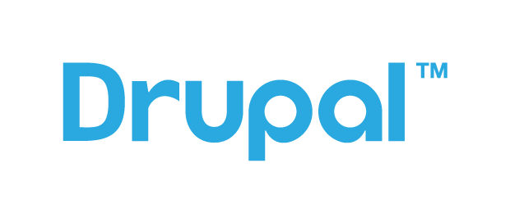



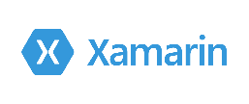

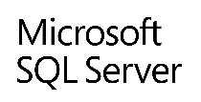








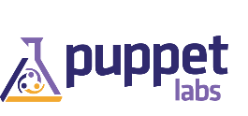

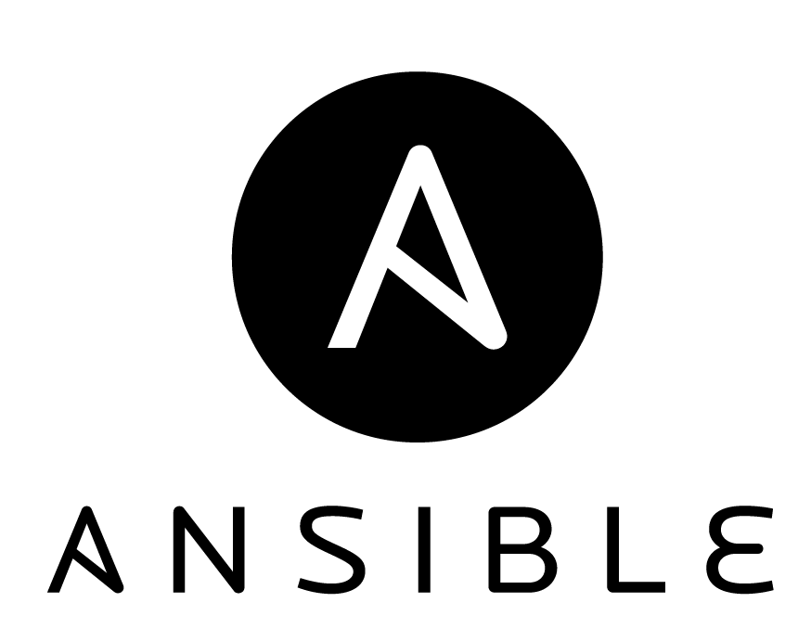
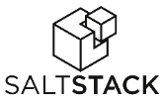



Azure is Open
Microsoft Integrated
Ecosystem Provided
Languages,
Dev Tools
and App Containers
Bring your own
CMS and Apps
Web App Gallery
Dozens of .NET and PHP CMS and Web applications
Devices
Via HTMl/JS, cross-platform and native
Databases
DocDB
Management
libcloud
jclouds
Operating
systems
Ubuntu, SUSE, OpenSUSE,
OpenLogic CentOS-based
Oracle Linux, CoreOS
Bring
your own

Slide 12
Cloud is a Shared Responsibility
  On-Premises
  IaaS
  PaaS
  SaaS
Applications
Data
Runtime
Middleware
O/S
Virtualization
Servers
Storage
Networking
Customer
Microsoft
Notes:
We have a shared responsibility for security, privacy, and compliance. Windows Azure helps reduce the security and compliance burden for customers with internal tools, processes, and controls, and enables customers to use their own tools, processes, and policies. For example, Microsoft uses access controls to protect the system administrator privileges while the customer is responsible for end user access control. The shared responsibility approach provides a more flexible and secure foundation for all users while giving individual customers the flexibility to build the solution that meets their specific security, privacy, and compliance needs.

Slide 13
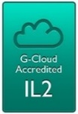












Built on a Trustworthy Foundation
Trustworthy
Computing
Initiative
1st Microsoft
Data Center
Malware
Protection
Center
UK G-Cloud Level 2
FedRAMP/
FISMA
Active
Directory
SOC 1
SOC 2
1989
1995
2000
2005
2010
Windows
Update
Security
Development Lifecycle
E.U. Data Protection Directive
CSA Cloud Controls Matrix
Global
Data Center
Services
Digital Crimes Unit
ISO/IEC 27001:2005
HIPAA/
HITECH
PCI DSS Level 1
Microsoft Security
Response Center
Notes:
Microsoft has proven experience delivering cloud services at global scale and uses this deep knowledge to develop best practices and technology innovations that support increased reliability and compliance readiness. Microsoft Trustworthy Computing (TwC) is a long-term, collaborative effort to create and deliver secure, private, and reliable computing experiences for everyone. TwC principles and processes inform every aspect of Windows Azure from design to development to operations, helping to deliver a more secure, private, and compliant platform for customers.
Microsoft also engages in industry-leading security efforts through the creation of centers of excellence:
Microsoft Digital Crime Unit (DCU). The DCU brings together a unique team of lawyers, investigators, business professionals, intelligence specialists and forensic analysts – deploys trailblazing techniques to fight a wide array of online criminal activity.
Microsoft Cybercrime Center. An effort of the DCU, the Microsoft Cybercrime is a secured facility at the company’s Redmond campus. It houses groundbreaking Microsoft technologies that allow the team to visualize and identify global cyber threats developing in real time, The Cybercrime Center includes a separate and secure location for third-party partners, allowing cybersecurity experts from around the world to work in the facility with Microsoft experts. With nearly 100 attorneys, investigators, technical experts and forensic analysts based around the world, the Microsoft Cybercrime Center is well positioned to make it safer for people online worldwide.
Microsoft Malware Protection Center (MMPC). By continuously gathering and analyzing data, and by working with organizations inside and outside Microsoft, the MMPC helps combat evolving threats. Labs in Redmond, Washington, U.S.A.; Munich, Germany; Vancouver, Canada; and Melbourne, Australia—with the help of additional researchers in other locations around the world—ensure that a response team is always online.

Slide 14
Azure Subscription Overview

Slide 15
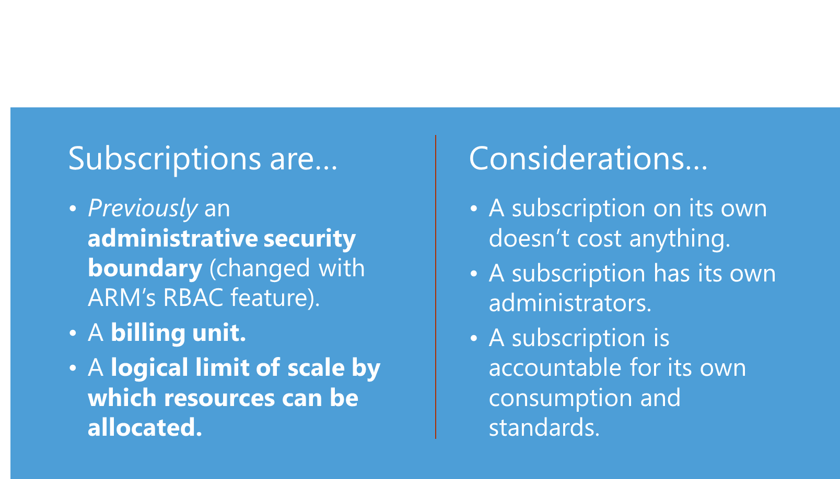
Subscription Principles
Notes:
Initially a subscription was the administrative security boundary of Microsoft Azure. With the advent of Azure Resource Management (ARM) environment, a subscription now has two administrative models. Service Management and Azure Resource Management. With ARM the subscription is no longer needed as an administrative boundary. ARM provides a more granular Roles Based Access Control (RBAC) model for assigning administrative rights at the resource level. RBAC is currently being released in stages, 22 new roles have been released and user defined roles is coming in a future release. There will be some complexity during the coexistence of the service management and resource management environments and will need to be carefully considered.
A subscription additionally forms the billing unit. Services charges are accrued to the subscription currently, as part of the new Azure Resource Management model it will be possible to roll up costs to a resource group. A standard naming convention for Azure resource object types can be used to manage billing across projects teams, business units, or other desired view.
A logical limit of scale by which resources can be allocated, these limits include both hard and soft caps of various resource types (like 10,000 compute cores /subscription) and are changing as capacity and capabilities are updated within Azure. Scalability will continue to be a function of subscriptions and therefore is a key element to understand how the Subscription strategy will account for growth as consumption increases.

Slide 16
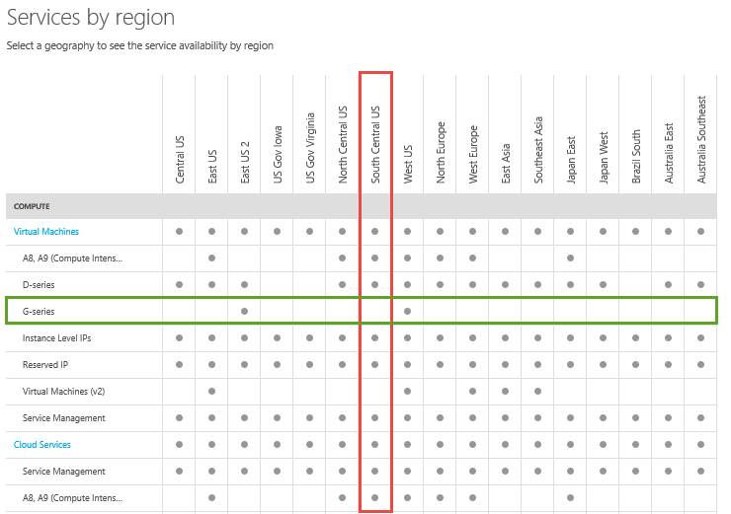
Correlating Azure Products and Regions
Features and Regions
  Ensure your feature is available in the region you wish to deploy
Preview and General Availability (GA)
  Understand differences in support, costs and available geographies
Special Regions
  MAG/China
  Full suite of Azure services may not be currently available and have timelines for certification and availability

Slide 17
Subscription Consumers
Customer Managed
When the Azure subscription is provisioned using the customer-owned account models described earlier in this document where the customer organization deploys and manages Azure workloads on their own.
Cloud Service Provider (CSP) Managed
When the Azure subscription is provisioned by Cloud Solution Provider who manages end customer Azure subscriptions
The focus of this workshop is on Cloud Service Provider (CSP) managed subscriptions

Slide 18
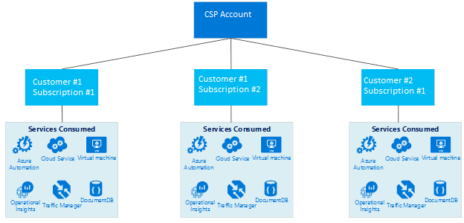
Subscriptions per Customer (CSP Managed)
One or more subscription per specific customer where a separate service deployment for a given customer may be assigned a dedicated subscription.

Slide 19
CSP Managed Subscriptions
Understanding how customers are approaching Azure today may influence how Service Providers connect their customers
Customer-Managed Models:
Per Department
Per Environment
Per Application

Slide 20
Subscription per Department (Customer Managed)
Each department contains different types of environments (e.g. Prod, Non-Prod). Virtual Networks will wrap the different environments for traffic separation. Subnets will be created within each environment to establish required security isolation zones between applications.
Simplified Subscription Management
Cons
Granular RBAC model required
Low ExpressRoute Circuit Costs
No Vnet Subscription Limit
Subscription Limit Issues in Cloud Services, Storage, NSGs
Complex Vnet addressing
Mistake in management will affect all environments
Pros

Slide 21
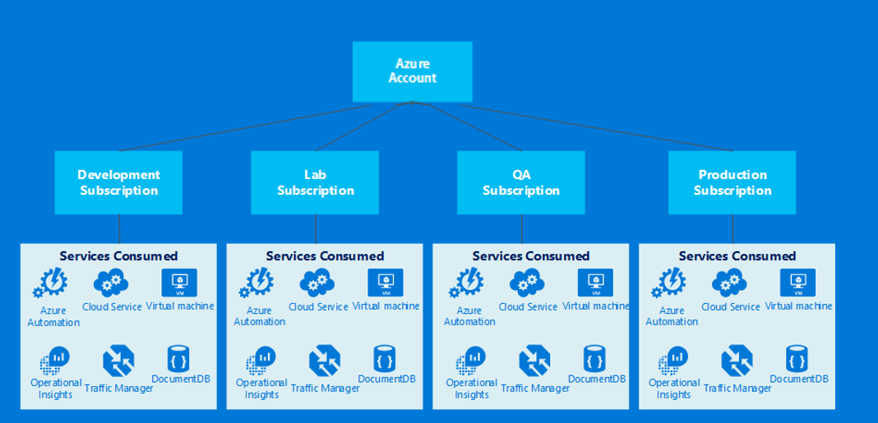
Subscription per Environment (Customer Managed)
Each environment contains the different types of applications. Virtual Networks will wrap the different applications for traffic separation. Subnets will be created within each environment to establish required security isolation zones among application tiers.
Pros
Cons
New ExpressRoute circuit required per 10th application
Shared ExpressRoute circuit model
Requires medium capacity planning
Max of 10 dedicated circuits per subscription, max of 100 applications
Low Vnet subscription limit issues (Limit Per 100th application)
Vnet address spaces can be tailored per application
Granulated Application RBAC model

Slide 22
Subscription per Application (Customer Managed)
Each application contains the different tiers. Virtual Networks will wrap the different tiers for traffic separation. Subnets will be created within each tier to establish required security isolation zones.
Pros
Cons
Minimal Capacity Planning
Per Application RBAC model
Management Complexity
Minimal Subscription limit issues.
Increased Network Costs

Slide 23
Multiple Subscriptions Per Customer = Complexity
On-premises networking and security infrastructures are typically shared resources
Patching, monitoring, auditing are frequently provided by dedicated organizations and trained staff
Allowing Azure subscriptions to be based on project or team, could result in having to:
Purchase dedicated network circuits arbitrarily rather than for bandwidth need
Support multiple Edge gateway devices
Increased management of IP address space allocation
Increased management of routing and firewall configurations
Duplicate services required including monitoring, patching, and Anti-Virus

Slide 24
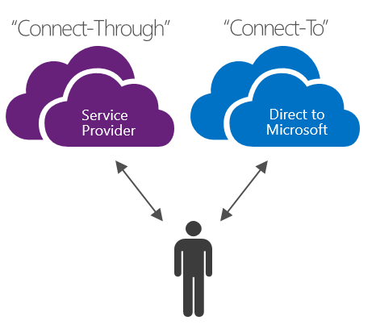
CSP Subscription Connection Models
Service Providers will be required to connect their customers to their CSP Azure subscriptions in one of two ways:
“Connect-Through”
“Connect-To”
These models are heavily dependent on decisions around network connectivity and identity integration scenarios

Slide 25
CSP Managed – Connect Through
Provider creates a direct connection between their datacenter and the provisioned customer Azure subscription using Site-to-Site using the provider’s network.
This connectivity scenario requires that the customer passes through a provider network to access CSP provisioned Azure subscription services, using a network connection that is created, owned and managed by the service provider.
For these customers it is assumed that the provider has a previously established tenant identity store which would then be replicated into Azure Active Directory for management of their CSP subscription
Notes:
Key drivers for this scenario include where a given partner or service provider has an established relationship with the customer, the customer is consuming provider services currently or the partner has a desire to provide a combination of provider-hosted and Azure-hosted solutions to provide flexibility and address customer challenges which cannot be satisfied by Azure services alone

Slide 26
CSP Managed – Connect To
Provider creates a direct connection between their datacenter and the provisioned customer Azure subscription using Site-to-Site VPN (or in the future over an Express Route connection) using the customer’s network.
This connectivity scenario requires that the customer connects directly through a customer network to access CSP provisioned Azure subscription services, using a direct network connection that is created, owned and managed either wholly or in part by the customer.
For these customers it is assumed that the provider does not currently have a tenant identity store established and would assist the customer in replicating their current identify store into Azure Active Directory for management of their CSP subscription.
Notes:
Key drivers for this scenario include where a given partner or service provider has an established relationship with the customer, the customer is consuming provider services currently or the partner has a desire to provide services that are based solely Azure-hosted solutions without the need for an existing provider datacenter or infrastructure.

Slide 27
CSP Management Portals
Portal | Location | Purpose
Partner Portal | https://partnercenter.microsoft.com | Manage CSP customers Manage CSP customer accounts Manage CSP customer subscriptions Manage user accounts assigned to CSP customer subscription administration Retrieve billing data as a CSP on behalf of CSP customers Administer services provisioned within CSP customer subscriptions Create and Manage Azure service requests
Management Portal | Azure Active Directory Management: https://account.windowsazure.com/PremiumOffer/Index?offer=MS-AZR-0110P&returnUrl=https://manage.windowsazure.com/<-csp->.onmicrosoft.com#Workspaces/ActiveDirectoryExtension/Directory/<-guid->/directoryQuickStart Customer Azure resource management: https://portal.azure.com/<tenant>.onmicrosoft.com (Preview) When accessed by the end customer: https://manage.windowsazure.com or https://portal.azure.com (Preview) | Provision/de-provision Azure services Manage co-administrators on subscriptions Open support tickets for issues within the subscription

Slide 28
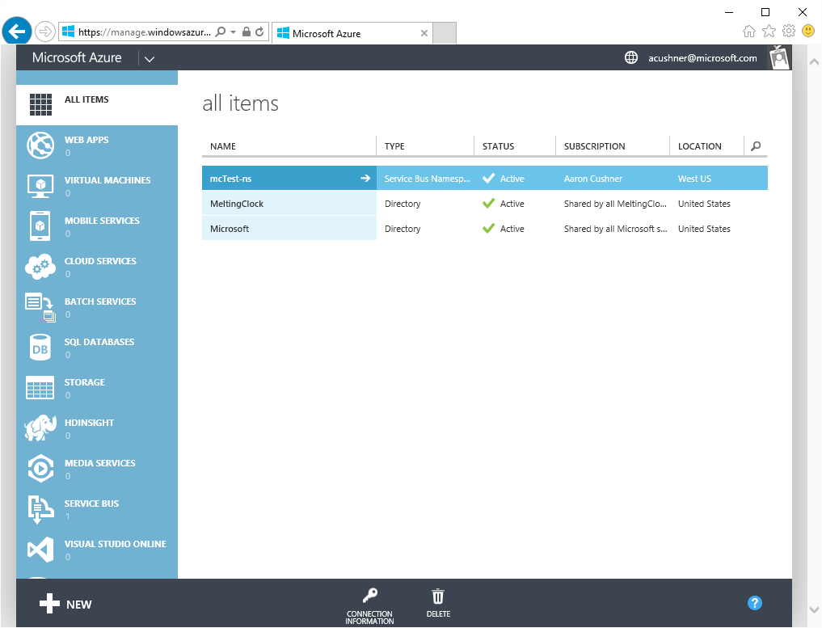
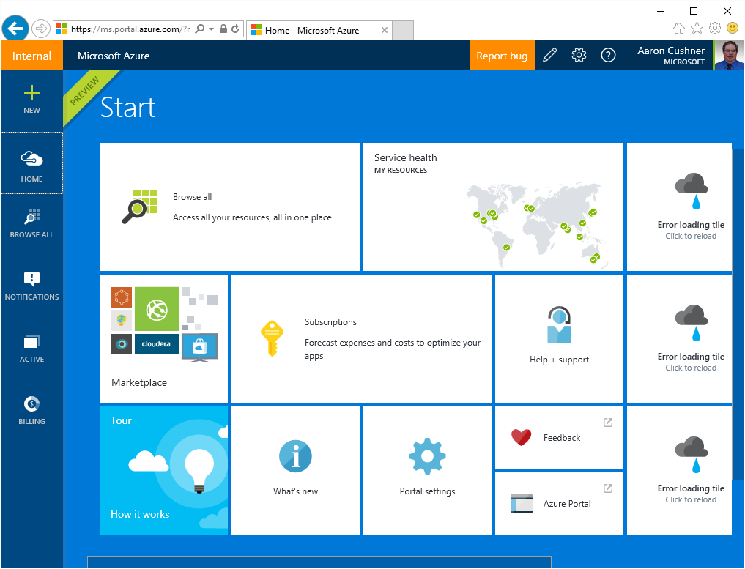
Azure Portals and Frameworks
Classic: manage.windowsazure.com
New: portal.azure.com
Azure Service Management (ASM)
No Role Based Access Control
Direct subscriptions only
Azure Resource Manager (ARM)
Role Based Access Control
CSP & Direct subscriptions
Notes:
Azure has two provisioning frameworks:
Azure Service Management (ASM) ← Classic
ARM (Azure Resource Manager) ← New
Separate Portals, CLIs and REST endpoints.
Direct subscriptions provisioned into RDFE and ARM:
Customers can fallback to RDFE + existing portal for services/features not in ARM yet.
CSP subscriptions provisioned into ARM only:
RDFE does not understand AOBO + assigning roles to groups (RBAC).
Therefore, partners can only access applications/services available in ARM + Azure Preview Portal.

Slide 29
What’s New About IaaS v2
v1: Service Management APIs
  Not fully integrated: no RBAC, tagging, templates
  Challenging network modelling
v2: ARM APIs
  Fully integrated into Resource Manager
  Tags and RBAC at granular levels
  More asynchronous operations - massive and parallel deployment of VMs
  Dependencies
  Network resource types are separate from compute
  3 Fault Domains in Availability Sets
  Part of Azure-consistent private cloud. Deploy same JSON template in Azure or Azure Stack
  Limited support for PaaS

Slide 30
Azure Hybrid Identity for Cloud Service Providers

Slide 31
What is Azure Active Directory?
A comprehensive identity and access management cloud solution.
It combines directory services, advanced identity governance, application access management and a rich standards-based platform for developers
Available in 3 editions: Free, Basic and Premium

Slide 32
Azure Active Directory Features
Cloud Directory
Central Management of Identity and Access
Application Monitoring and Access
End-User Features
Connect on-premises directories to Azure AD
Azure AD Sync Multi-Forest Support
Single Sign-on to thousands SaaS apps+ LoB and Custom application support
Application Proxy
Enterprise SLA of 99.9 percent
Self-service password change
Self-Service password reset
Delegated group management
Self-Service security settings management
Single Sign-On to on-premises applications from the Access Panel (Azure AD Application Proxy)
Group-based user assignment to SaaS apps
Group-based provisioning
Company branding
Password writeback
Advanced Security reporting and analytics
Application usage reports
Alerting/Notifications
Multi-factor authentication

Slide 33
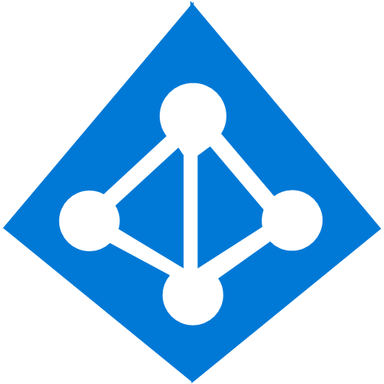
Provider Azure Active Directory
Provider tenant created on CSP sign-up
Users can be an agent (supporting customers) or an admin (supporting the provider) or both
Managed in the Partner Center Portal or Azure Active Directory
Groups
Admin Agents
Sales Agents
Helpdesk Agents
Roles
Global Admin
Billing Admin
User Management Admin
Provider’s AAD Tenant
Notes:
The default setting should always be Not an admin, unless the user genuinely requires additional access to do their job.

Slide 34
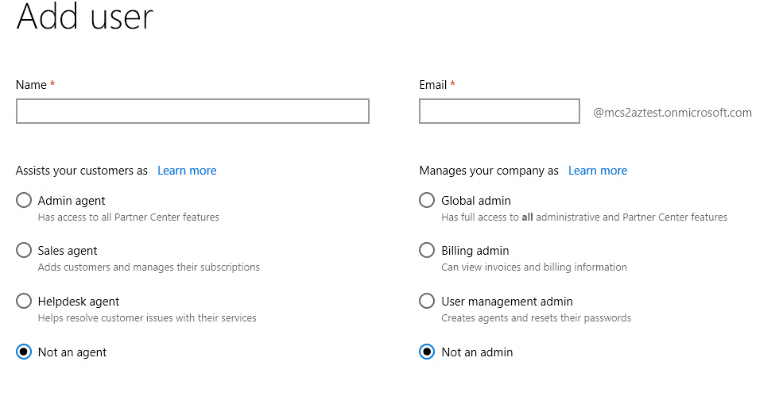
Partner Center User Management
Notes:
Provider users can be created using the Partner Center portal (as this screen shot shows) or using the Azure Active Directory portal at manage.windowsazure.com.
The left hand options are the roles for customer management (agents).
The right hand options are for managing the provider (admins).
It is a best practice to be either an agent or an admin but not both.

Slide 35
Provider Agent Roles
Role in Partner Center | What they can do | What they can't do
Admin agent | Customer management Subscription management Service health and service requests for customers Request delegated admin privileges View pricing and offers Billing Admin on behalf of Register a value added reseller | User management Service requests for Partner Center
Sales agent | Customer management Subscription management View support tickets Request a relationship Manage customer leads View the customer agreement Register a value added reseller | Create support tickets for services or Partner Center Resolve support tickets View service health View pricing and offers Billing Admin on behalf of
Helpdesk agent | Search for and view a customer Edit customer details Service health and service requests Admin on behalf of | View partner profiles Create a new customer listing Edit customer billing info Subscription management Request a relationship Manage customer leads View pricing and offers View the customer agreement Billing Register a value added reseller

Slide 36
Provider Admin Roles
Role in Partner Center | What they can do
Global admin | Can access all Microsoft account/services with full privileges Create support tickets for Partner Center View agreements, price lists, and offers Billing View, create, and manage partner users
Billing admin | Can access all bills from Microsoft with full privileges View agreements, price lists, and offers Billing
User management admin | View, create, and manage users View all partner profiles

Slide 37
Customer Azure Active Directory
Customer tenant created when the customer is provisioned (Partner Center or CREST API)
Have no rights to the Azure subscriptions unless specifically granted Azure RBAC roles
Managed through the Office Portal or Azure Active Directory
Admin Agent Group
Is Owner of
S
Azure CSP subscription
No Access
Unless Granted
Customer Users / Groups
Customer’s AAD Tenant
Notes:
When a new Azure CSP subscription is ordered for a customer, the provider’s Admin Agent Group is set to be the owner of the subscription. The customer has no rights to the subscription unless specifically granted.

Slide 38
How AOBO (Admin-on-Behalf-of) works
O365 + Intune honor AAD Tenant Admin Role. Therefore, members of Partner AdminAgents group can manage O365 + Intune on-behalf-of customers.
O365 + Intune
is Member of
can manage
AdminAgents Group
Tenant Admin Role
Partner’s AAD Tenant
Customer’s AAD Tenant

Slide 39
How AOBO (Admin-on-Behalf-of) works
Similar to O365, Azure CSP subscription is provisioned into customer tenant.
O365 + Intune
is Member of
can manage
AdminAgents Group
Tenant Admin Role
S
Azure CSP subscription
Partner’s AAD Tenant
Customer’s AAD Tenant

Slide 40
How AOBO (Admin-on-Behalf-of) works
However, Azure subscriptions have “subscription-scoped” boundaries and are not managed by Tenant Admins. Instead, Partner AdminAgents Group is granted Owner role to Azure CSP subscriptions.
O365 + Intune
is Member of
can manage
AdminAgents Group
Tenant Admin Role
S
Is Owner of
Azure CSP subscription
Partner’s AAD Tenant
Customer’s AAD Tenant

Slide 41
How AOBO (Admin-on-Behalf-of) works
To manage customer’s subscriptions through the Azure preview portal:
  Select customer through Partner Center, OR
  Navigate to https://portal.azure.com/<customer-domain-or-TenantId> (e.g., https://portal.azure.com/contoso.com)

Slide 42
How AOBO (Admin-on-Behalf-of) works
To manage customer’s subscriptions through PowerShell:
  Use Add-AzureAccount cmdlet with -Tenant parameter, specifying customer domain or TenantId
  PS C:\> Switch-AzureMode -Name AzureResourceManager
  PS C:\> Add-AzureAccount -Tenant <customer domain>

Slide 43
How AOBO (Admin-on-Behalf-of) works
To manage customer’s subscriptions through the Azure CLI:
  Use the login command with the --tenant parameter
  > azure login -u <partner admin agent account> --tenant <tenant domain>

Slide 44
How AOBO (Admin-on-Behalf-of) works
To manage customer’s subscriptions Azure REST API:
  Create a service principal in the customer AAD that has access to the subscription.
  Retrieve the service principal AAD security token and use that in calls to the Azure REST APIs.

Slide 45
Create the Service Principal
Switch-AzureMode -Name AzureResourceManager
Add-AzureAccount -Tenant “<customer domain>“ # log in with partner admin agent
$azureAdApplication = New-AzureADApplication -DisplayName “<your app name>" -HomePage "https://<your app name>" -IdentifierUris "https://<your app name>" -Password “<your password>"
New-AzureADServicePrincipal -ApplicationId $azureAdApplication.ApplicationId
sleep 60 # Needed to let the service principal propagate
New-AzureRoleAssignment -RoleDefinitionName Owner -ServicePrincipalName $azureAdApplication.ApplicationId
$subscription = Get-AzureSubscription | where { $_.IsCurrent }
# use <your password> in the next call
$creds = Get-Credential -UserName $azureAdApplication.ApplicationId -Message 'Enter App Credentials’
Add-AzureAccount -Credential $creds -ServicePrincipal -Tenant $subscription.TenantId
1
2
3
4
Notes:
First we switch to ARM mode and get into the context of the customer
(Fade) Next we create an azure application. Make sure to save the application ID generated and the password you used
(Fade) Then we create the service principal and give it the owner role assignment
(Fade)Then we get the subscription, the application credentials (use the password from before), and assign it to the subscription.

Slide 46
Get the Service Principal Security Token
AADTokenDetails details = null;
using (var httpClient = new HttpClient())
{
var content = new FormUrlEncodedContent(new[]
{
new KeyValuePair<string, string>("grant_type", "client_credentials"),
new KeyValuePair<string, string>("resource", "https://management.core.windows.net/"),
new KeyValuePair<string, string>("client_id", "<application ID>"),
new KeyValuePair<string, string>("client_secret", "<application password>")
});
var response = httpClient.PostAsync(
"https://login.windows.net/<customer tenant id>/oauth2/token?api-version=1.0", content).Result;
var result = response.Content.ReadAsStringAsync().Result
}
details = JsonConvert.DeserializeObject<AADTokenDetails>(result);
1
2
3
Notes:
Setup the request headers using the application ID and application password from creating the service principal
(Fade) Create the request URL including the customer tenant ID
(Fade) Save the token for later use. The AADTokenDetials class is a simple class that mimics the return data. Of note are the expires_in property which can be used with a caching strategy and the access_token which is what is required for Azure REST API calls.

Slide 47
Using the Azure REST API
using (var httpClient = new HttpClient())
{
httpClient.DefaultRequestHeaders.Authorization =
new AuthenticationHeaderValue("Bearer", details.access_token);
httpClient.DefaultRequestHeaders.Accept.Add(
new MediaTypeWithQualityHeaderValue("application/json"));
string URL = "https://management.azure.com/subscriptions/<subscription ID>?api-version=2015-01-01";
var response = httpClient.GetAsync(URL).Result;
result = response.Content.ReadAsStringAsync().Result;
//...
}
1
2
3
Notes:
Set up the request headers using the access token for the service principal
(Fade) Provide the URI for the call, using the customer’s subscription ID which can be obtained from the Partner Center portal or CREST API calls.
(Fade) Make the call and process the results.

Slide 48
Enabling Hybrid Identity

Slide 49
Azure AD Integration Options

Slide 50
Directory and Password Synchronization
Simplest Option
User accounts are synchronized from the on-premises directory to the Azure Active Directory tenant. The on-premises directory remains the authoritative source for accounts.
Azure AD performs all authentication for cloud-based services and applications.
Supports multi-forest synchronization.
Password Synchronization
User accounts are synchronized from the on-premises directory to the Azure Active Directory tenant. The on-premises directory remains the authoritative source for accounts.
Azure AD performs all authentication for cloud-based services and applications.
Supports multi-forest synchronization.
Multi-factor Authentication
Customers can take advantage of basic MFA features offered with Office 365.
PaaS and IaaS application developers can take advantage of the Azure Multi-Factor Authentication service.
Note: Directory synchronization does not provide integration with on-premises MFA solutions

Slide 51
Federation
Provides the following capabilities:
All authentication to Azure AD is performed against the on-premises directory via Active Directory Federation Services (AD FS) or another federated identity provider.
Works with non-Microsoft identity providers.
Password hash sync adds the capability to act as a sign-in backup for federated sign-in (if the federation solution fails).
Use Federation If:
Single sign-on is required.
AD FS is already deployed.
You use a third-party identity provider.
You use Forefront Identity Manager 2010 R2 (does not support password hash synchronization).
You have an on-premises integrated smart card or other MFA solution.
You require sign-in audit and/or disablement of accounts.
Your organization requires client sign-in restrictions by network location or work hours.
Compliance with Federal Information Processing Standards (FIPS)
Requires on-premises infrastructure:
Single sign-on is required.
AD FS is already deployed.
You use a third-party identity provider.
You use Forefront Identity Manager 2010 R2 (does not support password hash synchronization).
You have an on-premises integrated smart card or other MFA solution.
You require sign-in audit and/or disablement of accounts.
Your organization requires client sign-in restrictions by network location or work hours.
Compliance with Federal Information Processing Standards (FIPS)

Slide 52
Extend Active Directory to Azure IaaS
Extending Active Directory Domain Services to Azure is the first step to support line-of-business applications in Azure IaaS.
Supports cloud-based solutions that require NTLM or Kerberos authentication, or domain-joined virtual machines.
Adds additional integration potential for cloud services and applications and can be added at any time.

Slide 53
Domain Controllers in Azure IaaS
Domain controllers are highly sensitive roles
This topic area creates complexity for Azure implementations and is one of the first steps to enabling traditional IaaS workloads
Most concerns focus on trust of the service
Many alternative solutions do not support seamless lift and shift migration to Azure
Replica Domain Controllers
Best choice for IaaS workloads
Should mirror existing datacenter environment with respect to replica domain requirements
Read-Only Domain Controllers
Built for situations with poor physical security
Poor choice for Azure, does not address IaaS needs and typically results in downtime for extended applications
Resource Forest
Unless currently in place on-premises this posture can hinder migration efforts

Slide 54
Azure Role Based Access Control (RBAC)

Slide 55
Resource Groups
Manage resources as a single unit
Role based access and control (RBAC) on groups or resources
Billing integrated tagging on groups or resources
RESOU
R
CE G
R
OUP
container for multiple resources
IaaS + PaaS resources
resources exist in one* resource group
resource groups can span regions
resource groups can span services

Slide 56
Role Based Access Control
Users
Authentication
& Authorization
Groups
Azure Resources
in Resource Groups
Service Principals
Azure Active Directory
Azure Subscription

Slide 57
The needs from CSP Partners leading to need for ARM
Azure Resource Manager
Managing multiple customers – without sharing credentials
Granular RBAC at resource/resource group level
Fast time to solution using templated deployment
Audit Logs/Policy

Slide 58
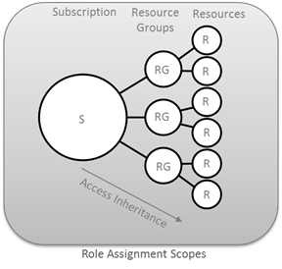
ARM Hierarchy and RBAC Roles
ARM provides a more granular Roles Based Access Control (RBAC) model for assigning administrative rights at the resource level.
Owner
Can perform all management operations for a resource and its child resources including access management and granting access to others.
Contributor
Can perform all management operations for a resource including create and delete resources. A contributor cannot grant access to other.
Reader
Has read-only access to a resource and its child resources. A reader cannot read secrets.
Notes:
There are twenty-two built-in Azure RBAC roles for controlling access to Azure resources:
The Owner can perform all management operations for a resource and its child resources including access management or granting access to others.
The Contributor can perform all management operations for a resource including create and delete resources. A contributor cannot grant access to others.
The Reader has read-only access to a resource and its child resources. A Reader cannot read secrets.

Slide 59
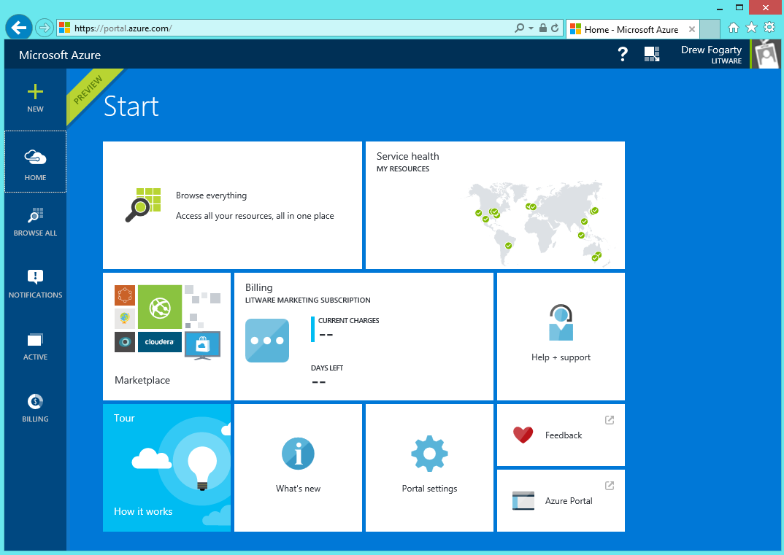
Least Privilege as a Model
Goal
  Users can do the tasks their job requires
  But no more than that
Best practices
  Use the preview portal and ARM API
  Assign the right role
  Use resource groups

Slide 60
Role Based Access Control

Slide 61
Key RBAC Concepts
Role Definitions
describes the set of permissions (e.g. read actions)
can be used in multiple assignments
Role Assignments
  associate role definitions with an identity (e.g. user/group) at a scope (e.g. resource group)
  always inherited – subscription assignments apply to all resources

Slide 62
RBAC - Granular Scopes
/subscriptions/{id}/resourceGroups/{name}/providers/…/sites/{site}
subscription level – grants permissions to all resources in the sub
resource group level – grants permissions to all resources in the group
resource level – grants permissions to the specific resource

Slide 63
Roles for Azure subscription resources
Three primary roles:
Owner, Contributor, Reader
Permissions on all Azure resources
20+ resource-specific roles
Website contributor, Virtual machine contributor, etc.
Permissions scoped to resources and actions typically required by customers
Will add more as new Azure resources come online
Custom roles
Currently in private preview, public preview coming soon

Slide 64
Built-in Roles
BUILT-IN ROLE | ACTIONS | NOT ACTIONS
Owner (allow all actions) | *
Contributor (allow all actions except writing or deleting role assignments) | * | Microsoft.Authorization/*/Write, Microsoft.Authorization/*/Delete
Reader (allow all read actions) | */Read

Slide 65
Resource Groups (Review)
Subscription
Collection of Azure resources
Hierarchical
One level deep
Resource Group
Resource
Resource
Resource Group
Resource
Resource
Can assign access at any node in the solution hierarchy
Access assignments at parent node are inherited by child resources

Slide 66
Resource Groups and Access Management
Marketing Subscription
Example
Best practices
Organize resources to meet access management requirements
Grant access at resource group when appropriate
Benefits
More granularity
Aligns with resource-specific roles
Ongoing manageability
Solution 1 Resource Group
Virtual machine
Storage account
Solution 2 Resource Group
Virtual machine
Storage account
SQL Server
Shared Infrastructure Resource Group
Virtual Network
Finance Subscription
Solution A Resource Group
Web app
SQL Server

Slide 67
Assigning Resource-specific Roles
Requirement
Map existing organizational roles (web, DB…) to their cloud solutions
Many Azure resources that work together are peers in the same resource group
  Virtual machine and storage account, web app and AppInsights
To fully manage a resource, a user may also need to manage its related peers
Best Practice
Assign resource-specific role on the resource group
Alternative
Assign access to each resource individually

Slide 68
Example RBAC Assignment
Marketing Subscription
Requirement (example)
User needs to manage “Web app A” and related resources such as “Application Insights B”
User shouldn’t manage “Virtual Machine C” or “Storage account D”
Best practice
Assign Web app contributor role on ‘Solution 1 resource group’
Alternative: Two assignments
Contributor role on ‘Virtual Web App” and
Contributor role on “Storage account B”
Solution 1 Resource Group
Web app A
Assigning role Web app contributor on Solution 1 resource group
Conveys permissions on web apps and Application Insights instances in the resource group
Does not convey permissions on virtual machines or storage accounts
Application Insights B
Virtual Machine C
Storage account D

Slide 69
Azure Active Directory Integration
Best practice
All organizational Azure subscriptions use the same Azure AD for access control.
I.e., don’t have each subscription in the organization relying on its own Default directory.
Benefits
Manageability
Compliance
Customer
Azure AD
Marketing Subscription
Resource Group 1
Resource
Resource
Resource Group 2
Resource
Resource
Finance Subscription
Resource Group A
Resource
Resource

Slide 70
RBAC Audit Logs and Resource Management Locks
Role assignment changes are captured in events where the ResourceProviderName is Microsoft.Authorization.
Azure Resource Manager provides the ability to restrict operations on resources through resource management locks.
Resource locks are policies which enforce a lock level at a particular scope.

Slide 71
Azure Hybrid Networking

Slide 72
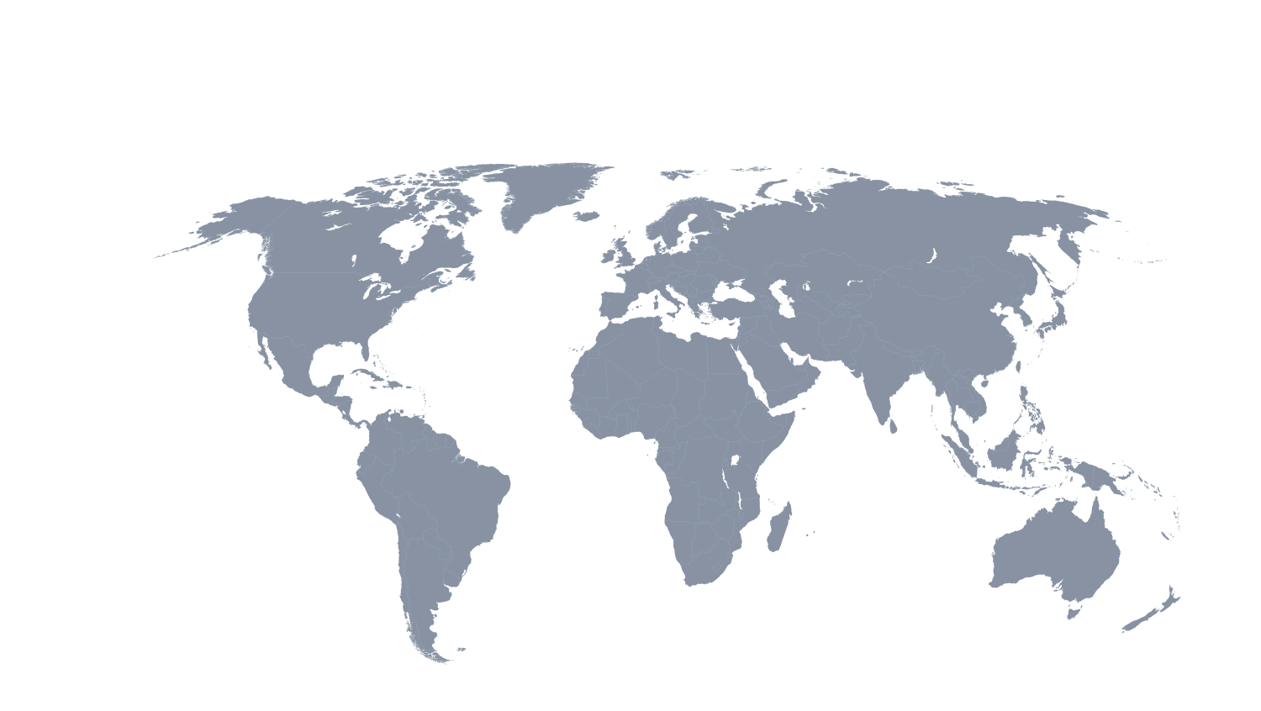
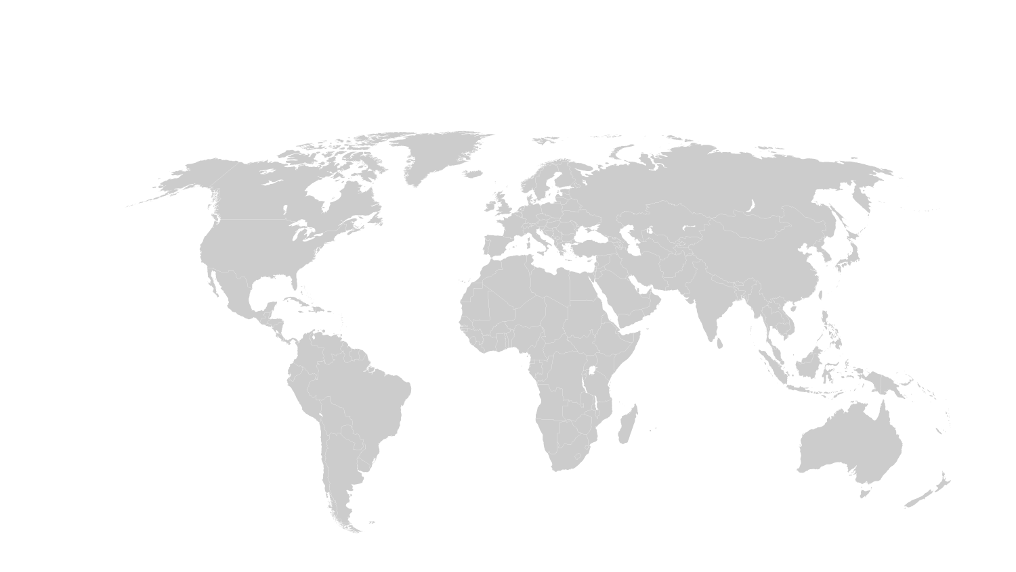
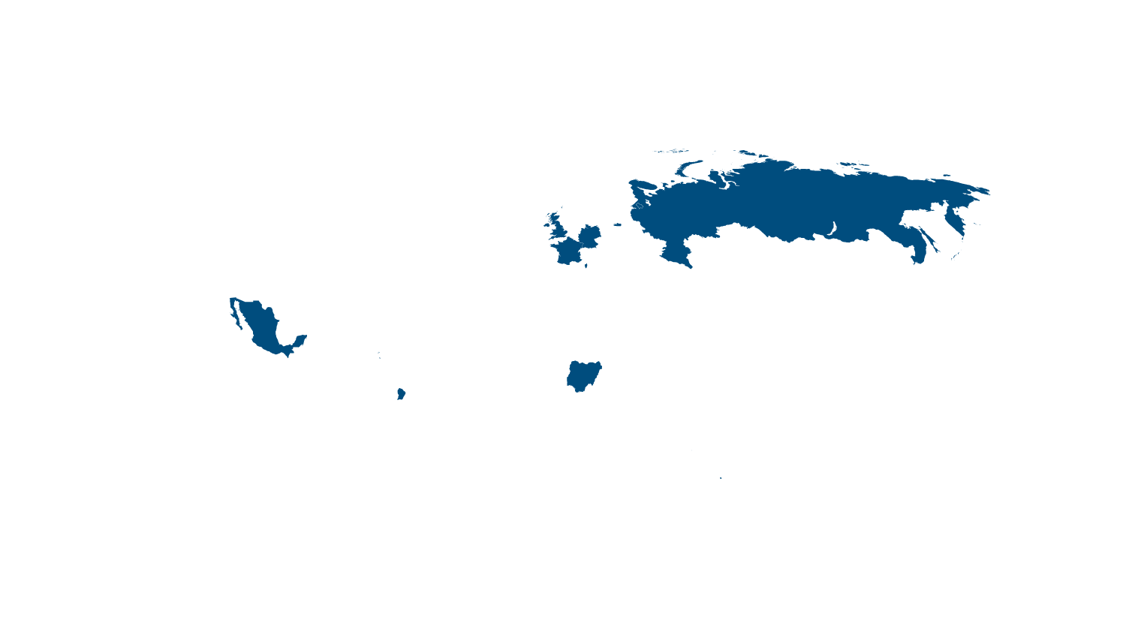
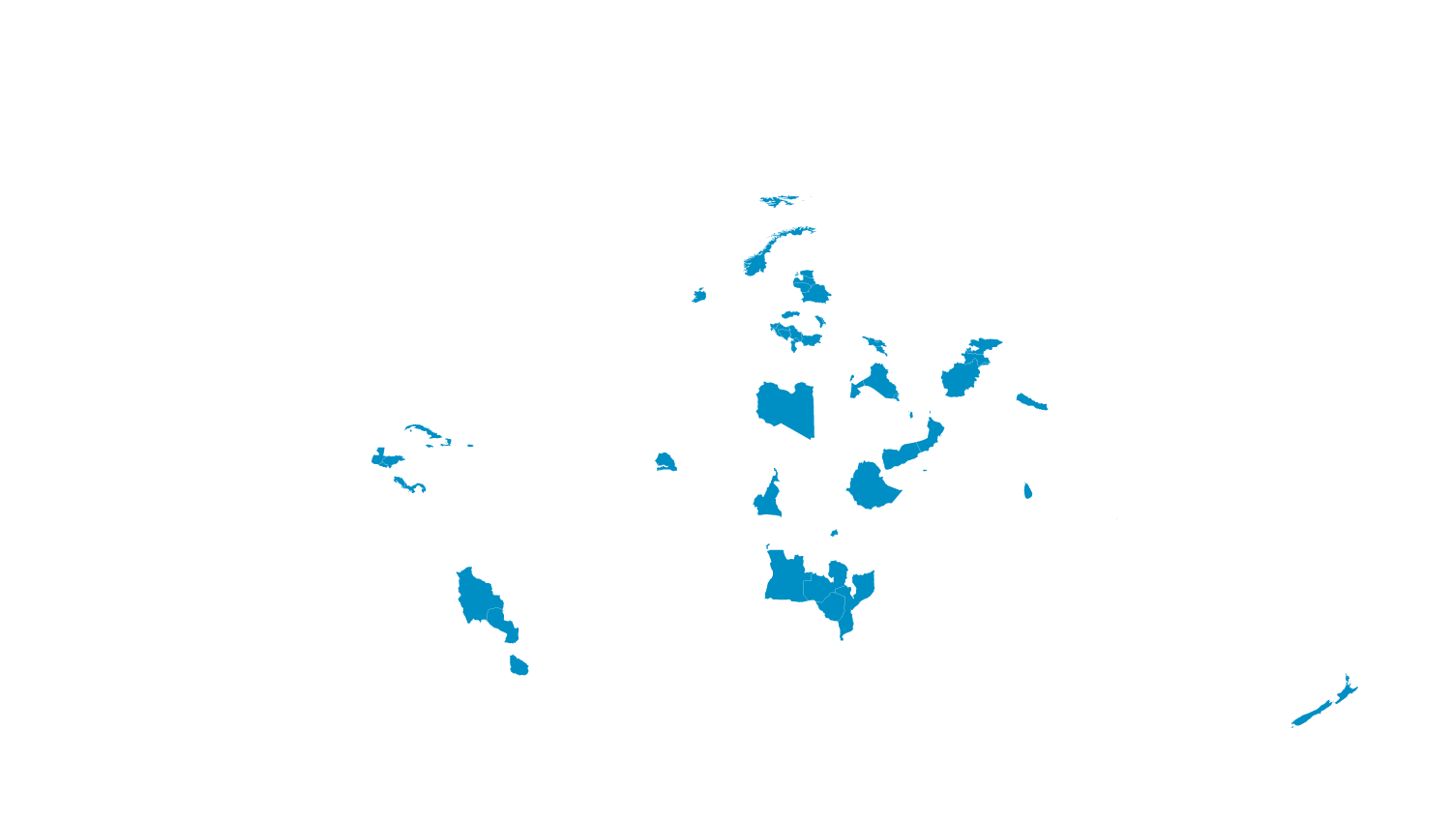
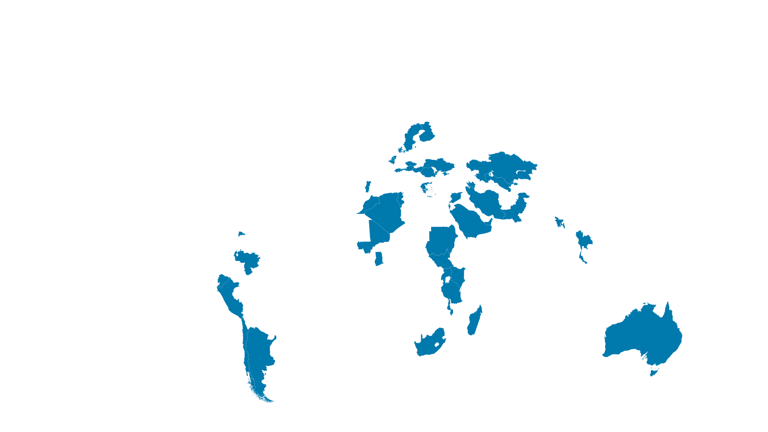
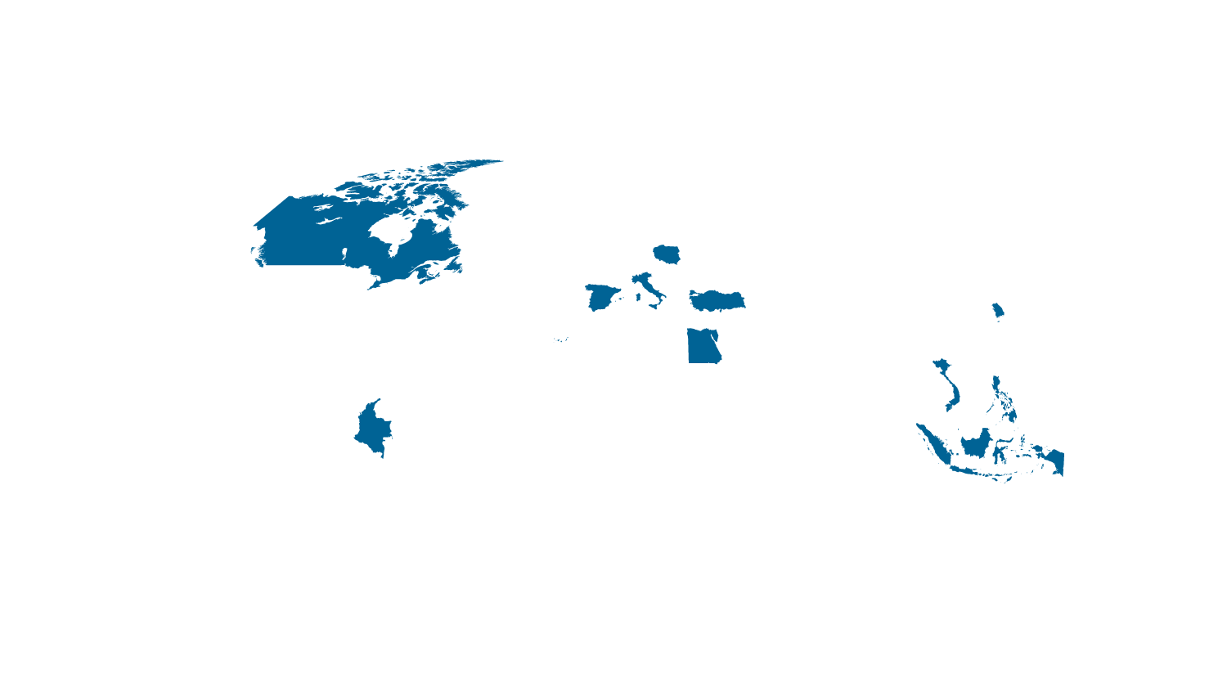


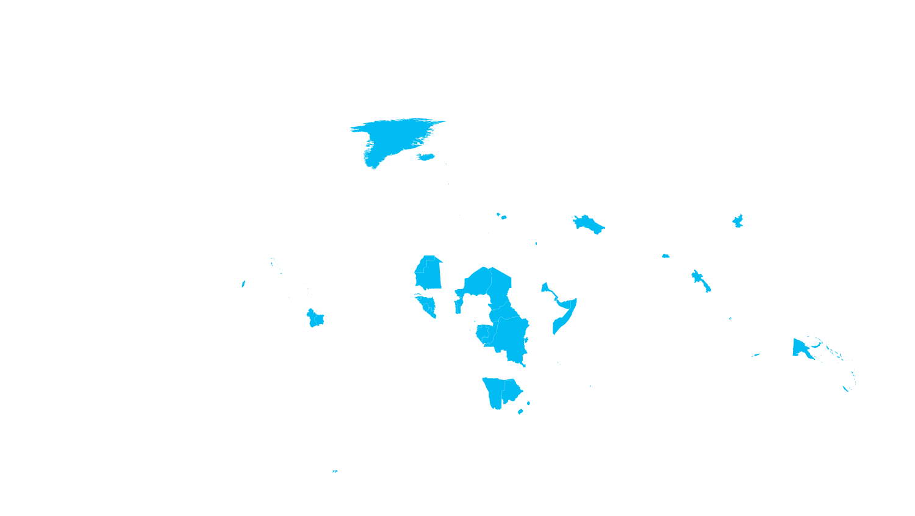




Internet connectivity by country
Microsoft Azure datacenter regions
Microsoft’s network is one of the largest in the world
INDIA NORTH
TBD
Internet users
■ 500,000,000+
■ 100,000,000 – 499,999,999
■ 50,000,000 – 99,999,999
■ 25,000,000 – 49,999,999
■ 5,000,000 – 24,999,999
■ 100,000 – 4,999,999
■ 50,000 – 999,999
■ 0 – 49,999
*Operated by 21Vianet

Slide 73

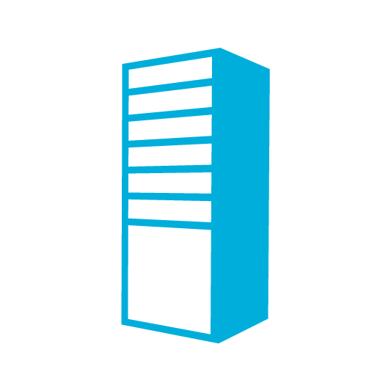
Azure Virtual Networks
On Premises
10.0/16
Virtual Networks are the primary building block for Azure networking
Scenarios:
Bring your own network
Create subnets with your private or public IP addresses
Bring your own DNS or use Azure-provided DNS
Secure with Network Security
Group ACLs
Control traffic flow with
User Defined Routes
Internet
VPN &
ExpressRoute
Direct Internet
Connectivity
Azure
VPN GW
Backend
10.3/16
Mid-tier
10.2/16
Frontend
10.1/16
AD / DNS
Virtual Network

Slide 74

Azure Virtual Networks & Subnets
  Logical isolation with control over network
  Create subnets with your private IP addresses
  Stable and persistent private IP addresses
  Bring your own DNS
  Use Azure-provided DNS
  Secure VMs with input endpoint ACLs
Microsoft
Azure
<subnet X>
<subnet Y>
<subnet Z>
DNS Server
Virtual Network

Slide 75
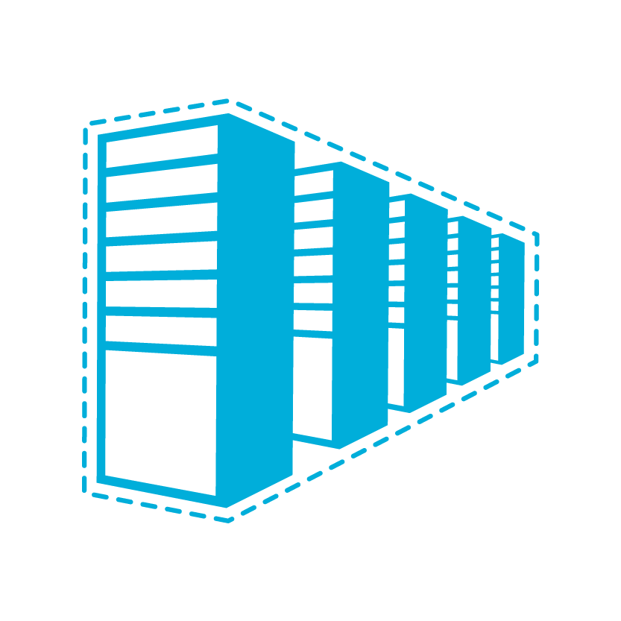

Connectivity Options for CSP Customers
Cloud
Customer
Segment and workloads
Consumers
Access over public IP
DNS resolution
Connect from anywhere
Internet Connectivity
Developers
POC Efforts
Small scale deployments
Connect from anywhere
Secure point-to-site connectivity
SMB, Enterprises
Connect to Azure compute
Secure site-to-site
VPN connectivity

Slide 76

Connectivity choices: Internet or Private
Branch Office 2
Branch office 2
Microsoft
Microsoft
WAN
WAN
Branch office 1
Branch office 1
Public
internet
Public
internet
Corp HQ
Corp HQ
IPsec VPN over Internet
  Encrypted data traverses Internet to reach Azure
  Limited bandwidth and higher availability
Cloud on your WAN
  Traffic flows directly from customer WAN to Microsoft
  Reduces complexity
  Lower latency, higher bandwidth and higher availability

Slide 77
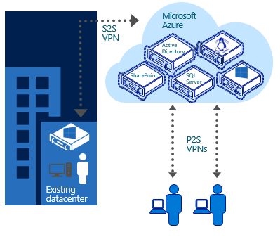
Point-to-Site VPN Connectivity
  Connect from anywhere securely
  No software installation required
  Easy to setup and use
  Ideal for prototyping,
  development, demos
  P2S and S2S coexist

Slide 78
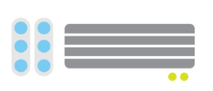

Site-to-Site VPN Connectivity
Extend your premises to the cloud securely
On-ramp for migrating services to the cloud
Use your on-premises resources in Azure (monitoring, AD, …)
Microsoft Azure
<subnet 1>
<subnet 2>
<subnet 3>
Virtual Network
DNS Server
Site-to-Site
VPN
On-premises
VPN
Gateway
HA VPN Gateway
Hardware VPN or
Windows RRAS
Your datacenter

Slide 79
Azure Resource Manager (ARM) Templates

Slide 80

Role Considerations
Azure Subscriptions have two administrative models:
Classic
(v1)
Azure Service Management (ASM)
Resource Manager (v2)
Azure Resource Manager (ARM)
Notes:
Azure Resource Management (ARM) environment, a subscription now has two administrative models: Service Management and Azure Resource Management. With ARM the subscription is no longer needed as an administrative boundary. ARM provides a more granular Roles Based Access Control (RBAC) model for assigning administrative rights at the resource level. RBAC is currently being released in stages, 22 new roles have been released and user defined roles is coming in a future release. There will be some complexity during the coexistence of the service management and resource management environments and will need to be carefully considered.

Slide 81
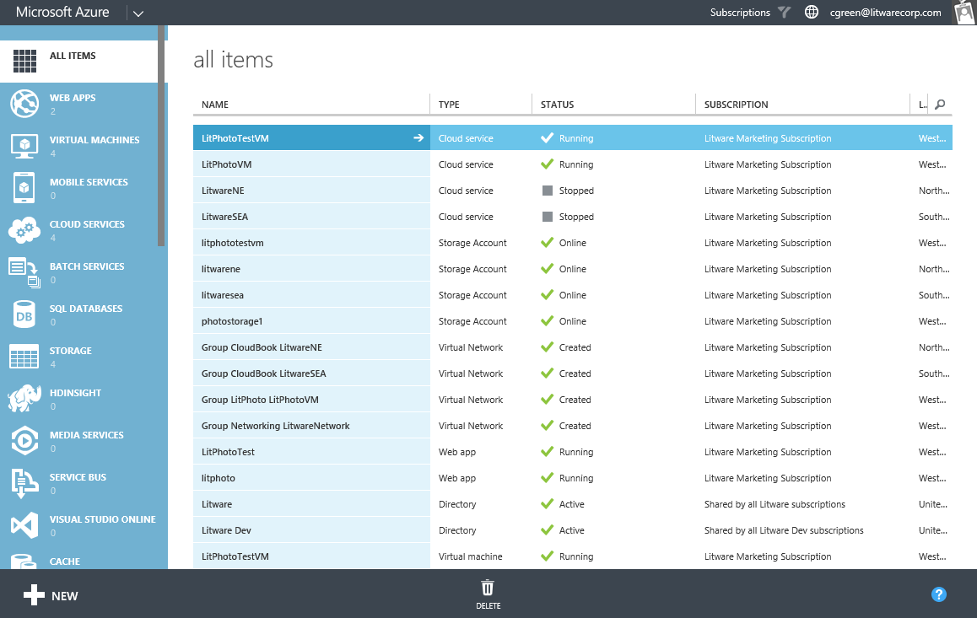
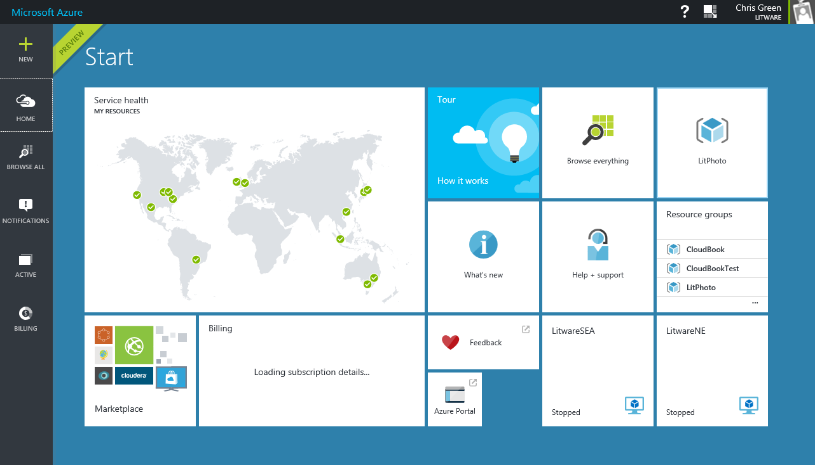
Portal and APIs
Feature | manage.windowsazure.com | portal.azure.com / ARM
Granularity | Subscription | Subscription, resource group, resource
Principal | User | User, directory group, application
Roles | Full control (or no access) | 20+ Built-in roles Custom roles in private preview

Slide 82
Resource Groups (Review)
Manage resources as a single unit
Role based access and control (RBAC) on groups or resources
Billing integrated tagging on groups or resources
RESOU
R
CE G
R
OUP
container for multiple resources
IaaS + PaaS resources
resources exist in one* resource group
resource groups can span regions
resource groups can span services

Slide 83
Management Models for Resource Manager
Classic Model (v1)
Resource Manager (V2)
Cloud Service
Resource Group
Load Balancer w/ IP Address
Backend Pool (NICs)
VM w/ IP Address
Storage Account
VM
NIC
VM IP Address
VNet
Load Balancer
LB IP Address
Disk (blob)
Subnet
Reference
Reference
Reference
Storage Account
Virtual Network
DependsOn
Reference
Reference
Disk (blob)
Subnet-1
Network Security Group

Slide 84
Resource Group Models
Single Resource Group
Storage Account
Front End VMs
Virtual Network
Back End VMs
Multiple Resource Groups
RG1:
Storage Account
RG3: Front End VMs
RG2: Virtual Network
RG4: Back End VMs

Slide 85
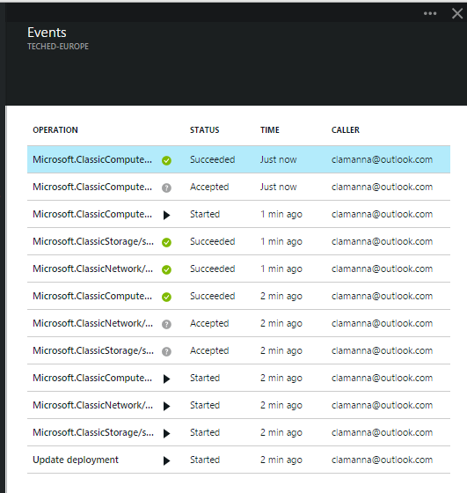
Resource Group Manager Services
Centralized auditing of operations
Simple tagging and grouping of resources
Consistent access control

Slide 86
Deployment Options
Manual
Not easily repeatable
Not easy to copy the deployment to a second region or subscription
Client Driven Automation (PowerShell Script)
Solves a lot of the manual deployment issues
Burden of deployment logic and dependencies in the script execution and order
Uses imperative logic
Hard to parallelize

Slide 87
Deployment Options: ARM Templates
Cloud based orchestration engine
Fully declarative
Automatically optimizes the deployment based on dependency graph
Compliments and integrates PowerShell automation for deployment tasks

Slide 88
Power of Repeatability
Instantiation of repeatable config.
Configuration → Resource Group
Azure Templates can:
Ensure Idempotency
Simplify Orchestration
Simplify Roll-back
Provide Cross-Resource Configuration and Update Support
Azure Templates are:
Source file, checked-in
Specifies resources and dependencies (VMs, WebSites, DBs) and connections (config, LB sets)
Parametized input/output
SQL-A
Website
[SQL CONFIG] VM (2x)
DEPENDS ON SQL
DEPENDS ON SQL
SQL - A
Website
Virtual
Machines
SQL
C
ONFIG

Slide 89
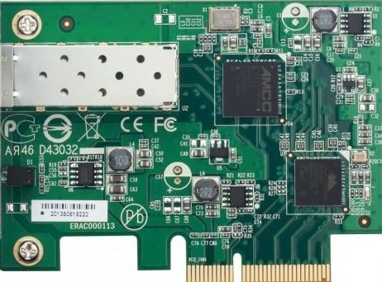

Azure Resource Manager: Building a Virtual Machine
Resource Group
virtualMachine
hardwareProfile
osProfile
storageProfile
networkProfile
Subnet
VM
NIC
networkInterface
privateIPAllocationMethod
storageAccount
accountType
Public IP
Storage
VNET
publicIPAddress
allocationMethod
domainNameLabel
virtualNetwork
addressSpace
Subnet
  addressPrefix
https://github.com/Azure/azure-quickstart-templates/tree/master/101-simple-windows-vm

Slide 90
Resource Loops: Declare Multiple Resources
Resource Group
Subnet
Subnet
VM
VM
VM
…
NIC
NIC
NIC
VNET
Storage
Storage
Public IP
Public IP
Public IP
https://github.com/Azure/azure-quickstart-templates/blob/master/resource-loop-vms-vnet/azuredeploy.json

Slide 91
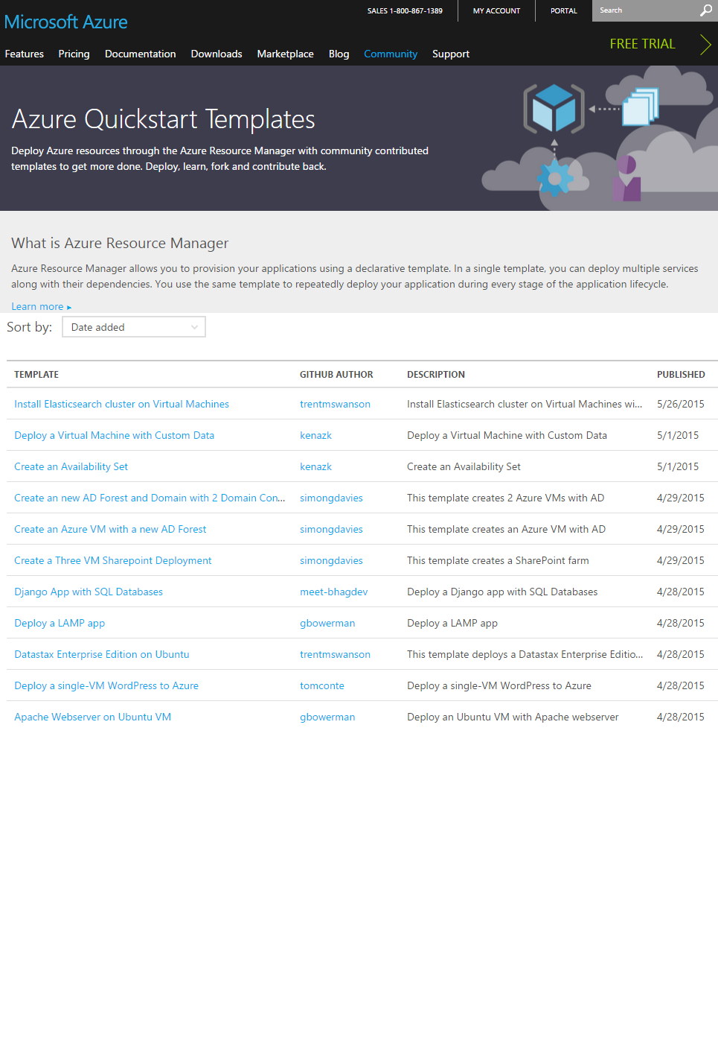
Getting Started with Azure Templates
  Wide range of Quickstart Templates
    Indexed on Azure.com
    Github Repo
    Community & Microsoft contributed
  Integration of IaaS with Azure Services
  Azure Resource Explorer
  https://resources.azure.com/

Slide 92
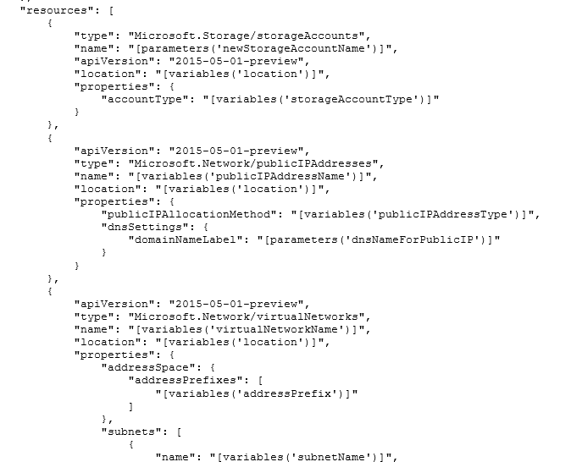
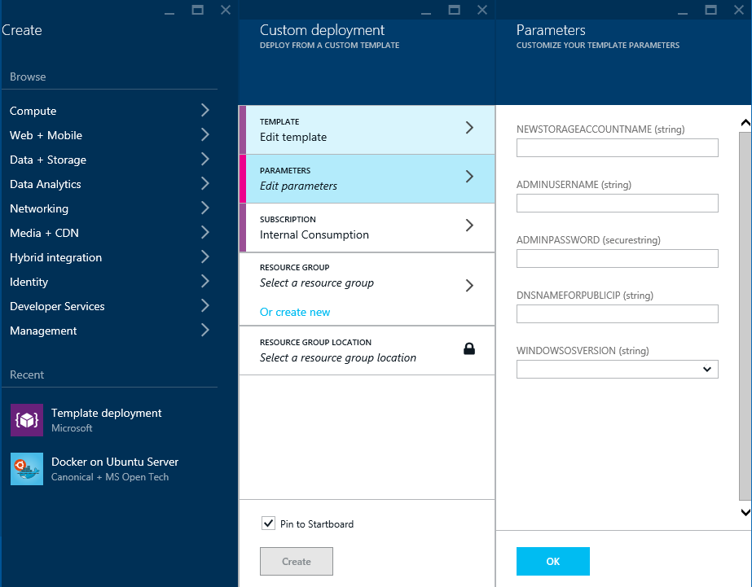

Azure Resource Manager: Deploying an App

Slide 93
Template Execution
Execution engine builds a state machine
dependsOn and reference() establish dependencies
App Insights
After Website Completes
After App Service Plan Completes
Once All Complete
Web
Site
Alert Rule
Start
App Service Plan
End
Auto Scale Setting
MS Deploy PKG

Slide 94
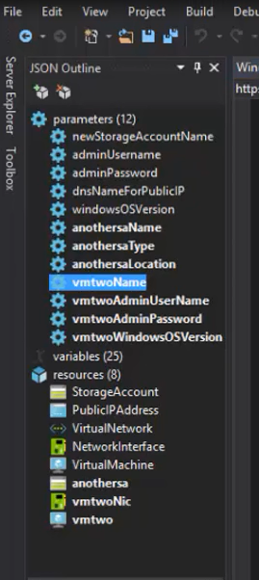
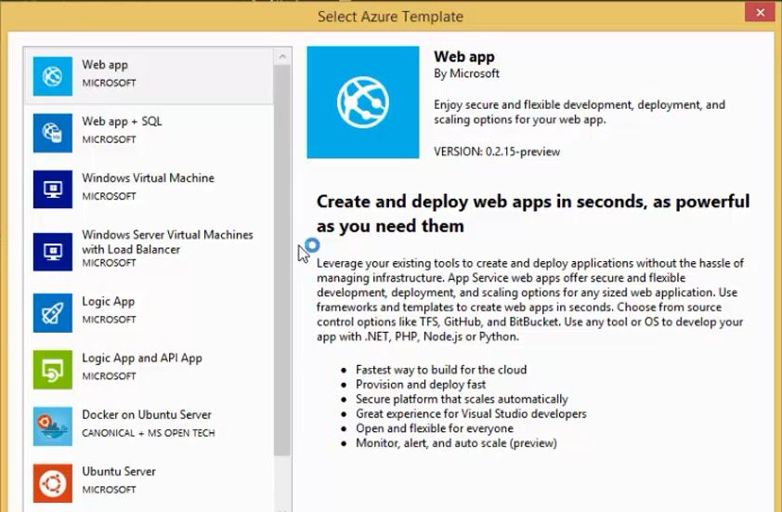
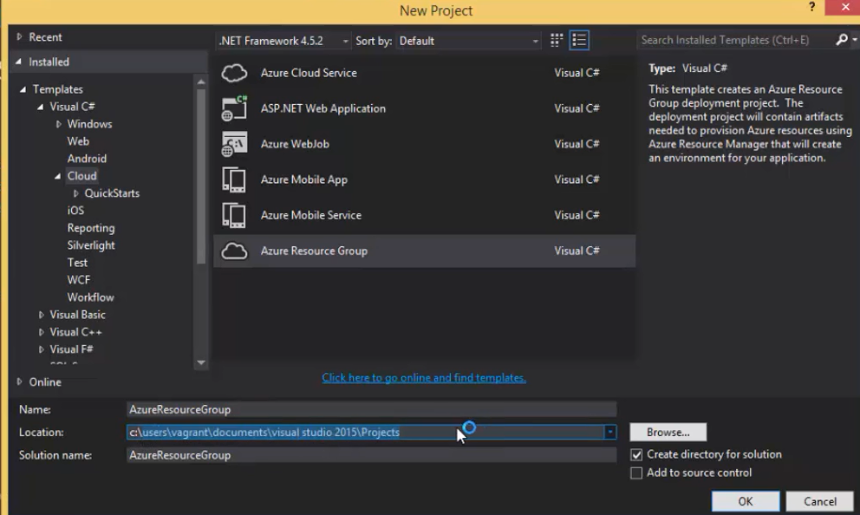
Deployment with Visual Studio

Slide 95
Resource Tags
Name-value pairs assigned to resources or groups
Subscription-wide taxonomy
Each resource can have up to 15 tags
Tagging Tips
Notes: Simple note for VM
Creator: track the “owner” of a VM
Department/Cost center: who pays
Environment: production vs. pre-production vs. test

Slide 96
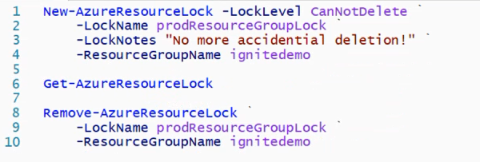
Resource Locks
Resource Locks prevent accidental deletion
Allows admins to create policies against deletion
Policy enforces a lock level (CanNotDelete)

Slide 97

Simplified Manageability of Applications on IaaS
Upgrade
complexity made simple
master template can be used to rollout upgrades
imperative APIs, client tools support to update resources
Manageability, Auditing
operations can be tracked upto 90 days
management Locks to lock down resources from deletion

Slide 98
Provisioning Resources in ARM

Slide 99
Steps
Download or create an Azure template
Edit the template variables and template parameters to match your desired deployment
Setup PowerShell in the customer’s context
Create a new resource group
Deploy the template
Monitor deployment
Validate deployment

Slide 100
Download the Azure Template
For this walkthrough we will be using the simple virtual machine template from:
https://github.com/Azure/azure-quickstart-templates/tree/master/101-simple-windows-vm

Slide 101
Edit the Template Variables
Open the azuredeploy.json file
"variables": {
"location": “East US",
"imagePublisher": "MicrosoftWindowsServer",
"imageOffer": "WindowsServer",
"OSDiskName": "osdiskforwindowssimple",
"nicName": "myVMNic",
"addressPrefix": "10.0.0.0/16",
"subnetName": "Subnet",
"subnetPrefix": "10.0.0.0/24",
…
},
Notes:
For example, edit the location to being East US.

Slide 102
Edit the Template Parameters File
Open the azuredeploy.parameters.json file
"parameters": {
"newStorageAccountName": {
"value": “myvmstorage001“
},
"adminUsername": {
"value": "myadmin“
},
"adminPassword": {
"value": "Password!1“
},
"dnsNameForPublicIP": {
"value": “myvm01"
} }
Notes:
Make changes here to match your deployment needs

Slide 103
Azure PowerShell
Customer Context:
  PS C:\> Switch-AzureMode -Name AzureResourceManager
  PS C:\> Add-AzureAccount -Tenant <customer domain>
New Resource Group:
PS C:\> New-AzureResourceGroup -Name "MyTenantRG" -Location "East US"
Deploy the Template:
PS C:\> New-AzureResourceGroupDeployment -Name "MyVMDeployment1"
-ResourceGroupName "MyTenantRG"
-TemplateFile c:\ARMTemplates\101-simple-windows-vm\azuredeploy.json
-TemplateParameterFile c:\ARMTemplates\101-simple-windows-vm\azuredeploy.parameters.json
Notes:
If there are errors reported, for example, that the storage account name is not valid, correct the values in the parameters file and try the deployment again with the line above.
Once no errors are reported, you can track deployment progress in the Azure Portal following the instructions above for logging into the Azure Portal.
Once deployment is completed, connect to the VM from the Azure Portal and make sure VM is accessible

Slide 104
Resources
Quick Start Templates
https://github.com/Azure/azure-quickstart-templates
Azure Resource Manager (ARM)
https://azure.microsoft.com/en-us/documentation/articles/resource-group-overview/
Deploying Azure Templates
https://azure.microsoft.com/en-us/documentation/articles/resource-group-template-deploy/

Slide 105
Support

Slide 106
First Line Support for CSP and the APIs
For CSP – Yammer Group
https://www.yammer.com/cloudpartnercommunity/
For CREST and Graph APIs – Partner Center API forum:
https://social.msdn.microsoft.com/Forums/en-US/home?category=microsoftpartnercenter

