Slide 1
Enterprise Mobility Suite Overview

Slide 2



Mobile First | Cloud First
61% of workers mix personal and work tasks in their devices*
>80% of employees admit to using non-approved software-as-a-service (SaaS) applications in their jobs**
>75% percent of network intrusions exploited weak or stolen credentials ***
* Forrester Research: “BT Futures Report: Info workers will erase boundary between enterprise & consumer technologies,” Feb. 21, 2013
** http://www.computing.co.uk/ctg/news/2321750/more-than-80-per-cent-of-employees-use-non-approved-saas-apps-report
*** Verizon 2013 data breach investigation report

Slide 3

What's Driving Change?
Users
Devices
Apps
Data
IT
Employees
Business Partners
Customers

Slide 4
Enterprise Mobility Suite
Identity & Access Management
Mobile Device & App Management
Information Protection
Behavior based threat analytics
Microsoft Azure Active Directory Premium
Microsoft Azure Rights Management Premium
Advanced Threat Analytics
Microsoft Intune
Easily manage identities across on-premises and cloud. Single sign-on & self-service for any application
Manage and protect corporate apps and data on almost any device with MDM & MAM
Encryption, identity, and authorization to secure corporate files and email across phones, tablets, and PCs
Identify suspicious activities and advanced threats in near real time, with simple, actionable reporting

Slide 5



Microsoft’s Enterprise Mobility Solution
Customer’s need:
Microsoft’s Solution:
Access from many devices
Integrated, Secure identity
Manage and secure productivity
It protects Office better
Support iOS, Android, Windows,
and 1000s of apps
It’s comprehensive
Preserve existing investments
It just works

Slide 6



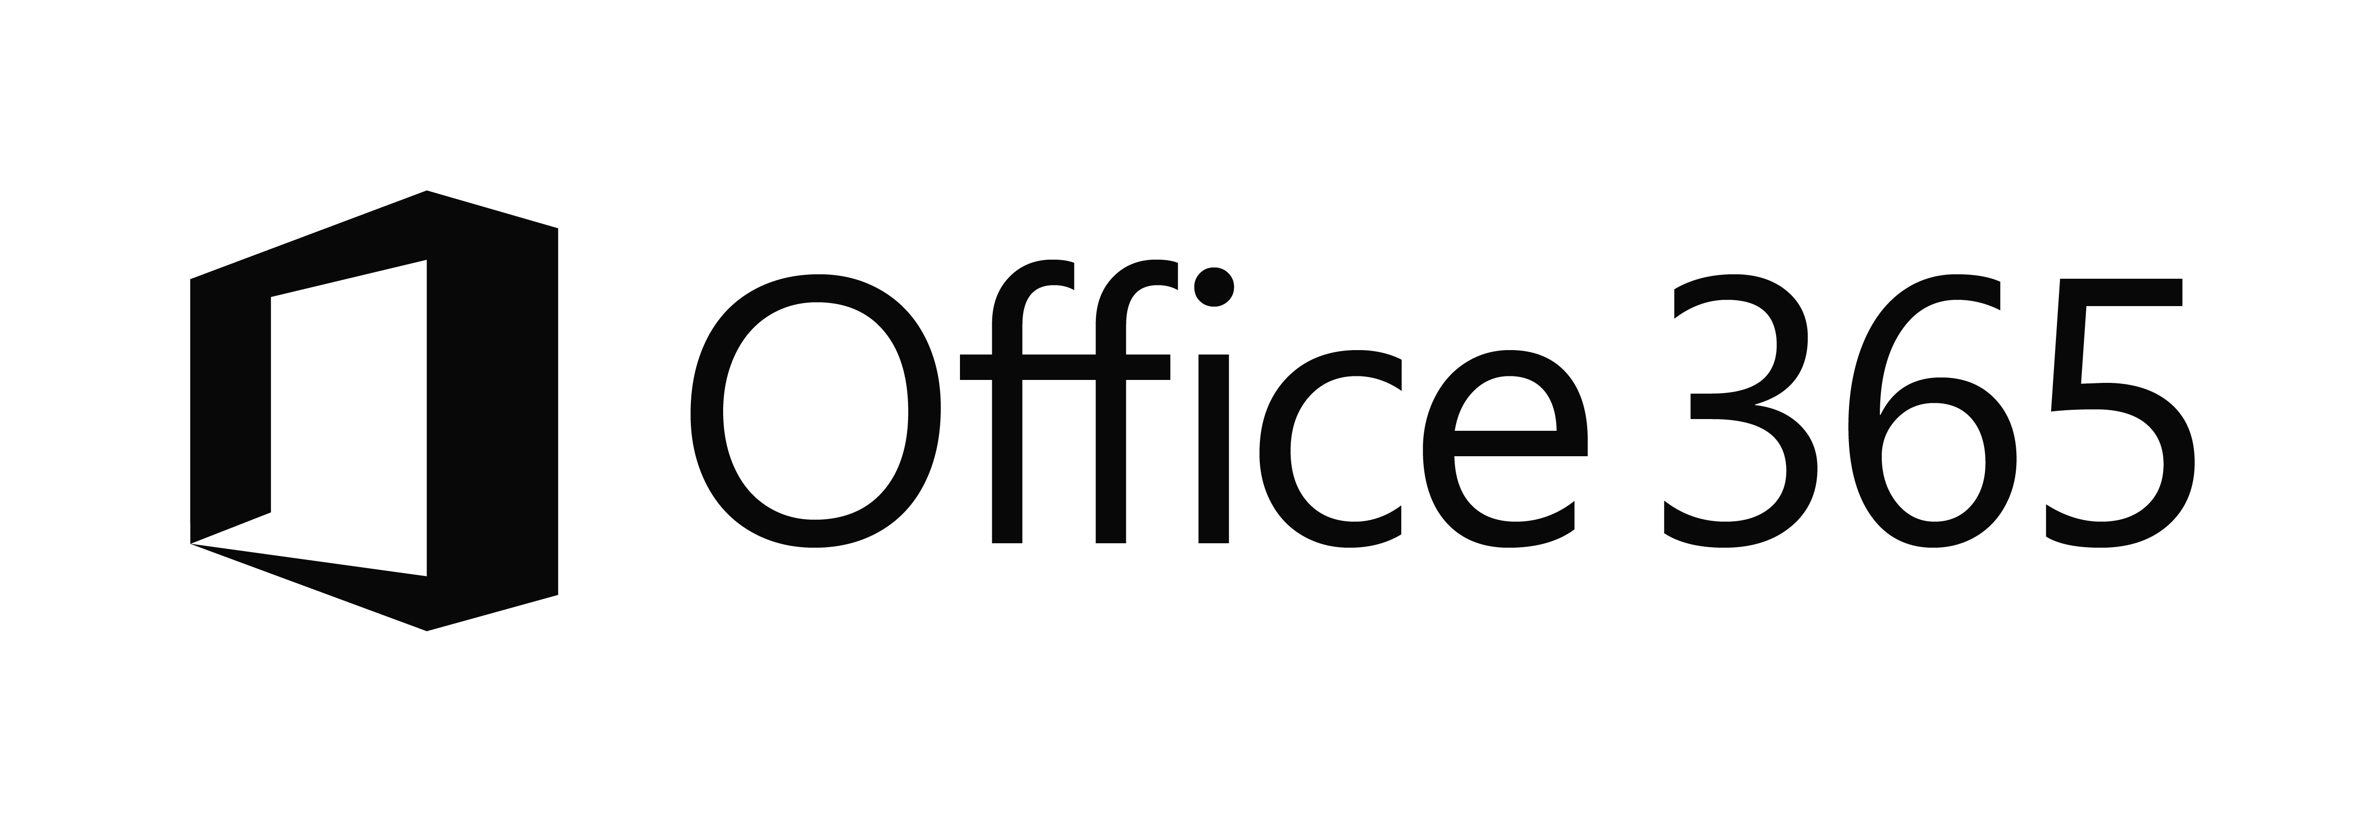

The current identity reality…
EC2
On-Premises
Managed devices
Private Cloud

Slide 7
Integrated Identity as the control plane
One common identity
Simple connection
Self-service
Single
sign on
Windows Server
Active Directory
Username
•••••••••••
Other
Directories
SaaS
Azure
Public
cloud
Office 365
On-premises
Cloud
Microsoft Azure Active Directory
Notes:
Integrated identity is the control plane of modern enterprise mobility -
[Click] Traditional identity and access management solutions providing sing-sign on to on-premises applications and directory services such as Active Directory and others are used from the vast majority of organizations and huge investments were made to deploy and maintain them. These solutions are perfect for the on-premises world.
[Click] Now, as we have discussed, there are new pressing requirements to provide the same experience to cloud applications hosted in any public cloud.
[Click] Azure Active Directory can be the solution to this new challenge by extending the reach of on-premises identities to the cloud in a secure and efficient way.
[Click] In order to do that, one simple connection is needed from on-premises directories to Azure AD.
[Click] and everything else will be handled by Azure AD. Secure single sign-on to thousands of SaaS applications hosted in any cloud by using the same credentials that exist on-premises
[Click] And we don’t forget the users. Azure AD provides Self-service capabilities and easy access to all the application, consumer or business, they need.
in the cloud but on-premises too (Application Proxy)

Slide 8



Identity Driven Security
Intelligent cloud
App security
Detect threats
1 4 5 6 7 6
ALERT
Machine learning
Security reports
Privileged Identity Management
Conditional access
Multi-factor authentication
Cloud App Discovery
User behavioral analysis
Simple attack timeline

Slide 9




Microsoft Advanced Threat Analytics
Behavioral Analytics
Forensics for known attacks and issues
Advanced Threat Analytics
ATA
Devices and servers
SIEM
Active Directory
Active Directory
Profile normal entity behavior (normal vs. abnormal)
Search for known security attacks & issues
Detect suspicious user activities, known attacks and issues

Slide 10
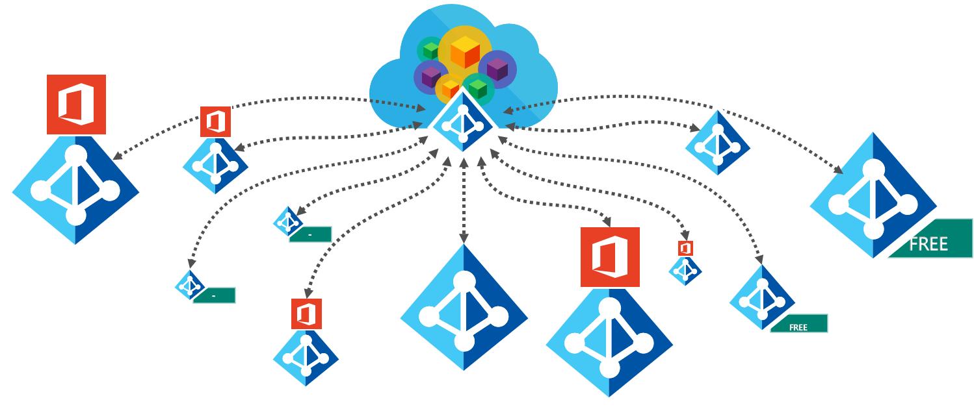
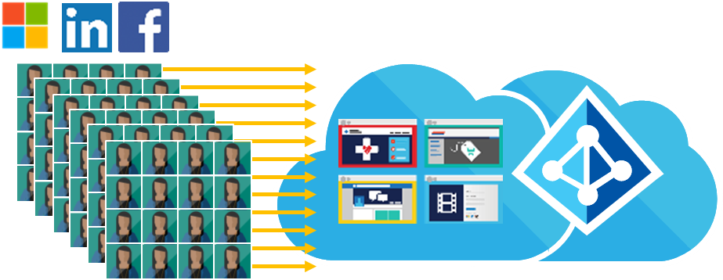
Manage your external identities
B2B Collaboration
Azure Active Directory B2C

Slide 11





It Protects Office Better – Managed Mobile Productivity
Manage and secure productivity
Multi-identity management for Office mobile apps
File / Data level protection

Slide 12
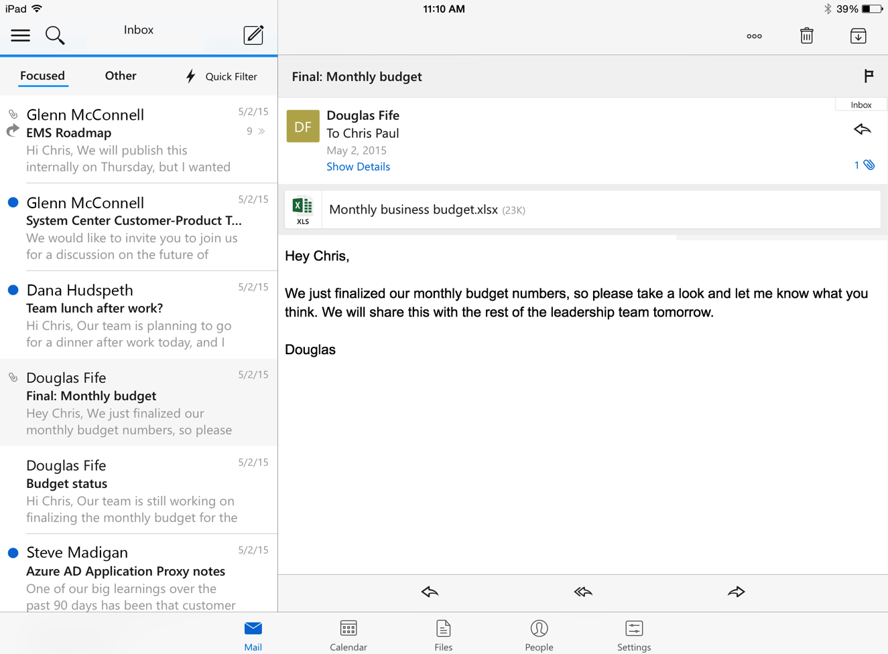
Managed email and productivity
Identity
Device
Application
Data
Notes:
Let’s quickly see how these 4 layers of protection can help deliver a great and secure email experience with EMS and Outlook.
First, EMS ensures that only authorized users are permitted to access corporate email and documents by using security features at the identity layer such as cloud-based authentication and authorization, multi-factor authentication, and advanced security reports that leverage Microsoft Azure machine learning capabilities.
At the next layer, EMS is able to manage and enforce device-level settings such encryption and password requirements via mobile device management (MDM).
EMS also provides the protection at the application layer with mobile application management (MAM) capabilities that help prevent the leakage of corporate data by restricting actions in Office mobile apps such as cut, copy, paste, and save as. And with the unique multi-identity capabilities, employees can use a single app (such as Outlook) for both personal and corporate use while EMS helps to ensure the corporate data is separated and protected.
Finally, EMS goes beyond app-layer protection to help secure highly confidential documents at the file-layer. Using EMS, employees can encrypt virtually any type of a file, set granular permissions, and track usage to ensure that only the right people inside and outside of the organization can access email attachments and documents, wherever the files are located.

Slide 13



Conditional access
Policy compliance verification
Device management
Exchange
Online
SharePoint
Online
Exchange
Online
SharePoint
Online
Device compliance
User
User
Measured boot integrity status (Windows PPCH)
Policy verification
Advanced device compliance (antivirus, firewall, patch state, etc.)
Windows 10
Windows Provable PC Health (PPCH)
Microsoft Intune
Microsoft Intune
Notes:
Corporate email is one of the most important resources that employees need to access in order to be productive. But organizations want to keep corporate information secure by restricting access on device that are not enrolled or not compliant with corporate policies. In the scenario that you see here, the user has enrolled their device into the Intune service and is now trying to access their corporate email using Office 365 or Exchange on-premises. Based upon the settings defined by their IT administrator at their company, the user’s device is still not compliant. During the policy verification process performed by Intune, the user’s access has been blocked until the device is encrypted, a passcode is set, and the device is no longer jailbroken or rooted.
Now, if a user tries to access corporate email and their device is not enrolled or not compliant based upon settings defined by the IT admin, the user experience is pretty intuitive. The user will receive an email explaining why their access has been blocked with steps for how to resolve the issue.
With Windows 10, Intune can verify additional device compliance attributes such as antivirus status, firewall status, patch state and can verify measured boot integrity status using Windows Provable PC Health (PPCH) service.

Slide 14

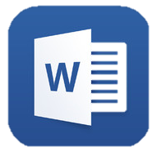



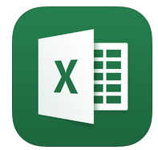
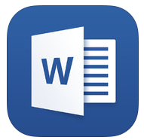








Mobile application management
Multi-identity policy
Managed apps
Managed apps
Corporate
data
Personal
data
User
IT
Maximize mobile productivity and protect corporate resources with Office mobile apps – including multi-identity support
Extend these capabilities to your existing line-of-business apps using the Intune App Wrapping Tool
Personal apps
Personal apps
Enable secure viewing of content using the Managed Browser, PDF Viewer, AV Player, and Image Viewer apps
Notes:
If we take a closer look at our user’s newly enrolled device which is now compliant and ready to go, we can see that she is still able to maintain a personal experience on her device. She has organized her applications the way she wants, with all of her apps available on one screen.
She has her managed corporate apps—the Office mobile apps she knows and loves and personal apps that she uses outside of work and may even consider using these personal apps to try to boost her productivity at work. Even though our user has all of her apps at hand on her personal device, IT is able to enjoy unparalleled management of the Office mobile apps, so that with Microsoft Intune, our IT pro has a different perspective on the organization of our user’s personal device. With the new multi-identity management feature, you an enable users to access both their personal and work accounts using the same Office mobile apps while only applying the MAM policies to their work account – providing a seamless experience while employees are on-the-go.
For our IT pro, there is still a clear separation of the managed corporate apps and our user’s personal apps. But, this doesn’t affect the user’s access to apps. By applying policy at the app level, our IT pro can support mobile productivity while maintaining user preferences, and still have the ability to protect corporate data and resources with the Intune-managed Office mobile apps.
The Intune App Wrapping Tool also allows IT to apply similar policies to your existing line-of-business applications so that these resources are equally protected through the organization’s proprietary apps. You can enable users to securely view content on devices within your managed app ecosystem using the Managed Browser, PDF Viewer, AV Player, and Image Viewer apps for Intune as well.

Slide 15


Mobile application management
Managed apps
Email
attachment
User
Copy
Paste
Save
Paste to
personal app
Save to
personal storage
Personal apps
Maximize productivity while preventing leakage of company data by restricting actions such as copy, cut, paste, and save as between Intune-managed apps and unmanaged apps
Notes:
Let’s now take a closer look at how app-level policies can help keep company data and information secure. Our user receives a work email through her managed Outlook account with an attached Excel spreadsheet containing information she needs for a report. Our user opens the attachment in her Excel mobile application to find the information she needs. She then wants to copy the info to add to her report.
But when she tries to paste it into her personal notepad, it doesn’t work—the personal notepad is not a managed app and our IT pro has applied policies that restrict copy, paste, and cut functions to only apps that are part of the managed app ecosystem (for Intune enrolled devices). So our user opens her Microsoft Word mobile app which is managed by Intune and she is successfully able to paste her information. Now our user wants to save the working copy of her report to her personal OneDrive account so that she can access it from her home computer.
Because her personal OneDrive account is not one of the managed applications, she’s unable to save it here. IT has applied policies restricting the ability to save to only apps that are part of the managed app ecosystem.
So our user must save her working copy to her managed OneDrive for Business account, which means when she does want to work on this report from another device, this device will have to be an enrolled for management . By using the mobile application management capabilities of Intune, the IT pro can help prevent leakage of important company data and make sure that this information doesn’t get into the wrong hands.

Slide 16
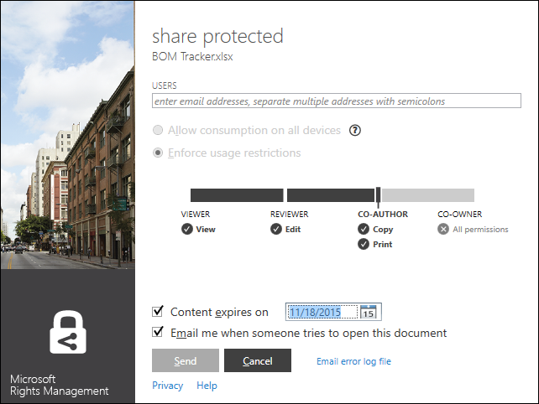
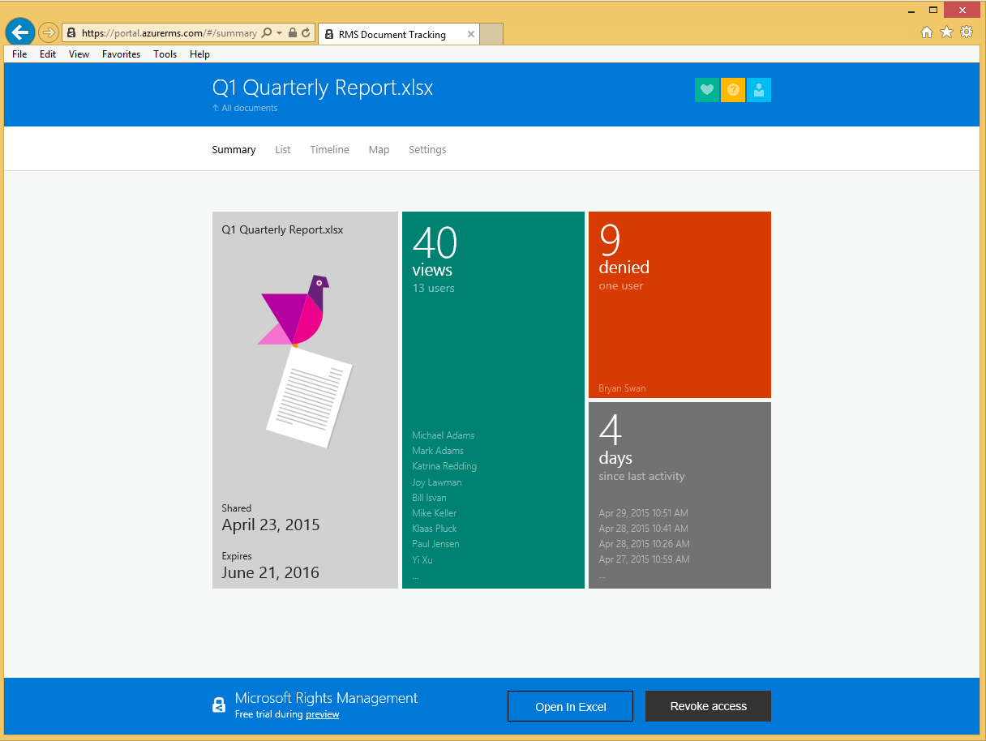
Encrypt files and data
Protect ANY File
Share with ANY Person
View on ANY Device
Track & Manage from the cloud

Slide 17

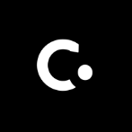
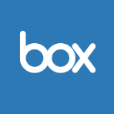
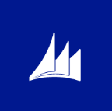

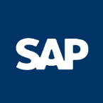
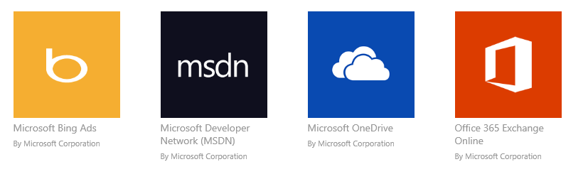




It’s Comprehensive - Cross Platform
iOS, Android, Windows
1000s of SaaS apps
LOB apps, RemoteApp

Slide 18
Cost Effective
 | Microsoft EMS | Other vendors
Identity and access management | Included | $8¹
Mobile device and application management | Included | $10²
Data protection | Included | No similar products
Advanced threat detection | Included | No similar products
Total cost (per user/month) | Microsoft EMS $8.75³ | Other vendors $18
¹ Okta Enterprise Edition as of 3/1/2015.
² Airwatch Orange Management Suite-Cloud as of 3/1/2015.
³ 50% savings over standalone offers
Notes:
To get all of the features provided by the Microsoft Enterprise Mobility Suite, you would need to buy three products or services. One for cloud identity management, (CLICK) one for mobile device management, (CLICK) and one for file encryption (CLICK) at a total cost of $11 per seat.
(CLICK) The Microsoft Enterprise Mobility Suite provides all three of these (CLICK) in one SKU (CLICK) at a lower price point—right now for only $4.50 per seat. It’s a special introductory promotional offer that’s going for 60 percent off the list price.

Slide 19
It Just Works - Flexible Architecture Matters
Always up to date
Works with what you have
Simple to set up and connect

Slide 20
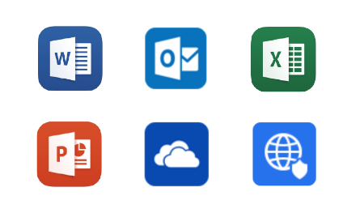
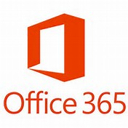
EMS for O365 customers
LOB
Apps
SaaS
Apps
…
Mobility Management
Simplify app delivery and deployment
Manage Mobile Productivity
Increase IT Productivity

Slide 21
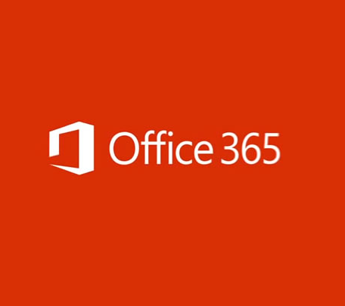
EMS benefits for O365 customers
Hybrid identity management
Mobile device and app management
Access & Information
protection
Enterprise Mobility
Suite
Azure AD for O365+
Single Sign on for all cloud apps
Advanced MFA for all workloads
Self Service group management and password reset with write back to on prem directory
Advanced security reports
MIM (Server + CAL)
MDM for O365+
PC Management
Mobile App Management (prevent cut/copy/past/save as from corporate apps to personal apps)
Secure content viewers
Certificate Provisioning
System Center integration
RMS for O365+
Protection for on-premises Windows Server file shares
Email notifications when sharing documents
Email notifications when shared documents are forwarded
Basic Identity Mgmt. via Azure AD for O365:
Single Sign on for O365
Basic Multifactor Authentication (MFA) for O365
Basic Mobile Device Management via MDM for O365
Device Settings Management
Selective Wipe
Built into O365 Mgmt. Console
RMS Protection via RMS for O365
Protection for content stored in Office (on-prem or O365)
Access to RMS SDK
Bring your own Key
GA Dec 2014

Slide 22



EMS for Windows 10 customers
Protect application
access
Flexible device & app management
Help secure data
everywhere

Slide 23
EMS benefits for Windows
Identity and access management
Mobile device and app management
Information
protection
Enterprise Mobility
Suite
Conditional access policies for enhanced single sign on security
MDM auto enrollment
Self-service group and application management
Password reset with write-back to on-premises directory
Cloud based advanced security reports
Microsoft Identity Manager
Mobile device management
Mobile app management
Secure content viewer
Certificate, WiFi, VPN, email profile provisioning
Agent-based management of Windows devices (domain joined via ConfigMgr and internet-based via Intune)
Tracking and notifications for shared documents
Protection for content stored in Office & Office 365
Protection for on-premises Windows Server file shares
Behavioral analytics for advanced threat detection
Detection for known malicious attacks and security issues
Windows 10
Single sign-on for business cloud apps
Device set up and registration for Windows devices
Windows Store for Business
Traditional domain join manageability
Manageability via MDM and MAM
Encryption for data at rest and generated on device
Encryption for data included in roaming settings

Slide 24

Enterprise Cloud Suite
+
ENTERPRISE MOBILITY SUITE
+
OFFICE 365
WINDOWS
Enterprise grade mobile solutions to drive business results

Slide 25

Microsoft | Your Mobile-First Partner
Market Leader
One Vendor. Unified Solution.
Partner-Centric Ecosystem
86% of Fortune 500 companies use the Microsoft Cloud (Azure, O365, CRM Online and PowerBI)
2,500+ SaaS apps managed by Azure Active Directory
93% of Fortune 1000 companies rely on Active Directory
Microsoft is listed as a Visionary in Gartner’s Magic Quadrant for Enterprise Mobility Management Suites
Empowers a common identity across
on-premises and cloud applications for every user
Simplifies device and application management
Provides access to the right info, for the right person, on the right device
Delivers remote productivity capabilities for a flexible work experience
More than 1,000 people and over $300M in investments for Cloud Platform programs*
Opportunities to bundle and resell Azure services as a Cloud Solution Partner (CSP)
Extends partner reach by onboarding cloud services into the Microsoft Azure Marketplace via the Microsoft Azure Certified program
Technical and marketing resources to build your business
*Not including channel incentives
Notes:
“Gartner recognized Microsoft as a Visionary in the 2015 Magic Quadrant for Enterprise Mobility Management Suites, based on its ability to execute and completeness of vision. This Magic Quadrant rates vendors on their ability to help organizations integrate mobile devices into their security frameworks and systems and information technology life cycles. According to Gartner, Visionaries have unique capabilities in certain aspects of EMM. They meet the requirements of customers that place a high priority in certain critical EMM areas.
Microsoft is currently the only vendor to be featured in all three Gartner’s Magic Quadrants for Enterprise Mobility Management Suites, Identity and Access Management as a Service and Client Management Tools. We believe this validates Microsoft’s strategy to provide a combined suite that enables companies to manage computers, devices and applications with identity at the center”**
** This graphic was published by Gartner, Inc. as part of a larger research document and should be evaluated in the context of the entire document. The Gartner document is available upon request from Microsoft. Gartner does not endorse any vendor, product or service depicted in its research publications, and does not advise technology users to select only those vendors with the highest ratings. Gartner research publications consist of the opinions of Gartner's research organization and should not be construed as statements of fact. Gartner disclaims all warranties, expressed or implied, with respect to this research, including any warranties of merchantability or fitness for a particular purpose.**
Market Leader
Azure Active Directory manages identity for >4.9 million organizations today

Slide 26
Partner Opportunities
Mobile Device & App Management
Identity & Access Management
Information Protection
Desktop Virtualization
Enable on-premises and cloud-based management of devices within a single console
Provide access to company resources consistently across devices
Protect corporate information by selectively wiping apps and data from retired and lost devices
Provide users with self-service experiences to keep them productive
Create a unified identity across
on-premises and cloud
Enforce strong authentication when users access resources
Secure collaboration inside and outside of the organization
Encrypt and apply access restrictions to any file
Leverage built-in protection to ensure file security and integrity at all times
Provide virtual desktop experiences on any device, anywhere
Extend corporate business applications to enable workplace flexibility

Slide 27
Technical and GTM Guidance available
Foundational IP
Scenario specific IP
  Azure Reference Architecture
Networking & Identity Patterns
Azure Subscription Management
  Monitoring, Identity, Storage
  Management, Planning and Security patterns
  IDaaS, MaM, SaaS, Hybrid models[IP 353603]
Deployment guidance automation
API documentation
Code samples
Integration assistance
Engagement delivery guides (for DIY or SI led engagements)
Service Catalog
Sales Enablement Playbook + Sales
Marketing
CSP + Others
Campaigns
Service Offer | OneNote Playbook | Business Case | Print Ads
Price Books (certain scenarios) | Sales Data sheets | Commercial models | Banner ad
HTML version | Sales Decks | Infographics | Keywords
Service Definition | Demand Tele script | Narratives | Demand Gen template
 | Demand Gen template
 | Discussion Guide

Slide 28
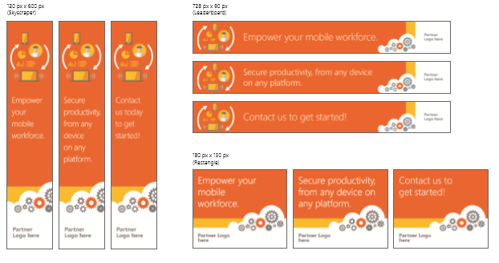
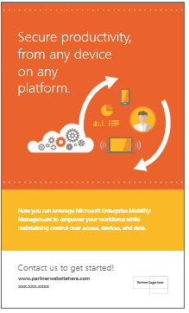
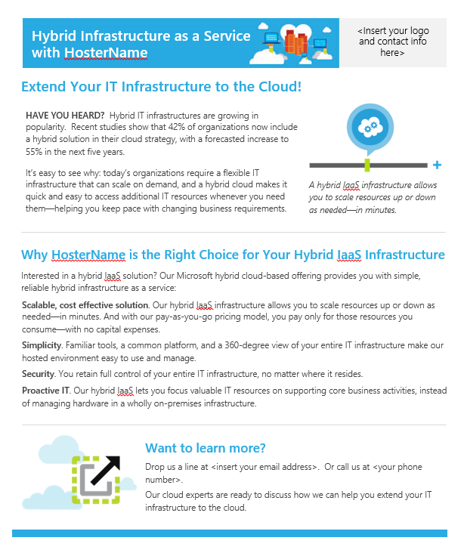
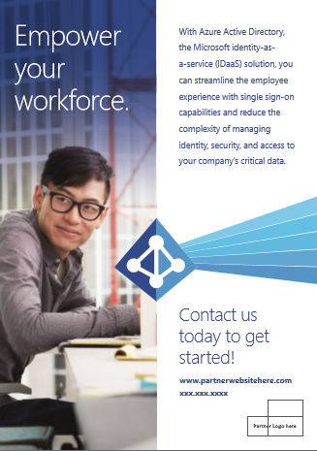
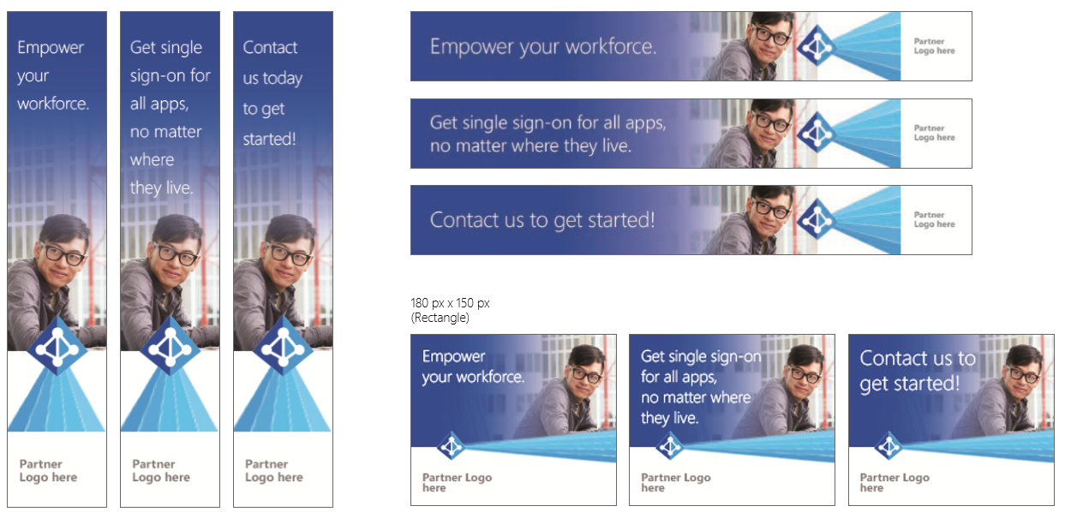
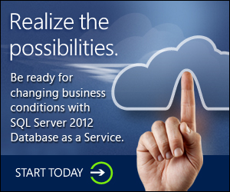

GTM collateral
Exclusive Azure playbook
Exclusive Azure certified portal
Exclusive GTM starting guide
Notes:
Speaker Notes:
Microsoft has great marketing assets that can support you in market. Make sure you take advantage of it!

Slide 29

Demo of Azure GTM Site

Slide 30
Microsoft FastTrack for Enterprise Mobility Suite
Incorporate it into your deployment and managed services offering
Provide a great and consistent user experience
Shorten time-to-value for organizations
Support partner engagement for
high-value services
  Give users a great experience right from the start so they use the service more regularly
Deliver rapid time-to-value by giving organizations the ability to use a cloud service as soon as they buy it
Allow partners to engage with organizations quickly to provide targeted high-value services

Slide 31
FastTrack for EMS
Highlights
FastTrack facilitates deployment
Provides a personal, knowledgeable Onboarding Center contact
Can assist in eight languages from multiple centers worldwide
FastTrack is based on experience
Learnings from Microsoft Office 365 FastTrack
Proactive adjustments around scope, training, and use
FastTrack provides an ongoing service benefit
Significant investment in individual organizations
Dedicated to each organization’s productivity and growth

Slide 32
FastTrack for EMS
Service description
Microsoft FastTrack for Enterprise Mobility Suite provides remote deployment assistance for Azure Active Directory Premium, Intune, and Azure Rights Management
FastTrack will:
Get organizational identities to the cloud
Set up single sign-on for test apps (including Azure Active Directory Application Proxy apps)
Configure self-service options like password reset and Azure Multi-Factor Authentication in the MyApps Portal
Azure Active Directory Premium
FastTrack will:
Set up users and groups
Enable management of test devices
Optionally connect on-premises Microsoft System Center Configuration Manager to Intune for a single management portal experience
Microsoft Intune
FastTrack will:
Activate rights management for users
Configure sharing with external partners
Track usage
Test revocation of protected assets
Azure Rights Management

Slide 33
Opportunity Economics¹
Project Services Economics¹
Per deal
Managed Services Economics¹
Per deal, per year
Unique IP Economics¹
Per deal, per year
Desktop Virtualization
Identity & Access Management
Revenue:
$314,111
Margin:
29%
3 Year Rev. Growth:
90%
Revenue:
$108,333
Margin:
50%
3 Year Rev. Growth:
94%
Information Protection
~35% Mar.
Mobile Device & App Management
39% Mar.
~38% Mar.
Common Partner Services:
90% – Problem Escalation & Remediation
80% – 27x7 Monitoring, Alerting & Logging
80% – Desktop Patch Management & Updates
80% – Set Security Policies
60% – Ongoing Reporting
Common Partner Services:
Practice Accelerators
Proprietary Software (ex. LOB Mobile Apps)
Deployment Templates
Azure Active Directory Management Tools
~37% Mar.
$14,738 Revenue
$13,450 Revenue
$13,905 Revenue
$6,796
Revenue
Source:
1: Microsoft Cloud Platform Partner Economics Research, 2015
~98hrs
~90hrs
~45hrs
~92hrs
Aggregate Growth Over 3 Years
59%
61%
40%
38%

Slide 34
Grow your Business
Partner
Tips & Tricks
Build Your Practice
Best Practices
Define your business roadmap with detailed guidance on practice development from Microsoft
Focus on the business problem the customer is solving
Consolidate identities first – Active Directory is often the entry point
Prove it with a Proof-of-Concept (POC)
Take advantage of the resources made available within the Azure Partner Group and on MPN
Leverage marketing materials from Microsoft within your practice, 67% of partners do!¹
Challenges
Enterprise mobility is new and
evolving – invest in education upfront, both internally and customer-facing
Clients think the ongoing management is easy. It isn’t. Build a Managed Service.
Positioning cloud solutions against on-premises entities – be sure to emphasize the benefits of cloud
Expand Your Services
71%
of partners offer Managed Services for their Enterprise Mobility practice¹
36%
of partners have also built Unique IP within their practice¹
Source:
1: Microsoft Cloud Platform Economics Research, 2015
Notes:
Speaker Notes:
Now that you have heard about new opportunities enabled by Microsoft technology, it’s time to grow your business. Microsoft offers many resources to partners who want to get involved. We provide detailed guidance on developing practices and defining roadmaps, and we apply our own learnings and those of our partners to create communities of like-minded people who are looking to solve customers’ needs with technology.
There are also excellent resources available within the Azure Partner Group, as well as from the Microsoft Partner Network (MPN). Many partners have found the marketing materials from Microsoft to be helpful within their practice as well, with 67% of partners polled mentioning that they had previously used marketing materials provided by Microsoft.
Once your application project services practice has matured, it may be beneficial to consider expanding your business into the managed services space and create unique, packaged IP to drive additional, ongoing revenue. 71% of the partners we surveyed offered managed services as part, or as an extension of, their Enterprise Mobility practice. Of those partners who do not currently offer managed services, 75% plan to offer it within the next year. 36% of partners polled also have created some sort of unique IP within their practice to serve as their differentiator or competitive advantage.
As part of our research, we also asked partners to provide some tips and tricks to others who are building out Enterprise Mobility practices.
Some best practice comments include:
Focus on the business problem the customer is solving
Consolidate identities first – Active Directory is often the entry point
Prove it with a Proof-of-Concept (POC)
Some methods for overcoming challenges include:
Enterprise mobility is new and evolving – invest in education upfront, both internally and customer-facing
Clients think the ongoing management is easy. Its not. Build a Managed Service.
Positioning cloud solutions against on-premises entities – be sure to emphasize the benefits of cloud

Slide 35










Partner Success Stories
“The single sign-on capability in Microsoft Azure Active Directory Premium really simplifies life for employees, who are in and out of multiple Walsh applications throughout the day.”
“Empire Today worked with Peters & Associates, to provision the Azure environment with Configuration Manager and Microsoft Intune. “The team from Peters & Associates was invaluable in helping us set up a complete, unified device management system in the cloud.”
“Other vendors were pushing us to expand our on-premises infrastructure, but we were trying to get out of the hardware management business. IOTAP had our best interests at heart and helped us move all our PCs under the care of Microsoft Intune in just a couple of weeks with no downtime.”
“We have better visibility across managed devices, we can automatically deploy apps using the Company Portal, and we can quickly provide remote assistance, instead of driving to schools.”
“Whether getting ready to launch a product or provide ongoing performance support, we can take advantage of our Azure cloud-based XstreamVideo solution to provide information quickly across the world.”
Patrick Wirtz
Innovation Manager,
The Walsh Group
Julien Leger
Systems Analysts,
Catholic District School Board of Eastern Ohio
Steven Rath Morgan
Global Learning Process and Innovation,
Xerox
Steven Creaney
Senior .NET Developer,
Empire Today
Saif Al Kindy
IT Manager,
Gulf Energy SAOC
For more partner evidence information, please visit: https://www.microsoft.com/en-us/server-cloud/enterprise-mobility/overview.aspx
Notes:
Speaker Notes:
Many partners have found great success building their businesses with Microsoft’s Enterprise Mobility stack and the Cloud Platform. Here are some highlights of their accomplishments:
The Walsh Group
The Walsh Group builds skyscrapers, subways, and bridges, and other big things all over the world. It’s also a leader in using technology to do construction better. Walsh is busy moving significant chunks of its datacenter environment to Microsoft Azure to reduce IT costs and accelerate IT service delivery. Building on the identity and access management foundation of Microsoft Azure Active Directory Premium, Walsh can deliver servers to the business in hours rather than weeks, gain unprecedented scalability, and reduce costs. Employees and contractors have a much simpler application sign-in experience using Microsoft Azure Active Directory Premium, and Walsh enhances data safety. Walsh has big plans for Microsoft Azure and plans to migrate 10 to 15 percent of its on-premises infrastructure into Microsoft Azure each year to sharpen its competitiveness.
Patrick Wirtz, an Innovation Manager remarked, “The single sign-on capability in Microsoft Azure Active Directory Premium really simplifies life for employees, who are in and out of multiple Walsh applications throughout the day”.
For full case study details, visit: http://www.whymicrosoft.com/see-why/walsh-group/
Empire Today
Empire Today installs flooring and window treatments. It is using Windows Intune to manage more than 1,200 tablets running Windows 8.1 RT and a proprietary app that helps its sales force streamline in-home service. The solution replaces a paper-based process, enabling a standard, efficient method of generating quotes, and capturing orders. Empire expects to win more sales, save money on increased material accuracy, and boost its competitive advantage.
Steven Creaney, a Senior .NET Developer commented, “Empire Today worked with Peters & Associates, to provision the Azure environment with Configuration Manager and Microsoft Intune. “The team from Peters & Associates was invaluable in helping us set up a complete, unified device management system in the cloud.”
For full case study details, visit: https://customers.microsoft.com/Pages/CustomerStory.aspx?recid=12505
Gulf Energy
Half of Gulf Energy SAOC workers are located outside the company’s Muscat, Oman, headquarters, making it difficult for the IT staff to manage and protect their PCs. Gulf Energy is using the Windows Intune cloud-based PC management service to remotely and proactively manage PCs, reduce support costs, improve productivity, and enhance PC security. With Windows Intune and Microsoft Office 365, Gulf Energy can easily meet the needs of its many field employees.
Saif Al Kindy, an IT Manager commented, “Other vendors were pushing us to expand our on-premises infrastructure, but we were trying to get out of the hardware management business. IOTAP had our best interests at heart and helped us move all our PCs under the care of Microsoft Intune in just a couple of weeks with no downtime.”
For full case study details, visit: http://www.microsoft.com/sv-se/kundreferenser/Windows-Intune/Gulf-Energy-SAOC/Omani-Oil-Services-Firm-Proactively-Manages-Field-PCs-Reduces-Costs-Using-Cloud-Service/710000004043
Catholic District School Board of Eastern Ontario
The Catholic District School Board of Eastern Ontario (CDSBEO) chose the Windows Intune mobile device management solution as the foundation of a new student BYOD (bring your own device) policy. Compared to its previous on-premises solution, Windows Intune offers the multiplatform management capabilities and simplified administration that CDSBEO required to provide a secure computing environment that improves student learning.
Julien Leger, a Systems Analyst commented, “We have better visibility across managed devices, we can automatically deploy apps using the Company Portal, and we can quickly provide remote assistance, instead of driving to schools.”
For full case study details, visit: https://customers.microsoft.com/Pages/CustomerStory.aspx?recid=10511
Xerox
Xerox, a global leader in business processes and document management, wanted to shift its employee learning focus from a traditional approach focused on classroom-based learning to a more needs-driven approach. Recognizing both the power of video in learning and the fact that its workforce is increasingly mobile, Xerox worked with Microsoft Azure Circle partner Ravnur to implement a Microsoft Azure cloud-based video content management solution that delivers learning content to mobile devices anywhere and anytime.
Steven Rath Morgan commented, “Whether getting ready to launch a product or provide ongoing performance support, we can take advantage of our Azure cloud-based XstreamVideo solution to provide information quickly across the world.”
For full case study details, visit: https://customers.microsoft.com/Pages/CustomerStory.aspx?recid=2797

Slide 36

Win With Microsoft
Plan
Enable
Deploy
Learn more about the Microsoft Enterprise Mobility Suite (EMS)
Read about Microsoft’s position in the Gartner “Visionary” Magic Quadrant for Enterprise Mobility Management (EMM)
Review the EMS overview – goals, services, and sales scenarios for partners
Go to the Microsoft EMS Learning Paths for presales, sales, and technical readiness
Use your EMS internal use rights benefit from your Microsoft Partner Network competencies
Leverage the hands-on proof-of-concepts to build your sales pitch
Engage customers with resources from the Partner Marketing Center
Promote your EMS solution with Pinpoint
Share strategic opportunities with your local Microsoft partner teams
Learn how to leverage Microsoft FastTrack for EMS with your customers
Visit aka.ms/EMSPartner for more partner resources on EMS

Slide 37
Next steps
To learn more about Microsoft Enterprise Mobility Suite:
  www.Microsoft.com/ems
To try and evaluate Microsoft Enterprise Mobility Suite:
  www.Microsoft.com/tryems

Slide 38

© 2014 Microsoft Corporation. All rights reserved. Microsoft, Windows, and other product names are or may be registered trademarks and/or trademarks in the U.S. and/or other countries.
The information herein is for informational purposes only and represents the current view of Microsoft Corporation as of the date of this presentation. Because Microsoft must respond to changing market conditions, it should not be interpreted to be a commitment on the part of Microsoft, and Microsoft cannot guarantee the accuracy of any information provided after the date of this presentation. MICROSOFT MAKES NO WARRANTIES, EXPRESS, IMPLIED OR STATUTORY, AS TO THE INFORMATION IN THIS PRESENTATION.

Slide 39
Appendix

Slide 40



Controlling access to corporate data
On-premises
Mobile devices
Devices
Apps
PCs
Data
Apps
Users
Data
Web browsers
Access control to corporate data today
The perimeter cannot help protect data stored in the cloud
Notes:
In the past, almost all the corporate data was stored on-premises which means that organizations could use the perimeter to manage access to the corporate data. Typically, this was a challenging project, that often required email gateways, servers in the perimeter network, lots of configuration, and custom scripts. However, a lot of corporate data today is stored in the cloud either because of the organization’s decision or because employees themselves intentionally or unintentionally stored in the cloud by using apps like Dropbox or SalesForce. This creates a security risk where the corporate data might end up in the wrong hands, and most of the EMM vendors in the market today don’t really have a good solution for this.

Slide 41
Protecting data in a mobile-first, cloud-first world
On-premises
Managed cloud
Enterprise
Mobility Suite
Devices
Apps
Users
Data
SharePoint
Online
Exchange
Online
Access control and data protection integrated natively in the apps, devices, and the cloud
Notes:
Microsoft takes a different approach where we believe that access control and data protection should be integrated natively in the apps, devices, and the cloud. With EMS, organizations can manage the access to the corporate data on-premises and in the cloud with conditional access capabilities but also protect the data once it is on the device with 4 layers of protection: identity, device, application, and data. And due to our cloud architecture, we significantly reduced the complexity, and made it very easy to configure.
We will discuss this in more detail shortly.

Slide 42
Typical EMM stack
Standard MDM provides device configuration and management
Native device MDM
Mobile application
management
DMZ/
Perimeter
network
Corporate
network
Custom data container provides mobile productivity apps integrated with content and access systems
Containers
Depends on specific DMZ infrastructure
Works on-premises only
Firewall
Firewall
Active Directory
Custom email app
Custom collab app
Custom
file app
Exchange Server
SharePoint
Server
Custom SDK/wrapper
enables line-of-business
apps to be managed
SDK/wrapper, managed browser, managed viewers
Notes:
Let’s take a look at how most of EMM vendor try to protect corporate data today.
First, they use MDM to protect the device. This is pretty much a commodity nowadays as almost all the vendors provide similar capabilities in this area.
Second, there is usually a container where EMM vendor provide their own email and productivity apps that also protected with mobile application management (MAM) capabilities. These custom apps usually have limited functionality and confusing user interface. Employees want Office.
Third, EMM vendor also provide their our SDK or app wrapper so organizations can wrap their internal apps, so they can be managed by the EMM tool.
Finally, they often also have a email gateway or appliance in the DMZ that they use to control access to the internal corporate network. As mentioned earlier, this does require custom appliance, lots of configuration, and custom scripts. And the bigger problem is that this does not solve the problem where corporate data is stored in the cloud.

Slide 43

Microsoft’s EMM stack
Intune: Cross-platform MDM
Native device MDM
Cloud integration
SharePoint
Online
Exchange
Online
Managed Office
productivity and more
Office 365: Mobile productivity
Azure AD: Access control to Office 365 and SaaS apps
Intune: App restrictions for Office mobile and LOB apps
Azure Rights Management: Information protection at the file layer
DMZ/
Perimeter
network
Corporate
network
Standard
on-premises
integration
Firewall
Firewall
Active Directory
Extensibility based on Azure AD and Intune Enable business apps to interoperate with Office mobile apps
Intune App SDK
Intune App Wrapping Tool
Exchange Server
SharePoint
Server
Notes:
Now let’s take a look at how Microsoft tries to solve the enterprise mobility challenges.
First, Intune provides a cross-platform MDM.
At the next layer, Intune is uniquely able to manage and enforce app restrictions for Outlook and Office mobile apps on iOS and Android. This provides best in class and consistent user experience for email, productivity and collaboration while protecting corporate data. Employees are productive with real Office, not Office like proprietary apps with limited functionality. Not only this provides a great user experience, but with EMS, corporate data is also uniquely protected at 4 layers that we will discuss later. Other vendors can’t say this.
Intune also provide Intune App SDK and App Wrapping tool so organizations and developers can bring their application under the management with Intune. However, there are some differences that are worth to mention: with extensibility based on Azure AD and Intune, organizations and developers can interoperate with Office mobile apps and Office 365.
When it comes to data access control, Intune is also able to manage access to the internal corporate network such as Exchange on-premises but there is not requirement for email gateways or other servers. Where the difference really stands is the ability of EMS and Intune to secure the access to corporate data stored in the cloud (such as O365) without any infrastructure requirements.
Complete identity management based on AAD
Native multi-factor authentication support
Access control both on premise and in the cloud
User experience based on Office
Separate work apps supported but not required
Isolate corporate data from personal data in the same app
File layer protection
Integrated cloud services infrastructure

Slide 44

Mobile data protection
    On-premises
User
IT
    Protect corporate data
    accessed from devices
    Protect corporate data
    stored on devices
Notes:
So in summary, Intune and EMS have a twofold philosophy for mobile data protection. First, Intune protects corporate data accessed ‘from the device’. For example, with Conditional Access - before the devices can access data, they must be managed and healthy. Once device is enrolled and healthy, Intune enables end users to access corporate resources such as email and internal web sites.
Second, Intune protects corporate data cached ‘on the device’. For example, with mobile application management – Intune protects and manages the data both in the apps and on the devices that users actually want to use. With remote tasks such as selected wipe – IT Pro can take action on devices that have been compromised to keep data protected.
Now, lets discuss in more detail how Intune protects the data on the device.
Protect corporate data accessed ‘from the device’
Conditional access
Certificates, VPN, WiFi and email profiles
Email and collaboration services
Network services – VPN, WiFi
Intranet sites
On-premises file shares
Protect corporate data cached ‘on the device’
Mobile device and application management
Remote tasks such as selective wipe
Emails, Attachments
Cached documents
Apps syncing corporate data
Apps sharing corporate data
Conditional Access
Before devices can access data, they must be managed and healthy.
VPN, WiFi, Email Profiles
Once device is enrolled, enable end users to securely get the data they need
Mobile App and Device Management
Protect and manage the data both in the apps and on the devices that users actually want to use.
Remote Tasks
Take action on devices that have been compromised to keep data protected.

Slide 45
Conditional access with EMS
Conditional access policies
Corporate
apps
IP Range
Device State
User
Cloud
Advanced Windows 10 options
User Group
On-premises
Notes:
Using conditional access capabilities in EMS, organizations are able to restrict access to cloud and on-premises resources based upon user health and device health. User health can be defined based upon IP range, user group membership, and additional options will be added over the coming months. Device health can be defined based upon if the device is managed by Intune and is compliant based upon the policies set by the IT administrator. Additionally, for Windows 10, using Azure AD Join, organizations can restrict access to corporate resources.

Slide 46
Azure Active Directory Offering Comparison
 | Azure AD Free (O365) | Azure AD Premium
Directory as a service | Up to 500,000 objects | No limit
User and group management
Single sign-on for pre-integrated SaaS and custom applications | 10 apps per user | No limit
Microsoft Directory Synchronization Tool (Windows Server Active Directory extension)
User-based access management and provisioning
Group-based access management and provisioning
Self-service group management for cloud users
Self-service password change for cloud users
Self-service password reset for cloud users
Security reports
Advanced security reporting (based on machine learning)
Usage reporting
Company branding (logon pages and Access Panel customization)
Multi-factor authentication (all available features on Windows Azure and on-premises environments)
Service-level agreement (SLA)
Forefront Identity Manager CAL + Forefront Identity Manager Server
Notes:
Here you can see all the available features in the free and premium Azure Active Directory offerings.
In the free offering each user can have up to 10 software-as-a-service applications in his or her access panel.
The Free Azure Active Directory tenant can go up to 500,000 user accounts.
Forefront Identity Manager server user rights include an unlimited number of Forefront Identity Manager servers and a Forefront Identity Manager CAL for every Azure Active Directory Premium subscriber/user.

Slide 47
Azure MFA Offering Comparison
 | MFA for O365/Azure Administrators | Windows Azure Multi-Factor Authentication / EMS
Administrators can Enable/Enforce MFA to end-users
Use Mobile app (online and OTP) as second authentication factor
Use Phone call as second authentication factor
Use SMS as second authentication factor
Application passwords for non-browser clients (e.g. Outlook, Lync)
Default Microsoft greetings during authentication phone calls
Custom greetings during authentication phone calls
Fraud alert
MFA SDK
Security Reports
MFA for on-premises applications/ MFA Server.
One-Time Bypass
Block/Unblock Users
Customizable caller ID for authentication phone calls
Event Confirmation

Slide 48
Azure RMS Offering Comparison
 | RMS for O365 | Azure RMS (EMS)
Consume & Create RMS content with company ID
Protection for content stored in O365
Protection for content stored in on prem Office (Exchange, Sharepoint via RMS Connector)
Bring your own Key (Hybrid protection)
RMS protection for non office files
RMS SDK
RMS On Prem Connector for on-premises Windows Server file shares* (via RMS FCI Connector)
* As of July 1, 2014

Slide 49
Compare Microsoft Intune to MDM for Office 365
Category | Feature | Exchange ActiveSync | MDM for Office 365 | Microsoft Intune (cloud only) | Intune + ConfigMgr (hybrid)
Device configuration | Inventory mobile devices that access corporate applications | ● | ● | ● | ●
 | Remote factory reset (full device wipe) | ● | ● | ● | ●
 | Mobile device configuration settings (PIN length, PIN required, lock time, etc.) | ● | ● | ● | ●
 | Self-service password reset (Office 365 cloud only users) | ● | ● | ● | ●
Office 365 | Provides reporting on devices that do not meet IT policy |  | ● | ● | ●
 | Group-based policies and reporting (ability to use groups for targeted device configuration) |  | ● | ● | ●
 | Root and jailbreak detection |  | ● | ● | ●
 | Remove Office 365 app data from mobile devices while leaving personal data and apps intact (selective wipe) |  | ● | ● | ●
 | Prevent access to corporate email and documents based upon device enrollment and compliance policies |  | ● | ● | ●
Premium mobile device & app management | Self-service Company Portal for users to enroll their own devices and install corporate apps |  |  | ● | ●
 | App deployment (Windows Phone, iOS, Android) |  |  | ● | ●
 | Deploy certificates, VPN profiles (including app-specific profiles), email profiles, and Wi-Fi profiles |  |  | ● | ●
 | Prevent cut/copy/paste/save as of data from corporate apps to personal apps (mobile application management) |  |  | ● | ●
 | Secure content viewing via Managed Browser, PDF Viewer, Image Viewer, and AV Player apps for Intune |  |  | ● | ●
 | Remote device lock via self-service Company Portal and via admin console |  |  | ● | ●
PC management | Client PC management (e.g. Windows 8.1, inventory, antimalware, patch, policies, etc.) |  |  | ● | ●
 | PC software management |  |  | ● | ●
 | Comprehensive PC management (e.g. Group Policy, login scripts, BitLocker management, virtual desktop and power management, custom reporting, etc.) |  |  |  | ●
 | Windows Server/Linux/UNIX/Mac OS X support |  |  |  | ●
 | OS deployment and imaging |  |  |  | ●
Notes:
More content on MDM for Office 365 can be found here:
Office Blog Post from 10/28: http://blogs.office.com/2014/10/28/introducing-built-mobile-device-management-office-365/
Office Blog Post from 3/30: http://blogs.office.com/2015/03/30/announcing-general-availability-of-built-in-mobile-device-management-for-office-365/
Office FAQ Document: http://infopedia/docstore/Pages/KCDoc.aspx?k=KC00-15-211846
MDM for Office 365 Slide Deck: http://infopedia/docstore/Pages/KCDoc.aspx?k=KC00-15-211848
EMS and Office 365 Comparison Deck: http://infopedia/docstore/Pages/KCDoc.aspx?k=KC02-23-55587
Choose between Microsoft Intune and Built-in MDM for Office 365: https://technet.microsoft.com/library/dn957912.aspx
Recording of MDM for Office 365 Academy Live session: https://microsoft.sharepoint.com/sites/academy/media/AEVD-3-87446

Slide 50
EMS and Windows 10
Home
Pro
Enterprise
Existing Differentiated Features in Win7 /Win8.1
Domain Join and Group Policy Management
Existing Win7 / Win 8.1 Enterprise features
Windows 10: Management and Deployment
Side-loading of LOB apps
MDM auto enrollment
Azure AD Join
The Business Store
Private Catalog
Granular UX Control and Lockdown
Windows 10: Security
Microsoft Passport
Enterprise Data Protection (EDP)
Pass the Hash Mitigations (using Virtual Secure Mode)
Device Guard
Windows 10: Windows as a Service, Support, and Entitlements
Windows Update for Business and Current Branch for Business
Access to Long Term Servicing Branch
EMS
Management with Intune or ConfigMgr
EMS
Intune
MDM auto enrollment requires Azure AD Premium.
Management and app delivery via Intune
Advanced management via Intune Company Portal
EMS
Management with Intune or ConfigMgr
Extend EDP w/ Azure Rights Management for data encryption when files leave the device
EMS
Management with Intune or ConfigMgr
Notes:
Desktop features placemat

