Slide 1
Microsoft 365 Business
Sales Readiness Series
Introduction
Notes:
Hi and welcome to the Microsoft 365 Business Sales Readiness series. In this video I’m going to introduce you to Microsoft 365 Business.

Slide 2
Placeholder for Satya Video
Notes:
Before we get started let me give you a sense of what you can expect. First I will share the Microsoft 365 vision that Satya Nadella, Microsoft’s CEO, shared at Inspire.
This product, and this vision, is a fundamental shift and will require time to absorb and understand the implications. Take your time to understand and absorb the future of how our customers will digitally transform. Microsoft 365 Business is the first proof point to show the vision for how our products are evolving to become more integrated and holistic.
Let’s watch Satya Nadella, Microsoft’s CEO introduce Microsoft 365 at Inspire 2017 in Washington DC.

Slide 3
Microsoft 365
Microsoft 365 Enterprise
Microsoft 365 Business
Microsoft 365 Education
Microsoft 365 E5
Microsoft 365 E3
Microsoft 365 F1
Notes:
I love this video, but the nuance that Satya did in his speech can be missed by some. Let me break it down. He first talked about Office, Windows, and EMS. Those products are distinct and we’ve had success in SMB with most of them. But then he pivots quickly and says that we’re starting to talk about them in the terms that customers will get the most value. He talks about them coming together as a single product, a holistic product. And that is super powerful.
He introduced Microsoft 365 Enterprise and Microsoft 365 Business at Inspire. We also announced our Microsoft 365 Education offer and Firstline worker offer with our Microsoft 365 Enterprise plans at Ignite 2017. You’re starting to see the whole picture of Microsoft 365 within our portfolio, and you’ll learn more about all of this over time. Today, however, I’m going to talk to you about that first proof point on the vision that is Microsoft 365 and that is our SMB offering—Microsoft 365 Business.
We’ve been looking across the landscape at many of the trends and challenges that small and midsize businesses have been facing. For years now, customers have been rapidly deploying software as a service apps and other aspects of the cloud. In fact, they have many “clouds” and for many small business customers, many of their assets are no longer on prem.

Slide 4













Office 365
Apps & SaaS
On-premises
Notes:
Since the BYOD movement in 2009, we’ve seen many more different types of devices being brought into the workplace so it’s no longer on just company owned PCs that people use to get work done.
© Microsoft Corporation. All rights reserved. MICROSOFT MAKES NO WARRANTIES, EXPRESS, IMPLIED OR STATUTORY, AS TO THE INFORMATION IN THIS PRESENTATION.
7/23/2018 9:54 PM
4

Slide 5

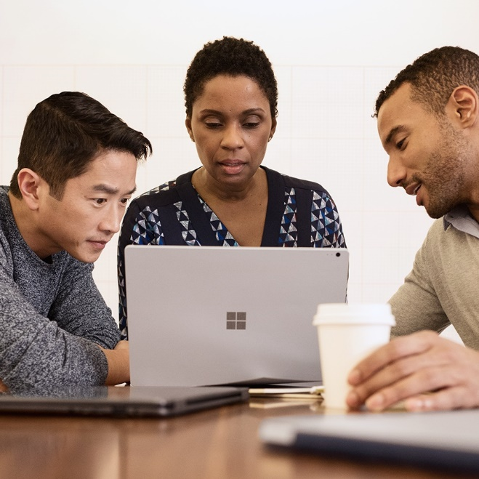

Office 365
Company-owned and personal devices
On-premises
Notes:
As a result, the expectations for cloud providers has changed significantly in the last several years and customers are expecting modern tools to work across a multitude of devices, anywhere they are, and at any time.
(Alt: Small to mid-size businesses also recognize that supporting diverse workstyles means that they can attract and retain employees from a greater pool of talent.
This leads businesses allowing employees greater connectivity to business information from personal devices whether it’s accessing business email on an iPhone or enabling employees to work remotely.)
© Microsoft Corporation. All rights reserved. MICROSOFT MAKES NO WARRANTIES, EXPRESS, IMPLIED OR STATUTORY, AS TO THE INFORMATION IN THIS PRESENTATION.
7/23/2018 9:54 PM
5

Slide 6





Office 365
$$
Data
On-premises
Notes:
And one of these reasons that so many businesses support such a diverse environment is because their success depends on ensuring that their employees are connected to the right people and information at the right time to make intelligent informed decisions.

Slide 7














Office 365
$$
On-premises
Notes:
This introduced three big challenges …
First, our customers and partners end up managing multiple clouds inefficiently, solving for a myriad of security, provisioning, or SSO challenges.
© Microsoft Corporation. All rights reserved. MICROSOFT MAKES NO WARRANTIES, EXPRESS, IMPLIED OR STATUTORY, AS TO THE INFORMATION IN THIS PRESENTATION.
7/23/2018 9:54 PM
7

Slide 8














Office 365
$$
On-premises
Notes:
The second problem is having to maintain on-prem infrastructure such as a Domain Controller, firewalls, Group Policies, file shares, etc). While this on-prem infrastructure was once the de facto IT standard, it is becoming rapidly marginalized and expensive to maintain; and sometimes even a drag on progress.
The last problem is that businesses have had to sometimes trade off giving employees modern tools that empower them while at same time protecting company data. Many times the tradeoffs are too great and the customer optimizes for being one or the other, many times at the detriment to progress.
How do we get out of this? How do we collectively deliver rich, enterprise-class capabilities to even the smallest business while reducing costs?
© Microsoft Corporation. All rights reserved. MICROSOFT MAKES NO WARRANTIES, EXPRESS, IMPLIED OR STATUTORY, AS TO THE INFORMATION IN THIS PRESENTATION.
7/23/2018 9:54 PM
8

Slide 9


Office 365
$$
Microsoft 365 Business
On-premises
Notes:
The only way to really start to solve for all of these problems will be to put the user at the center of everything and bringing together all of the data, devices, and apps in a single solution that really enables the customer to full move away from on-prem technology and embrace Microsoft 365 for all of the productivity, management, and security needs.

Slide 10


$$
Microsoft 365 Business
Office 365
Empower your team, safeguard your business, and simplify IT management with a single solution, purpose-built for your business.
Notes:
OUR VISION for Microsoft 365 Business is to empower teams, safeguard business data, and simplify IT management with a single solution, purpose-built for small and mid-size business.
This vision can only happen if all of their IT infrastructure is in the cloud. This requires us to think very differently about two things
Windows is in the cloud == it’s an appliance which has its status and user data in the cloud so the physical device is a commodity and it can be managed from the cloud
Identity is mastered in the cloud – essential for SSO, provisioning and user-centric security
It’s going to be some work to achieve this.
For example, moving legacy file shares and apps to the cloud will require using new tech and creating new tech.
The same is true for finding ways to enable users and devices to be joined to the cloud via Azure Active Directory yet provide SSO for on-prem resources using AAD.
In the short term, it will feel like we are creating constraints. For example, we don’t support AAD Connect or co-management states with M365B – customers must use AADJ or alternatively use other great products from Microsoft. But this is the right thing to do for customers and for our collective business. We are looking forward to partner with all of you to figure this out over time.

Slide 11



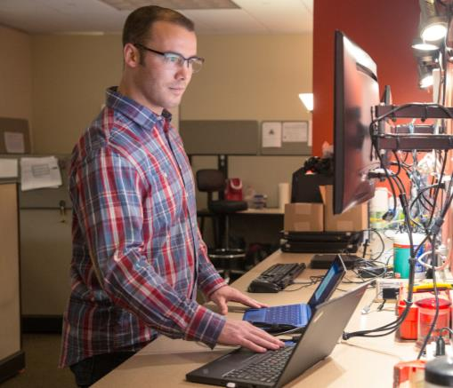
Microsoft 365 Business
Achieve more together
Anywhere it matters
Always-on security
Simplified for business
Notes:
The M365B we have in market now is the first step in this direction
Azure Active Directory and Windows 10 Creators Update is required. By registering PCs with Azure and auto-enrolling into our MDM, we make the first move in bringing Windows to the cloud.
We’re providing one simplified management experience with a single experience to deploy and manage Office 365, Windows and mobile devices including security, Office auto-deployment and Windows Autopilot. We aspire to get to a state where everything the customer needs can be templated and custom PC images are not required.
Simple, user-centric security. This starts the journey of democratizing security by using behind the scenes workflows to allow you to bring enterprise-grade security to even the smallest customer and without a need for security experts. We aspire to extend this to third party apps and a broader range of scenarios.

