Slide 1
MICROSOFT CONFIDENTIAL
FOR PARTNER USE ONLY
Windows 10 Commercial Depolyment Guide
Notes:
This content is considered Microsoft Confidential information and is intended ONLY for Microsoft Partners. This content should not be presented to customers.

Slide 2
Windows 10 Enterprise Partner Deployment Guide
September 2016

Slide 3
Table of Contents
  Windows Momentum & Partner Opportunity
  Windows 10 Enterprise on CSP
  How to talk to Customers about Windows 10
  Deployment, Updates, and Servicing Options: What’s new
  New Offerings – Windows 10 E3/E5 and SPE
  Driving Customer Deployment – Process Guidance
  Partner Revenue Opportunity Detail
  Programs to Drive Partner Success
  Next Steps & Resources

Slide 4
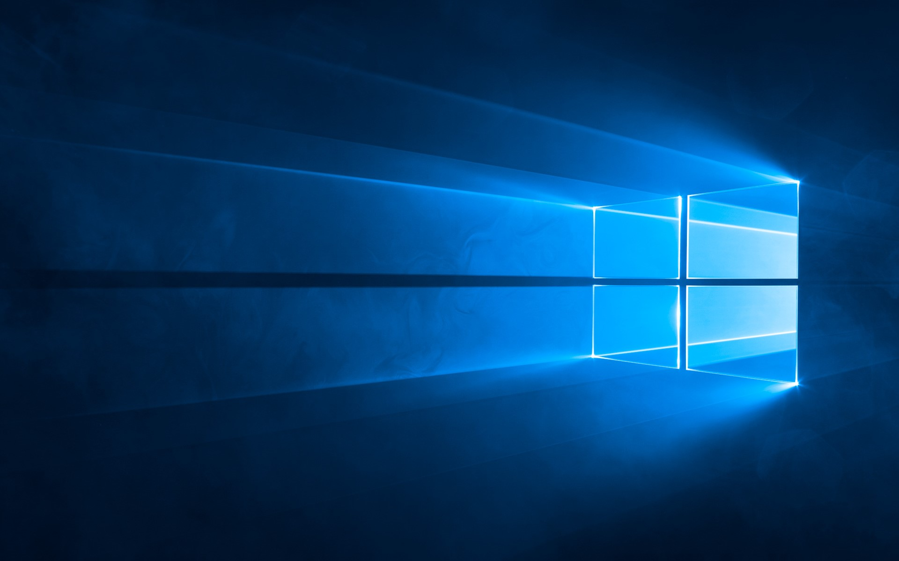
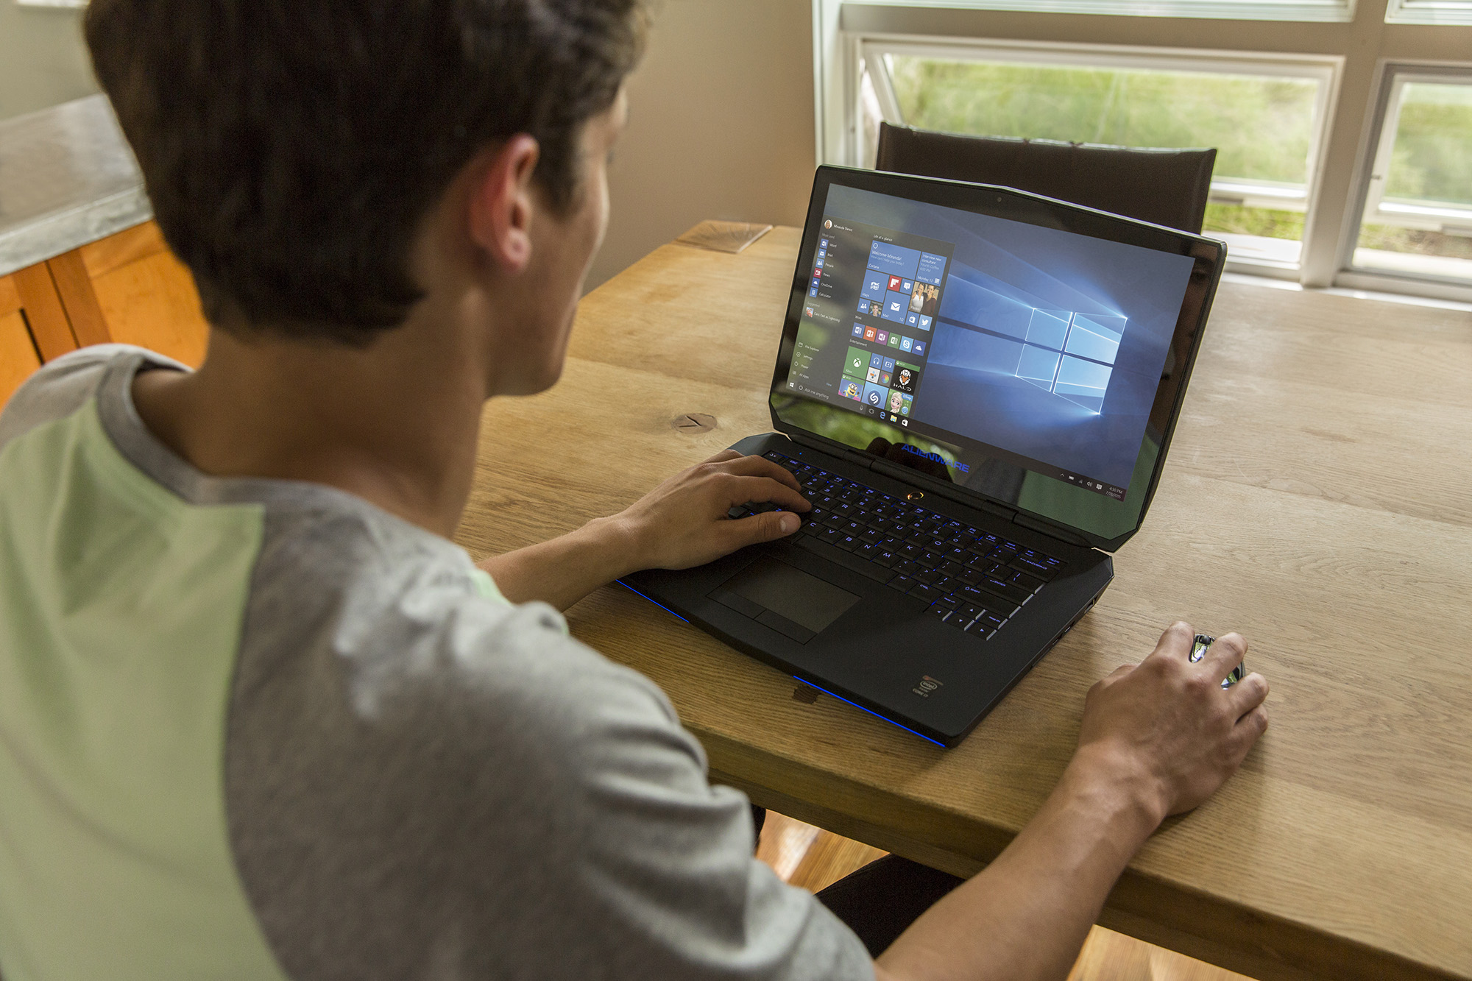
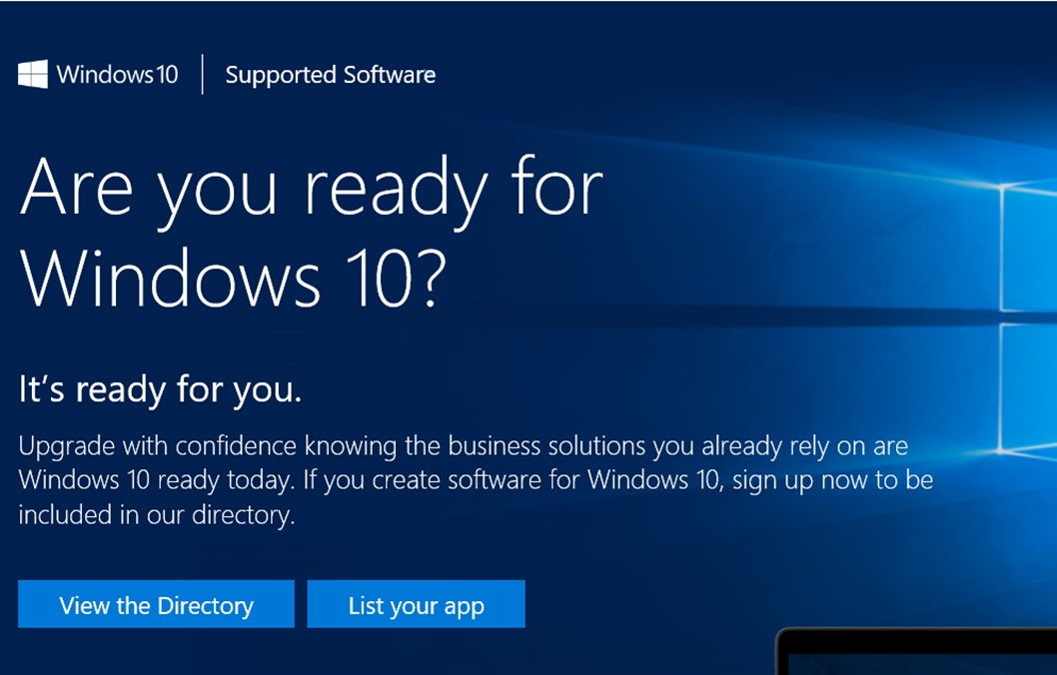





+350M*
96%*
145%*
Active devices running Windows 10
Of our enterprise customers
in active pilots
Growth trajectory for Windows 10 compared to Windows 7
Windows 10 is on a roll!
“Migration to Windows 10 will be the fastest yet…
50% of enterprises will have started Windows 10 deployments by January 2017.”
“49% of companies plan on upgrading to Windows 10 by 2016.”
“More than half of customers have Windows 10 now and we are in a sprint to get all customers to Win10.”
Carl Mazzanti, Owner, EVP
“I try to get executives to take a Windows Surface, once business leaders try it, they see the value and want to adopt Windows 10.”
Reed Wilson, CEO
* Estimate March 2016, Source: Windows Experience Blog
Notes:
+350 Million Active Devices running Windows 10
96% of Enterprises are actively testing, piloting, or deploying Windows 10
145% Growth Trajectory for Windows 10 compared to Windows 7

Slide 5


This is the year businesses will deploy, act now!
WINDOWS 10 DEPLOYMENT TIME YEARS (FORRESTER)*
YEAR 2
PILOT + Deploy
YEAR 1
TRIAL
TRIAL
BEFORE
4
% INSTALL BASE
PILOT
WINDOWS 10
2
DEPLOY
WINDOWS 10 LAUNCH
WPC 2016
“Every customer is involved with some Windows 10 POC or pilot, we believe most will begin deploying this Summer.”
Chidu Nachiappan, GM & Global Microsoft Alliance Head, Wipro Limited
“All our customers are either in midst of deployment
or considering it. Everyone is in a conversation on Windows 10, at all levels.”
Ric Opal, EVP
*The Total Economic Impact™ Of Microsoft Windows 10, Cost Savings And Business Benefits Enabled By Windows 10, Forrester Research June 2016
Notes:
Forrester has done some recent research on Windows 10 deployments and has determined that Windows 10 is a game-changer! Because of the deployment efficiency engineered into Windows 10, and also because of the positive customer reception to Windows 10, Forrester thinks that the Windows 10 Enterprise OS migration will now take 2 years instead of 4! If you look at the chart on the right, you can see where we are on the deployment wave. We’re right in the middle – at WPC16 – 1 year after launch. With almost all of Enterprises actively considering or already deploying Windows 10 today, you are on the verge of a HUGE migration opportunity! This is going to be a banner year for anyone associated with Windows 10 deployments, and we want to make sure you go get all of this opportunity that you can!

Slide 6



Windows 10 is your foundation for services revenue
PARTNER MANAGED RECURRING
REVENUE IS PRIMARY GROWTH DRIVER
IP AND NEW INDUSTRY/ FUNCTION SCENARIOS
PROJECTS
Windows 10 momentum/
customer
interest
Device
renewal
OFFICE 365, EMS, AZURE AD, IMPLEMENTATION AND RECURRING REVENUE
30–40% project margin
40–60% IP margin
MANAGED SERVICE (DESKTOP+) MONTHLY RECURRING REVENUE
30–40% margin
NEW WINDOWS PROJECTS, SECURITY, LIFECYCLE MANAGEMENT
DEVICES & ACCESSORIES
HW/SW RESALE
40–50% margin
Windows 10 momentum/
customer
interest
POC, PILOT, SCCM PREP & DEPLOYMENT PROJECTS
30–40% margin
“Windows 10 unlocks cloud profitability. Without Windows 10 we won’t have a successful cloud business”
CHRIS HERTZ – FOUNDER
5–15% margin
20–30% margin bundled as monthly managed service
20–30% margin
PARTNER REVENUE BUILT ON WINDOWS 10
Notes:
As we said before, Windows 10 has great customer momentum. Almost all of our enterprise customers are actively looking at Windows 10 deployments! On top of that, Windows 10 is the very foundation for your services business. In talking to many top partners from around the globe, it was proven that the strength of their services business depends on Windows, and Windows 10 in particular. WITH Windows, our partners make more $. Plain and simple. While partners CAN manage other operating systems, those “mixed OS” environments cost more $ to manage, and there is inherently less cross-sell and up-sell opportunity for partners.
So how do customers enter this “Windows 10 Revenue Ramp”? 2 main ways. The first, we have already spoken about. There has been amazing press coverage for Windows 10 and customers love it. 350 million active devices are running Windows 10 and that number is still climbing quickly each day! The other main customer entry-point for the Windows 10 deployment is around Device Refresh. Windows 10 Pro devices are better and a better value - than ever before. And there are a LOT of devices that are coming-up on their 3 year refresh period from when they were sold-in for Windows XP End of Support in 2013/2014. Every one of the Notebooks, Tablets, and 2-in-1s that were sold in 2013 or 2014 are due for a refresh and this is an excellent place to start a Windows 10 deployment conversation.
Now… Windows 10 Deployments and Devices may be the start of the conversation with your customers but it’s really just the start. With Windows trusted boot, Device Guard, BitLocker, Credential Guard, Windows Information Protection, and now Windows Defender Advanced Threat Protection, you can sell Windows Security Services as a high-value (and high margin) service for your customers that will ensure they, their data, and their customers’ data remains secure.
And don’t forget – with ongoing releases of Windows 10 features and product updates, there needs to be ongoing testing with a company’s applications and internal systems to ensure there are no compatibility issues. This is another ongoing, high-margin service that you can provide to your customers.
And for those of you that have a strong Outsourced IT business, that business just gets more profitable for you as customers move to Windows 10 because management becomes more efficient with Azure AD integration and fewer support issues related to the user interface or application/ driver compatibility issues. So your costs go down with Windows 10 while your revenues don’t need to. Of course, if you are locked into contracts where your revenues MUST go down on a periodic basis, then Windows 10 deployment presents a “reset” point for you while also granting cost efficiencies. Any almost any scenario, you WIN when Windows 10 gets deployed!
Of course, our other Microsoft Cloud products: O365, EMS, Azure AD, and CRM Online, all work BEST on a Windows 10 operating system. Windows 10 enables touch features and APIs that allow for the best, fullest functionality of our Microsoft products. When we design our products, we design for OUR other products first to ensure best compatibility. This shows when customers are aligned across a Microsoft product stack. Thus, when you have sold or deployed Windows 10 to your customers, you have a CLEAR opportunity to sell and manage these other Microsoft products and earn additional, recurring revenues at a high margin.
Perhaps most importantly, lets not forget about your own “Special Sauce” that you bring to the table for your customers. Whether it’s an industry-focused application that you have designed or a software “layer” that you have developed to better serve your customers across their various devices and software, many of you bring that extra ingredient to the customer which helps to ensure customer loyalty while returning high margins for you. This is something we strongly encourage you to continue to provide. And please know that Microsoft is dedicated to providing you with the tools and support you need to make sure that your integration – On TOP of the Windows 10 foundation and WITH our other Microsoft products – is brilliant.

Slide 7
Strong opportunities for all types of partners
SYSTEM INTEGRATION
MANAGED CLOUD SERVICES
SALES & LICENSING REVENUE
Deployment Projects, LTSB
Application Testing as a Service
Application Migration (App Store)
Security Project Implementation
Device Margins
Windows 10 Enterprise E3 and E5
O365
EMS with Azure AD, MDM
CRM Online
Application Management (Azure)
Bundled Devices
SW Licensing Margins (traditional EA)
Cloud Solution Provider Incentives
Device Margins (Surface Book, Premium Devices, New Form Factors and peripherals)
SECURITY SERVICES
OUTSOURCED IT SERVICES
ISV/IP REVENUE
Windows Defender Advanced Threat Protection
Windows Information Protection
Passport for Work
Device Guard
Multi-Factor Authentication
Helpdesk/Support Services
Device Management
Application Development (Azure)
ISV Software Updates and Extensions leveraging Touch, Mobility, Security…
Templates and Integrations
Notes:
Whether you are a Device Seller, a System Integrator focused on helping customers deploy Windows 10, a Managed Service provider with an emphasis on the cloud, an LSP focused on agreement renewals, a Security Services partner working to ensure the best protection for your customers, an Outsourced IT partner, or an ISV, you all have something in common for the next year. Windows 10 deployments are going to be BIG. As they happen, as YOU drive to make them happen, you have a great opportunity to better serve your customers. Not just in your field of comfort, but also in additional service areas. Because Windows 10 deployments require less labor minutes than in the past, you can dedicate fewer resources to this effort while transitioning more resources to the services Cross-Sell and Up-Sell motion – Gaining you more of those high margin, recurring revenue streams!

Slide 8


Introducing:
Windows 10 Enterprise
for Cloud Solution Providers (CSP)
Notes:
The Cloud Solution Provider Platform provides strong synergies for partners selling services across multiple Microsoft cloud products. Launching Windows 10 Enterprise on CSP enables new revenues and service opportunities for System Integrators and Managed Solution Providers, with Windows 10 Enterprise as the foundational product for ongoing service revenue.

Slide 9

Windows 10 Enterprise E3 Edition Current Branch (CB) or
Current Branch for Business (CBB)
No LTSB or downgrade rights
1 seat minimum, 1 year co-terminus
$7 per user, per month (list price)
No seat limit. 5 devices per user
Rollback to Pro functionality when subscription lapses (90-day grace)
Notes:
Enterprise E3 for CSP offers CB and CBB feature upgrade options, but no LTSB, downgrade rights, or VDA rights.
There is only a 1 seat minimum and a 1 year commitment. The list price is $7 per user, per month. There is no seat limit and each user can get Enterprise E3 on up to 5 devices.
If a subscription lapses, it rolls back to Window 10 Pro functionality until it’s renewed. You can turn the full Enterprise feature set on or off month-to-month based on whether a subscription is active. In order to maintain device, data, and ID security, not all features are turned off when a subscription lapses. Some are put into a frozen state so that they still work but cannot be changed until the subscription is renewed.

Slide 10

Increased CSP service opportunity
Windows 10 Enterprise E3 in CSP makes it easier than ever before to sell Windows 10 Enterprise edition and offers a huge sales opportunity for partners to reach new customers
Simplified sales motion Per-user licensing model eliminates seat minimums and device counting Easy add-on to your existing O365 and EMS business; no new partner sales motions required
Seamless cloud deployment One-click configuration via Mobile Device Management/Group Policy; no labor-intensive deployments Assignment and provisioning via Azure Active Directory and CSP Portal
Customer-friendly subscription model Low barrier to entry with no up-front costs and low monthly payments Reduced term commitments with flexible license re-assignment
Notes:
Because Windows 10 Enterprise E3 for CSP is designed for partner-managed IT solutions, it creates a new opportunity for you to deliver enterprise-grade security and management features. A simple sales motion that aligns with your current O365 and EMS business, one-click configuration, and low barriers to entry make it easy for you to reach new customers and grow your business.

Slide 11
The Complete Partner Managed IT Solution
CRM
Dynamics CRM Online
Windows 10 Pro Devices
Productivity
Office 365 E3
Partner added
Management Services
Cloud
Mgmt
Enterprise Mobility Suite (EMS)
Partner added
IP Services
Operating System
Windows Enterprise E3
Notes:
Windows 10 Enterprise E3 for CSP will complete the CSP stack, enabling full-stack solution selling.

Slide 12


HOW TO TALK TO CUSTOMERS ABOUT WINDOWS 10
Notes:
Let’s recap for a moment…
People LIKE Windows 10!
Big Deployment / Migration Opportunity in FY17, year #2 of Windows 10!
There is opportunity for ALL types of partners to make more $ with Windows as the foundation for an IT Services business.
Now let’s move on to how we talk to our customers about Windows 10.

Slide 13
Develop your Windows 10 Enterprise deployment 2-min pitch
Windows 10 is the best received Windows Operating System ever.
350M devices. Almost all enterprises are actively testing. A clear winner.
It’s great for your organization for 4 reasons:
IT’S MORE SECURE, PEOPLE LOVE IT, IT SAVES YOU MONEY, and IT’S EASY TO DEPLOY
1
2
3
4
It’s safer
against
modern
threats
It’s easier
and cheaper
to manage
It’s
much easier and faster to deploy
Customers
love its interface, mobility, and modern
devices
Windows 10 Enterprise is MORE SECURE, PEOPLE LOVE IT, IT SAVES YOU MONEY and IT’S EASY to DEPLOY!
We can get started right away!
Notes:
Windows 10 is the best received Windows Operating System ever. 350M devices. 96% of enterprises are actively testing. Windows 10 is a clear winner. But those are just stats, let’s talk about why Windows 10 is great for your organization now.
4 reasons: IT’S MORE SECURE, PEOPLE LOVE IT, IT SAVES YOU MONEY, and IT’S EASY to DEPLOY!
IT’S SAFER AGAINST MODERN THREATS (than prior versions)
Data theft is now a big business with unprecedented threats, and consequences
Windows 10 makes security better and easier for users: replacing passwords with Windows Hello and Multi-Factor Authentication to manage identity on the device and online
Windows Information Protection, Trusted Boot, Bitlocker, and malware defenses are built into the core
Windows Defender ATP detects breaches and recommends proactive responses against hackers (Only available in E5)
CUSTOMERS LOVE ITS INTERFACE, MOBILITY, AND MODERN DEVICES
Immediately familiar and intuitive – no retraining (it’s what they are using at home)
Build to work with cloud mobility (O365, OneDrive, Azure AD) increasing productivity
Touchscreen and new device form factors that let you work from anywhere
It’s the fastest adopted OS ever, growing 145% faster than Windows 7
IT’S EASIER AND CHEAPER TO MANAGE
Forrester estimates 15% savings in IT desktop management and a 33% reduction in security issues and time to resolve
Frequent updates means latest features and security and no additional cost - the end of big OS upgrades
Delivered as one service we can provide and manage for you (Cloud Solution Provider packaged with O365, EMS, Azure AD)
IT’S MUCH EASIER AND FASTER TO DEPLOY THAN YOU EXPECT
With In-Place Upgrade nothing moves – just the OS is swapped out files and data remain in place
It’s generally compatible with what works on Windows 7/8 – no pre-app compat testing is advised, pilot assess any issues and go
Less than 1/10th the IT time to deploy (Forrester) – more like a patch than an OS update
Easy for users to launch the upgrade themselves or partners can do it remotely
Most SMB deployments can be completed in a few weeks, large enterprises will move the bulk over this year
Deploy Windows 10 Enterprise now because it’s MORE SECURE, PEOPLE LOVE IT, IT SAVES YOU MONEY and IT’S EASY. We can get started today.

Slide 14

The most trusted platform
1
2
3
4
It’s safer
against
modern
threats
Customers
love its interface, mobility, and modern
devices
It’s easier
and cheaper
to manage
It’s
much easier and faster to deploy
REPLACE PASSWORDS, PROTECT IDENTITIES
ONLY RUN SOFTWARE
YOU TRUST
PROTECT SENSITIVE CORPORATE DATA
DETECT COMPROMISED DEVICES QUICKLY
WINDOWS HELLO
MICROSOFT PASSPORT
COMPANION DEVICE FRAMEWORK
CREDENTIAL GUARD
SECURE BOOT
DEVICE GUARD
WINDOWS DEFENDER
WINDOWS INFORMATION PROTECTION
WINDOWS DEFENDER ADVANCED THREAT PROTECTION
Notes:
Windows 10 Enterprise = the most trusted platform
From the beginning, Windows 10 Enterprise was designed to be the safest OS Microsoft has ever released. We designed Windows 10 from the very beginning to be our most secure platform ever. With features like Credential Guard, Device Guard, Windows Hello, and Windows Information Protection. Windows 10 offers unique defenses from attacks. Windows Defender, our free anti-malware service, provides protection to almost 400 million devices – every day. And Windows continues to raise the defenses in the system every month as any security issues are investigated and proactively updated through Windows Update.
This ongoing commitment to security has led to strong demand from enterprise customers. From the Department of Defense, which is adopting Windows 10 across all branches of service, starting this year with 4 million devices – to NASCAR to Virgin Atlantic to schools all over the world – we’re excited to see customers with the most demanding requirements move to Windows 10 faster than ever before.
Key points to land
Passwords need to be replaced with something more secure, but we don’t stop there, we drive a series of innovations that will both protect identities and delight users.
Running only the software you trust is a key to protecting your devices. Windows does this to help eliminate malware.
EDP products against accidental data leakage.
Barcelona uses micro-virtualization to secure the browsing sessions. (Coming in 2017)
Windows Defender ATP provides post breach protection to quickly detect suspicious behavior.
Replace Passwords & Protect corporate identities]
It starts with replacing passwords and protecting corporate identities.
Windows Hello and Microsoft Passport are the most personal and secure way to access Windows devices and services and today. They provide enterprise grade security with fingerprint, facial, and iris recognition.
This summer we will make good on the promise to enable you to use you phone to remotely unlock your Windows 10 PC’s, we’ll start with Windows Phone and Android this year and follow up with iOS next year. Adding a second factor of authentication just got a lot easier and cost effective for your organization.
But phones are just one type of device you want to use for authentication. So we’re introducing the Microsoft Passport companion device framework. This means that hardware vendors can more easily innovate and create devices of all types In addition, this framework allows you to extend multi-factor auth to sites and services on the web!
These devices will range from traditional ID cards or smart cards, to wearables, or even IoT devices. Each of these devices can offer the same enterprise grade security that you’re used to today. This means you can choose the solution right for you—including defense, financial, retail, and health care—just to name a few.
You will see devices from partners like Yubico, HID, and others. One interesting device is the Nymi band. The Nymi band can monitor your heart rate to uniquely identify you, and log you in when you get close to your device.
In addition to authentication, we continue to harden the OS to protect corporate identities (certificates, tokens, tickets, etc.). This includes using hardware based virtualization to isolate and protect logins from attacks, heading off an entire category of attacks.
This means that, if an employee falls victim to an attack, Windows 10 has technologies, such as Credential Guard, to help contain the breach and prevent the attacker from moving beyond that device.
In the past, attackers could spread across your network from one device using a technique known as “Pass the Hash.” With Windows 10, these attacks (in their current form) no longer work.
[Only run software you trust]
We have to rethink our approach to running only software we trust. Today we run anti-malware programs and try to look for malware signatures. While important, we need to do more. In one study almost half of the PCs breached lacked any currently detectable malware on them. Hackers often compile specific code for specific attacks and they go after the weak like, the users, to get them to install it.
Windows protects the applications you run so you can ensure only software your IT department has signed is trusted and runs with a technology called Device Guard. Even if an employee accidently downloads dangerous software your devices can be protected against it.
[Protect enterprise data against leaks, theft, or accidental disclosure.]
We are also making advances to help protect sensitive intellectual property.
With the increase of employee-owned devices in the enterprise, there’s also an increasing risk of accidental data disclosure through apps and services that are outside of the enterprise’s control like email, social media, and the public cloud.
Many of the existing solutions try to address this issue by requiring employees to switch between personal and work containers and apps, which can lead to a less than optimal user experience. Enterprise data protection (EDP) offers a better user experience, while helping to better separate and protect enterprise apps and data against accidental disclosure risks across both company and personal devices, without requiring changes in environments or apps. Additionally, EDP when used with Rights Management Services (RMS), can help to protect your enterprise data by persisting the protection even when your data roams or is shared.
[Browse Securely]
Browsing securely is an area that many companies worry about. This is an area where we are doing some very innovative things.
In 2017, we will introduce a way to move Edge browser sessions within a micro-virtualized environment. Similar to how Credential Guard uses hardware based security today, this will isolate whatever is running in the browser from your corporate data, and protect your devices.
If a user’s session is attacked and the attacker is able to drop any type of malware or gain any kind of foothold on the device, it all disappears when the browser session is closed.
We are very excited about the level of security this can bring and will have more information to share as we progress and get closer to 2017.
[Detect suspicious behavior quickly]
Even with all of the defenses Windows 10 introduces it’s hard to keep every intruder out. Sometimes they find and exploit vulnerabilities that aren’t known, or more often they find ways around the best defenses with social engineering and attacking the user. Regardless of how they get in, if you don’t know they are there they can do real damage. While we will continue to invest heavily in building stronger defenses you should also use a mindset that assumes breach to provide additional protections.
Everything we have talked about so far is about working to better keep the users out of your devices and network. To help protect our enterprise customers, we are developing Windows Defender Advanced Threat Protection, a new service that will help enterprises to detect, investigate, and respond to advanced attacks on your network and devices.
Let’s talk more about Windows Defender ATP… CLICK…

Slide 15
Windows 7 Security features
Windows Update
BitLocker Admin and Monitoring
Trusted Platform Module
Windows Firewall
BitLocker
SmartScreen
BitLocker to Go
Device protection
Threat resistance
Identity protection
Information protection
Breach detection investigation & response
PRE-BREACH
POST-BREACH
Notes:
Security features for Windows 7 were representative of a different era and didn’t include all of the modern threat protection available in Windows 10 Enterprise. Our approach with Windows 7 was to provide basic security while leveraging the Partner Ecosystem to provide more advance security features.

Slide 16
Windows 10 Security Features when Upgrading from a 32-bit version of Windows 7 / 8
Windows Trusted Boot
Windows Information Protection
Windows Update
Microsoft Edge
Windows Hello Companion Devices
BitLocker Admin and Monitoring
Windows Defender
Trusted Platform Module
Windows Firewall
Windows Hello
BitLocker
Windows Defender Advanced Threat Protection
SmartScreen
BitLocker to Go
Device protection
Threat resistance
Identity protection
Information protection
Breach detection investigation & response
PRE-BREACH
POST-BREACH
Notes:
Security was a critical design priority for Windows 10. We made a decision to provide comprehensive security so our customers would have the protection to defend themselves against sophisticated modern threats. Some of the new security features added when upgrading from Windows 7 include Windows Trusted Boot, Windows Defender, Windows Information Protection, and Windows Defender Advanced Threat Protection.
While upgrading from Windows 7 Enterprise to Windows 10 Enterprise will substantially improve an organization’s security posture, it’s important to realize that the approach you take will have impacts on which (and how many) security features you will be able take advantage of. If you deploy Windows 10 Enterprise with an in-place-upgrade over Windows 7 or Windows 8 32-bit, you will get to utilized all of the security features listed here.

Slide 17
Full Windows 10 Security on Modern Devices
Virtualization Based Security
UEFI Secure Boot
Device Guard
Device Encryption
Windows Trusted Boot
Microsoft Edge Barcelona
Credential Guard
Windows Information Protection
Security Management²
Windows Update
Microsoft Edge
Windows Hello Companion Devices
BitLocker Admin and Monitoring
Conditional Access
Windows Defender
Trusted Platform Module
Windows Firewall
Windows Hello
BitLocker
Windows Defender Advanced Threat Protection
SmartScreen
BitLocker to Go
Device protection
Threat resistance
Identity protection
Information protection
Breach detection investigation & response
PRE-BREACH
POST-BREACH
Notes:
But… If you want the FULL advantage of Windows 10 Enterprise security features, you will need to take a different upgrade/deployment approach. If upgrading from an Windows 7 or Windows 8 32-bit OS, and you want all of the security features seen here, then you will need to utilized a Fresh/Clean install using a 64-bit version of Windows 10 Enterprise on existing devices, or use a provisioned 64-bit image on a new Windows 10 Pro device.

Slide 18




Windows Defender Advanced Threat Protection
Helps enterprise customers detect, investigate and respond to advanced attacks and data breaches
1
2
3
4
It’s safer
against
modern
threats
Customers
love its interface, mobility, and modern
devices
It’s easier
and cheaper
to manage
It’s
much easier and faster to deploy
POST BREACH DETECTION
FOR ACTIVE ATTACKS
EASILY INVESTIGATE
AND EXPLORE BREACHES
SELF HUNTING ACROSS
PROTECTED ASSETS
BUILT IN THREAT INTELLIGENCE KNOWLEDGE BASE
Notes:
Cyber Attacks Are Increasing in Sophistication
We’re seeing increasingly brazen cyberattacks. Cybercriminals are well organized with an alarming emergence of state-sponsored attacks, cyber-espionage and cyber terror. Even with the best defense, sophisticated attackers are using social engineering and zero-day vulnerabilities to break-in to corporate networks. Thousands of such attacks were reported in 2015 alone. We’ve found it currently takes an enterprise more than 200 days to detect a security breach and 80 days to contain it. During this time, attackers can wreak havoc on a corporate network, stealing data, breaching privacy, and destroying the trust of customers. These attacks are incredibly expensive, costing organizations an average of $12 million per incident with broader impact to a company’s reputation.
As the attackers’ approaches have evolved and become more sophisticated, so too must our approach to provide security to our enterprise customers. And, our customers agree, as 90% of surveyed IT Directors said they need a full-fledged advanced threat protection solution that identifies attacks quicker with comprehensive intelligence, and provides actionable remediation.
Windows Defender Advanced Threat Protection will Help Detect, Investigate and Respond to Attacks
To help protect our enterprise customers, we are developing Windows Defender Advanced Threat Protection, a new service that will help enterprises to detect, investigate, and respond to advanced attacks on their networks. Building on the existing security defenses Windows 10 offers today, Windows Defender Advanced Threat Protection provides a new post-breach layer of protection to the Windows 10 security stack. With a combination of client technology built into Windows 10 and a robust cloud service, it will help detect threats that have made it past other defenses, provide enterprises with information to investigate the breach across endpoints, and offer response recommendations.
Windows Defender Advanced Threat Protection:
1) Detects Advanced Attacks provides key information on who, what, and why the attack happened. Sophisticated threat intelligence enables attack detection, informed by the world’s largest array of sensors and expert advanced threat protection, including a team of experts at Microsoft and expert security partners.
image: https://winblogs.azureedge.net/win/2016/02/Security-image-1.jpg
Windows Defender Advanced Threat Protection is powered by a combination of Windows behavioral sensors, cloud based security analytics, threat intelligence, and by tapping into Microsoft’s intelligent security graph. This immense security graph provides big-data security analytics that look across aggregate behaviors to identify anomalies – informed by anonymous information from over 1 billion Windows devices, 2.5 trillion indexed URLs on the Web, 600 million reputation look-ups online, and over 1 million suspicious files detonated every day.
This data is then augmented by expertise from world-class security experts and advanced threat protection Hunters from across the globe, who are uniquely equipped to detect attacks.
2) Response Recommendations. The service’s security operations data provides an easy way to investigate alerts, explore the entire network for signs of attacks, examine attacker actions on specific devices, and get detailed file footprints from across the organization to recommend responses.
With time travel-like capabilities, Windows Defender Advanced Threat Protection examines the state of machines and their activities over the last six months to maximize historical investigation capabilities and provides information on a simple attack timeline. Simplified investigation tools replace the need to explore raw logs by exposing process, file, URL and network connection events for a specific machine or across the enterprise.
image: https://winblogs.azureedge.net/win/2016/02/Security-image-2.jpg
And, a cloud-based detonation service enables files and URLs to be submitted to isolated virtual machines for deep examination. In the future, Windows Advanced Threat Protection will also offer remediation tools for affected endpoints.
3) Complements Microsoft Advanced Threat Detection Solutions. Because Windows Defender Advanced Threat Protection is being built into Windows 10, it will be kept continuously up-to-date, lowering costs, with no deployment effort needed. Powered by a cloud backend, no on premise server infrastructure or ongoing maintenance is required. It complements email protection services from Office 365 Advanced Threat Protection and Microsoft Advanced Threat Analytics
Read more at https://blogs.windows.com/windowsexperience/2016/03/01/announcing-windows-defender-advanced-threat-protection/#bil7CyXuZA3cxgXQ.99

Slide 19
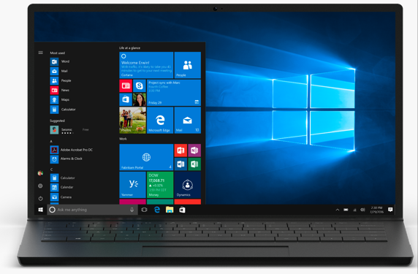
An Interface Customers Love
1
2
3
4
It’s safer
against
modern
threats
Customers
love its interface, mobility, and modern
devices
It’s easier
and cheaper
to manage
It’s
much easier and faster to deploy
Feel like an expert from the start with familiar features.
Windows 10 is friendly and familiar—with lots of similarities to Windows 7 including the Start menu. You’ll feel like an expert from the get-go.
Get an at-a-glance view of everything that matters most.
The Start menu is better than ever. Pin your go-to apps and files for fast access; you can even pin underlying content to jump right into a specific post or song. Live Tiles stream updated info—like weather and headlines—so you don’t need to open the app.
Natural user experience
Windows 10 allows users to choose the best input method for how they want to work—traditional keyboard and mouse, touch, pen/inking, handwriting/annotation, and voice.*
(Screens simulated, subject to change; Some apps sold separately, availability may vary).
* Hardware dependent.
Notes:
Microsoft listened to a LOT of feedback from customers and incorporated that into the Windows 10 User Interface. Responses have been extremely positive. The improved Start menu, the Task Bar, Integrated Search, and Improved Security are just some of the reasons customers are flocking to Windows 10.

Slide 20
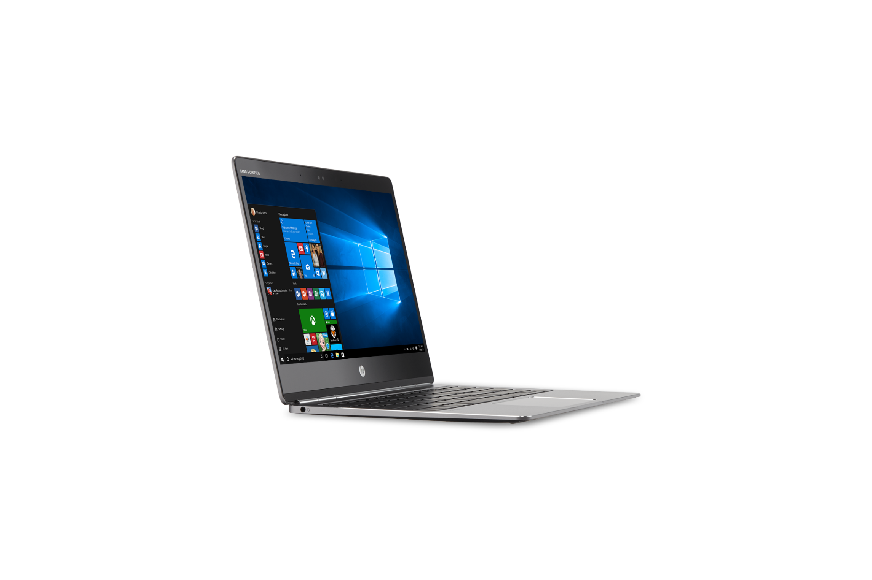
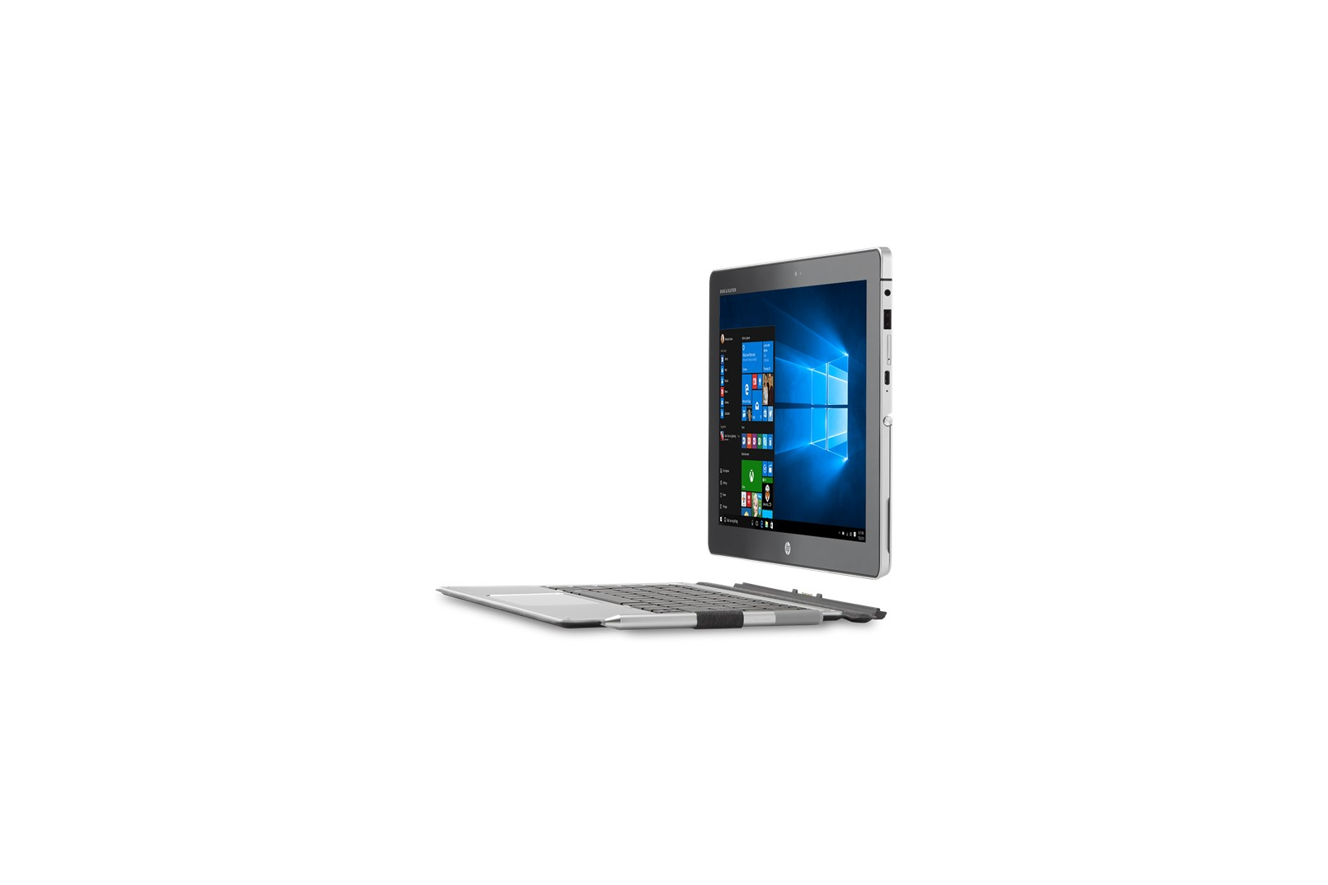
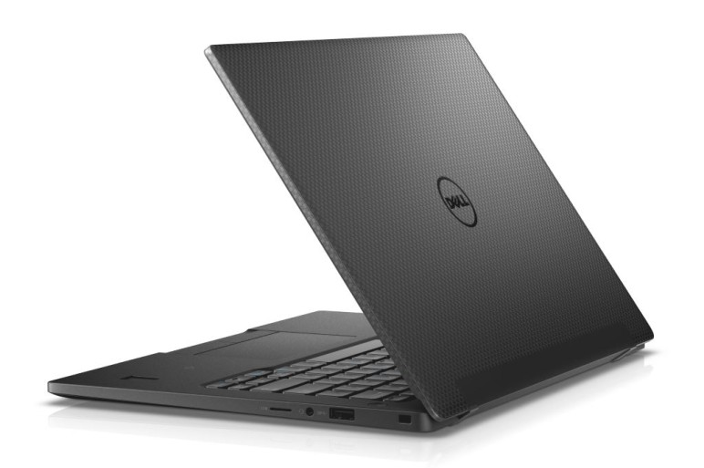
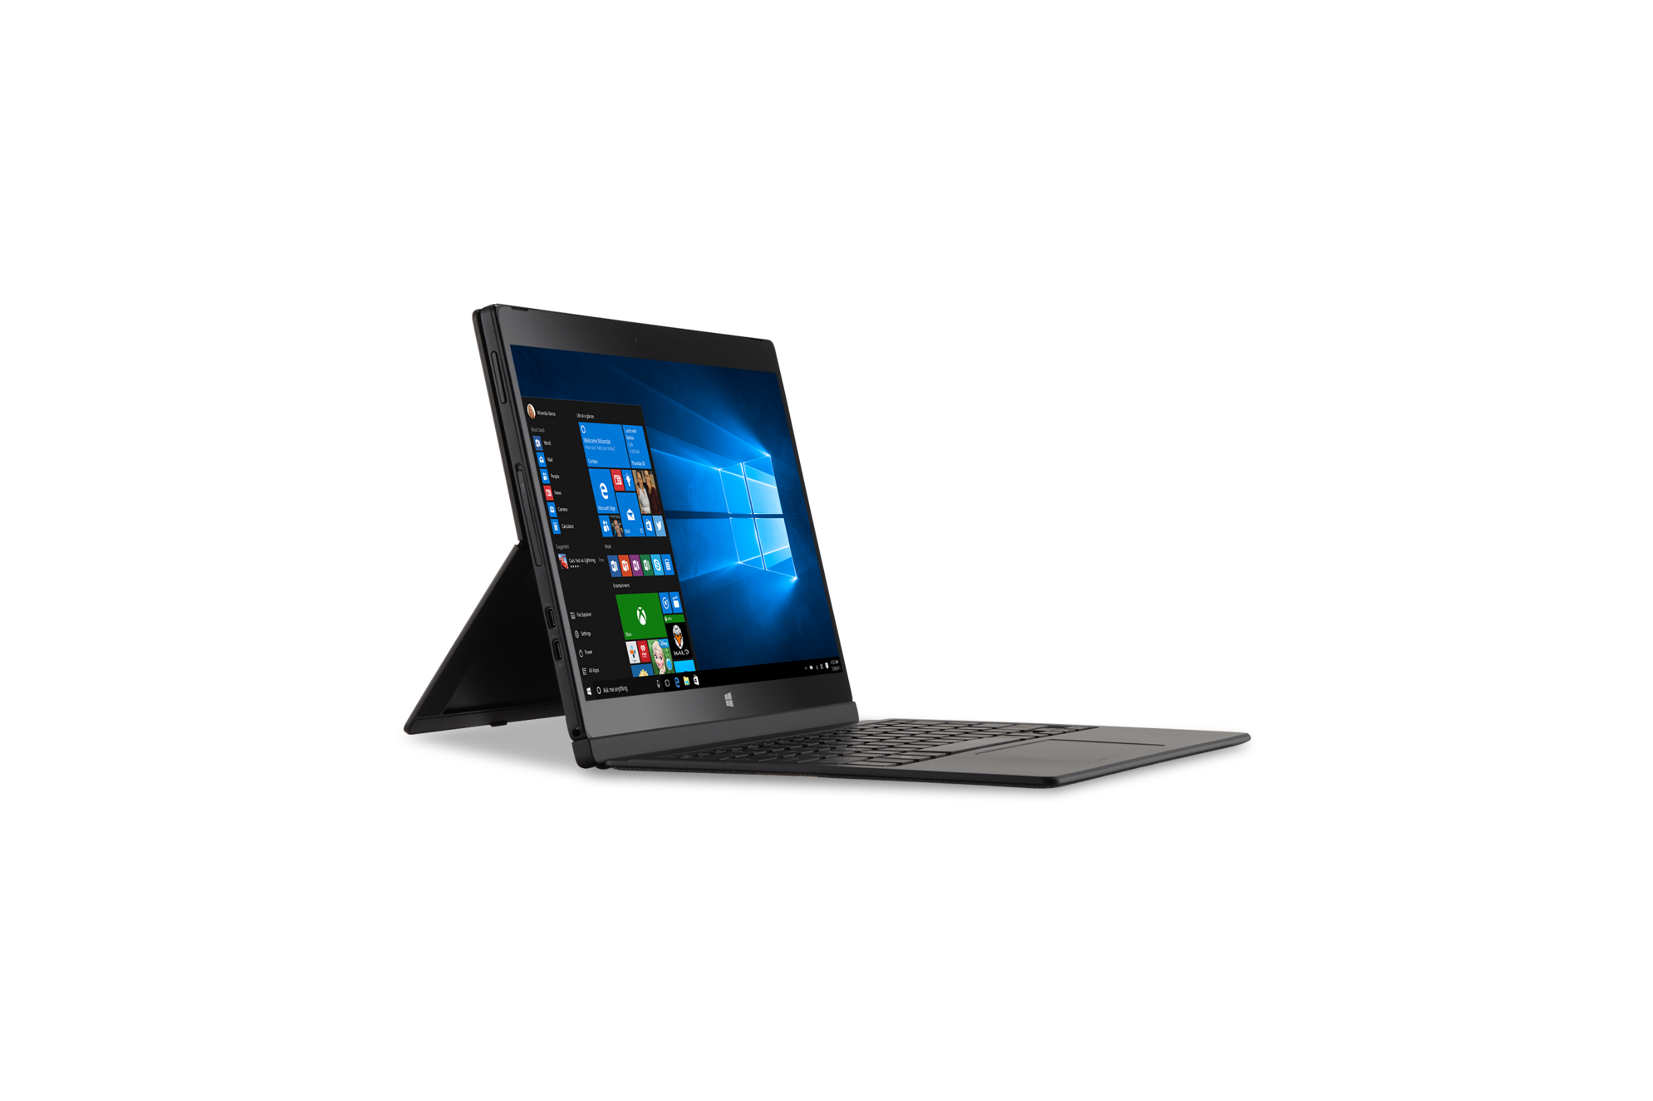
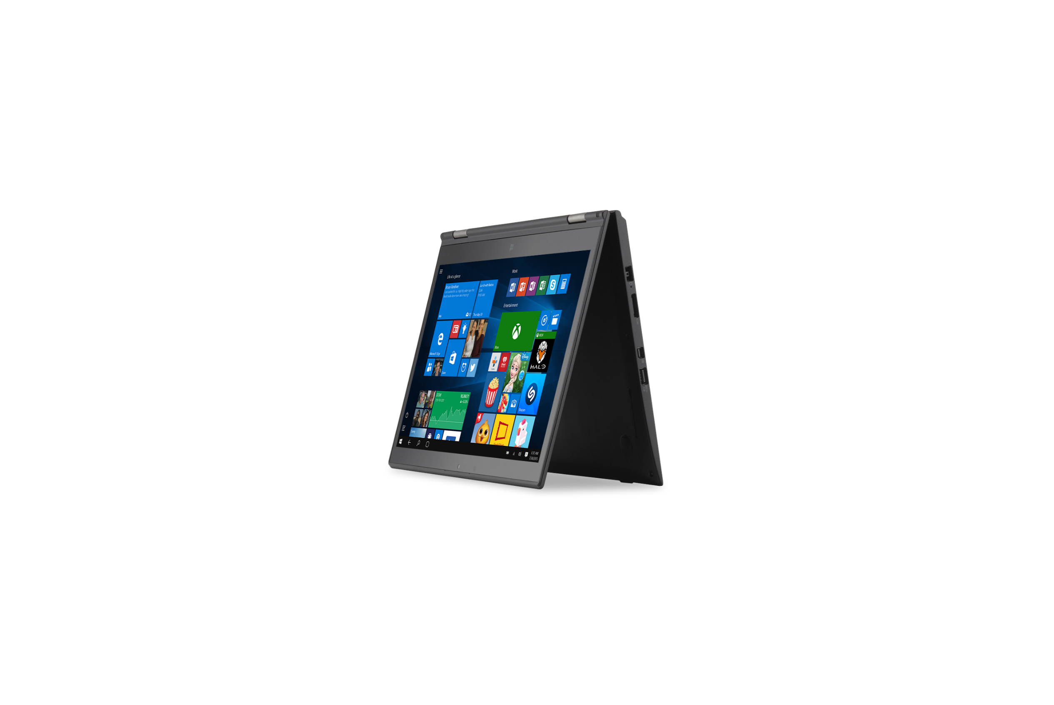
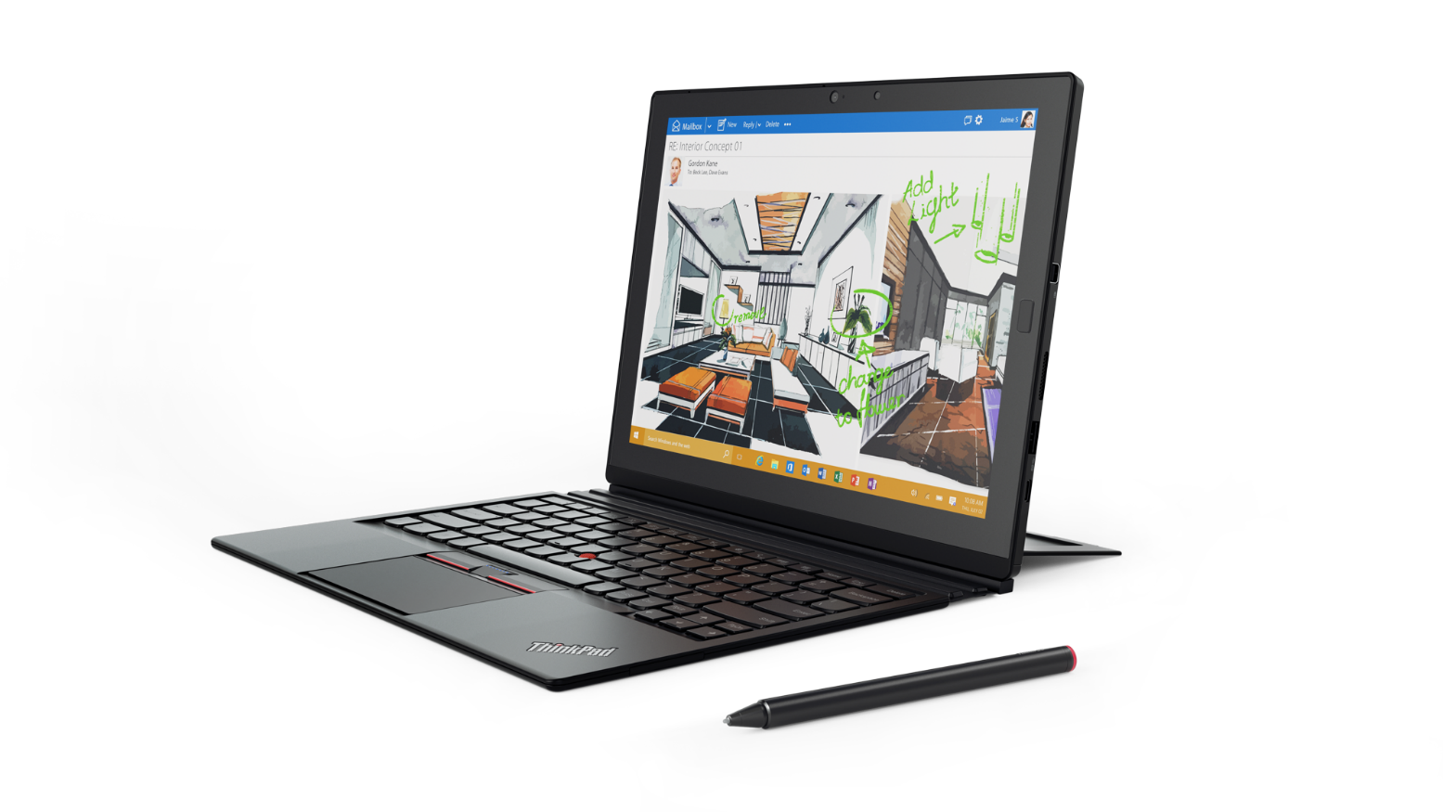
Windows 10 ROCKS on new devices!
1
2
3
4
It’s safer
against
modern
threats
Customers
love its interface, mobility, and modern
devices
It’s easier
and cheaper
to manage
It’s
much easier and faster to deploy
ENHANCED SECURITY – TPM 2.0 processor, Biometric support
INSTANT ACCESS – Windows Hello* and Microsoft Passport multifactor credentials require modern hardware
MOBILITY OF PC/TABLET 2-n-1 – Seamless keyboard connection transition with Continuum
TOUCH PRODUCTIVITY – Windows and modern apps are designed for touch screen display and stylus (write, draw, annotate on screen)
SPEECH PRODUCTIVITY – Cortana* Personal Assistant uses array microphones to respond to your commands
HP EliteBook Folio
HP Elite X2 1012
Dell Latitude 13 7000
Dell Latitude
12 7000 2in1
Lenovo X1 Yoga
Lenovo X1 Tablet
Windows Hello requires specialized hardware, including fingerprint reader, illuminated IR sensor or other biometric sensors
Cortana available in select markets at launch; experience may vary by region and device..
Notes:
Windows 10 devices can protect you from modern security threats with new hardware enabled security features, like TPM 2.0, Processor based virtualization extensions, and biometric support that provide protection Windows 7 and 8/8.1 devices can’t provide today.
Windows Hello* and Microsoft Passport provide secure and easy to deploy multifactor credentials that requires specialized hardware, including illuminated IR sensor or other biometric sensors.
Personal assistant Cortana* helps you get things done. Array microphones enable you to speak directly with Cortana.
Be productive with or without a keyboard with Continuum. A new feature that allows you to transition easily from touch and stylus to keyboard and mouse with new 2-n-1 devices.
Use touch naturally to go beyond how you use your smartphone—for scrolling, sizing, navigating, and more.
Write, draw, and annotate documents naturally using a stylus.

Slide 21
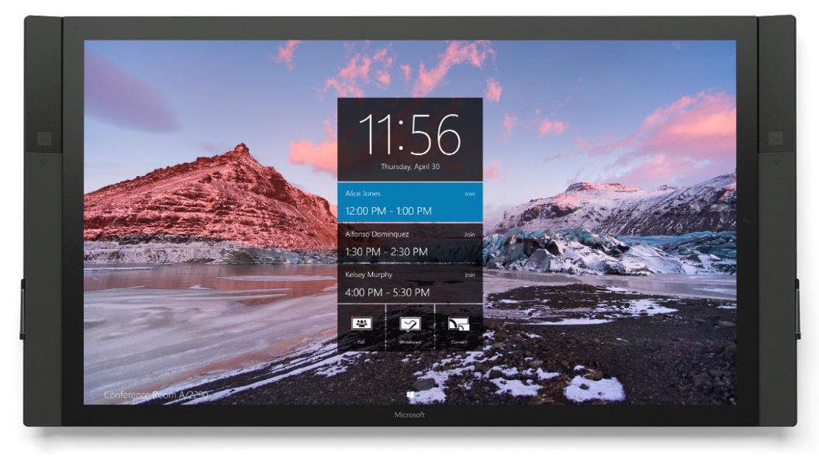
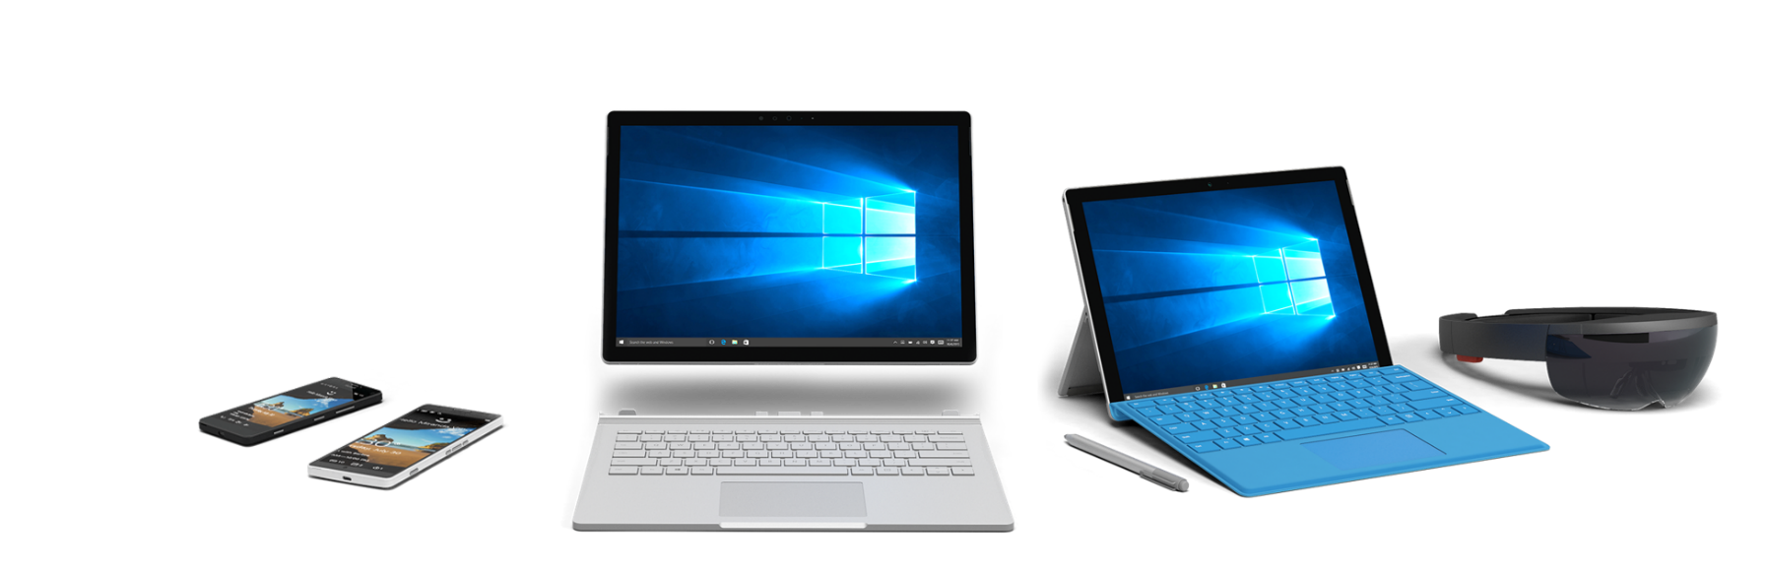
1
2
3
4
It’s safer
against
modern
threats
Customers
love its interface, mobility, and modern
devices
It’s easier
and cheaper
to manage
It’s
much easier and faster to deploy
Powerful, modern Microsoft devices
Quality Craftsmanship
& Design
Mobility of
Experience
Breakthrough
Categories
Versatile
Form Factors
Notes:
Microsoft has brought together our R&D into one 1st party devices engineering team, so that the team which has built Surface, Surface Hub and Hololens will also be the team that builds our next generation devices. This is critical to ensure we are consistent in our investments to design business-class devices that support more human centric experiences.
Our 1st party devices engineering team are devoted to building quality devices,
which breakthrough categories,
empower more versatile experiences
And that seamlessly integrate with Windows to allow people to be productive.
We are seeing fantastic momentum in our Surface business – where revenue increased by 61% in Q3 (FY16) – and we are generating excitement by innovating in new categories like HoloLens and Surface Hub and you can count on us to continue innovating in emerging categories of devices.
<OPTIONAL LONGER TALK TRACK>
As a company, one of our bold ambitions is to deliver more personal computing. In order to have more personal computing, you have to have hardware that supports more human-centric experiences. We are committed to designing business devices – from Lumia to Surface & Surface Hub, to HoloLens – that are the most seamlessly integrated with Windows. They put people in the driver’s seat and can be engaged with multiple senses, they push the envelope on what versatility means by easily adapting to be more than a smartphone and more than a tablet.
Real business transformation will happen because devices are becoming more personal, more human. Interacting with technology should be as natural as interacting with people – using voice, pen, gestures and even gaze for the right interaction, in the right way, at the right time. With form factors of all sizes that move and adapt to your needs – whether you are on the go, in your lap, or at your desk – moving from individual work to collaborative work and back again.
Just like you - the businesses who use Microsoft, we obsess over every detail. We strive to find ways that technology can make it easier to get work done, to innovate on the small change that’ll make a big difference. A minute or two saved here and there adds up to hours that can be spent doing what actually matters – doing great things.

Slide 22
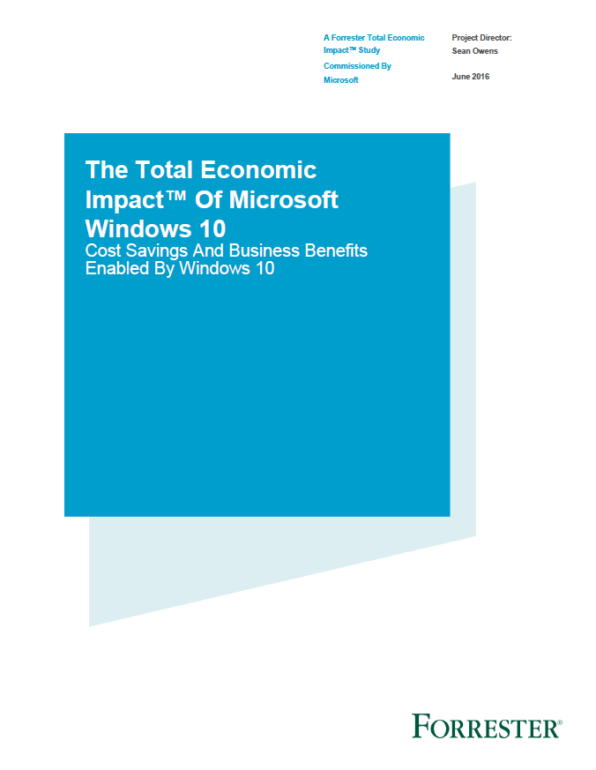
Windows 10 deployment pays for itself in just 13 months
1
2
3
4
It’s safer
against
modern
threats
Customers
love its interface, mobility, and modern
devices
It’s easier
and cheaper
to manage
It’s
much easier and faster to deploy
Forrester Consulting Total Economic Impact findings:
Improved productivity, mobile workers gain
25% of time previously unavailable for work
15% savings in
IT Desktop Management
33% reduction in security
issues and time to resolve
$710K in security issue
remediation savings
$403 per user 3 year NPV
188% ROI
13 month payback
Source: “The Total Economic Impact^{(TM)} Of Windows 10, a commissioned study conducted by Forrester Consulting on behalf of Microsoft, June 2016.
Results are for a risk adjusted composite organization based on customer interviews.
Notes:
Customers want to know the financials of Windows 10, and Forrester has analyzed the Total Economic Impact, we will make this report available for you to use with your customers.
To start with, most customers already are licensed to run Windows 10, so if they don’t deploy, they are not using something very valuable that they have already paid for.
We’ve talked about how the deployment costs are much lower than with prior versions, so now lets focus on three of the key economic benefits highlighted in this report:
15 % savings in IT desktop Management – “Windows 10 requires less IT administration time to install, manage, and support, with easy-to-use features and more self-service functions.”
33% reduction in Security issues and time to resolve – “New features such as Credential Guard and Device Guard and improvements in existing features (such as BitLocker), security events requiring IT remediation are reduced or avoided.”
25% reduction in employee time previously unavailable for work especially mobile workers, “enabling them to get more done more quickly wherever they may be.“
Additional saving in Application Provisioning, Reduced or eliminated 3rd party licensing, faster wake and boot time
With these savings against a lower deployment cost in less than half the time, they calculated a positive NPV of $403 per user over 3 years, a dramatic 188% ROI, and payback in only 13 Months.
Your customers can’t afford NOT to deploy the Windows 10 system that they already own!
To help your customer understand how these savings would apply to their situation we have developed a TCO calculator for you to use with them for economic justification

Slide 23
Windows 10 deployment is easy and fast!
1
2
3
4
It’s safer
against
modern
threats
It’s easier
and cheaper
to manage
It’s
much easier and faster to deploy
Customers
love its interface, mobility, and modern
devices
WINDOWS 10 IN-PLACE UPGRADE*
IT INSTALLATION TIME (LABOR MINUTES) FORRESTER**
DEPLOYMENT TASKS
WINDOWS 7/8
DATA
DATA – WIPE AND RELOAD
DATA – STAYS IN PLACE
Only the OS is swapped out—data, apps, and device are unchanged
60
BEFORE
APPS
APPS – REINSTALL COMPATIBLE APPS
APPS – ASSESS/PILOT
Automated upgrade (Upgrade Analytics Service—app utilization telemetry)
5
OS
OS – REPLACE
OS – AUTOMATED UPGRADE
WINDOWS 10
DEVICE
DEVICE – NEW DRIVERS
DEVICE – COMPATIBLE
Upgrading to 10 is
like a current branch update, minimal change to users
“Windows 10 was easier and quicker to deploy compared with earlier operating system upgrades. Deployment tasks are able to be completed by more end users in a self-service fashion, or by unattended automated IT processes. And even attended installations are much quicker, with fewer clicks needed.”
UI
UI – RETRAINING
UI – FAMILIAR
*Note “In Place Upgrade” does not guarantee that all new Windows 10 Enterprise features will be enabled – dependent on hard drive partitioning and hardware
**The Total Economic Impact™ Of Microsoft Windows 10, Cost Savings And Business Benefits Enabled By Windows 10, Forrester Research June 2016
Notes:
Windows deployments used to be difficult and time-consuming. There was a need to migrate data carefully so nothing was lost or mis-placed. There was a need to carefully assess every application and often times drive application updates/configurations. The OS installation itself often required a full “wipe and reload”. Device-drivers had issues that need to be sorted out and even the user-interface itself often required re-training of employees so they could to their jobs. With Windows 10, that story changes quite dramatically!
With Windows 10, data migration isn’t an issue because it stays in-place and is intergrated seamlessly with Windows 10. Applications that work on Windows 7 or Windows 8 will almost always work well in Windows 10, too, and this can be easily confirmed in a POC or Pilot phase of deployment. The OS installation itself is highly automated, using just 1/10th of the previously required labor minutes - because you don’t need someone sitting there during the installation. Device-Drivers are also compatible with Windows 10 and the user-interface is one that is familiar and easy for customers to use. In short, Windows 10 is an easy, efficient and effective deployment for you to make with your customers.
Now… You may be asking yourself how you still make $ in this new Windows 10 deployment scenario, with labor minutes being reduced. Well, that question is easily answered. You re-focus the labor minutes of your staff in other directions. First, you focus your staff on deployments with MORE customers as it takes less time. Second, you use their extra time to do more Cross-Selling and Up-Selling – hopefully to MORE customers, thus growing your long-term annuity income stream.
Let’s walk through this opportunity in a bit more detail in the next slide…

Slide 24

Compatibility in Windows 10
1
2
3
4
It’s safer
against
modern
threats
Customers
love its interface, mobility, and modern
devices
It’s easier
and cheaper
to manage
It’s
much easier and faster to deploy
Outstanding compatibility means a smooth migration from Windows 7 or Windows 8.1
Desktop apps
Web sites
Modern apps
Hardware
Organizations are observing compatibility rates above 99%
High compatibility achieved through:
Minimal changes
to Win32 APIs
Insider feedback during development
Telemetry
Internet Explorer 11 included (unchanged) for backwards compatibility
New Microsoft Edge browser for modern HTML5-based web sites
Enterprise Mode features to ensure proper use
High compatibility achieved through:
Validation of
Windows Store apps
Insider feedback during development
Telemetry
Significant investments, enhancements in each release
Windows 10 supports all devices capable of running Windows 7 and above
Identical hardware minimum requirements
as Windows 7
Strong driver compatibility, with updates delivered as needed through
Windows Update
Notes:
As customers have told Microsoft, application compatibility is a key pain point in the OS deployment process. So with Windows 10, we are doing everything we can to make sure that existing apps “just work.”
Microsoft understands the challenges that many organizations experienced as part of their Windows XP to Windows 7 migrations, and is working hard to ensure that compatibility between Windows 7, Windows 8 and Windows 10 is excellent. This also applies to hardware: Windows 10 is designed to have the same overall hardware requirements as Windows 7 and Windows 8, making it possible to run Windows 10 on your existing devices.
For desktop apps, compatibility will also be very good, with a significant percentage of apps that “just work” on the new OS. (We would expect this to be in the high 90’s, percentage-wise. We can’t guarantee that all apps will work, as developers can always find a way to cause things to break, but this should be the exception. Our experience with customers that have moved from Windows 7 to Windows 8.1 has shown very good desktop app compatibility, and it should be just as good when moving to Windows 10.)
We know that web app compatibility has also been a challenge for organizations, which is why we invested in Enterprise Mode IE to support older web apps being used in an organization. These Enterprise Mode capabilities were originally included in Windows 7 and Windows 8.1, and carried forward to Windows 10 to ensure that that it’s easy to move to Windows 10 – IE doesn’t change, so the web apps “just work.” We’ll continue to support Internet Explorer on Windows 10 for a long time, while at the same time continuing to add new browser features through the new Edge browser.
For existing Windows Store apps, including modern line-of-business apps, these should just work as well. (As we make changes to the Windows Runtime environment that these apps run in, we can try out existing apps from the Windows Store to ensure we don’t break anything. As a result, we know pretty quickly if we’ve introduced any issues, and we can quickly resolve these before an organization even sees the issue.)

Slide 25
How to overcome customer objections to deploy
OBJECTION | RESPONSE
Application Compatibility | Windows 10 is designed to be compatible with software that runs on Windows 7/8 Use a pilot approach rather than pre-testing applications Upgrade Analytics Service provides telemetry data on who is using what applications, known compatibility, and machine capacity for upgrade With In-Place upgrade, the applications and data stay where they are on the hard drive, only the OS is replaced
Time Limitations | Forrester found: Windows 10 takes 1/10th the IT time to deploy, 1/3 the number of FTE project resources, and one half the project duration With partner support and expertise, leveraging tools like SCCM, the deployment is fully or highly automated, more like a patch than an OS upgrade. In-Place Upgrade does not require the machines to be brought in or reimaged. The time required from your people is minimal
Need to Retrain Staff | Existing functionality does not require extensive retraining, highly intuitive Materials are available online for reference Partner can support the complex elements
Product Maturity | Windows 10 was released a year ago, the Anniversary Update is being released in August Enterprise deployment options give you control: LTSB for no changes, CBB for controlled pilot waves even after the product has been tested, then validated by consumers and SMB globally Reviews have been stellar, 350M machines deployed, rollout 145% faster than Windows 7. This product is a winner
Associated Costs | Deployment costs are far less than prior versions because 90% less IT time is required, application compatibility uses a pilot rather than pre-test approach, and the project is far quicker Forrester found 15 % savings in desktop management, 33% reduction in security issues and time to resolve, 25% reduction in employee time previously unavailable for work delivering a positive NPV of $403 per user over 3 years, a dramatic 188% ROI, and payback in only 13 Months. You can’t afford NOT to deploy the Windows 10 system that you already own – use the TCO calculator to learn how much you will save Many Partners bundle deployment as part of a managed service offering paid monthly with no upfront cost
Telemetry | Only application performance and crash data is shared to validate compatibility, no application content data is accessible Used by Upgrade Analytics Service to identify what applications are used, and if their compatibility has been validated Users have option to share more information (E.g. Cortana knowing location for local insights, or Data dump for diagnostics)
Note: For Partner-Reference ONLY. Do NOT present this slide to customers!
Notes:
Objection handling around Windows 10 deployments.

Slide 26

Deployment, Updates and Servicing Options: What’s New in Windows 10
Notes:
Now let’s take a look at some of the deployment details that you will want to be familiar with as you are considering your broader Windows 10 Deployment business strategy for the next 18 months…

Slide 27
Now there are 3 Windows 10 deployment choices for different customer situations
Existing Devices
New Devices
Custom Image
Runtime configuration to customize without imaging
Reduced installation, validation and deployment costs
Managed in-place upgrade
(or Wipe-and-Load)
In-Place Upgrade
Let Windows do the work
Preserve all data, settings,
apps, drivers
Install (standard) OS image
Restore everything
Recommended for existing devices (Windows 7/8/8.1)
Provisioning
Configure new devices out of box
Upgrade OS to Windows Enterprise
Remove extra items (e.g. OEM)
Add organizational apps
Configure settings and security
New capability for new devices
Wipe-and-Load
Traditional process
Capture data and settings
Deploy (custom) OS image
Inject drivers
Install apps
Restore data and setting
Still an option for all scenarios
Notes:
We know that deploying a new version of Windows requires a lot of effort for organizations. Using a traditional wipe and load process requires creating a custom Windows image for the organization, identifying and obtaining all the needed drivers and apps for reinstallation, and significant engineering effort to implement the process.
For Windows 10, we want to reduce that effort by moving to an in-place upgrade process for existing devices. We also want to provide new capabilities to help with the configuration of new computers, avoiding the need for reimaging those devices. And to help with the application compatibility process, we want to provide new tools to help.
For Windows 10, we will provide a few deployment choices. For existing computers, we believe the easiest approach is to leverage the in-place upgrade process to move from Windows 7, Windows 8, or Windows 8.1 directly to Windows 10. This process lets Windows do all the work for you – leveraging existing software distribution or patch deployment capabilities to initiate and monitor the upgrade process.
We will still fully support the traditional wipe-and-load process to, for customers that prefer to go that route.
We will also provide new runtime provisioning capabilities to help transform a new device from its initial out-of-box configuration into a fully-configured enterprise device. That transformation can change the SKU, install apps, apply configuration, and more. We believe this will enable organizations to effectively support choose your own device (CYOD) policies, giving end users more choice in the types of Windows devices they use.

Slide 28

In-place upgrade is the preferred option for enterprises for existing devices
DEPLOYMENT TASKS
WINDOWS 7/8
WINDOWS 10
IN-PLACE UPGRADE*
Upgrade from either Windows 7, 8, or 8.1
Fast and reliable, with roll-back if issues are encountered
Similar to Windows Update used by consumers, but gives enterprises control
Use either System Center Configuration Manager or MDT, WSUS, Windows Update for Business, for managing the process
Deploys the standard Windows 10 image
DATA –
STORE, WIPE AND RELOAD
DATA
STAYS IN PLACE
Only the OS is swapped out—data, apps, and device are unchanged
APPS – REINSTALL COMPATIBLE
APPS
ASSESS/PILOT
OS – REPLACE
Automated upgrade (Upgrade Analytics Service—app utilization telemetry)
OS
AUTOMATED UPGRADE
DEVICE –
NEW DRIVERS
DEVICE
COMPATIBLE
Upgrading to 10 is
like a current branch update, minimal change to users
UI – RETRAINING
UI
FAMILIAR
*Note “In Place Upgrade” does not provide full new capabilities/security of Windows 10 but covers earlier OS capabilities
Notes:
The simplest approach is using an in-place upgrade. For those currently running Windows 7 or Windows 8, you’ll be able to do this through an automated in-place process initiated using the Microsoft Deployment Toolkit (MDT), System Center Configuration Manager, or any other software distribution tool.
The process will be fast and reliable, taking between 15 minutes and a couple of hours depending on device speed and network performance. (If by chance anything bad happens during the deploying, Windows will automatically roll back to the previous version of Windows with everything – apps, data, configuration – still intact.) We know there is a strong demand for a deployment process like this, and we’ve already been piloting this approach, both with our internal deployments as well as with existing customers, to learn how we can make this process the best it can be for Windows 10.
(NOTE: Third-party disk encryption tools can present a challenge with this, as the in-place upgrade process won’t be able to access the encrypted disk. We are working with the ISVs to ensure that this end-to-end process can work, but there may be a few ISV-specific extra steps that need to be performed. Note that BitLocker will work with no extra steps required.)

Slide 29
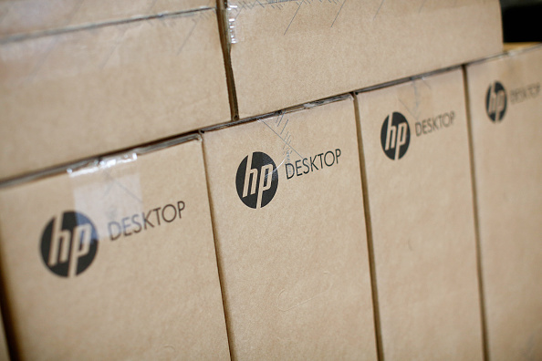
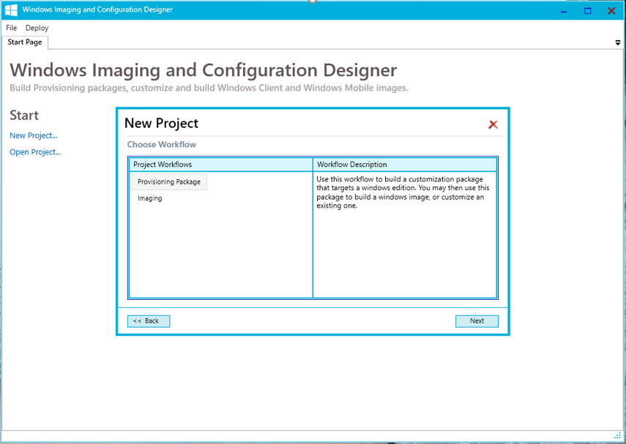
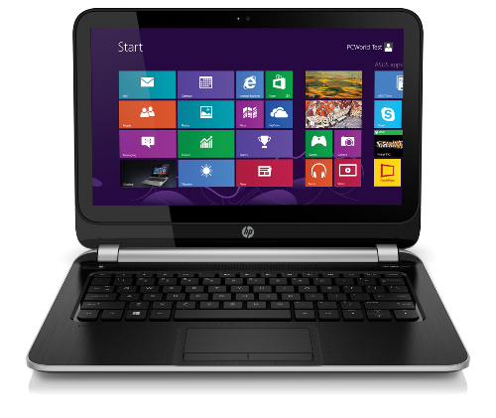
Provisioning, not reimaging (for new devices)
Take off-the-shelf hardware
Apply a provisioning package
Device is ready for productive use
Transform a Device
Flexible Methods
  Enable the Enterprise SKU
  Install apps and enterprise configuration
  Enroll the device to be managed via MDM
  Automatically trigger from the cloud or connection to a corporate network
  Or initiate with NFC or QR codes
  Or for manual distribution use media, USB tethering,
  or e-mail
Notes:
In-place upgrades are great for existing devices. But what about new ones? Today we know most organizations buy new devices, typically running a standard Windows Pro operating system – which contains all the needed drivers and configuration necessary for that device. But because it is difficult to configure that device for the organization’s needs, the first step is usually to wipe the system and deploy a standard organization image to the device. That adds an extra cost, as it can take 1-2 hours to do this.
We want to provide new tools to eliminate the wipe-and-load need. Instead, we want to be able to run through a simple provisioning process to transform the device into one that is ready for productive use. To do this, we want to enable a simple workflow:
Take a new device out of the box
Apply a provisioning package to it, turning it into a full-configured enterprise device
Once done, hand the device off to the end user who can immediately be productive
We will provide new tools to enable this, with the Windows Imaging and Configuration Designer to create these provisioning packages will all the necessary configuration steps included in them. Once created, we’ll provide a variety of ways to deploy these packages, from simple double-click operations to fully-automated solutions.
It’s also worth noting that this process will be exactly the same for Windows 10 phone devices. With these, wipe-and-load isn’t possible (they come preinstalled from the phone OEM), so this is a simple way to perform the initial configuration, without manually needing to set up each device.
[Note that this isn’t designed for ongoing management of the device; it’s just for the initial setup. These provisioning packages can be used to enroll the device into a management system, e.g. using Mobile Device Management, with that handling the ongoing configuration, app management, and more.]
That’s the process we envision: Transforming a device from its out-of-the-box state into a fully-configured enterprise device. We’ll provide flexible ways for doing this, some manual and some automated.
You can try this out today yourselves, as the Windows ICD tool is available in the Assessment and Deployment Kit for Windows 10 preview release, available on the Microsoft download center.

Slide 30
Traditional wipe and reload is still an option
Use Cases
Improvements
Updating multiple apps, or architecture at the same time as OS
Minimal application compatibility or driver issues change approach from application pre-test, to preview, pilot, then roll out in “rings”
Changing from BIOS to UEFI (Unified Extensible Firmware Interface) for Secure Boot, faster boot time, and ability to support extremely large drives
Upgrade Analytics Service uses telemetry data for device assessment, application inventory, utilization, compatibility validation, and roll-out wave planning
Devices with existing application issues (clean fresh environment – e.g. clean OS registry, wipe unused apps and temporary files)
Automation of deployment scripts in System Center Configuration Manager reduces IT installation and eliminates need to be on site at the device
Notes:
When we look at the breakdown of the traditional deployment project, we can see that it is composed of four major components:
Application testing and validation
The deployment process itself
Infrastructure updates
Image creation process
To reduce the overall effort, each one of these needs to be reduced by nearly an order of magnitude:
For apps, we need to reduce the number of apps that we test.
For infrastructure, we need to reduce the dependencies between Windows 10 and other infrastructure components, and in cases where these dependencies can’t be eliminated, make it easier to update the infrastructure.
For the deployment process, we need to shift from traditional wipe-and-load deployments to in-place upgrade.
And since we’re using in-place upgrade, we don’t need custom images at all.
Of course customers want proof that this can be done, and we’re working on customer case studies that explore this in greater detail. In the meantime, it’s worth noting that Microsoft’s own deployment took only a few weeks – see the IT showcase whitepaper for more information.

Slide 31
Threat protection over time
Game change with Windows and Software as a Services
Capability
Protection Gap
Attackers take advantage of periods between releases
Disrupt and out innovate our adversaries by design
Time
Product Release
Threat sophistication
Notes:
Windows as a Service is a Game-Changer in terms of security. Microsoft has a goal to continue with security feature improvements for Windows 10 that release regularly, to close the gap with hackers, and to start getting ahead of them.

Slide 32
Windows-as-a-Service shifts periodic deployment to ongoing upgrade management
Traditional Deployment (every 3-5 years)
Vista
Windows 7
Windows 8.1
Effort Required
Windows as a Service (twice per year)
Windows 10
Deployment is much easier, but customers still value partner support
Package as an ongoing partner managed desktop offering with support and other services
Drives recurring revenue stream, higher margins, lower cost of sales, and lower churn
Add on security support offerings leveraging Windows Defender Advanced Threat Protection as part of this managed service
Notes:
It’s fairly obvious that the traditional Windows deployment project, which organizations would typically do every 3-5 years, needs to change. These changes are need to reduce the overall effort to something that can reasonably be performed twice per year.
Let’s drill into the differences between old and new to understand how to do this.

Slide 33
Comparing Windows 10 servicing branch choices
 | Current Branch | Current Branch for Business | Long Term Servicing Branch
Primary purpose | Pilot Deployments | Broad Deployment | Special Devices
Deployment timeline | Soon after release | ~ 4 months (or more) after release | Any time during lifecycle
Release frequency | 6 months (approx.) |  | 2-3 years (approx.)
Updates | All security fixes, moderate bar for other fixes |  | All security fixes, high bar for other fixes
Apps | All in-box apps |  | No in-box apps (except system apps)
Browser | Edge and Internet Explorer 11 |  | Internet Explorer 11
Windows features | All |  | Excludes Cortana, Windows Store
Notes:
When we talk about Windows as a service, we typically talk about three different servicing options. Two of these, Current Branch and Current Branch for Business are very similar – not surprising, because they are the same Windows 10 release, just at different points in time: Each release is initially considered a Current Branch release, and then after about four months it’s declared a Current Branch for Business release, signaling that it is ready for broad deployment.
Contrast that with the Long Term Servicing Branch, which is distinctly different – it has a 10-year lifecycle with no new features, with ongoing updates that focus primarily on security fixes. It has no built-in apps, and fewer Windows features – for example, it doesn’t include Edge, Cortana and the Windows Store, because those features are frequently updated with new capabilities driven by app and service updates.
You shouldn’t think of devices as being “Current Branch” or “Current Branch for Business”. Instead, devices can be running a Windows 10 release that is currently considered Current Branch, but that release will eventually become a Current Branch for Business release, with no action needed on the device to achieve that transition – it’s just a changed declaration.

Slide 34
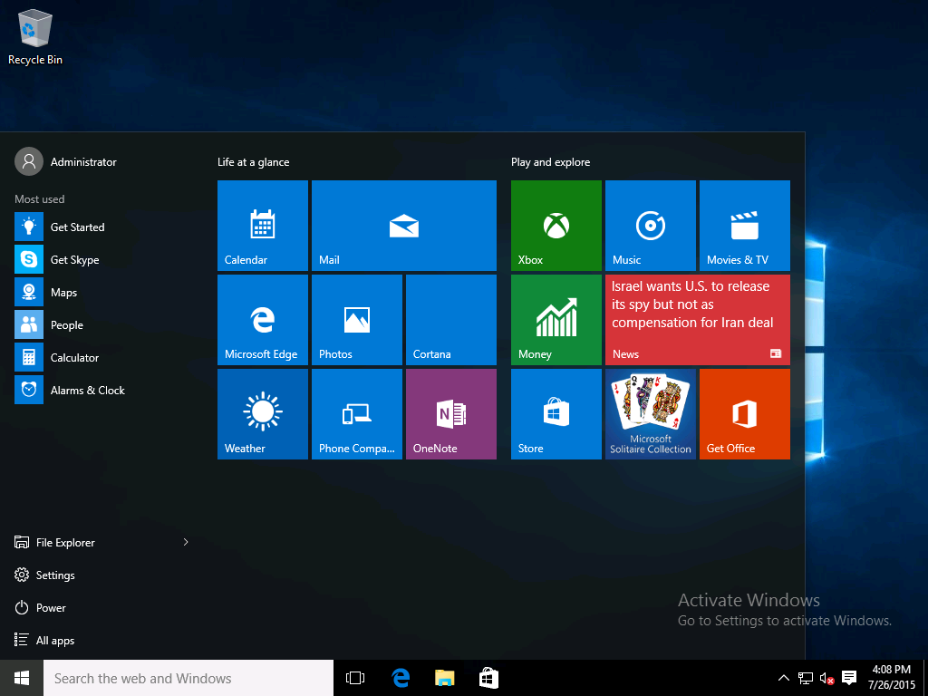
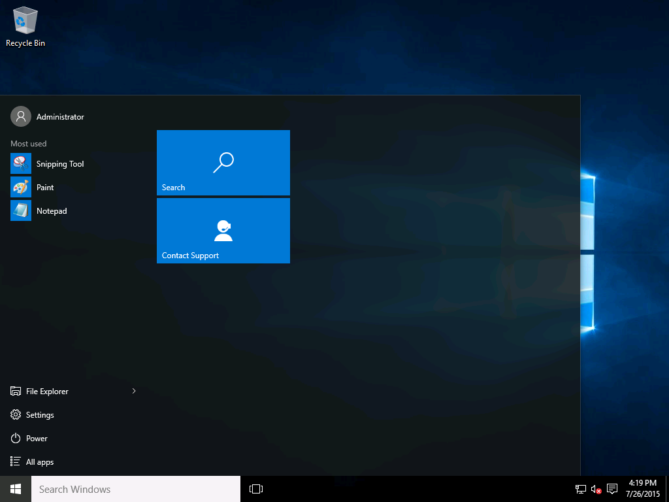
LTSB is great for specialized devices running mission critical apps
Current Branch and
Current Branch for Business
Long Term Service Branch
Example Apps Not Installed in LTSB:
System Apps: Microsoft Edge, Store Client, & Cortana
Universal Windows Platform Apps: Outlook Calendar, Outlook Mail, OneNote, Weather, News, Sports, Money,
Sound Recorder (Modern),Video (Player), Photos, Camera, Music, Solitaire, Alarms and Clock, Calculator (Modern)
Notes:
The Long Term Servicing Branch (LTSB) option for Windows 10 Enterprise definitely has it’s applications. But we feel the Current Branch for Business (CBB) will prove to be the best option for most commercial customers, as well as the best opportunity for Partners to help manage the updates for their customers.

Slide 35
Windows as a service – worldwide deployment waves
Windows 10 Development/Deployment Rings
Deployment of Windows 10 Releases Over Time
Broad Deployment Ring III
Specific feature
and performance feedback
Application compatibility
validation
Deploy to pilot audiences
Validate and prepare for broad deployment
100 M
Broad Deployment Ring II
Deploy to all audiences,
in waves to reduce risk
Broad Deployment Ring I
Pilot Ring
Early Adopters
Broad Deployment
Evaluate
Pilot
(CB)
Deploy/Use (CBB)
Grace
10 M
60 days
6+ months
of active development
~4 months
12+ months
Worldwide Users
Pilot Ring
QA
Pilot
16+ months to validate, deploy, and use each release
Pilot Ring IT
1 M
Microsoft
Insider Preview Branch
The process repeats…
Evaluate
Pilot
(CB)
Deploy/Use (CBB)
100 K
Broad Microsoft Internal Validation
1,000
Evaluate
Pilot
(CB)
Deploy/Use
(CBB)
Engineering
Builds
Windows Insider Preview Branch
1
6 Months
16+ Months
New Windows 10 Releases
Only 2 CBB versions in active support at one time
*Conceptual illustration only
Time
Notes:
Looking at the entire timeline, from the earliest engineering builds through the final devices in an enterprise-wide deployment, you can see that we’re talking about a process that spans almost two years: Six months of active development, followed by about four months of pilot deployments, before starting broad deployment throughout the entire organization – and of course, then using this particular Windows 10 feature update until it’s time to repeat the process.
Notice the “rings” defined in this picture: This is our recommended way of performing the deployment of each Windows 10 feature update, with each ring representing a group of PCs. First using a small number of pilot groups to ensure everything works as expected, then a number of broad deployment rings (primarily to reduce risk, e.g. don’t deploy the whole Accounting department at once).

Slide 36
Partner/Customer deployment by “rings”
Initial Windows 10 Deployment
Later Windows 10 Updates
Special purpose dedicated devices Security patched but not updated
Full Customer Deployment
LTSB
LTSB
Wave 3
Deployment
Wave 3
Deployment
CBB
Divide up broad population balanced for risk reduction, business impact, network load, functional role, application use, and geography
Wave 2
Deployment
Wave 2
Deployment
CBB
Partner/Customer Validation
Wave 1
Deployment
CBB
Wave 1
Deployment
Pilot
Representative Sample
of Volunteer Users
Pilot
CB
POC
Insider Preview
IT Test Devices
Notes:
The initial Windows 10 Deployment will start with a Proof of Concept. From there, you will move through the Pilot deployment and on to incremental “wave” deployments through-out the customer’s organization. Similarly, each time a new Windows 10 update comes out (every 6 months), you will want to help customers to deploy the updated Windows 10 operating system. The POC will be done using Insider Preview bits. Once the full update is released, you will move your customer through the Pilot and “wave” deployments of the updated Windows 10 operating system – just as before. This is an on-going service that you can provide to your customers, with the additional opportunity to address service, application, and infrastructure needs along the way. Windows-as-a-Service will become an integral part of your business relationship with the customer, one that opens up numerous new project and service revenue opportunities!

Slide 37
Thinking through deployment strategy
1
  Configure Your Insider Preview PCs
  Lab or secondary PCs
  Enough to explore new features, measure compatibility on behalf of your customer(s)
2
  Recruit volunteers for pilots
  Willing participants who will provide feedback
  Cover the broadest set of apps and devices possible
3
  Identify LTSB PC candidates
  Deploy Windows 10 Enterprise LTSB
  Limited numbers (we hope)
4
  Divide broad population of PCs for roll-out
  Standard deployment best practice
  Focus on risk reduction, minimizing disruption
  Consider deploying waves by functional area, applications utilized, and geography
Notes:
Thinking about this from a deployment strategy perspective, there are a few steps that we need to consider:
What PCs will we use for the Insider Preview program? Each organization needs to try out new features and at the same time ensure that strong compatibility is maintained, providing feedback with any concerns.
Can we identify the special PCs that would be good candidates for LTSB? (Remember again that special PCs typically don’t run Office – they run other specialized software suited for their unique purpose.) Those will be deployed separately, so they can be set aside.
Can we recruit the appropriate set of volunteers for pilot deployments? Remember, we want to identify a small group of PCs that covers the broadest set of apps and devices – 10% of devices should be able to provide 90% coverage. And we want to ensure that these pilot participants are volunteers – if they find issues, we want them to call the IT helpdesk; we don’t want them to immediately escalate up their management chains if something doesn’t go quite right.
Finally, can we divide up the broad population of PCs into a reasonable number of groups, so that we can deploy quickly and still manage risk appropriately.

Slide 38
Why Windows-as-a-Service updates run better
Windows 7 and 8 Servicing
What Microsoft & ISVs Test
Windows Test Lab PC:
Fully Patched
Windows 10 Servicing
Security Updates
Most organizations deploy right away
Limited Partner/Customer pre-trial
Non-Security Updates
Reliability, bug fixes, etc.
Deployed ad-hoc or sometimes not at all
The option to take each service upgrade or not (selective patching) in Windows 7 and 8, increased fragmentation, added complexity and cost, and reduced quality
Version Upgrades
New features, new UI, new architecture
Deployed years apart with customers running non-current versions
Quality Updates
A single cumulative update each month, which supersedes the previous month’s update
Security fixes, reliability fixes, bug fixes, etc. but no new features
Partner/customer pre-trial with Security Update Validation Program (SUVP)
Feature Updates
Targeting twice per year with new capabilities
Very reliable, with built-in rollback capabilities
Simple deployment using in-place upgrade,
driven by existing tools
Partner/customer pre-trial with Insider Preview
What Customers Are Running
Typical Windows 7 PC:
Selectively Patched
Windows 10 PC:
Cumulative Update
With Windows 10 servicing, consistency and simplicity are paramount
Notes:
When we talk about changes to the way we service (or patch) Windows, it’s important to first understand how things worked with Windows 7 and Windows 8.1. Each month, we release somewhere between 1 and 20 individual fixes for each one – some security updates, some non-security updates. Most organizations deploy the security fixes right away. But the non-security fixes sometimes aren’t deployed at all. The result is that each organization ends up with their own unique Windows configuration, defined by the set of patches that they have installed.
Compare that to the configuration that we test: Fully-patched PCs that have all the updates ever released installed. For each new update, we verify that there are no adverse effects on these fully-patched PCs.
But we’ve seen instances where these new updates cause issues on partially updated PCs (often with specific combinations of updates) – we can’t possibly test all these different possible combinations. And affected customers wonder why we didn’t catch these “simple issues” when we did our testing. ISVs are also challenged in choosing what patch deployment to test their updates against, most use the fully patched version.
So we decided that to improve the overall quality of Windows, and to reduce the overall complexity of the patching process, we would rework the patching process altogether with Windows 10. Let’s explore these changes in more depth.
First, it’s important to understand that we have two different types of updates with Windows 10: Quality updates, released each month with no new features to resolve security and non-security fixes, and feature updates, targeting twice per year with new features added.
For quality updates, each month we will release a single update, containing all the new security and non-security fixes (but with no new features), as well as all the existing fixes from previous months. As a result, there is only ever one update that needs to be installed on a Windows 10 device for it to be completely up-to-date.

Slide 39
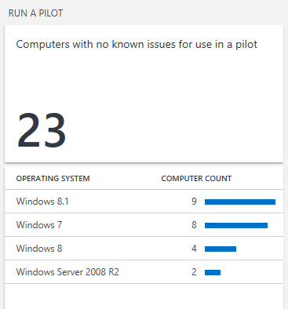
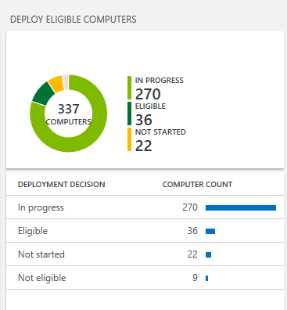
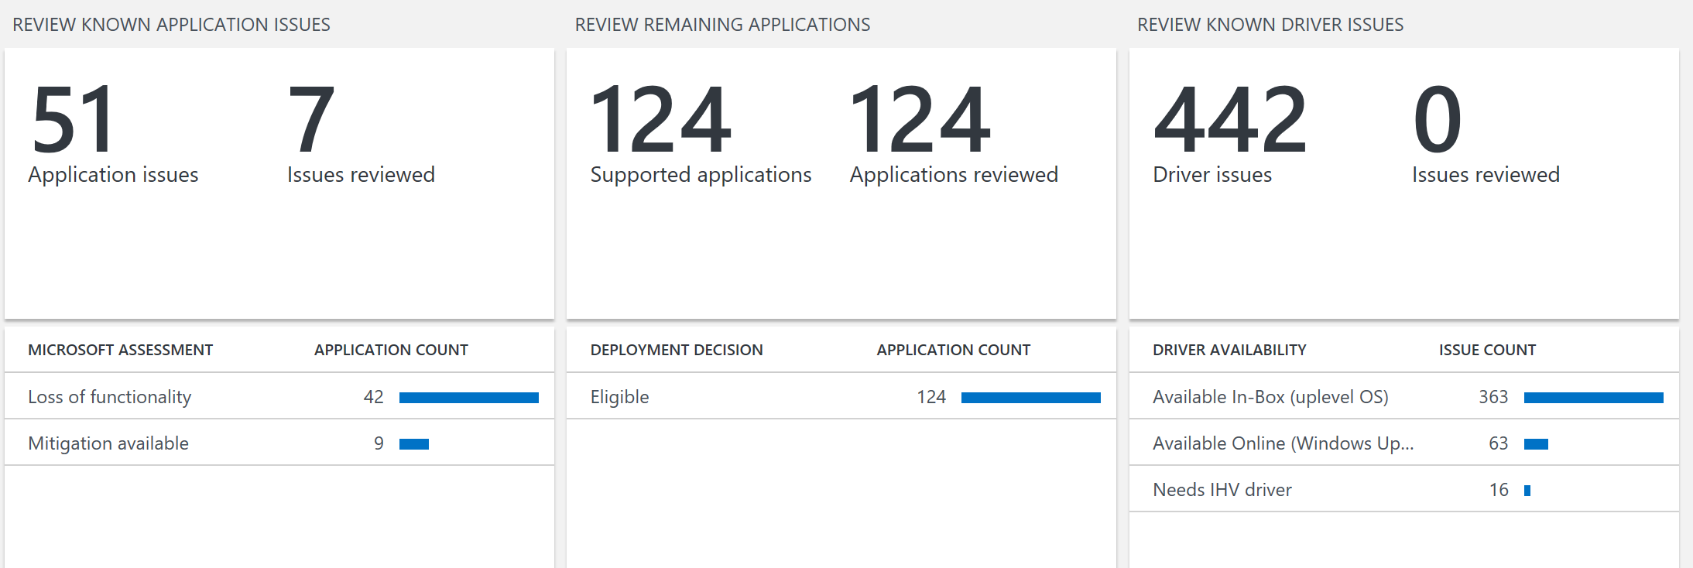
New Upgrade Analytics Service supports your management of Windows 10 and future upgrades
Free service from Microsoft
Deployment dashboard
“Devices Ready to Deploy” Reports
Inventory reports: devices, drivers and applications
Device level app usage information
App and driver report – known issues to Microsoft
Deployment validation tool
Data export into management tools (e.g. SCCM)
Upgrade Analytics Service for Windows 10
Notes:
360 degree view into the organization device, driver and application inventory keeps you in control
Clear workflow visualization from pilot to deployment reduces complexity and risk
Data driven app rationalization tools reduce validation time and cost
Direct access to guidance and insights into compatibility issues known to Microsoft gives you help when you need it

Slide 40
Customers can use different tools today, so it’s important to consider customer infrastructure…
Identify the
best tool for
managing
Windows-
as-a-service
Windows Update
for Business
Windows Server Update Services
System Center Configuration Manager
Cloud
Upgrades can be deferred
Builds on top of Windows Update
Uses Windows Update for content
On-Prem
Upgrades are deployed when you approve them
Content distributed from WSUS servers
Requires KB3095113 and KB3159706 updates
BranchCache to reduce bandwidth
On-Prem
Choice of task sequence-based upgrades or (with vNext) software update capabilities
Content distributed from ConfigMgr Distribution Points
BranchCache to reduce bandwidth
Notes:
We have a variety of tools that can be used by organizations to implement Windows as service. Fortunately, most organizations are already using one of these tools, so as long as you are using a reasonably current version of them, you’re already got what you need.
The simplest possible tool to use is Windows Update: just point all PCs to the Windows Update cloud service and let them update themselves as new feature updates are released. Most organizations probably want more control over that process, and we’ve provided those controls as part of Windows Update for Business, an additional layer of control that sits on top of the Windows Update service to provide more advanced capabilities.
For organizations already using WSUS or ConfigMgr, both have built-in capabilities for managing feature updates.
Most organizations probably aren’t interested in Windows Update directly, so let’s look at the other three choices in more detail.

Slide 41


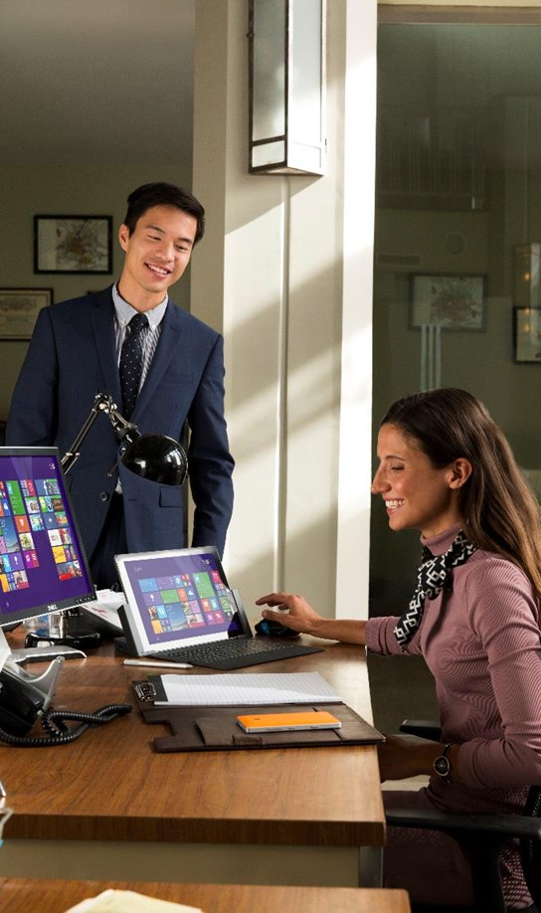
NEW OFFERINGS
WINDOWS 10 ENTERPRISE E3/E5 AND SECURE PRODUCTIVE ENTERPRISE SUITE
Notes:
The Windows 10 Anniversary Update brings some exciting new products and features with it. We are excited to walk through some of those innovations with you in this next section.

Slide 42
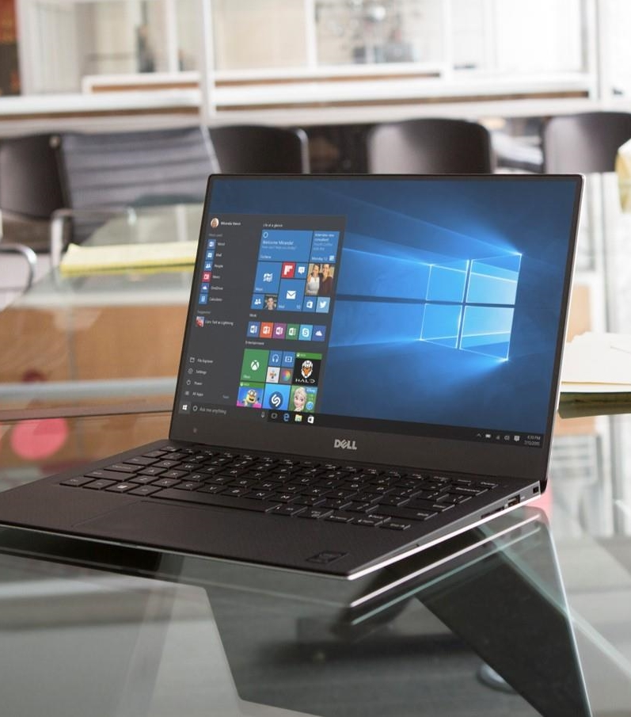
Windows offerings through volume licensing
Hero Commercial Offers:
Windows 10 Enterprise E3
Windows 10 Enterprise E5
Hero EDU Offers:
Windows 10 Education E3
Windows 10 Education E5
Available
per user
or per device
Other VL Offers:
Windows 10 Pro Upgrade
Windows 10 Enterprise LTSB
Windows Virtual Desktop Access (VDA)*
*available per User or per Device
Notes:
The hero commercial offers are Windows 10 Enterprise E3 and E5. E3 is the new name for Windows 10 Enterprise with Software Assurance. E5 is a new top tier enterprise offering. Window 10 Education E3 and E5 are the hero EDU offers. All four of these offers are available per user or per device.
Windows 10 Pro upgrades and Enterprise LTSB upgrades will continue to be available without Software Assurance, and we will continue to offer Windows VDA on per user or a per device basis.

Slide 43
Comparing commercial desktop edition features
 | PRO | ENTERPRISE E3 | ENTERPRISE E5
SECURITY AND IDENTITY
Microsoft Passport | ● | ● | ●
Windows Information Protection | ● | ● | ●
Credential Guard |  | ● | ●
Device Guard |  | ● | ●
Direct Access |  | ● | ●
Windows Defender Advanced Threat Protection |  |  | ●
MANAGEMENT AND DEPLOYMENT
Domain Join and Azure AD Join | ● | ● | ●
MDM Enablement | ● | ● | ●
Windows Store for Business, Private Catalog | ● | ● | ●
Long Term Service Branch Option |  | ● | ●
Managed User Experience |  | ● | ●
AppLocker |  | ● | ●
Microsoft Application Virtualization (App-V) |  | ● | ●
Microsoft User Environment Virtualization (UE-V) |  | ● | ●
Cortana Management |  | ● | ●
Windows Store Management |  | ● | ●
Advanced Telemetry Controls |  | ● | ●
FOR A FULL LIST OF FEATURES AND CAPABILITIES PLEASE VISIT THE WEBSITE
Notes:
Pro, Enterprise E3, and Enterprise E5 are the three commercial offers available through volume licensing.
Windows 10 Pro includes all of the great features of Windows 10 Home edition, along with additional security and management features designed to meet the needs of small and medium size businesses.
Windows 10 Enterprise E3 (formerly Windows 10 Enterprise with Software Assurance) builds on Windows 10 Pro with even more security, management, and control features geared toward larger and mid-size organizations or companies of any size with more complex IT requirements, such as those who process sensitive data, operate in a regulated industry, develop software in-house, and/or are publicly listed or planning to issue an IPO.
Windows 10 Enterprise E5 is a new Windows offering that includes everything in E3, with the addition of Windows Defender Advanced Threat Protection (WDATP), a new service that will help enterprise customers detect, investigate and respond to advanced attacks on their networks. Enterprise E5 provides businesses with the maximum level of security available in Windows 10.

Slide 44



Secure Productive Enterprise
Delivered through best in class cloud services
Office 365
Enterprise Mobility + Security
Windows 10 Enterprise
Notes:
Microsoft wants to help you empower your employees by creating a Secure, Productive Environment. Thus, we are happy to announce the creation of the Secure Productive Enterprise E3 and E5 product suites. These suites provide the most trusted, secure and productive way to work that brings together the best of Office 365, Enterprise Mobility + Security, and Windows Enterprise. These products and services together enable employees uncompromising productivity, collaboration, mobility, business insights and, perhaps most importantly, a secure experience.
As we’ve continued to innovate at a rapid pace in the cloud, we’ve heard from many customers that navigating Microsoft technology licensing options can be challenging. This is why we created the Enterprise Cloud Suite (ECS) a few years ago, to help simplify this purchase experience. Building from this approach, today, we’re taking the next step in continuing to simplify our enterprise technology licensing offerings while also delivering more value to our customers – introducing the Secure Productive Enterprise. We are bringing together Office 365, Windows 10 Enterprise, and the Enterprise Mobility + Security suite into a single licensing offering called the Secure Productive Enterprise E3, that replaces the Enterprise Cloud Suite, and introducing even more value within this offering. With the Secure Productive Enterprise, customers have the latest and most advanced technology for empowering employees.
In recent months, we’ve announced cutting edge cloud-based security technology including Windows Defender Advanced Threat Protection for end point breach detection, Microsoft Cloud App Security for getting control of the SaaS apps employees are using, Azure Information Protection to ensure information stays secure and Office 365 Advanced Security Management to give greater visibility and control over your Office 365 environment. All of these capabilities are included in the Secure Productive Enterprise E5 offering. We’ve also introduced leading cloud-based productivity technology including Office 365 Delve Analytics to understand personal productivity, Skype for Business PSTN conferencing and Cloud PBX bringing voice to the cloud, Microsoft Power BI for data analysis & visualization, and even Office 365 Advanced e-Discovery to ensure customers can find just the information they need for the issues at hand. All of these technologies are part of the Secure Productive Enterprise E5.
Everything you need to empower employees in a single package. It’s that simple
Read more at http://blogs.microsoft.com/blog/2016/07/07/empower-your-employees-with-the-secure-productive-enterprise/#ratdtkbTwyK3EV7z.99

Slide 45
Empower your employees by creating a secure productive enterprise
Trust
Protect your organization,
data and people
Collaboration
Create a productive workplace
to embrace diverse workstyles
Mobility
Enable your people to get
things done anywhere
Intelligence
Provide insights to drive
better business decisions
Notes:
Today’s cloud and mobile technology is enabling companies to reshape their business and capitalize on the digital transformation impacting us all. By taking advantage of the latest innovations, businesses can transform their products and services, engage their customers in completely new ways, and gain new efficiencies by modernizing operations. And, importantly, companies now have the most advanced technology at hand to empower their employees to achieve more.
Employees perform better when they trust that their organization, data, and people are protected. Teams perform better when they are able to collaborate in a productive workplace that embraces their diverse workstyles. The Secure Productive Enterprise product suite enables people to get things done anywhere and provides insights to drive better business decisions

Slide 46
Secure Productive Enterprise E3/E5 pricing and packaging
SPE E3
SPE E5
$32/u/m
5% SPE suite discount
$57/u/m
5% SPE suite discount
Window Enterprise E5
$10/u/m
SPE E5 Pricing
SPE E5 unifies premium offers across Office 365, EMS & Windows
Uplift creates opportunity for significant APRU Expansion
Suite discount rewards coverage on top of existing suite discounts
EMS E5
$15/u/m
Window Enterprise E3
$5/u/m
Office 365 Enterprise E5
$35/u/m
EMS E3
$8.75/u/m
Promo for SPE E5 Launch
25% discount on uplift from E3 to E5 - save $6.25/u/m
Availability of first 6 months after launch (10/1) with option to extend based on promo performance
For details about the promotion in your region contact your Microsoft representative
Office 365 Enterprise E3
$20/u/m
In Market
Coming October 2016
Notes:
Understanding the Secure Productive Enterprise
To further simplify our offerings, we are standardizing packaging offers across Office 365, Windows 10 Enterprise and the Enterprise Mobility + Security suite. Moving forward you will see E3 and E5 offerings for each of these products.
Consistent with this, we will offer two tiers of the Secure Productive Enterprise offering: E3 and E5. (For those of you familiar with the Office 365 licensing, this nomenclature should be familiar.)
For those of you who’ve been following us closely, you might have noticed a few other changes. First, we are renaming Windows 10 Enterprise to Windows 10 Enterprise E3. We are releasing Windows 10 Enterprise E5 later this summer that includes Windows Defender Advanced Threat Protection.
Additionally, Enterprise Mobility + Security is the new name for what was previously the Enterprise Mobility Suite. This name change reflects the tremendous new security value in this offering. Aligned with the new packaging, there will be an Enterprise Mobility + Security E3 and an Enterprise Mobility and Security E5. The new E5 offering will become available later this calendar year and include the advanced security capabilities. You can learn more about these changes at the Enterprise Mobility + Security blog.
The Secure Productive Enterprise E5 offering includes the latest, most advanced enterprise security, management, collaboration and business analytics. The Secure Productive Enterprise E5 offering will become available later in calendar year 2016 when the new Windows 10 and Enterprise Mobility + Security functionality has all released.
While we are making a number of changes, the outcome is a simpler approach to ensuring customers have the technology they need to run a secure and productive enterprise and enable their digital transformation.
Read more at http://blogs.microsoft.com/blog/2016/07/07/empower-your-employees-with-the-secure-productive-enterprise/#ratdtkbTwyK3EV7z.99
As part of the Secure Productive Enterprise product launch Microsoft is offering at 25% discount on the uplift from E3 to E5 for the next 6 months.

Slide 47

DRIVING CUSTOMER DEPLOYMENT – PROCESS GUIDANCE
Notes:
In this next section, we’ll cover in some detail what we view as a good Windows 10 Deployment Process for you to leverage, as well as how you can look to sell additional, on-going services on top of your initial Windows 10 Deployment project.

Slide 48
Enterprise deployment process steps
1
2
3
4
5
Customer Targeting
Deployment Pitch
Proof of Concept (Accelerate or
Self Serve POC)
POC Conclusion (Pilot Buy-in)
Develop Deployment
Plan and Pilot
Begin Pilot
6
Ongoing Windows-as-a-Service Management
Breadth Deployment Launch
Pilot Conclusion, and Green Light to Extend Deployment
Windows-as-a Service Support Discussion
Security Services Evaluation
11
10
9
8
7
Notes:
This is just one view of a potential Windows 10 deployment process for you to consider. We firmly expect you to have your own versions of this, but we feel this is a good reference framework for us to walk through together.

Slide 49
Step 1 …
Customer Targeting
1
2
Your Windows 7/8
Deployment Customers
Customers for whom you installed Windows 7/8, a few years ago, and are ready to take next step
Security And Compliance
Driven Customers
Especially those with a recent security breach
3
4
Device Refresh Customers
Those that updated at XP end of life have machines ready to retire
LOB/Industry Mobility Scenarios
Where Windows 10/EMS features enable new capabilities e.g.
  Mobile sales and service
  Retail & kiosk
  Secure collaboration beyond firewall
  Band branch transformation
Notes:
Customer targeting is key. There are many great Windows 10 deployment opportunities out there today, so choose your focus area quickly and get started!

Slide 50

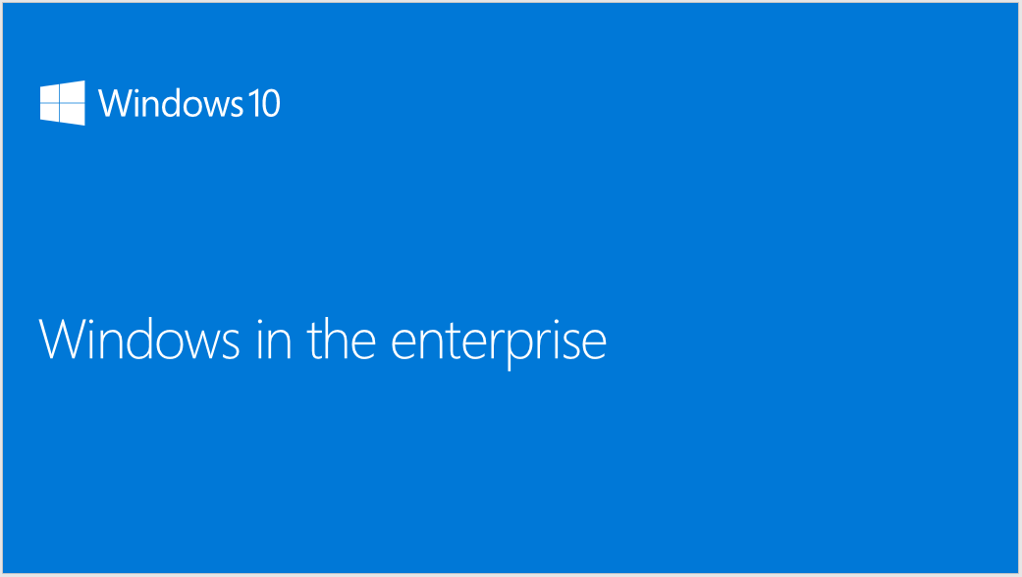

Step 2…
Deployment Pitch
Schedule meeting with CIO, CFO/COO (or budget owner), Desktop IT management
Include Windows TSP or Windows BG lead
“Windows in the Enterprise” customer pitch deck
Objective is to get customer to agree to do a POC (either Microsoft funded through Windows Accelerate or Self-Service)
Windows in the Enterprise
This deck is intended as a high level business overview of Windows 10, both shipping features as well as future looking features, and is for 1 to 1 direct customer conversations only. You should not blog or publicly share the content broadly
https://microsoft.sharepoint.com/sites/infopedia/pages/layouts/kcdoc.aspx?k=G02KC-1-6496

Slide 51
Step 3…
Proof of Concept (Accelerate or Self-Serve POC)
Leverage Windows Accelerate funding
(if customer qualifies) or use self serve materials
Show Windows 10 Enterprise functionality/value
Demonstrate In-Place Upgrade
Include Browser and Mobility POC
Validate key organization and LOB app compat
https://connect.microsoft.com/accelerate/
Self-Serve Delivery Materials
Files in Download
File Name | File Size | Download single file
Hydration 1604.zip | 104.21 MB | Download
Hydration 1604-ServerParent.zip | 5,790.27 MB | Download
Hydration 1604-ServerParentGen2.zip | 5,801.91 MB | Download
Hydration 1604-InclEvalSource.zip | 19,566.36 MB | Download
Windows 10 Enterprise PoC Sales and Delivery Materials.zip | 77.55 MB | Download
Windows 10 Enterprise Proof of Concept Scope
Day 1
Kickoff
Windows 10 overview
User experience demo
Deployment
In-Place Upgrade lab
Cloud service setup
Day 2
Management
Lab options
Cloud domain join
Provisioning
MGM
Windows store for Business
Windows as a service
Day 3
On premises lab setup
Lab image creation
Platform delivery lab
Day 4
Browser and app compat.
Identity and security
Lab options
Identity and security
Office 365
Day 5
Establish a vision for Windows 10 and Office based on the outcomes of the POC. Assessment and roadmap of get ready activities you can start now to prepare your infrastructure

Slide 52
Step 4…
POC Conclusion (Pilot Buy-in)
Meet with key decision makers to validate POC results
Ensure customer sees the value of Windows 10
Identify any issues to resolve during pilot deployment
Show how partner can help support pilot deployment
Gain customer agreement to begin pilot deployment
POC Checklist
Provide hands on experience of Windows 10 Enterprise Deployment
Demonstrate In-Place Upgrade
Provision new PC out of box
Review intuitive UI with IT staff and small sample of users – to show minimal retraining required
Demonstrate new security and management features e.g. Windows Hello, Identity Protection, Windows Information Protection
Show browser and how to test application compatibility

Slide 53
Step 5…
Develop Deployment Plan and Pilot
Select pilot PC groups as representative companywide workload sample
Leverage Upgrade Analytics Service telemetry data on application use and hardware capability in developing plan
Identify PCs for In-Place Upgrade, vs. those replaced in PC refresh with Provisioning
Build Provisioning package for New devices
Identify any PCs with business requirements for LTSB
Create first draft plan for company wide deployment waves
Wave 3
Deployment
Wave 2
Deployment
Wave 1
Deployment
Pilot
POC

Slide 54
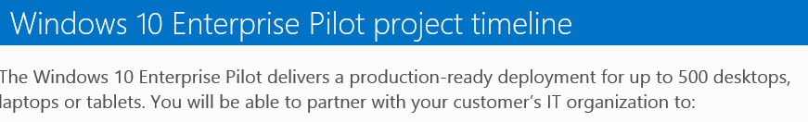
Step 6…
Begin Pilot
Leverage Windows Accelerate funding if customer qualifies
Get materials from Accelerate website https://connect.microsoft.com/accelerate/content/content.aspx?ContentID=31991&IsDraft=False
Design for 500 seat deployment
Include Windows 10 Enterprise Compatibility Briefing and Security Integration Briefing
ASSESS
REMEDIATE
ENABLE
MIGRATE
Envision
Plan
Plan
Build
Build
Stabilize
DEPLOY
Requirement Workshops,
Agreement on Solution
2 Weeks
2 Weeks
4 Weeks
2 Weeks
Core Infrastructure,
Designs and Lab
Pilot Deployment
Full Production Pilot Deployment & Windows as a Service Preparations
The Windows 10 Enterprise Pilot delivers a production-ready deployment for up to 500 desktops, laptops or tablets. You will be able to partner with your customer’s IT organization to:
Conduct planning and architecture design workshops
Application deployment
Image engineering
Configure In-Place Upgrade, Lite and/or Zero Touch Installations

Slide 55
Step 6…
Address Any Application Compatibility Issues Identified in Pilot
Use Upgrade Assessment Tool to:
  Choose PCs ready to upgrade for pilot
  Identify applications not yet confirmed as compatible
  Assess telemetric data on application use/status/crash
Get feedback from pilot users on any application, device driver, or user issues experienced
Ask your Microsoft contact (i.e. SSP, TSP, Services, PBEs, Tech Evangelist, etc.) to use the internal escalation process tool: www.Apps4Windows.com to escalate any Windows 10 App Compat blockers.

Slide 56

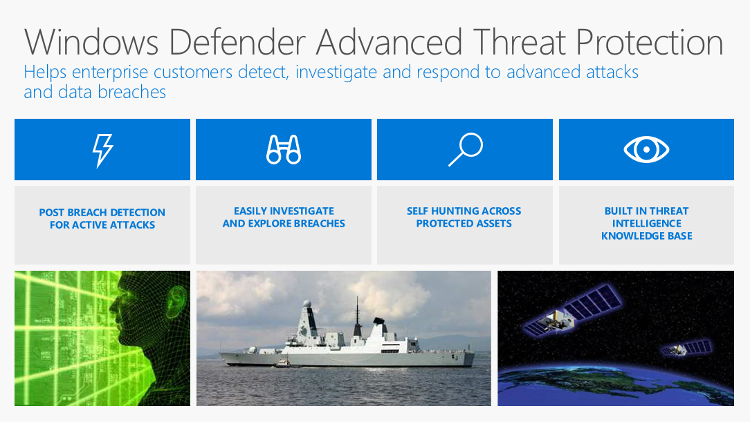
Step 7…
Security Services Evaluation
Demonstrate value of Windows Defender Advanced Threat Protection (ATP) using
To Customer deck
Leverage Pitch Perfect Secure Learning Path https://mspartnerlp.partner.microsoft.com/LearningPath/LearningPath/DLPaths?trackId=1717&rowId=2326&trackPathId=14432
Support customer implementation or offer as a service Windows/SPE security capabilities e.g.:
  Windows Information Protection,
  Device Guard
  Multi –Factor Authentication
  Office 365 security
  EMS security/Azure AD/Identity Management
Offer IT Security Service to respond to threats or incidents
Get trained on ATP and other security capabilities (consider Premier Support for Partners as backup)

Slide 57
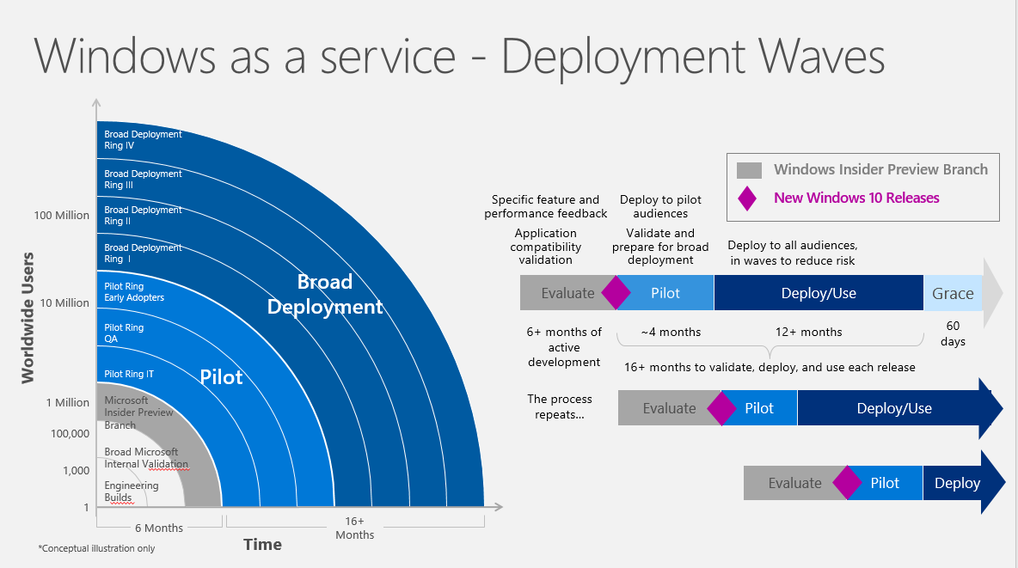
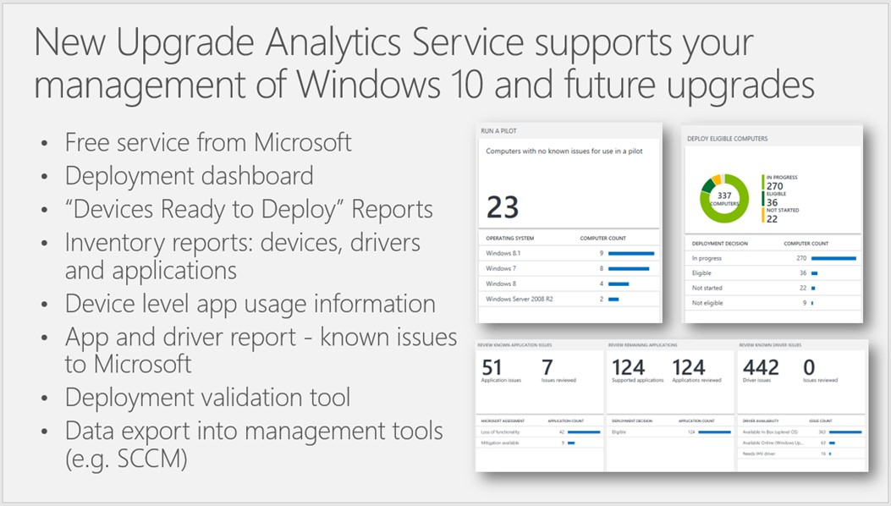
Step 8…
Windows-as-a-Service Support Discussion
Monetize WaaS including:
Desktop Management
Helpdesk
Identity Management
Hardware support break/fix
Specify customer environment to simulate to use Windows Insider Preview to test future updates in Current Business Branch
Consider offering Test-as-a-Service for critical custom LOB apps
Leverage Upgrade Analytics Service tool to support upgrade wave deployments

Slide 58
Step 9…
Pilot Conclusion and Green Light to Extend Deployment
Validate application and systems capability
Ensure full range of customer scenarios have been tested successfully
Prove efficient deployment models
Gather user feedback and productivity data
Adapt customer deployment plans as needed
Agree to begin companywide deployment
Pilot Checklist
Deploy Windows 10 Enterprise in Production Environment Targeting 500 Seats
1 Primary Location, 1 Branch Location
Current Branch for Business
Group Policy Starter – Management Environment
Servicing Environment (WaaS)
Application Delivery
Platform Delivery – Deployment Environment (Zero Touch, In Place Upgrade, Lite Touch)
Image Creation

Slide 59


Step 10…
Breadth Deployment Launch
Plan scaled deployment in organizational waves (e.g. by Geo or functional area)
Assess network load considerations
Support customer change management, project planning, and employee communications
Schedule customer and partner resources to support
Launch automated deployment
Management Tools
Upgrade Analytics

Slide 60
Step 11 – Post Deployment…
Ongoing Windows-as-a-Service Management
Define strategy, and timing for next/ongoing upgrade management
Build customer environment for Windows Insider Preview
Test upcoming updates in Current Business Branch
Load and simulate critical custom LOB apps for Test-as-a-Service
Begin next cycle of Windows upgrade deployments
Deployment of Windows 10 Releases Over Time
Specific feature
and performance feedback
Application compatibility
validation
Deploy to pilot audiences
Validate and prepare for broad deployment
Deploy to all audiences,
in waves to reduce risk
Evaluate
Pilot
(CB)
Deploy/Use (CBB)
Grace
6+ months
of active development
~4 months
12+ months
60 days
16+ months to validate, deploy, and use each release
The process repeats…
Evaluate
Pilot
(CB)
Deploy/Use (CBB)
Evaluate
Pilot
(CB)
Deploy/Use
(CBB)
Windows Insider Preview Branch
New Windows 10 Releases
Only 2 CBB versions in active support at one time

Slide 61


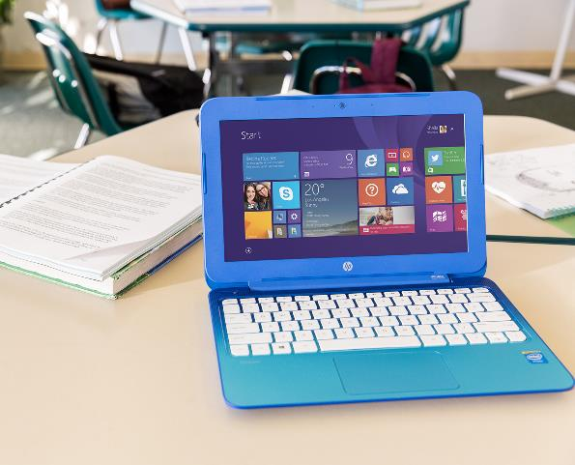
PARTNER REVENUE OPPORTUNITY DETAIL
Notes:
PROFITABILITY
We get it. Windows 10 is well-received by businesses, and it’s really important to enable our Cloud Services Business.
Now tell us about the CASH $$!!

Slide 62
Windows 10 is your foundation for services revenue
PARTNER MANAGED RECURRING
REVENUE IS PRIMARY GROWTH DRIVER
IP AND NEW INDUSTRY/ FUNCTION SCENARIOS
PROJECTS
Windows 10 momentum/
customer
interest
Device
renewal
OFFICE 365, EMS, AZURE AD, IMPLEMENTATION AND RECURRING REVENUE
30–40% project margin
40–60% IP margin
MANAGED SERVICE (DESKTOP+) MONTHLY RECURRING REVENUE
30–40% margin
NEW WINDOWS PROJECTS, SECURITY, LIFECYCLE MANAGEMENT
DEVICES & ACCESSORIES
HW/SW RESALE
40–50% margin
Windows 10 momentum/
customer
interest
POC, PILOT, SCCM PREP & DEPLOYMENT PROJECTS
30–40% margin
“Windows 10 unlocks cloud profitability. Without Windows 10 we won’t have a successful cloud business”
CHRIS HERTZ – FOUNDER
5–15% margin
20–30% margin bundled as monthly managed service
20–30% margin
PARTNER REVENUE BUILT ON WINDOWS 10

Slide 63
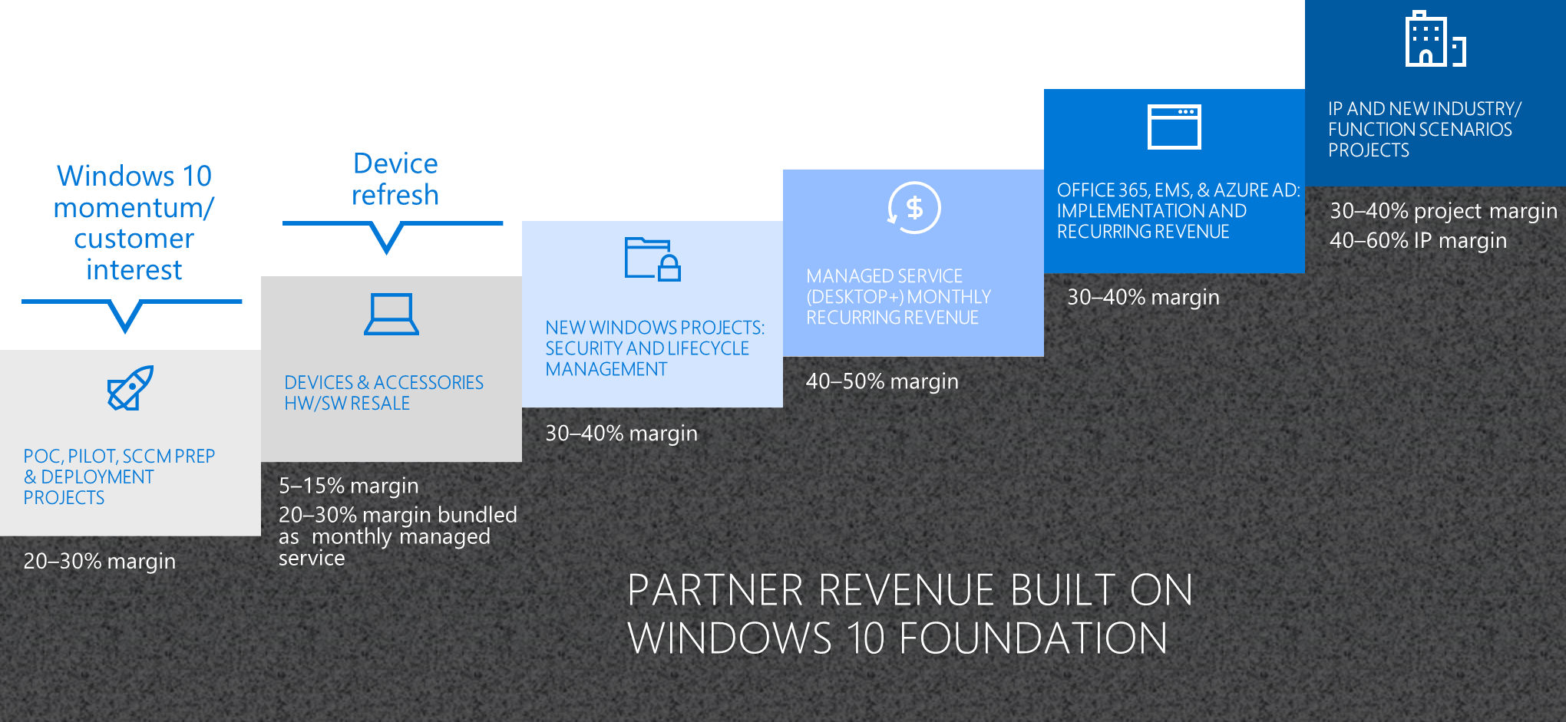

Partner revenue…
POC, Pilot, SCCM Prep and Deployment Projects
Windows 10 momentum/
customer interest
Windows 10 is an easy conversation starter. Massive migration already, +350M devices on Windows 10!
Windows 7 and Windows 8 customers, will want to migrate for better security features in Windows 10
POCs and Pilots will demonstrate ease of migration + device and application compatibility. (Funding available via Windows Accelerate for qualifying customers)
Before customers can move to Window 10, larger customers will need the Nov 2015 updated version of SCCM (more partner revenue).
While deployment is automated, easier and faster, customers still need your expertise
  New deployment approach and choices
  New licensing options
  Upgrade Analytics Service device assessment and pilot waves
  Expertise in automated deployment, provisioning scripts, network load
  Program/Change management
Because deployments are faster and easier, consider up-sell, cross-sell, and new customer opportunities
POC, PILOT, SCCM PREP & DEPLOYMENT PROJECTS
20–30% margin

Slide 64
Partner revenue…
POC, Pilot, SCCM Prep and Deployment Projects
Windows 10 momentum/
customer interest
POC, PILOT, SCCM PREP & DEPLOYMENT PROJECTS
20–30% margin
Note: Revenue and margin values are based on partner interviews, and will vary by partner, geography, and local market conditions.

Slide 65
Partner revenue…
Device and Accessories HW/SW sale
Device
refresh
Device Refresh is another great opportunity to engage customers around Windows 10 deployment
  Aging devices purchased for the XP End of Support wave are now due for refresh
  Intel estimates 400M devices more than 4 years old, ready for refresh
New devices and form factors do so much more and take advantage of new Windows 10 features
  Windows Hello, Pen & Ink, Touch-Screen, Light-Weight, Longer Battery, etc…
Windows 10 Pro Devices typically have a high gross sales value, which more than makes up for the smaller margins associated
Partners we have talked to typically captured higher total sales margins of 20-30% in small and mid-market customers by bundling premium devices, break-fix, and warranty as part of a managed services package - e.g. $50/month for a Surface Book
Distributor & OEM financing packages minimize the capital investment for partners and customers
DEVICES & ACCESSORIES
HW/SW RESALE
5–15% margin
20–30% margin bundled as monthly managed service

Slide 66
Partner revenue…
Device and Accessories HW/SW sale
Device
refresh
DEVICES & ACCESSORIES
HW/SW RESALE
5–15% margin
20–30% margin bundled as monthly managed service
Note: Revenue and margin values are based on partner interviews, and will vary by partner, geography, and local market conditions.

Slide 67
Partner revenue…
New Windows Projects: Security, and Lifecycle
Management
New Feature Implementations: Windows capabilities and security features allow customers to do more – and your support in implementation of these features adds high value
  Data Protection
  Passport For Work
  Device Guard
  Multi-Factor Authentication
Security Management Service: Security is a high concern for all commercial customers today. Experts say there are 2 types of company today: 1) Those who have been hacked, and 2) Those who don’t know they have been hacked.
  Windows Defender Advanced Threat Protection
  Incident Response Services (Threat Elimination, Breach Assessment, Repair / Prevention)
  O365 Security + EMS Security Integration
Lifecycle Management: Windows as a Service, offers opportunities for you to manage patches, and pilot/roll-out of new feature updates on customer applications, networks, PCs and Mobile devices
NEW WINDOWS PROJECTS: SECURITY AND LIFECYCLE MANAGEMENT
30–40% margin

Slide 68
Partner revenue…
New Windows Projects: Security, and Lifecycle
Management
NEW WINDOWS PROJECTS: SECURITY AND LIFECYCLE MANAGEMENT
30–40% margin
Note: Revenue and margin values are based on partner interviews, and will vary by partner, geography, and local market conditions.

Slide 69
Partner revenue…
Managed Service (Desktop+) as Monthly
Recurring Revenue
Commercial customers are turning to trusted Partners to manage their Desktop Services on a monthly recurring revenue model
  Network / Desktop / Application Configuration
  Device Management (Patching, Upgrades, Device Refresh, Device Configuration)
  Help-Desk Support (1st Level Software + Systems Support)
  Break-Fix (2nd Level Root-Cause Analysis, Hardware Support)
  Identity Management
Successful partners are shifting their business model to prioritize Managed Desktop Services and support the customer demand
  Attractive margins of 40-50% (some as high as 60%) are reported as standardizing on Windows 10 lowers the cost of providing these services
  Banks are willing to lend more to fund growth once recurring revenues make up the majority of the business revenue stream
MANAGED SERVICE (DESKTOP+) MONTHLY RECURRING REVENUE
40–50% margin

Slide 70
Partner revenue…
Managed Service (Desktop+) as Monthly
Recurring Revenue
MANAGED SERVICE (DESKTOP+) MONTHLY RECURRING REVENUE
40–50% margin
Note: Revenue and margin values are based on partner interviews, and will vary by partner, geography, and local market conditions.

Slide 71
Partner revenue…
Office 365, EMS and Azure AD:
Implementation and Recurring Revenues
Windows 10 Enterprise paves the way to sell other service offerings in an age of digital transformation:
  Office 365
  EMS / Azure AD (e.g. identity management services)
These services can be bundled as part of a larger offering, increasing the total service revenue per user per month.
  Implementation can be billed separately or factored into the monthly recurring revenue (with a minimum commitment duration)
OFFICE 365, EMS, AZURE AD: IMPLEMENTATION AND RECURRING REVENUE
30–40% margin

Slide 72
Partner revenue…
Office 365, EMS and Azure AD:
Implementation and Recurring Revenues
OFFICE 365, EMS, AZURE AD: IMPLEMENTATION AND RECURRING REVENUE
30–40% margin
Notes: Revenue and margin values are based on partner interviews, and will vary by partner, geography, and local market conditions.
Software Pricing Levels will vary by customer size, licensing model, and geography.

Slide 73
Partner revenue…
IP and New Industry Function Scenario Projects
Custom development work can also be leveraged across multiple customers (and included in recurring revenue) – often this reflects industry or functional expertise
  Software/Cloud interfaces
  Templates
  Custom software
The digital transformation, security, portability, and new form factors enabled by Windows 10 open a host of new industry or function specific scenarios – e.g. new forms of customer interaction, kiosk solutions, mobile check-out, selling scenarios. These can lead to major partner development and implementation opportunities
IP AND NEW INDUSTRY/ FUNCTION SCENARIOS
PROJECTS
30–40% project margin
40–60% IP margin

Slide 74
Partner revenue…
IP and New Industry Function Scenario Projects
IP AND NEW INDUSTRY/ FUNCTION SCENARIOS
PROJECTS
30–40% project margin
40–60% IP margin
Note: Revenue and margin values are based on partner interviews, and will vary by partner, geography, and local market conditions.

Slide 75
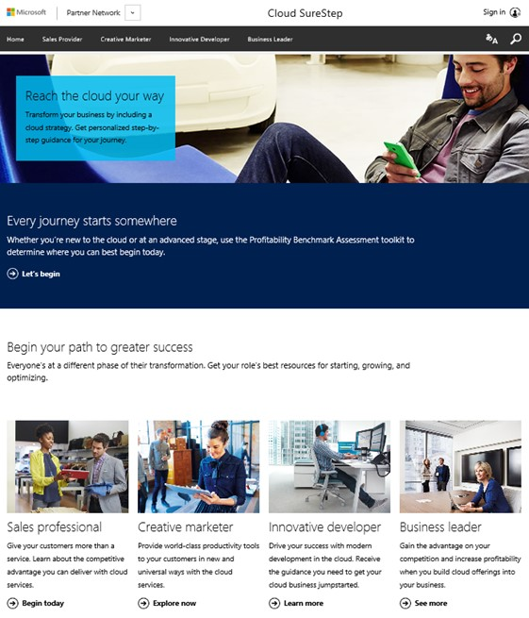
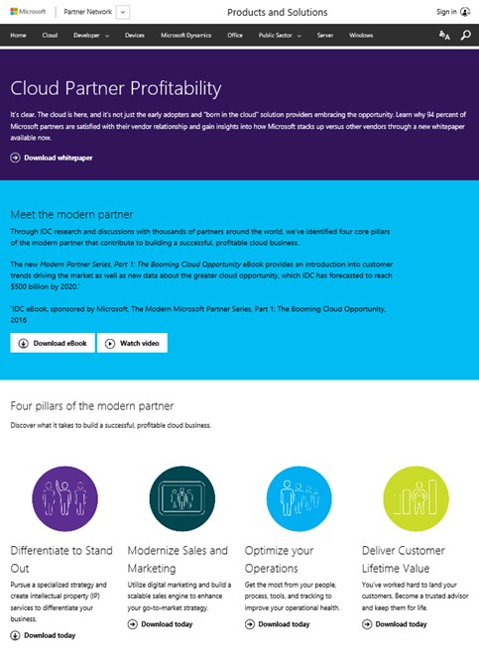
Partner transformation and profitability resources:
Cloud SureStep
Cloud Partner Profitability
https://partner.microsoft.com/en-US/SureStep
https://partner.microsoft.com/en-us/solutions/cloud-partner-profitability
Notes:
If you are new to building a Cloud Services business, please check-out these resources from Microsoft to help you get started. Of if you are already rolling, consider these resources to help you optimize your business further.

Slide 76



PROGRAMS TO DRIVE PARTNER SUCCESS
Notes:
What programs and investments is Microsoft making to help you be successful selling Windows 10 next year? A lot! Let’s talk about them…

Slide 77
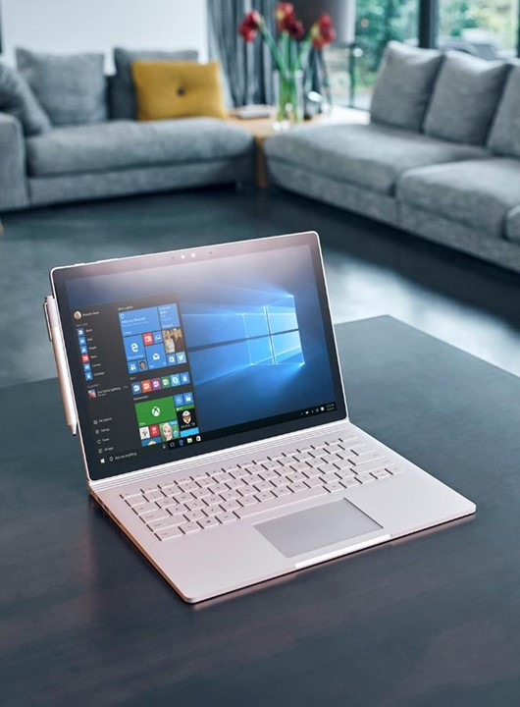
Many Windows FY17 partner programs and initiatives
TYPE | PROGRAMS & INITIATIVES
Events | Accelerate Your Business events (customer events)
 | Device Days events (partner events)
 | Tech-series training events (in-person and online)
Customer Acceleration | Windows Accelerate Program
 | Windows and Office FastTrack Program
 | EMS FastTrack Program
 | Application Compatibility
Incentives | OEM ProWins partner incentive
 | Partner Discounts, Internal Use Rights
 | Windows Defender ATP rebate offer (to-customer)
Contact your Microsoft Account Manager for more information on any of these programs / initiatives

Slide 78




Accelerate Your Business adds marketing support
OBJECTIVES
      Drive small business customer interest in Windows 10 Pro, new form factors and accelerate Pro device refresh
      Showcase new productivity technologies, security tools and form factors
      Support OEM partners through PR and media coverage
PROGRAM EXECUTION COMPONENTS
IN PERSON EVENTS
DIGITAL MEDIA & ONLINE CUSTOMER EXPERIENCE
PR & MEDIA
DEVICE OFFER &
CONVERSION
CHANNEL AMPLIFICATION
Delivering rich content, small business panels, keynote speakers and device experience
Paid Media & Social Customer impressions delivering Windows 10 Pro Value Prop
Driving new stories and editorials for new WIn10 Pro Devices
Providing small business leads to Partners and Resellers
Reseller Demand Generation
& Readiness
250K Customer Engagements
1B Impressions
250+ Press Coverage
150k Referrals to OEMs
15k Sellers Trained
TARGET GOALS
Contact your Microsoft account representative for information on events in your area
Notes:
Always on global execution program to nurture new device purchases integrated with “Accelerate your business” customer journey

Slide 79
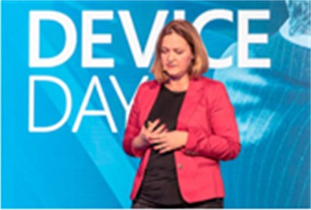
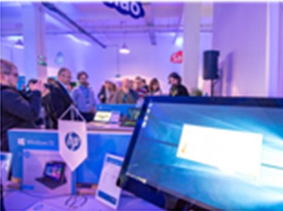
Device Days Plus, the sales training you need
Train resellers on selling Windows 10 Pro devices and how to increase attach rate
AUDIENCE
Top to mid-tier resellers sales teams
selling to SMB/CA space
LIVE EVENT MATERIALS & SPONSORSHIP
Event-in-a-box materials: Registration website, main presentation deck, demo script, videos, event invite templates, signage design, event hand-outs, eval forms.
Sponsorships: OEM Partner booth and break out sessions for Silver and Gold sponsors
Special Incentive Program or Eval units for attendees only
EVENT AGENDA
Windows across devices, Pro right licensing
Industries and scenarios, testimonial videos
Device demos, compete, objection handling
Cross-selling the stack– Office, Servers
Resources to help drive sales and offers
30-minute break-out session for Gold Sponsors
Microsoft Kiosk to showcase Windows 10 Pro hero devices -> Phone continuum, CTE, IOT
DIGITAL DEVICE DAY ONLINE MODULES
English recorded version delivered in 5-10 minute segments
Online delivery through the Device Partner Center online training engine
WHEN, WHERE, HOW
August to
June
120 live Training Events Worldwide, reaching over 10,000 resellers
10 Online-modules
for Further Scale
Contact your Microsoft account representative for information on events in your area

Slide 80
Windows Partner Tech-Series Program, FY17
End-to-end experience (consumption path)
Goal: 6000 Partners Trained in FY17
SELF-SERVE DIGITAL
PARTNER UNIVERSITY
1:M ONSITE
TARGETED
RSC/RTC
PLANNED
CALLDOWNS
WINDOWS 10
1:1 WINDOWS WORKSHOP
1:1
DEPLOYMENT SHADOWING
“Provide me with some self-consumption content around Windows and help me obtain the competency”
“Help identified Partners understand their options and choose the right technology focus area(s) for their needs”
“Help me understand the next options I have to increase my knowledge”
“Help me build my Windows Practice…”
“Help me with my first Windows deployment(s)”
WINDOWS & DEVICES COMPETENCY
SUBSIDIARY IDENTIFIED
SUBSIDIARY NOMINATED WINDOWS PARTNERS
Contact your Microsoft account representative for information on events in your area
Notes:
Self-Serve Digital: Partner U with built in Assessment
Planned Call downs: RSC (managed partners) / RTC (unmanaged partners)
After attending an event (remote or onsite), Partner is encouraged to then complete the Windows & Devices competency

Slide 81
Windows Accelerate puts Windows 10 Enterprise in customers’ hands to drive adoption
OVER 2,500
ENGAGEMENTS
IN FY16
CUSTOMER ENGAGEMENT OPPORTUNITY
PROJECT GUIDANCE AND IP PROVIDED BY MICROSOFT
FUNDING TO DELIVER ENGAGEMENT PROVIDED
BY MICROSOFT
ENTRYWAY TO ADDITIONAL SERVICE REVENUE OPPORTUNITIES
DEPLOYMENT
SOLUTION
5+ DAY
2–3 DAY
10 DAY
WINDOWS 10 ENTERPRISE POC
BROWSER MIGRATION POC
WINDOWS 10 MOBILITY POC
30–50 DAY
4 DAY
Q1 FY17
NEW
2–4 DAY
Q1 FY17
NEW
WINDOWS 10 ENTERPRISE PILOT
WINDOWS 10 ENTERPRISE COMPATIBILITY BRIEFING
WINDOWS 10 ENTERPRISE SECURITY INTEGRATION BRIEFING
Proof-of-Concept (PoC) takes place in a test environment at the customer location, delivered by MCS or MS certified SI Partners.
Production Pilot takes place in a production environment at the customer location, delivered by MCS or MS certified SI Partners.
https://partner.microsoft.com/en-US/Solutions/windows-accelerate
Notes:
Windows 10 Enterprise Compatibility Briefing: Aimed at removing the key deployment blocker around App Compatibility while also accelerating the speed of deployment especially among the large enterprise accounts.
Windows 10 Enterprise Security Integration Briefing: Security is a key value driver for Windows 10 and offers a clear and compelling reason for customers to deploy. Features such as Windows Defender ATP, Windows Information Protection and Credential Guard will be included.

Slide 82

Microsoft FastTrack for Windows 10 and Office 365 Pro Plus
ONBOARD
ENVISION
DEFINE VISION & DEPLOYMENT PLAN
FOR A SUCCESSFUL ROLLOUT
MOVE TO
WINDOWS 10 & OFFICE 365 ProPlus, SMOOTHLY AND
WITH CONFIDENCE
FastTrack
DRIVE VALUE
METHODOLOGY
& RESOURCES
PARTNER
SERVICES
TOOLS
& INSIGHTS
  Customer Benefits
  Reliable deployments at less risk
  Realize business value faster
  Maximize Microsoft investment
FastTrack.microsoft.com
  Partner Benefits
  Qualified deployment leads
  Leverage deployment offers
  Lead deployment engagements
CUSTOMER | PARTNER
BOOST USER ENGAGEMENT AND MANAGE CHANGE
http://fasttrack.microsoft.com/
Notes:
Launching for H2.

Slide 83
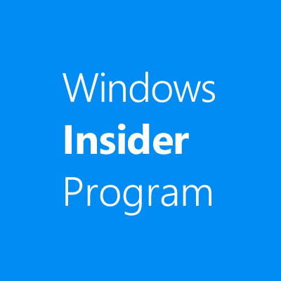

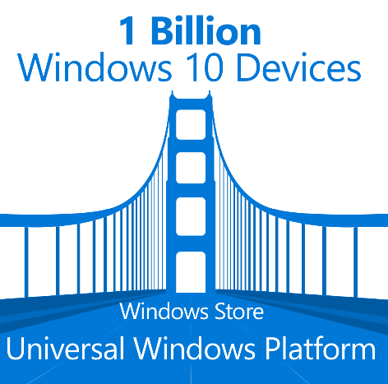
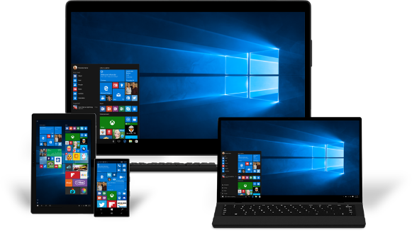

Ready for Windows program helps ISVs succeed with Windows 10 AND WaaS
Ready For Windows
WaaS Logo Program
Desktop Bridge
Cookbook
Join the Windows Insiders Program community to help shape the future of Windows, get early releases and more.
Leverage the Application Compatibility Cookbook for guidance in verifying compatibility of existing and planned apps for Windows 10.
Get your application in front of Microsoft’s global Ready for Windows Directory for IT decision makers around the world.
Use the new Windows Compatible Logo in your marketing materials and websites to grow sales opportunities.
Use the Desktop Bridge to bring your existing desktop apps to the Universal Windows Platform
Download a preview build of the latest Windows SDK and Emulator to explore what's new in building apps. for Windows.
Download the Application Compatibility Cookbook for Windows 10.
Submit your compatible application to the Ready for Windows Directory.
Register for the Windows 10 Compatible Logo Program and assure your customers of quality and compatibility.
Download Desktop Application Converter to make your applications available in the Windows Store.
1
2
3
4
5
https://www.readyforwindows.com/
Notes:
Declare Support for Windows 10 and List Compatible Applications in Windows Directory
Drive global awareness and grow your business
Build customer confidence in quality of your applications
Gain valuable telemetry data for insights to customer usage patterns and app. behavior
Microsoft Ready for Windows Directory is a new web site that makes it easy for ISVs to list commercial applications that support Windows 10 and generate market visibility for their solutions.
All ISVs have to do is create a support statement for Windows 10 that we can link to on their web site, and complete a short application. Once reviewed and accepted by Microsoft, solutions will be listed in the directory for anyone looking for Windows software providers.
Ready for Windows will be heavily promoted to commercial customers world-wide on Microsoft web properties and through paid search, so ISVs can now reach a global market, generating leads to grow their business. And business customers will be able to search the directory for compatible apps and upgrade to Windows 10 with confidence knowing the business solutions they rely on are Windows ready today.
Partners can also benefit from using Windows 10 Compatible Logo to differentiate and promote the quality of their apps.
ISVs that issue a support statement for Windows 10 and Windows as a Service (WaaS) are granted (limited) usage rights to the Windows Compatible logo, helping them to build customer confidence and demand for their apps. by enhancing their marketing materials and websites.

Slide 84
ProWins program adds device incentives and support
ProWins
Channel incentive design to incentivize sales of commercial devices with Windows Pro
ProWins Per Unit Incentive
ProWins Accelerator
ProWins CMI
PROGRAM
DETAILS
Disti and Reseller payment for all Windows Pro devices sold*
Marketing and training funds to grow Pro devices sales**
Up to $25 per hero device, for commercial marketing investment*
GOALS
Mix Shift To Commercial/Pro
Sell-through Growth
$15M
$5M
$25M
To Enroll:
Go to the OEM Reseller Incentives Page
Check the How to Become Eligible and Incentives Eligibility Criteria sections
Email your MPN ID to oemincentives@microsoft.com to confirm your eligibility and initiate the enrollment process.
*Based on Disti reporting data
**Select Distributors and Resellers only
https://www.microsoft.com/OEM/en/SALESMARKETING/Pages/OEM-reseller-incentives.aspx#fbid=WmHmdIfX77M

Slide 85
Get proactive security with the Windows Defender ATP Customer Rebate Offer
WINDOWS DEFENDER ATP REBATE OFFER
BUY | Purchase a minimum of 500 seats of Windows Defender ATP between August 1, 2016 and December 31, 2016
GET | Receive 6 month rebate on Windows Defender ATP (up to a maximum of 10,000 seats)
DEPLOY | Must deploy a minimum 500 devices on Windows 10 Anniversary Update by 6/30/2017
ASK | Customers asked to provide updated plan to deploy at least 10% of installed base on Windows 10 (not condition of rebate)
Offer Excludes phone, IoT, server, and virtual machines.
Notes:
Targets: All EPG & CAM/CTM commercial & PS accounts with new/existing EA or Select agreements.
VL Discount: Normal WDATP pricing with empowerment may be used as part of WDATP negotiation.
Rebate Availability: Customers must purchase WDATP and then register for the WDATP rebate online. Only one rebate claim per customer. Account teams requested to have an updated deployment plan loaded in CET showing the customers commitment to deploy 10% of PCIB by 6/30/17 (not a condition of rebate).
Rebate Payment Date: Coupon code must be issued during Offer Term but payment will only be made once the minimum 500 Windows devices have been deployed on or before 6/30/17. Rebate will be paid directly to customer. Rebate will be calculated as the first 6months cost of the already paid WDATP amount and paid in USD currency within 90 days.
Terms & Conditions: Please refer terms & conditions sheet for more details.

Slide 86
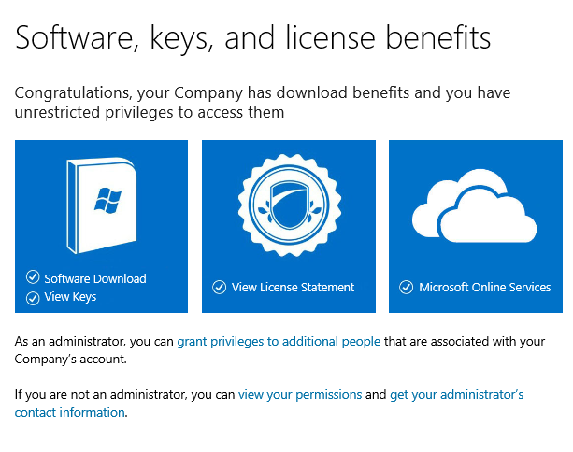
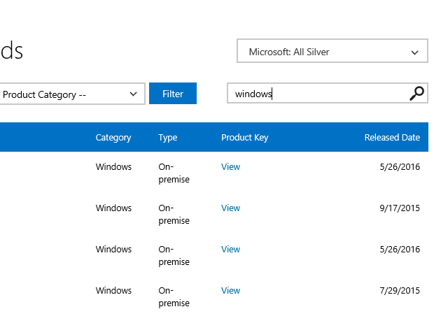
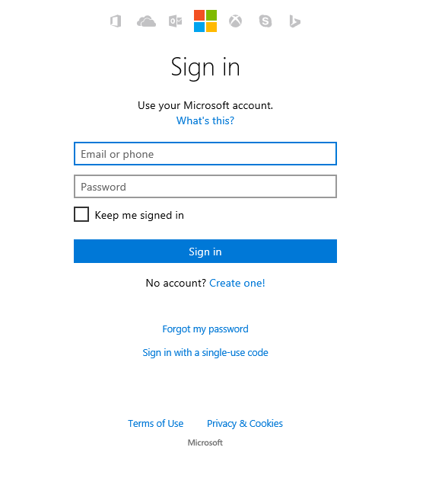
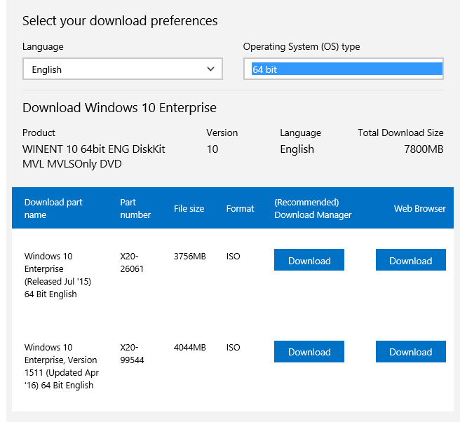
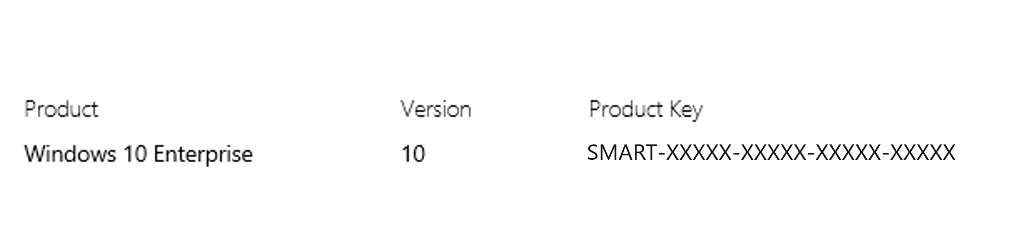
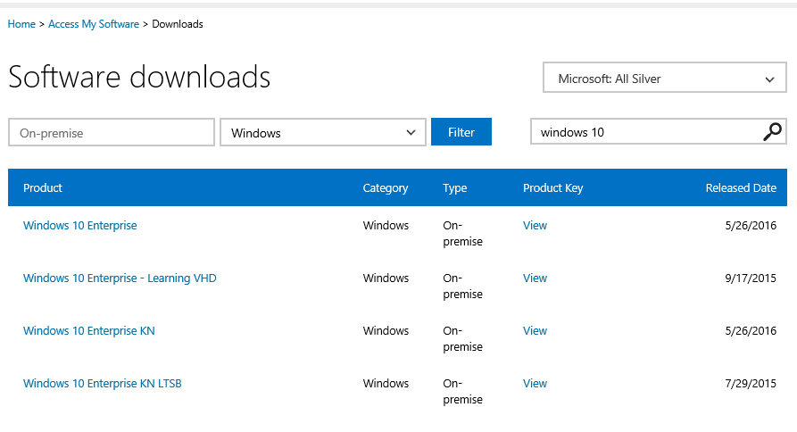
Start using Windows 10 – Six steps to activate Internal Use Rights
Go to the Partner Digital Download Portal http://aka.ms/activateIUR and sign in with your Microsoft Account with admin right (formerly Windows Live ID)
2. Click at the first tile (Software Download)
3. Search for “Windows 10” in the search bar.
Choose the Windows 10 edition you would like to use. In this example, Windows 10 Enterprise is chosen.
5. Choose a language and OS Type (either 32-bit or 64 bit), then click one of the download options.
6. Make sure to copy a product key to use during the Windows 10 installation.
And now, you can happily use Windows 10
For more information visit the Internal Use Rights site: http://aka.ms/iur
Notes:
All partners should leverage their Internal Use Rights to Windows 10 Enterprise.

Slide 87

Next steps for you to win with Windows 10
Leverage your internal use rights to adopt Windows 10 Enterprise—using it is the best way to sell it
Get training and other resources available on MPN Windows
Enroll in a Windows Tech Series Training Event
Leverage Windows Accelerate to extend POCs & Pilots
Prioritize Customer Targets for New POCs and Pilots
  Early Windows 7 Adopters with device renewal needs
  Security motivated customers
Build a Managed Services Business model into your offerings
Capture the service revenues that build on Windows 10 Enterprise

Slide 88
Partner resources pave your path to Windows 10 success
PLAN your path for growth
SELL effectively, to the right customers
DELIVER the right solution/services
Enable
your team
Plan your
business
Create customer demand
Sell advise,
and transact
Deploy
Get services
and support
People
Partner Sales Executive (PSE)
Partner Learning & Development Specialist (PLDS)
Windows Technical Sales Professional (TSP)
Account Executive (AE), Inside Sales Executive (ISE)
Partner Channel Marketing Manager (PCMM – CA)
Account Technology Strategist (ATS) – (EPG only)
Partner Technology Strategist – (CA only)
Programs and Content
Windows Tech Series – Contact your PSE
Microsoft Partner Learning Paths
Windows Roadmap, Windows 10 Security
Drumbeat Start, Drumbeat Grow
Windows 10 Commercial Campaign
Windows 10 & Devices Campaign
Smart Partner Marketing
Microsoft Marketing Resources
Windows & Devices Competency
Deployment Planning Services (DDPS) vouchers
Technical Pre-sales and Advisory Services
Windows for Your Business Content
TechNet Library for Windows 10
IT Showcase Windows 10 Use Cases
IT Showcase Windows 10 Productivity Guide
Windows 10 Gartner Whitepaper on digital workplace strategy
Forrester Total Economic Impact Of Windows 10
TCO Calculator
Windows 10 Deployment Options
Windows 10 Self-Serve POC
For ISVs: Post Win 10 support statements on Ready for Windows
Windows Accelerate
Advisory services and Break-fix support
Premier Support for Partners
Signature Support for Partners
New
Funds
New Content from WPC July 2016
Windows Blog
OEM Featured Devices
Window 10 Enterprise Internal Use Rights and Partner Rights Activation
Partner Incentives: Online Services Advisor Web-Direct, Enterprise, Managed Reseller, Commercial Distributor
Business Investment Funds (BIF)
Cloud Jumpstart – Invitation only, contact PSE
Business Investment Funds (BIF)
Windows Accelerate
Deployment Planning Services (DPS) vouchers

