Slide 1
Windows 10 Enterprise Subscriptions in CSP
Windows Commercial Marketing
Notes:
Completing the stack: New partner-managed servicing opportunities for SMBs with Windows

Slide 2
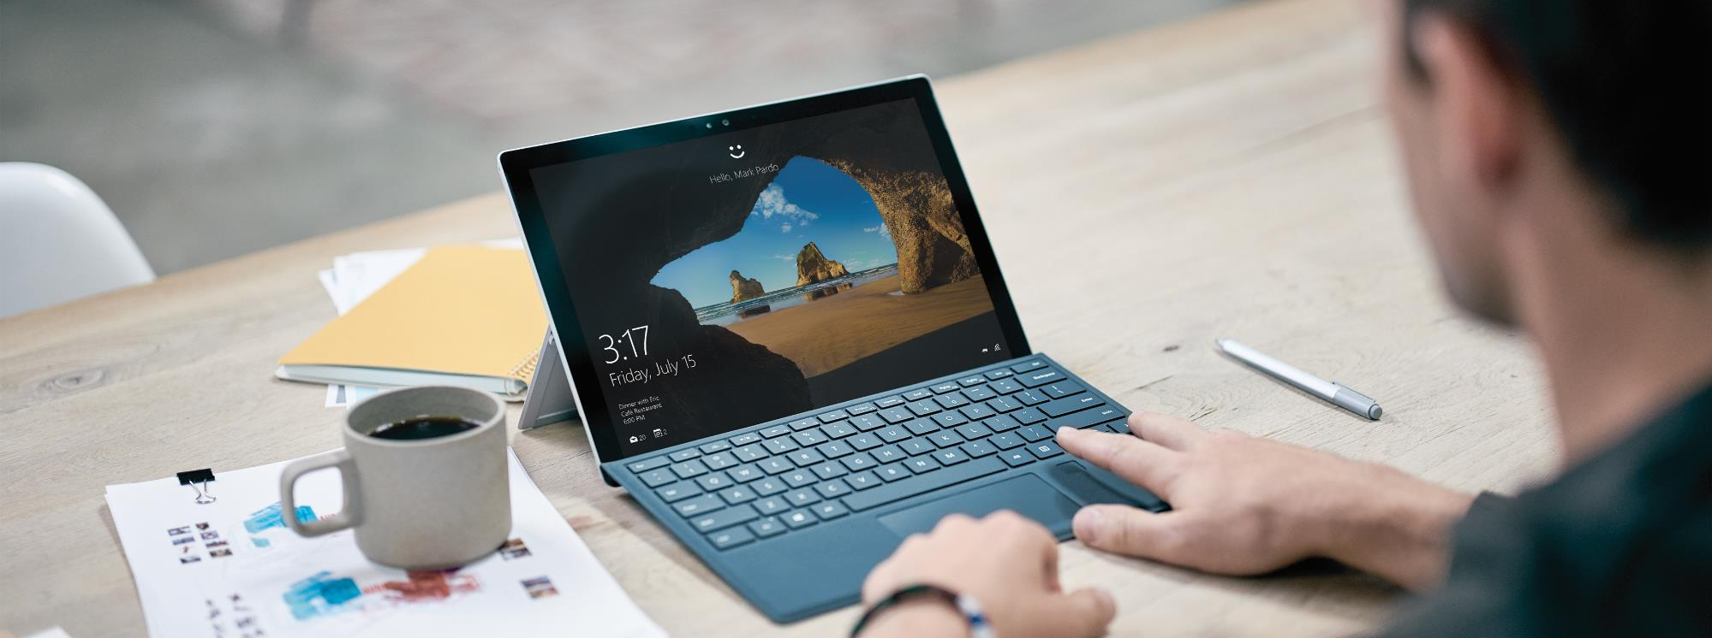
Windows Versions
The most secure Windows ever
XP
2001
Vista
2007
7
2009
8
2012
8.1
2013
10
2015
Notes:
Here are the six major versions of Windows over the last fifteen years. Now, with Windows 10, we’ll be talking about how it’s the most secure Windows ever.

Slide 3
Windows 10 editions
 | Consumer | Commercial
OEM Pre-install
VL Upgrade
Windows 10 Home
Windows 10 Pro
Windows 10 Enterprise
Notes:
Let’s take a look at the various Windows editions available today. Understanding this will make clear the big advantages of the CSP subscription model we are here to talk about.
Windows can come pre-installed by an OEM on either consumer or commercial devices. And Windows 10 Enterprise is a Volume License upgrade for commercial customers.

Slide 4
Legacy paths to Enterprise for SMBs
Software Assurance
LTSB (Long Term Servicing Branch)
< 0.5% penetration in SMBs in the US
Multi-year contracts, annual upfront payments
Full payment due at transaction
Per-device licenses
Bits and keys via VLSC
Wipe and reload deployments
Notes:
Historically, if you were a small business and you wanted Enterprise, in the past you had two options: buy Software Assurance or buy LTSB. Both were multi-year contracts with big upfront costs or you were paying the full payment at transaction for LTSB. They were all device–based. They all required you to go to LTSB download ISOs and get keys and most of the deployments then required wipe and reload. This doesn’t scale and doesn’t work for small businesses.
Less than 5% of the SMBs run Enterprise – BUT – when we go talk to SMBs and put the value prop in front of them, they want it.
*SA penetration in developed markets: 0.49%

Slide 5
Introducing
Windows 10 Enterprise Subscriptions
For the Cloud Solution Provider Program
Notes:
That brings us to Windows 10 Enterprise Subscriptions for the CSP program

Slide 6
Democratizing enterprise grade security
Notes:
The exact same Windows that the US Department of Defense is deploying, is now available to any business – not for a three year, per device software assurance agreement of $380 – but for the price of coffee and donut
https://blogs.windows.com/windowsexperience/2016/02/17/us-department-of-defense-commits-to-upgrade-4-million-seats-to-windows-10/#GM7cIly7mOfTPqW3.97
**This image is a work of a U.S. military or Department of Defense employee, taken or made as part of that person's official duties. As a work of the U.S. federal government, the image is in the public domain in the United States.

Slide 7
Windows 10 Enterprise in CSP
The most secure Windows ever
Managed by a trusted partner
Easy pricing for small businesses
Secure your data and devices
Secure your user identities
Secure your business
Your IT managed by experts
A customized security strategy
You’re free to manage your business
Per-user per-month pricing
Pay-as-you-go subscription
Flexibility to scale up or down
Enterprise-grade security and control. . . With small-business-friendly pricing
Notes:
Per user, per month; cloud deployed; single step-up; aligned with Office; managed by partner.

Slide 8
The most secure Windows ever
Secure your data
Secure your devices
Secure your people
Notes:
Your data is your business. It’s your revenue stream – your livelihood. Protect your sensitive data, your devices, your customer identities, and your intellectual property – with the same level of enterprise-grade protection and control trusted by many of the world’s largest organizations.
Secure your data
Protect your growing business against ever-evolving cyber threats with the same level of security and control used by many of the world’s largest organizations and governments.
AppLocker management helps administrators determine which applications and files users can run on a device, also known as “whitelisting.” These include executable files, scripts, Windows Installer files, dynamic-link libraries (DLLs), packaged apps, and packaged app installers.
App-V: Make applications available to end users without installing the applications directly on end user computers by streaming them using App-V. App-V transforms applications into centrally managed services that are never installed and don't conflict with other applications. It also helps ensure that applications are kept current with the latest security updates.
Secure your devices
Safeguard your devices with advanced security and control features that protect against malware, untrusted apps, and executables. Lock down the user experience on specific devices so they can only perform certain functions. And keep all your devices and applications current and protected with the latest security updates and patches through the cloud.
Device Guard puts you in control of your environment—and a step ahead of malware—with rigorous access controls that help protect the Windows system core and prevent untrusted apps and executables from starting. Device Guard helps you to:
Eliminate malware: Help secure your environment and prevent untrusted apps and code from running by using the ultimate form of app control. Using virtualization-based security, the Device Guard feature in Windows 10 offers a solution more powerful than traditional app control products, providing rigorous protection from tampering and bypass.
Get hardware-rooted app control: Device Guard uses hardware-based isolation and virtualization to protect itself and the Windows system core from vulnerability and zero-day exploits.
Only run trusted apps: Device Guard enables your IT department to decide which software vendors and apps can be trusted within your environment. IT can designate as trustworthy the right combination of apps for your organization, from internal line-of-business apps to everything from the Windows Store to apps from specific software vendors.
Managed User Experience:
Advanced lockdown capabilities in Windows 10 give your Internet of Things (IoT) devices an extra layer of security and provide a predictable experience for line-of-business device scenarios by allowing you to:
Protect a device from write operations: using Unified Write Filter (UWF), you can intercept all write attempts to a protected volume and redirect them to a virtual overlay instead. You can also specify any files, directories, and registry keys that should not be filtered.
Control the start screen layout and access to USB devices
Automatically boot to a Classic Windows app: using Shell Launcher in Windows 10, you can launch Classic Windows apps as a custom shell to create a dedicated device and app experience. You also gain flexibility and control by using multiple shells for different user groups.
Automatically boot to a Universal Windows app: using the Assigned Access setting, you can restrict a specific standard account to using only one Windows Store app. For example, you can restrict customers at your business to using only one app so your PC acts like a kiosk.
Secure your people
You don’t ever want to have to inform your customers that they’ve been the victim of identity theft. Get peace of mind knowing that you have the highest degree of security available to help protect your user or client identities.
Credential Guard: While Windows 10 Pro features such as Microsoft Passport and Windows Hello strengthen and help protect user credentials, Credential Guard takes the next step and helps protect the user access tokens that are generated once your users have been authenticated. Credential Guard provides:
Identity protection: Credential Guard stores user access tokens within a virtualization-based security (VBS) environment running on Hyper-V technology. This helps prevent attackers from extracting the tokens from devices, even when the Windows kernel itself has been compromised. Malware running in the operating system, even with the highest privilege level, can‘t access tokens that are protected by Credential Guard.
Hardware-level security: Credential Guard uses hardware-based virtualization and Hyper-V to host Windows 10 security credentials and isolate them from malware. This helps prevent one infected virtual machine from damaging others running in the same datacenter.
Easy manageability: you can manage Credential Guard using Group Policy, Windows Management Instrumentation, a command prompt, and Windows PowerShell —environments very familiar to your IT staff.

Slide 9
Windows 7 security features
BitLocker Admin and Monitoring
Windows Firewall
BitLocker
Trusted Platform Module
SmartScreen
BitLocker to Go
Device protection
Threat resistance
Identity protection
Information protection
Breach detection investigation & response
PRE-BREACH
POST-BREACH
Notes:
Productive and happy users are great but the threats we face have never been more serious. The attackers are changing their playbook to stay ahead, and we need to as well.
With Windows 7 our goal was to provide a baseline level of protection. It included the security fundamentals that our customers needed plus a few extras like BitLocker. In the end our model was effectively to outsource the delivery of advanced security capabilities to 3rd parties.
Given the threat landscape our customers are now living in we believe it’s our duty to deliver far more.
ADVANCE SLIDE
Additional detail:
Trusted Platform Module (TPM): hardware protects and isolates your Windows credential from the rest of the operating system, helping to thwart malware and advanced attacks.
Windows Firewall: stop attacks in their tracks. This network protection helps keep hackers and malicious software from gaining access to your PC through a network or the Internet.
SmartScreen Filter: protection online. Built into Microsoft Edge and Internet Explorer browsers, SmartScreen Filter helps protect against malicious websites and downloads.
Bitlocker and Bitlocker to Go: If your Windows 10 Pro device or USB drive is lost or stolen, BitLocker and BitLocker to Go are designed to put everything on lockdown so no one else can access your business systems or data. And with Windows Information Protection your business files are encrypted at the file level and can’t be moved to unauthorized locations.

Slide 10
Windows 10 security on Windows 7 hardware
Microsoft Edge
Windows Information Protection
Windows Defender
BitLocker Admin and Monitoring
Windows Trusted Boot
Windows Firewall
Windows Hello Companion Devices
BitLocker
Windows Defender Advanced Threat Protection
Trusted Platform Module
SmartScreen
Windows Hello
BitLocker to Go
Device protection
Threat resistance
Identity protection
Information protection
Breach detection investigation & response
PRE-BREACH
POST-BREACH
Notes:
With Windows 10 we’ve gone all in on security.
For the very first time Windows is offering the full spectrum of security capabilities and we’re no longer punting the problem to 3rd parties. Just take a look at this list of new capabilities!
[Device Protection and Threat resistance]
We’re tackling hacking and malware threats with a deep bench of inbox solutions that can help address all of the vectors of attack that customers are facing
[Identity Protection]
Passwords are finally on their way out of organizations with Windows Hello
[Information Protection]
To better protect business information the Anniversary Update includes a brand new feature called Windows Information Protection (WIP), formerly EDP, to help prevent users from accidentally leaking business data to unauthorized apps and locations.
[Breach Detection…]
And then we have one of our most exciting additions to Windows which is Windows Defender Advanced Threat Protection (ATP) which isn’t just another Windows security feature. ATP is quite literally on the scale of a completely new product which is designed to help our customers detect and remediate from the most sophisticated types of attacks.
ADVANCE SLIDE
Additional detail:
Windows Trusted Boot: Windows trusted boot on Windows 10 is built on top of a security standard developed by members of the PC industry to help make sure that your PC boots using only trusted software. When the PC starts, the device's firmware and then Windows itself validate each boot-related component, avoiding headaches caused by malware that can load before the OS boot process has begun or within it.
Microsoft Edge: Secure by design, Microsoft Edge has a security sandbox and Windows Information Protection and supports only newer, more secure web technologies. It is optimized for the modern web and renders sites quickly.
Windows Defender: malware’s worst enemy. This anti-virus security delivers comprehensive, ongoing and real-time protection against every category of software threat across email, the cloud and the web.
Windows Hello: Fast and password-free. With Windows Hello, you can sign into your Windows devices, compatible apps and sites 3 times faster than a password that you have to remember and type in and worry about keeping secure. Windows Hello uses your face, fingerprint, or a Windows Hello companion device to recognize you instantly. You can always keep your PIN as a backup if you choose.
Windows Information Protection: Separate personal and professional data. Windows Information Protection* (WIP) helps IT and users prevent accidental leaks by separating personal and business data. WIP allows IT administrators to apply rules to control how business data can be used. WIP recognizes business data as it arrives on devices, is generated by business applications, or when it is designated as business data by the user.
Windows Defender Advanced Threat Protection: Behavior-based, post-breach detection. Windows Defender Advanced Threat Protection (ATP) detects attacks that have made it past all other defenses, based on behaviors. Windows Defender ATP uses real-time as well as historic information to identify attacks, and provides actionable alerts for known and unknown adversaries. Windows Defender Advanced Threat Protection (ATP) is powered by behavioral sensors built into Windows 10 and a cloud back-end. No additional deployment is required, and the service can be switched on through configuration. Running alongside any anti-virus (AV) solution, Windows Defender ATP is continuously up-to-date, and can help lower costs.

Slide 11
Windows 10 security on Windows 10 hardware
Device Guard
Windows Defender Application Guard
Device Encryption
Virtualization Based Security
Microsoft Edge
Windows Information Protection
UEFI Secure Boot
Windows Defender
Credential Guard
BitLocker Admin and Monitoring
Conditional Access
Windows Trusted Boot
Windows Firewall
Windows Hello Companion Devices
BitLocker
Windows Defender Advanced Threat Protection
Trusted Platform Module
SmartScreen
Windows Hello
BitLocker to Go
Device protection
Threat resistance
Identity protection
Information protection
Breach detection investigation & response
PRE-BREACH
POST-BREACH
Notes:
And here are the Windows 10 security capabilities that leverage current hardware, including:
Virtualization Based Security and Device Guard to help secure your environment and prevent untrusted apps and code from running by using the ultimate form of app control. This offers a solution more powerful than traditional app control products, providing rigorous protection from tampering and bypass. Device Guard uses virtualization-based security to isolate and help protect Device Guard features, such as the Hyper-V Code Integrity Service (HVCI), from malware and attacks, even if Windows itself has been compromised. HVCI enables Device Guard to help protect kernel mode processes from in-memory attacks, giving you a strong defense against zero-day exploits.
UEFI Secure Boot used in combination with Windows trusted boot, is a hardware standard developed by members of the PC industry, helps make sure that your PC boots securely and that only trusted software can run during start-up. When the PC starts, the UEFI firmware checks the signature of each piece of boot software and the operating system, avoiding headaches caused by malware that can load before the OS boot process has begun. From here, Windows trusted boot helps ensure that all Windows boot components, drivers, and compatible antimalware solutions start with integrity.
Windows Defender Application Guard for Microsoft Edge provides unprecedented protection against targeted threats using Microsoft’s Hyper-V virtualization technology. Application Guard is designed to stop attackers from establishing a foothold on the local machine or from expanding out into the rest of the corporate network.
Credential Guard helps protect the user access tokens that are generated once your users have been authenticated. It stores user access tokens within a hardware isolated container running on top of Hyper-V technology, which helps prevent Pass-the-Hash attacks, one of the key tactics used to compromise networks.
Conditional Access:
In today’s BYOD environment, enterprises can’t assume that devices accessing their networks are malware-free. Windows 10 helps ensure that unhealthy devices can be identified and gated from business resources using a combination of the Windows Device Health Attestation cloud service and mobile device management systems such as Microsoft Intune.*** Windows 10 uses the Trusted Platform Module (TPM) hardware built into newer PCs to monitor startup processes services and determine if data is trustworthy. With Conditional Access, IT departments can detect and prevent low-level malware, and noncompliant devices can be denied access to specific applications, like email and Microsoft SharePoint sites, or to the entire corporate network.

Slide 12
Enterprise-grade security with E3 or E5
E3
Device Guard
Windows Defender Application Guard
Device Encryption
E3
Virtualization Based Security
Microsoft Edge
Windows Information Protection
E3
E3
UEFI Secure Boot
Windows Defender
Credential Guard
BitLocker Admin and Monitoring
Conditional Access
Windows Trusted Boot
Windows Firewall
Windows Hello Companion Devices
BitLocker
Windows Defender Advanced Threat Protection
E5
Trusted Platform Module
SmartScreen
Windows Hello
BitLocker to Go
Device protection
Threat resistance
Identity protection
Information protection
Breach detection investigation & response
PRE-BREACH
POST-BREACH
Notes:
E3 includes Virtualization Based Security, Device Guard, Credential Guard, and Conditional Access. Windows Defender Advanced Threat Protection comes with E5.

Slide 13
Managed by a trusted partner
No IT? No worries
Your IT managed by experts
Customized security strategy
You manage your business
Notes:
No IT? No worries
Businesses with fewer than 50 employees are unlikely to have full time in-house IT. Work with a trusted partner to get the time you need to focus on strategic priorities.
Your own customized security strategy
Your partner is empowered to manage all your IT for you, not just your Windows configuration. Your partner will work with you to implement the powerful security and control features of Windows Enterprise and develop a customized security strategy tailored to the needs of your business. They can also help you meet compliance requirements by monitoring your devices, network traffic, and data integrity and providing detailed compliance reports on a regular basis.
Your IT is managed by experts so you can focus on managing your business
Save time with one single point of contact that knows and understands your needs so you can focus on more strategic priorities – like growing your business. Windows 10 Enterprise is designed to be delivered as a cloud service and managed by a trusted partner, so you get comprehensive management and support for all aspects of implementation, users, subscription ordering and configuration of services and devices, so you can focus on long-term initiatives.

Slide 14
Easy pricing for small businesses
Per-user, per-month pricing
Pay-as-you-go subscription model
Scale as you grow
Upgrade from Windows 7/8.1 included
Notes:
Scale up or down – month-to-month - Reduce up-front costs with a pay-as-you go subscription model, paying only for the users you need on a monthly basis – up or down. Your partner can also easily reassign licenses, onboard new employees, or add and manage additional cloud services as necessary.
Per-user, per-month pricing
Save on up-front costs by paying monthly, only for the users you need. Spend less time managing devices and licenses and get a simpler process for staying compliant by eliminating the need for device counting and audits. And your employees can stay productive with access to up to 5 devices each.
Pay-as-you-go subscription model Get the security and control you need while lowering up-front costs with subscription-based licensing. You can also now manage all of your cloud services with one partner since other Microsoft cloud services – such as Office 365 – use the same subscription model.
Scale as you grow
Get scalable IT that grows with your business. Your partner can quickly onboard new employees and reassign licenses as needed. They can also manage as much or as little as you need, whether it’s just Windows 10 Enterprise or all of your cloud services and support.
Windows 7/8.1 upgrade included
As a Cloud Solution Provider (CSP) program subscriber, you can now upgrade your Windows 7 and Windows 8.1 PCs and devices to Windows 10 at no additional cost.
* Pricing is per-user per-month. Windows 10 Enterprise E3: $7. Windows 10 Enterprise E5: $14.

Slide 15
When you require the most advanced protection
Behavior-based, post-breach detection
Rich machine timeline
Built-in threat intelligence knowledge base
* Windows Defender Advanced Threat Protection is available only with Windows 10 Enterprise E5.
Notes:
OPTIONAL SLIDE – Only use this slide if the customer requires Windows Defender Advanced Threat Protection
Enterprise-grade security for any size businesses - Use a post-breach layer of protection to detect, investigate, and help you respond to advanced attacks and data breaches on your networks.
Windows Defender Advanced Threat Protection, available only in Windows 10 Enterprise E5, builds on the pre-breach security measures of E3, and adds a post-breach layer of protection to detect, investigate, and remediate Advanced Attacks and data breaches on your networks.
Protect your endpoints from advanced threats with additional solutions already built into Windows 10. Windows Defender Advanced Threat Protection (WDATP)* is powered through the cloud, so no additional deployment or infrastructure is required, and it is always up-to-date.
Find the attacks that make it past all other defenses with behavior-based, post-breach detection that provides actionable, correlated alerts for known and unknown adversaries.
Easily investigate scope of breach or suspect behaviors on any machine through a rich machine timeline. WDATP helps you gain insights using deep collection and analysis for any file or URLs.
Let the experts do the work. WDATP has a built-in threat intelligence knowledge base – combining 1st and 3rd party intelligence sources to inform every threat detection and mitigation response.

Slide 16
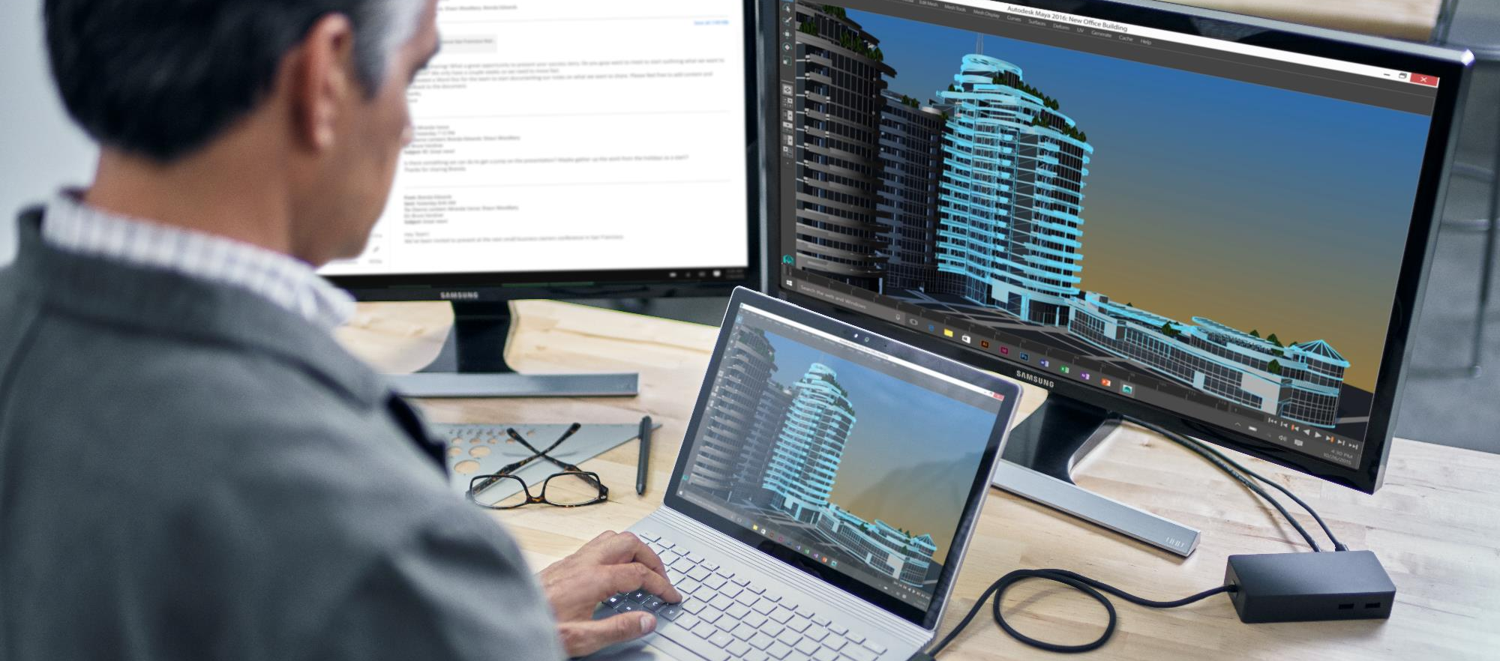
Deployment reimagined
Windows 10 Pro Anniversary Update
+
Azure Active Directory
+
Cloud Solution Provider Platform
=
Pro to Enterprise in 2 mins or less*
* Actual time may vary
Notes:
We spoke earlier about the previous versions of Windows. Historically, there were a few legacy transaction paths through SA and LTSB. You would get a username and password, go to VLSC (Volume License Software Center) and download a 3-4 GB ISO image and some tools to help you configure the deployment. Then you do KMS activation followed by a wipe and reload deployment process across all of your devices. That’s quite a process and takes some time.
Now, we have reimagined deployment. Here’s how you get to Enterprise from Windows 10 Pro with CSP: Pull your Windows 10 Pro device out of the box. Log in with your Azure Active Directory user credentials and if there’s a Enterprise subscription attached to that user account via CSP, it just flips – steps up from Pro to Enterprise. There’s no download. There’s no Install. There’s no reboot. You literally go from Pro to Enterprise in two minutes or less.
*Also means the inverse so when you subscription lapses or ends your device seamlessly falls back to Windows Pro (90 day grace)

Slide 17
Secure Productive Enterprise
Windows 10 Enterprise
Office 365
Enterprise Mobility + Security
Notes:
Microsoft technology is coming together to empower employees through a combination of Office 365, Windows 10 Enterprise, and the Enterprise Mobility + Security suite.

Slide 18
Empower your employees by creating a Secure Productive Enterprise
Trust
Collaboration
Mobility
Intelligence
Protect your organization, data and people
Create a productive workplace to embrace diverse workstyles
Enable your people to get things done anywhere
Provide insights to drive faster, better business decisions
Windows 10 Enterprise
Enterprise Mobility + Security
Notes:
We are introducing Secure Productive Enterprise as the hero offer to help our customers empower employees on their Digital Transformation journey. Secure Productive Enterprise delivers the latest and most advanced innovations in enterprise security, management, collaboration and business analytics, delivered through best-in-class cloud services. Secure Productive Enterprise is targeted to address these top customer priorities:
Trust - It is built in our products and not an after-thought. We give customers ownership of their data. We are transparent and publish our policies Public trust center. We support major compliancy requirements
Collaboration- Embracing new ways of working to help people achieve more. Giving people new ways of finding information, expertise and colleagues around the world. Moving seamlessly from email to impromptu 1:1 to team meetings to broadcasting your message to thousands.
Mobility- Talks about where people do their work, with portable and consistent experience across iOS, Windows, Android as well as the ability to secure those mobile devices with management capabilities so the work, data, person and organization are secure.
Intelligence – Centers on fast and better decision making. Providing insights to make decisions. Feels natural for people and helps them be more effective.

Slide 19
Windows in the Microsoft Secure Productive Enterprise
A better way for SMBs to access the latest security, control and management features in Windows 10 Enterprise via a per-user subscription
Seamless step-up from Windows 10 Pro Anniversary Update with AAD sign-in
Simplified per-user licensing model, aligned with Office 365 and Azure
Designed for partner managed IT solutions delivered through the CSP program
Notes:
This is a merging of Pro and Enterprise bits – it’s a BIG engineering change! For the first time ever, all Windows Pro machines now have the Enterprise features sitting on the device but dormant until activated
You have the ability to turn the full Enterprise feature set on or off, month-to-month based on whether a subscription is active
If subscription lapses or ends the device rolls back to Pro functionality
In order to maintain device, data and ID security not all features are turned off, some are put into a frozen state so that they still work but cannot be changed until the subscription is renewed

Slide 20
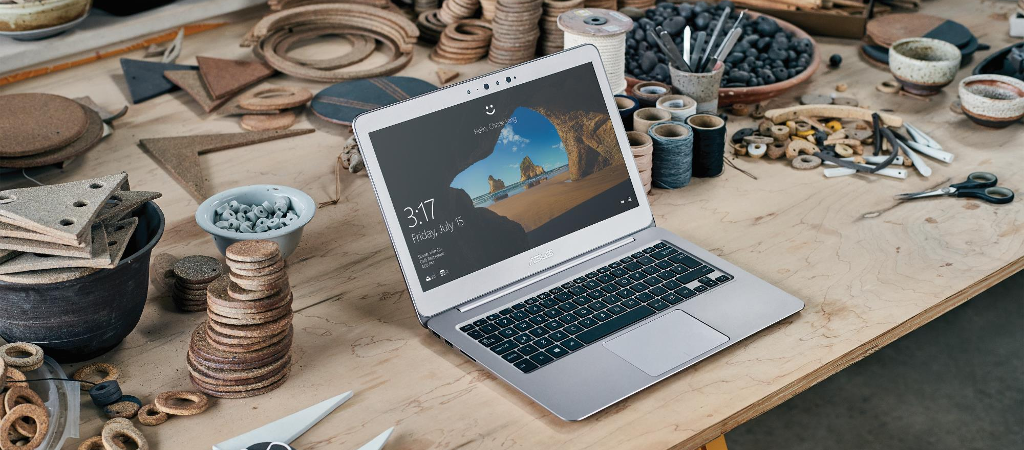
Simplify and save money
A la carte from Microsoft and/or third parties
Enterprise-grade device management & security
PBX & Voice Solution
Productivity Apps
$32
Per-user, per-month
Secure Productive Enterprise E3
BI & Analytics
Cloud-based identity management & security
Notes:
It can be complicated and costly to assemble all the pieces necessary for a secure solution. Whether you use Microsoft solutions exclusively or in combination with 3rd party software, you still need to account for the OS itself, device security and management, a host of productivity, communication and analytics applications, and a robust cloud-based identity management and security solution. Secure Productive Enterprise delivers the latest and most advanced innovations in enterprise security, management, collaboration, and business analytics, delivered through enterprise cloud services at a small-business-friendly price.

Slide 21
What’s included in Secure Productive Enterprise
 | E3 | E5
Windows 10 Enterprise E3: includes all of the features of Windows 10 Pro plus Credential Guard, Device Guard, App Locker, App-V, UE-V, Managed User Experience, Conditional Access, and more Office 365 E3: Word, Excel, PowerPoint, OneNote, Outlook, Exchange, Yammer, OneDrive for Business, SharePoint, Skype for Business Enterprise Mobility + Security E3: Intune, Advanced Threat Analytics, Azure Information Protection P1, Azure Active Directory Premium P1 | ● | ●
Windows 10 Enterprise E5: includes Windows 10 Enterprise E3 plus Windows Defender Advanced Threat Protection Office 365 E5: includes Office 365 E3 plus Advanced Threat Protection, Advanced Security Management, Customer Lockbox, Advanced eDiscovery Enterprise Mobility + Security E5: includes all of EMS E3 plus Microsoft Cloud App Security, Azure Active Directory Premium P2, and Azure Information Protection P2 |  | ●
Notes:
Microsoft Application Virtualization (App-V)
Microsoft User Environment Virtualization (UE-V)

Slide 22
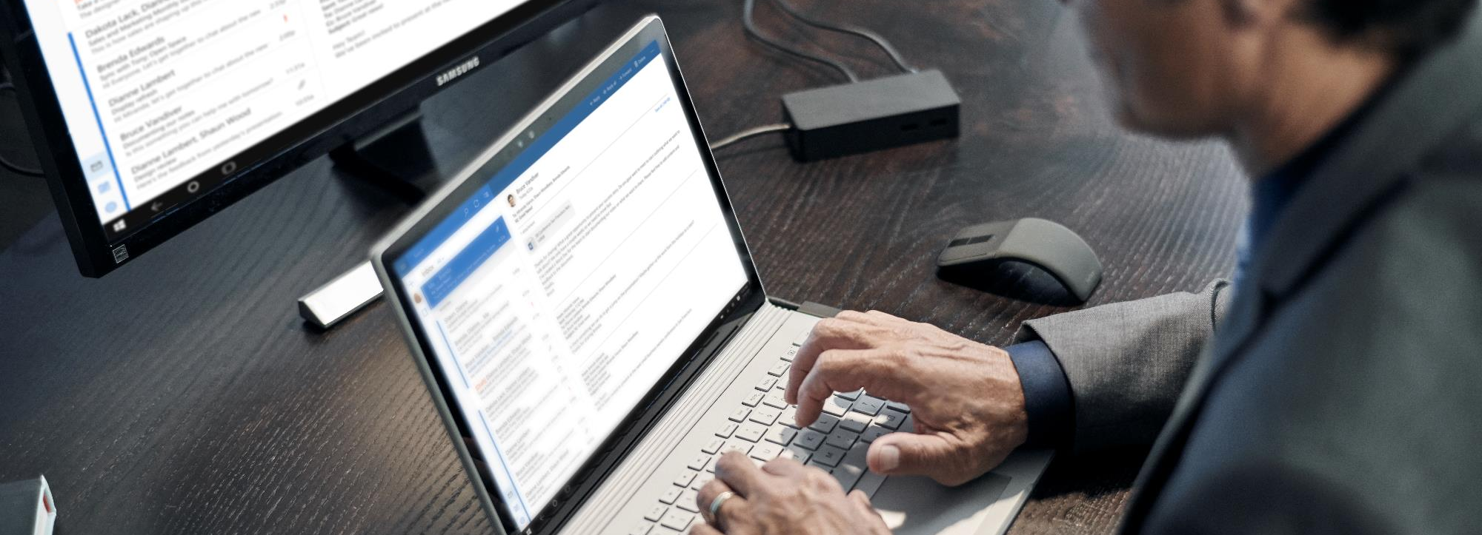
What it means for you
Now all businesses, regardless of size, can realize the full Windows security vision
The most
secure
Windows ever
Managed by a
trusted partner
Easy pricing
for small
businesses
Notes:
So now you can have the same secure Windows used by many of the largest, most security conscious companies and organizations in the world. It’s fully managed by an expert partner, and packaged and priced sensibly for small businesses.

Slide 23
Next steps
(insert next steps here)
Notes:
Completing the stack: New partner-managed servicing opportunities for SMBs with Windows

Slide 24
© 2016 Microsoft Corp.

Slide 25
Appendix

Slide 26
Windows 10 Enterprise Do great things. The best Windows ever keeps getting better
Safer and more secure
More productive
More personal
Powerful, modern devices
Windows Information Protection
Windows Hello
Credential Guard
Device Guard
AppLocker
Windows Defender Advanced Threat Protection
Azure Active Directory Join
Mobile Device Management
Application Virtualization
(App-V)
Windows Ink
Windows Store for Business
Cortana Management
Managed User Experience
User Experience Virtualization (UX-V)
Windows 10 for Industry Devices
Innovative designs
New experiences
Best in class performance
The most trusted platform
Always up to date
The most versatile devices

Slide 27
Office 365 The most complete, secure cloud productivity service
Authoring
Mail & Social
Sites & Content Management
Chat, Meetings & Voice
Analytics
Word
Excel
PowerPoint
OneNote
Outlook
Exchange
Yammer
OneDrive
SharePoint
Delve
Skype
Power BI
Delve Analytics
Secure and Compliant
Manageable
Extensible
Always up to date

Slide 28
Enterprise Mobility + Security Holistic, innovative security for your transition to mobility & cloud
Identity and Access Management
Managed Mobile Productivity
Information Protection
Identity Driven Security
Azure Active Directory
Premium P2
Azure Information Protection Premium P2
Microsoft Cloud App Security
Azure Active Directory
Premium P1
Microsoft Intune
Azure Information Protection Premium P1
Microsoft Advanced Threat Analytics
Productivity without compromise
Intelligent security for new threats

