Slide 1
How to use this deck: Overview Published: July 2016
NO EXTERNAL ONE TO MANY PRESENTATIONS OF THIS CONTENT IS PERMITTED. THIS DECK IS FOR 1 TO 1 DIRECT CUSTOMER CONVERSATIONS ONLY. YOU SHOULD NOT BLOG OR PUBLICLY SHARE THIS CONTENT BROADLY
This deck is intended as a high level business overview of Windows 10, both shipping features as well as future looking features.
You can find more information on Windows 10 http://windowsready
Please do not make changes to this presentation. However, feedback is very welcome. Please send feedback to Microsoft through your Microsoft Partner Sales Executive.
Please make sure you review all notes prior to presenting this deck.
© 2016 Microsoft Corp.
Notes:
This is a hidden slide for internal use only.

Slide 2
Windows in the enterprise
Notes:
Hello, I am excited to have the opportunity to speak with you today.
My name is….
A little about me…

Slide 3
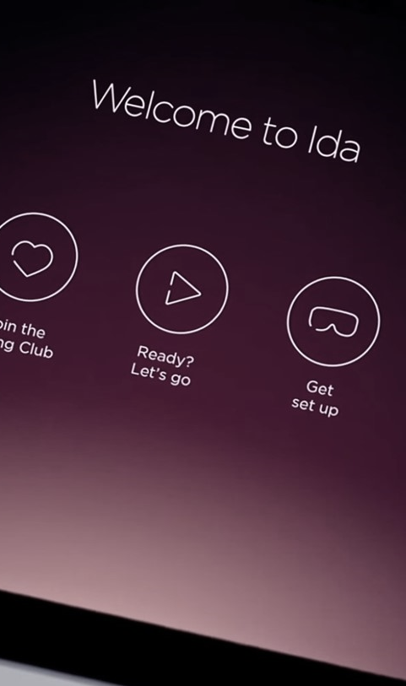
DIGITAL TRANSFORMATION
Is everywhere
Notes:
Complete slide talk track below.
Key points to land
The transformation cuts across all industries and companies big and small. Even the most entrenched industries are being disrupted by digital transformation.
Some of the most disruptive companies we have seen arise over the last few years have been riding this trend.
These companies are using technology to meet the demand for more personal experiences for customers.
Established companies are creating more personal experiences – leading the charge of their digital transformation, in attempts of beating digital disruptors to the punch
Talk track
We have seen a wave of digital transformation happening in business over the last few years. This transformation cuts across all industries and companies big and small.
Some of the most disruptive companies we have seen arise over the last few years have been riding this trend. These companies are using technology to meet the demand for more personal experiences for customers.
Companies like: Uber delivering the type of car when and where you need it making it reliable and seamless – and disrupting the 100+ year old taxi industry.
AirBnB, taking the middle-man out of lodging and really allowing you to find a perfect, and personal location.
Even the most entrenched industries are being disrupted by digital transformation.
(Click)
But digital transformation is not just on the minds of startups.
We see companies from established travel, hospitality, banking, healthcare, retail, and a host of others working hard to digitally transform themselves. They are not just worried about non-traditional competitors or new business models invading their space—they are using these more personal experiences to succeed.
In a world where digital technology is evolving and often disrupting any industry you can think of, building and maintaining personalized customer relationships has become more important than ever. That’s why CMOs and brand leaders need to look beyond the traditional marketing tactics of yesterday and embrace new, immersive and unexpected ways of delivering powerful experiences for their customers.
Virgin Atlantic did just that with the creation of Ida, an immersive digital adventure which features specially created content that takes viewers on a guided tour through a virtual Upper Class experience, from check-in to boarding — all shown on a compact mobile device that can meet the audience where they are.
Ida allows Virgin Atlantic to seamlessly and flexibly share this experience across multiple devices, while capturing more insightful intelligence about their customers’ wants and needs.
Whether at large trade events or sending field agents for small-scale client meetings, they have a digital experience to share that isn’t the focal point, but rather a way to create curiosity and spark conversations.
**************************************************************************************************
** Talk track from here is based on Virgin Atlantic case study. Other case study links are at the end of the slide notes. Feel free to replace with a different case study that is more appropriate for your customer. **
**************************************************************************************************
Virgin Atlantic, source: http://blogs.microsoft.com/business-matters/2015/11/10/virgin-atlantic-brings-its-customer-experience-to-life-using-windows-10/
TGIF, source: http://news.microsoft.com/2015/01/12/tgi-fridays-partners-with-microsoft-on-tablets-to-streamline-orders-improve-customers-visits/
SunGard, https://www.sungard.com/company/newsroom/press-releases/2015/investor-financial-planning-apps-2015
Sheraton Hotels and Resorts, https://customers.microsoft.com/Pages/CustomerStory.aspx?recid=6799
University of Pittsburgh Medical Center (UPMC), https://customers.microsoft.com/Pages/CustomerStory.aspx?recid=3094
**************************************************************************************************

Slide 4
CIO BUDGET
ALLOCATION
71%
55%
Say their top priority is supporting new business needs
Percent of budget spent on business as usual
Source: Deloitte CIO Survey 2014
Notes:
Complete slide talk track below.
Key points to land
Today, technology ranks as a priority along side growth, labor, materials and more among business?
Although you have the attention of the CEO to transform over half of your budgets are being spend on keeping the lights on
Talk track
More than ever, CEOs are looking for ways to digitally transform the companies they run—looking to technology as a way to enable growth and differentiation.
And clearly, you understand this too. 71% of you say supporting new business needs is at the top of your list of priorities.
But there is a problem.
Although you have the attention of the CEO and the mandate to transform, (Click) over half of your budgets are being spent on doing what you are doing now.
So what’s holding you back?
Source:
Deloitte CIO Survey 2014

Slide 5
What we hear from you
200+ Days
Median # of days attackers are present before detection
Decade-old PC tech, infrastructure, and processes drive up IT costs and slow business agility.
$146-$188 per device
Cost of keeping user devices up to date and secure
I’m worried about security threats and managing the risk to my business.
$3.5M
Average cost of data breach (15% YoY increase)
$1,930 per PC
Cost of upgrading Windows XP to Windows 7
80% of workers
spend a portion of their time working outside the office
41% of CEOs
Expect digital revenue to double over the next 5 years
My employees need to be productive on every device they use.
We need to capitalize on new business opportunities quickly.
38% of Millennials
feel outdated collaboration tools hinder innovation
47% of existing revenue
considered to be under threat in the next 5 years
Sources: Gartner, Ponemon Institute, IdeaPaint, MIT Center for IS Research
Notes:
Complete slide talk track below.
Key points to land
Security is, of course, another top concern. The cost of a security breach can have a material impact on your financial performance.
Agility is also a top priority. Older methods for deployment and management are create challenges in the current environment.
Millennials have arrived, and they won’t stand for outdated processes that hinder their out of the box thinking
There is great business opportunity for companies that transform quickly.
Talk track
Security threats are on everyone’s mind. With the sophisticated attacks we are seeing the stakes are very high and a single breach can have a material impact on a company’s success or failure.
Many of you tell us that agility is a top priority for you and your business, but are struggling with infrastructure and processes that are no longer good enough. What worked a decade ago is no longer enough. You need new options.
At the same time, you have employees and internal customers who want/demand the best. They use the latest technology and devices at home, and they expect the things they use at work to deliver just as well and be just as personal.
“Millennials” are starting to make up a greater and greater percentage of the workforce. Giving them the collaboration tools they expect is important to keeping them productive and staying ahead of the competition.
And, you are looking to capitalize on the new business opportunities that digital transformation offers, and you are looking for technology partners that can help.
===
Sources:
-243 days for attacker to be present: http://www.fireeye.com/news-events/press-releases/read/fireeye-releases-annual-mandiant-threat-report-on-advanced-targeted-attacks
-$3.5 million cost: http://www.ponemon.org/blog/ponemon-institute-releases-2014-cost-of-data-breach-global-analysis.
-Gartner: Use TCO to Assess Choices in Devices, Support Policies and Management Approaches, November 4, 2014.
-Ponemon Institute: 2014 Cost of Data Breach Study.
-EOs see technology-related change as a way to achieve growth in 2015 and 2016… CEOs expect digital revenue to double over 5 years, from 22 to 41%. Mark Raskino. 2015 CEO Survey: Committing to Digital. Gartner. April 10, 2015
IdeaPaint source: http://d1jbvhpem1c36a.cloudfront.net/wp-content/uploads/IdeaPaint-2013-Millennial-Survey.pdf
MIT Center for IS Research, September 2015

Slide 6
DESIGNED FOR DIGITAL TRANSFORMATION
The most trusted platform
More productive
More personal
The most versatile devices
Notes:
[Complete slide talk track below.]
Key points to land
Security is key to a successful digital transformation. We’ve made great investments in Security to protect your company from modern security threats, Windows is THE most trusted platform for businesses
We have designed Windows to help you lower TCO and get rid of a lot of the costly processes that you were using before.
Windows exceeds employee expectations for more personal computing and productivity.
That is delivered on with the versatile devices you already own, AND lighting up the newest and most innovative devices out there.
Talk track
These needs have guided our investments in Windows 10.
We could talk for hours about security alone, where we are working hard to deliver new ways to protect your company from modern security threats - making Windows THE most trusted platform for businesses.
We have also designed Windows to help you lower TCO by making your IT department more productive. We want to help you reduce the amount you are investing in maintaining the status quo with old infrastructure and processes, so you have more to invest in digital transformation.
And we are focused on the user, meeting and exceeding their productivity needs—and delivering on their expectations for more personal computing.
We are delivering this on with the devices you already own, AND lighting up the newest and most innovative devices out there.

Slide 7
MODERN SECURITY THREATS
“There are two kinds of big companies, those who’ve been hacked, and those who don’t know they’ve been hacked.”
James Comey, Director FBI
Notes:
Here is the quote you saw a second ago from FBI Directory James Comey.
This is a scary statement from a man on the front lines in this battle.
Let’s talk about the implications of these threats, and how Windows 10 can help.

Slide 8
“Cyber security is a Ceo issue.”
-McKinsey
$3.0 Trillion
$3.5 Million
Impact of lost productivity and growth
Average cost of a data breach (15% YoY increase)
CYBER THREATS ARE A MATERIAL RISK TO YOUR BUSINESS
Source: McKinsey, Ponemon Institute, Verizon
Notes:
Complete slide talk track below.
Key points to land
Security is no longer the problem of simply the security team, security is a CEO issue
Security issues can have a material risk to business
Talk track
The severity and prevalence of these threats means that, today, cyber security has become a CEO issue, it is no longer confined to the halls of the IT department.
When these attackers have compromised your systems, it takes and average of over 200 days before they are discovered. This is a lot of time to steal information and do damage to your business.
An analyst firm recently calculated that the average cost of a data breach was $3.5 million dollars, and had grown 15% year over year. This is simply the average cost; some breaches are far more than this.
One recent study by McKinsey put the global cost of lost productivity from security incidents at $3 trillion dollars. How does security impact productivity? Some attackers are not looking to simply steal your data, they are looking to hold it hostage, as we saw with the recent attacks on hospitals in California.
Today’s attacks are not launched by script kiddies. Attackers are very advanced, and attacks are targeted and persistent. Modern attackers are well funded, in some cases backed by nation states.
They will research your employee’s online, looking at sites like LinkedIn and using what they learn to send them very well crafted phishing emails. These aren’t the emails you might have seen with spelling and grammar errors claiming to be a prince that wants to give you money. These are tailored based on what they learned about the employee in their research and very well written.
A study by a security group found that if you send 100 phishing emails to employees, on average 23 of those mails will be opened. If those emails have an attachment, the attachment will be opened by 11 of those people, and 6 of them will do it in the first hour! You have very little time to respond.
Once those email attachments are opened or links clicked the attacker is in. Many people feel if they just have an anti-virus or anti-malware program on their computer they are safe but in almost half of the attacks studied there was no malware on the system to be detected by these programs.
This is scary, but Windows 10 was designed to help you defend against these threats.
---
Source 1 (HEADING): “Cyber security is a CEO issue”: http://www.mckinsey.com/insights/business_technology/why_senior_leaders_are_the_front_line_against_cyberattacks
Source 2: 243 days for attacker to be present: http://www.fireeye.com/news-events/press-releases/read/fireeye-releases-annual-mandiant-threat-report-on-advanced-targeted-attacks
Source 3: 140 countries developing cyber weapons: Infosec Institue, “The Rise of Cyber Weapons and Relative Impact on Cyberspace”
Source 4: $3 trillion in lost productivity: http://www.mckinsey.com/insights/business_technology/why_senior_leaders_are_the_front_line_against_cyberattacks
Source 5: $3.5 million cost: http://www.ponemon.org/blog/ponemon-institute-releases-2014-cost-of-data-breach-global-analysis

Slide 9
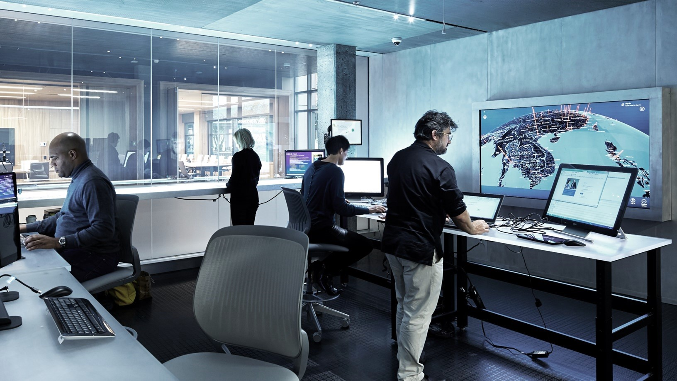
THE MOST TRUSTED PLATFORM
Notes:
Windows has strong defenses to keep your devices and network secure.

Slide 10
THE MOST TRUSTED PLATFORM
Replace passwords, protect identities
Only run software
you trust
Protect sensitive corporate
data
Browse securely
and with confidence
Detect compromised devices quickly
Strengthen auth. with biometrics and hardware-based multi-factor
Eliminate Malware on corporate devices
Automatic encryption with persistent protection
Move browser sessions to an isolated micro-virtualized environment
Use behavioral detection, cloud, and human threat intelligence to quickly identify compromised devices
Windows Hello
Microsoft Passport
Companion Device Framework
Credential Guard
Secure Boot
Device Guard
Windows Defender
Enterprise Data Protection
Project “Barcelona” *
Windows Defender Advanced Threat Protection
* 2017 projected delivery
Notes:
[Complete slide talk track below.]
Key points to land
Passwords need to be replaced with something more secure, but we don’t stop there, we drive a series of innovations that will both protect identities and delight users.
Running only the software you trust is a key to protecting your devices. Windows does this to help eliminate malware.
EDP products against accidental data leakage.
Barcelona uses micro-virtualization to secure the browsing sessions. (Coming in 2017)
Windows Defender ATP provides post breach protection to quickly detect suspicious behavior.
Replace Passwords & Protect corporate identities]
It starts with replacing passwords and protecting corporate identities.
Windows Hello and Microsoft Passport are the most personal and secure way to access Windows devices and services and today. They provide enterprise grade security with fingerprint, facial, and iris recognition.
This summer we will make good on the promise to enable you to use you phone to remotely unlock your Windows 10 PC’s, we’ll start with Windows Phone and Android this year and follow up with iOS next year. Adding a second factor of authentication just got a lot easier and cost effective for your organization.
But phones are just one type of device you want to use for authentication. So we’re introducing the Microsoft Passport companion device framework. This means that hardware vendors can more easily innovate and create devices of all types In addition, this framework allows you to extend multi-factor auth to sites and services on the web!
These devices will range from traditional ID cards or smart cards, to wearables, or even IoT devices. Each of these devices can offer the same enterprise grade security that you’re used to today. This means you can choose the solution right for you—including defense, financial, retail, and health care—just to name a few.
You will see devices from partners like Yubico, HID, and others. One interesting device is the Nymi band. The Nymi band can monitor your heart rate to uniquely identify you, and log you in when you get close to your device.
In addition to authentication, we continue to harden the OS to protect corporate identities (certificates, tokens, tickets, etc.). This includes using hardware based virtualization to isolate and protect logins from attacks, heading off an entire category of attacks.
This means that, if an employee falls victim to an attack, Windows 10 has technologies, such as Credential Guard, to help contain the breach and prevent the attacker from moving beyond that device.
In the past, attackers could spread across your network from one device using a technique known as “Pass the Hash.” With Windows 10, these attacks (in their current form) no longer work.
[Only run software you trust]
We have to rethink our approach to running only software we trust. Today we run anti-malware programs and try to look for malware signatures. While important, we need to do more. In one study almost half of the PCs breached lacked any currently detectable malware on them. Hackers often compile specific code for specific attacks and they go after the weak like, the users, to get them to install it.
Windows protects the applications you run so you can ensure only software your IT department has signed is trusted and runs with a technology called Device Guard. Even if an employee accidently downloads dangerous software your devices can be protected against it.
[Protect enterprise data against leaks, theft, or accidental disclosure.]
We are also making advances to help protect sensitive intellectual property.
With the increase of employee-owned devices in the enterprise, there’s also an increasing risk of accidental data disclosure through apps and services that are outside of the enterprise’s control like email, social media, and the public cloud.
Many of the existing solutions try to address this issue by requiring employees to switch between personal and work containers and apps, which can lead to a less than optimal user experience. Enterprise data protection (EDP) offers a better user experience, while helping to better separate and protect enterprise apps and data against accidental disclosure risks across both company and personal devices, without requiring changes in environments or apps. Additionally, EDP when used with Rights Management Services (RMS), can help to protect your enterprise data by persisting the protection even when your data roams or is shared.
[Browse Securely]
Browsing securely is an area that many companies worry about. This is an area where we are doing some very innovative things.
In 2017, we will introduce a way to move Edge browser sessions within a micro-virtualized environment. Similar to how Credential Guard uses hardware based security today, this will isolate whatever is running in the browser from your corporate data, and protect your devices.
If a user’s session is attacked and the attacker is able to drop any type of malware or gain any kind of foothold on the device, it all disappears when the browser session is closed.
We are very excited about the level of security this can bring and will have more information to share as we progress and get closer to 2017.
[Detect suspicious behavior quickly]
Even with all of the defenses Windows 10 introduces it’s hard to keep every intruder out. Sometimes they find and exploit vulnerabilities that aren’t known, or more often they find ways around the best defenses with social engineering and attacking the user. Regardless of how they get in, if you don’t know they are there they can do real damage. While we will continue to invest heavily in building stronger defenses you should also use a mindset that assumes breach to provide additional protections.
Everything we have talked about so far is about working to better keep the users out of your devices and network. To help protect our enterprise customers, we are developing Windows Defender Advanced Threat Protection, a new service that will help enterprises to detect, investigate, and respond to advanced attacks on your network and devices.
Let’s talk more about Windows Defender ATP… CLICK…

Slide 11
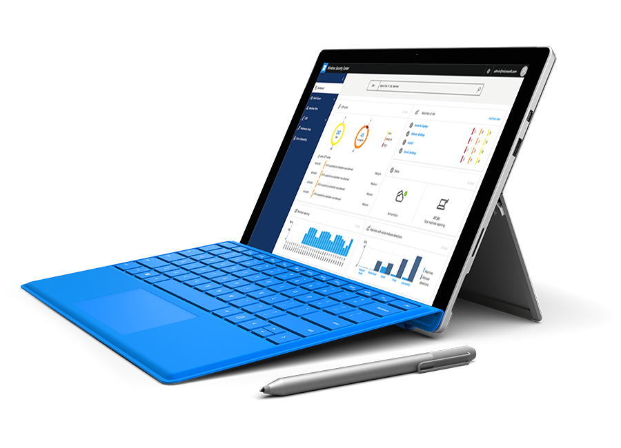
WINDOWS DEFENDER
ADVANCED THREAT PROTECTION
DETECT ADVANCED ATTACKS AND REMEDIATE BREACHES
Built in to Windows
No additional deployment & infrastructure. Continuously
up-to-date, lower costs.
Behavior-based, cloud-powered breach detection Actionable, correlated alerts for known and unknown adversaries. Real-time and historical data.
Rich timeline for investigation
Easily understand scope of breach. Data pivoting across endpoints. Deep file and URL analysis.
Unique threat intelligence knowledge base Unparalleled threat optics provide detailed actor profiles
1st and 3rd party threat intelligence data.
Notes:
Building on the existing security defenses Windows 10 offers today, Windows Defender Advanced Threat Protection provides a new post-breach layer of protection.
With a combination of client technology built into Windows 10 and a robust cloud service, it will can quickly detect threats that have made it past other defenses. It does this by looking at the behavior of the machine, not just by looking for malware signatures.
For example, if a machine suddenly is firing up PowerShell and connecting to strange IP address while scanning your network – and it’s never done anything remotely similar to this before, it’s very likely been compromised.
Windows Defender ATP spots these behaviors and can take action to both shut them down, and to give you the information you need to quickly understand the extent of the compromise.
But maybe it’s not that simple? Maybe the behaviors are not as blatant. This is where the cloud solution comes in. Microsoft has a unique degree of visibility into the threat landscape. The ATP cloud service is constantly receiving information from over a billion sensors around the world. By finding the patterns in that noise, it can spot new threats very quickly.
This is supported by a team of human hunters that are experts in threat detection. They apply their expertise to extend and constantly improve the system.

Slide 12
New challenges require a new platform
WINDOWS 7
WINDOWS 10
Malware starts before Windows, takes control, and evades detection
Prevents malware from compromising system before OS and defenses can start
Windows Trusted Boot
Passwords are easily stolen, multi-factor authentication hard and complex
Passwords can be replaced with biometrics and easy to use multi-factor authentication
Windows Hello
User credentials are easily stolen on companies networks
User credentials are protected using hardware based virtualization/isolation
Credential Guard
Malware can bypass anti-virus and app control solutions
Next Gen app control and OS hardening gives IT complete control of what runs in their environment
Device Guard
Users and apps can leak business data without restriction
Data separation and containment capabilities help prevent accidental data leaks
Enterprise Data Protection
3rd party solutions required to detect targeted attacks on devices
Detect and respond to breaches with built in behavioral sensors and cloud based analytics
Windows Defender ATP
Notes:
[Complete slide talk track below.]
Key points to land
Windows 7 was great for it’s time but the modern security landscape requires a new platform.
We’ve looked at a lot of the new security technologies built into Windows. You can see that these new challenges your business faces require a new platform to protect your assets.
It’s these new challenges that are leading many companies and organizations to switch to Windows 10.

Slide 13
US DEPARTMENT OF DEFENSE
Microsoft Receives The Ultimate Windows 10 Security Proof Point from US Department of Defense
Pentagon orders Windows 10 to be installed on all 4 million of its PCs
Notes:
As you might imagine, the United States Department of Defense is a demanding customer of ours, and they face the same challenges we all do, but at a very different scale.
So we are very proud to say that the DoD has looked at the security in Windows 10 and determined it is what they need to defend themselves in a world where they are “getting shot at every day.”
They have a plan to migrate 4 million devices to Windows 10 in the next year – they place that level of importance on it.
====
Pentagon to move fast in shift to Windows 10
Seattle Times – February 17, 2016
System Update: Pentagon Upgrading 4 Million Devices to Windows 10
NextGov – February 17, 2016
Microsoft just landed a huge deal to bring Windows 10 to 4 million Defense Department employees
Business Insider – February 17, 2016
Microsoft Receives The Ultimate Windows 10 Security Proof Point From U.S. Department of Defense
Forbes – February 17, 2016
Microsoft Sells U.S. Defense Dept. on Windows 10
The Wall Street Journal – February 17, 2016
Pentagon orders Windows 10 to be installed on all 4 million of its PCs
CNN Money – February 17, 2016

Slide 14
MORE PRODUCTIVE
Notes:
With Windows 10 we want to help you reduce the amount you spend on doing what you are doing today, so you have more to invest in digital transformation.

Slide 15
MORE PRODUCTIVE
FOR IT
FOR END USERS
Use the cloud to drive IT transformation
Reduce disruptive deployments
Always have what you need
Put your digital assistant to work
Streamline IT process by harnessing the power of the cloud on your terms
End wipe-and-reload deployments, enable managed, phased rollouts
Access your apps and data from any Windows device
Get proactive help and business intelligence from a true assistant
Cross device MDM support
Azure Active Directory
Windows Store for Business
Mobile App Management * (MAM)
Dynamic provisioning
In-place upgrades
Application compatibility
Windows as a Service
Azure AD user state roaming
OneDrive for Business and Office 365
Cortana, with Azure AD
Cortana Analytics and Power BI
* 2017 projected delivery
Notes:
[Complete slide talk track below.]
TRANSISION:
Our vision for productivity spans IT and End User productivity.
First I’d like to focus on IT (CLICK to fade out End User side of slide)
Key points to land
Decades old IT processes need to modernize to reduce costs and increase agility. With Windows you can leverage the cloud, at your pace, to drive IT transformation.
Windows rollouts shouldn’t be years long projects with large user disruption.
[Use the Cloud to drive IT transformation]
As the management landscape changes, Windows 10 helps you to become more cloud enabled—on your terms.
We already have support for MDM to help simplify management, as well as Azure Active Directory (AAD) Join to enable you to use the latest in cloud connected security, and the Windows Store for Business for you to be able to create a curated store experience for your employees to quickly get the apps they need in a self-service manner.
But, we heard you, you need more. You want employees to use their personal devices to access work files, yet you need to manage the app and the data, not the device. So, in 2017 we will introduce Mobile Application Management (MAM) to enable you to define security and policy at the app level, not the device level. For example, corporate apps can be blocked from being shared on Facebook or only saved to the corporate cloud service like OneDrive for Business while all other personal apps would be unaffected. You secure and manage the apps, not the entire device.
Soon, with Windows, any app will be able to be managed, on both mobile devices AND PCs. iOS and Android can’t do that—their apps need to be specially designed to be managed or even have two copies installed.
By contrast, MAM doesn’t require your existing apps, both your Win32 (desktop) apps and your Windows Store apps, to change as all types of apps can be managed right out of the box.
[Reduce disruptive deployments]
Most organizations today buy a new computer and then send it off to IT to “flatten” it and reload a new image. The process of creating and maintaining those images is expensive. With Dynamic Provisioning in Windows now you can take a brand new machine, straight out of the box, and when the user logs in for the first time with their Azure AD credentials you can automatically enroll that device in MDM management, push down any policies IT wants to set, change the editions of Windows from Pro to Enterprise, push down corporate apps, and soon even remove preinstalled apps. All of this can happen without IT involvement for the user and without deleting any of the drivers or critical machine setup parameters.
We have heard your feedback around ongoing upgrades.
[Note to presenter: It’s important here to be empathic with the customer. We have heard the feedback on time, package size, etc. and are focused on updates that will make this less impactful for the end user but you most set customer expectations properly that 2016 will not see a “silver bullet” answer to these concerns. We will make some minor changes in 2016 but this is a long lead item and will show up more noticeably in 2017]
We are focused on making the process as friction-free as possible and minimizing its impact. You will see some improvements in the upgrade process in 2016, and even more noticeable improvements coming in 2017.
We continue to address concerns, like package size, in the short term we aim to provide better deployment guidance around network and peer to peer technologies (like BranchCache) - to help you reduce the impact of upgrades immediately.
We will also provide IT increased control over update rollout through deployment rings and ability to control update delivery optimizations to suit the bandwidth needs, through Windows Update for Business.
When we talk about “stay up to date on a proven platform” a big part of that story is Windows as a Service.

Slide 16
Managing innovation
Speed of change drives need for increased agility
Not all users and devices are the same. Some need to be current and up to date, others need to stay static, sometimes for years.
Addressing modern security threats requires rapidly deploying updates and new functionality.
Historically, technology adoption is dragged down by compatibility, complexity and cost.
Managing the tension between staying up to date and the historic complexity of migration.
Reducing Fragmentation
Notes:
[This is meant to tee up a discussion on WaaS and uncover deployment concerns, or blockers, that might exist. There are deeper dive decks you should use for a more complete conversation. For more information see the video and deck at https://microsoft.sharepoint.com/sites/infopedia/Media/details/aevd-3-104915.]
[Complete slide talk track below.]
Key points to land
Not all devices and users are the same.
We have options both for special systems (LTSB) and business users to keep devices current and still maintain stability.
Talks Track
Why Windows as a Service?
We’ve heard from you that now all of your devices are the same. You have business users that want and need to have the latest features and functionality. You also have to have devices, like on a factory floor, that run the same OS for years.
When you attempt to consume years of change and new technology with upgrade projects that happen every 3 to 5 years it leads to challenges with capability and complexity integrating it into your environment. These factors leads to increased cost and delays.
With the modern security landscape its not just about deploying patches, you also often need to deploy new functionality, such as Credential Guard or Project “Barcelona” to stay ahead of the attackers. The attackers don’t work on 3 to 5 year cycle and neither can your defenses.
There is a tension that must be managed between staying up to date and the historic complexity of migrations. With Windows as a Service we work to address this.
You have the option to use the Long Term Service Branch (LTSB) for your special systems that need to remain static for specific reasons for years. For most of your systems and business users we work to balance this tension to help you innovate faster in your organization.

Slide 17
Windows as a service
Release LIFECYCLE
RELEASE
Feedback
Pilot
Production
4 - 8 months
4 months
12 – 22 months
60 days
Notes:
[This is meant to tee up a discussion on WaaS and uncover deployment concerns, or blockers, that might exist. There are deeper dive decks you should use for a more complete conversation. For more information see the video and deck at https://microsoft.sharepoint.com/sites/infopedia/Media/details/aevd-3-104915.]
[Complete slide talk track below.]
Key points to land
You have on average 4 to 8 months to provide use feedback before release and do early evaluation.
Your pilot phase should be about the first 4 months after release
Broad production and deployment is the next phase and is about 12 to 22 month
Talks Track
With Windows as a Service we shorten the timeframe between releases from the historic 3-5 years but work to make it at a pace consumable by your organization. Let’s start by looking at the lifecycle of a single release.
Each individual release lifecycle starts with a Feedback period. Here you have time to evaluate the product for 4-8 months before release and let us know what you think, what works, and what doesn’t. You can get early looks at the product to give us this feedback by signing up for the Windows Insider program or the Windows TAP program. This is your chance to impact and influence the product as well as do some early, preliminary evaluation.
After release, there is a 4 months period for Piloting time for you to run broader pilots in your organization and test on a wider scale than you might have during the Feedback phase. It’s during this phase you should be reviewing the performance of any mission critical apps you have.
After 4 months we move into broad deployment and the Production phase begins. This is when you should look to start moving beyond your pilot users and scaling across your organization in a phased rollout.
We will support TWO production releases at any time so the end of a production phase is based on that n+2 release date. This is an important point, and we will talk more about how it works and what it means the next slide. Since we support two releases at a time, there are times you might want to skip a release. We don’t recommend you skip a release, but there are some cases when this is the right answer.
We heard feedback about the 4 month pilot phase; many see it as too short to make the jump to the newest release if you opted to skip a release. As a result, we added 60 days to give you a full 6 months after the new release comes out to complete deployment.
We also heard that the cadence of releases was too fast as we collectively start this new process. So we are adjusting our pace in 2016 and into 2017. Now, there will only be a one release in 2016 and potentially two releases in 2017
That’s the model of an individual release. Let’s look at what this means in the real world….

Slide 18
Windows as a service CADENCE
TWO RELEASES SUPPORTED IN MARKET
2016
2017
2018
July
Jan
July
Jan
July
Jan
Windows 10 July 2015
Feedback
Pilot
Production
November Update November 2015
Feedback
Pilot
Production
Anniversary Update
Summer 2016
Feedback
Pilot
Production
Example 2017 Release
Hypothetical date
Feedback
Pilot
Production
Notes:
[This is meant to tee up a discussion on WaaS and uncover deployment concerns, or blockers, that might exist. There are deeper dive decks you should use for a more complete conversation. For more information see the video and deck at https://microsoft.sharepoint.com/sites/infopedia/Media/details/aevd-3-104915.]
[Complete slide talk track below.]
Key points to land
We have adjusted the cadence based on feedback, you don’t have to update three times a year.
Talks Track
Here we see:
…the initial release of Windows 10,
…the November Update
…the coming 2016 release this summer, formally known as the Anniversary Update.
…and a hypothetical example of how the first 2017 release might look.
Remember that we now support two production releases in market at a time. This means that if you have deployed the November Update, you have until late 2017 to move to the 2016 Summer release.
Some customers have told us that they have concerns about the cadence of releases, because they are worried new releases will arrive before they are able to deploy the last release, they would fall behind. Now that each release has a longer lifespan, you have more time to deploy, and more time to optimize your processes and infrastructure for this new model.
So far, the response to these changes has been largely positive, but our priority here today is to hear your thoughts.

Slide 19
MORE PRODUCTIVE
FOR IT
FOR END USERS
Use the cloud to drive IT transformation
Reduce disruptive deployments
Always have what you need
Put your digital assistant to work
Streamline IT process by harnessing the power of the cloud on your terms
End wipe-and-reload deployments, enable managed, phased rollouts
Access your apps and data from any Windows device
Get proactive help and business intelligence from a true assistant
Cross device MDM support
Azure Active Directory
Windows Store for Business
Microsoft App Management (MAM)
Dynamic provisioning
In-place upgrades
Application compatibility
Windows as a Service
Azure AD user state roaming
OneDrive for Business and Office 365
Cortana, with Azure AD
Cortana Analytics and Power BI
* 2017 projected delivery
Notes:
[Complete slide talk track below.]
TRANSITION: That’s a look at how we are making IT more productive, let’s take a look at what we are doing for end users (CLICK to build slide).
Key points to land
Employees are on the go and using multiple devices.
They should expect the best experience no matter what screen they’re using by running in desktop or tablet mode, using typing or touch inputs, or use your phone like a desktop.
With Window 10’s tight integration with Office 365 and Azure Active Directory your employees always have what they need, on any device
Personal assistants and bots will change the way people interact with technology and the way that business functions. With Windows 10 we introduced our own digital personal assistant to the PC - Cortana.
Looking ahead, Cortana will become more business friendly….we are investing heavily in ensuring she is compliant and manageable in your environment
[Always have what you need]
Employees are on the go and use multiple devices, no surprise there. With Windows we want your work to follow you, right where you left off, as you move. You can create a document on your PC at work, make some edits on the train home, and make a quick update while on the go with your phone. Windows will make it all easy and quick thanks to deep and seamless connections with Office 365 and OneDrive for Business.
[Put your digital assistant to work]
Speaking about Cortana, we are moving from a world where you use your device to look up a weather forecast for your city, to one where you simply say “do I need a jacket?” This level of personalized productivity experience is coming to business users with Cortana for enterprise.
Cortana will also be able to help you control your business schedule in more ways than simply telling you when you have to leave for a meeting. Wondering what documents you should read to prepare for meeting or other important information? Cortana has your back.
Control of information is important to businesses and with AAD integration you have the ability to manage what Cortana learns, and have Cortana forget this information when an employee leaves the company.
You can also give Cortana access to your Cortana Analytics & Power BI data in your Office 365 cloud and she can now provide you rich answers to help you find the next big business opportunity, or alert you to concerning trends.

Slide 20
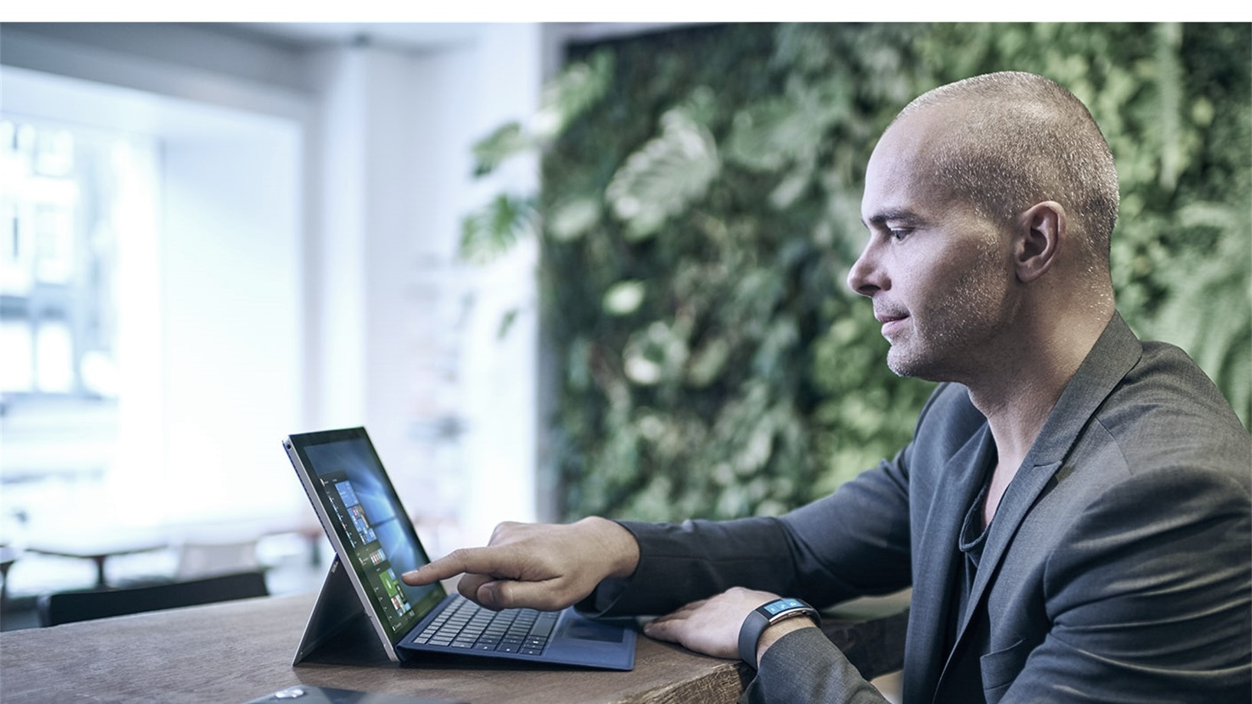
MORE Personal
Notes:
I think we all can agree that, as time goes on, we will be asked to do more and more, so we must increase productivity to keep up. But it’s not just about tools to do things faster, we are now at a point where to become more productive you need tools that learn how you work and adjust to your personal style.

Slide 21
MORE PERSONAL
Interact the way you want
Get the best experience
Do more with digital ink and a choice of input experiences
The best screen is always the one you’re on
Pen and Ink
Touch
Mouse and keyboard
Continuum
Continuum for Phone
Universal Windows Apps
Notes:
[Complete slide talk track below.]
Key points to land
Windows 10 is familiar, and every user is a first class citizen. Whether the situation calls for using mouse and keyboard, touch, pen & ink or voice.
One area we have worked hard to improve is the ink experience with Windows to make it as natural and fluid as pen and paper.
Employees are on the go and using multiple devices.
They should expect the best experience no matter what screen they’re using by running in desktop or tablet mode, using typing or touch inputs, or use your phone like a desktop.
[Interact the way you want]
Working with Windows 10 feels familiar, whether the situation calls for using mouse and keyboard, touch, pen & ink or voice. Employees are instantly productive without the need for training.
And, more and more people are seeing the benefits to using a pen. When you use a pen, so many subtle changes happen. You appear more open and engaged in meetings since you are not separated by a laptop screen, and many people say that using the pen for certain tasks helps them even think differently.
In schools, researchers have found that when trying to solve really challenging science problems, students that started by organizing their ideas using a pen scored 25-36% higher than those who just used a keyboard. So why would we limit ourselves to just one approach?
And in the coming update to Windows 10, it gets even better.
From the moment you touch the pen to the screen to the moment you take it away, it does everything you would expect it to do in Windows—even when you are at the lockscreen.
You can edit and mark up documents in Office 365. Want to remove a paragraph or block of text? Simply scribble over it like you would on paper and Office 365 will delete it from your document. You can even use the pen to draw and sketch your ideas.
Sometimes the free form nature of ink is nice, but at the same time you miss the linear precision of drawing tools. In those cases, you simply pull up the built in ruler or protractor. You hold the ruler with your fingers, just as you would expect, and you draw crisp lines with the pen. It’s a great example of combing pen and touch input in the same experience to create something natural and powerful.
As you would expect from Windows, you can also use these tools in your own internal apps because Windows ink is not just something that sits on top of an app, it’s part of the app. Maybe you are looking to plan a quick run after work? With Windows you could draw your (non-linear) route right on the map app and it can tell you the distance of the line you draw. The ink is also bound to the map, if you rotate the map, look at it in 3D, or zoom in the ink adjusts with you. What can you do with ink in your business apps?
Of course, there is the to-do list. This is quite possibly the #1 thing people do with pen and paper today. Cortana can read your sticky notes and take action for you. Simply right “Call John tomorrow” and Cortana and set a remind for you for tomorrow to call John. Since Windows is cloud powered you’ll be notified on any device when it’s time to make your call.
[Get the best experience]
You should never be held back by the form-factor of the device you are on. In Windows 10, your 2 in 1 device (such as a Surface Pro) adapts so you get a great mouse and keyboard experience when typing, and then can shift into a touch-optimized “tablet mode” when the keyboard is removed thanks to a feature we call Continuum.
But Continuum is not just a PC feature, on many Windows Phones, you can connect a mouse and keyboard as well as a large monitor. In this mode you see what you would expect on a desktop, you get the start menu and can use productivity apps as you would expect. Then when you are done, you disconnect and walk away with your phone. It’s like having your PC in your pocket when you need it.
The bottom line is, with Windows 10 the best screen to use is the one you are already on.
*****
Sources:
Computer interfaces and their impact on learning by Sharon Oviatt (Infopedia)

Slide 22
MORE PERSONAL
Interact the way you want
Get the best experience
Chose devices that are right for you
Do more with digital ink and a choice of input experiences
The best screen is always the one you’re on
Range of innovative devices across 2-in-1s, tablets, and phones
Pen and Ink
Touch
Mouse and keyboard
Continuum
Continuum for Phone
Universal Windows Apps
Surface
Lumia
3rd party devices
Notes:
[Complete slide talk track below.]
Key points to land
Windows 10 is familiar, and every user is a first class citizen. Whether the situation calls for using mouse and keyboard, touch, pen & ink or voice.
One area we have worked hard to improve is the ink experience with Windows to make it as natural and fluid as pen and paper.
Employees are on the go and using multiple devices.
They should expect the best experience no matter what screen they’re using by running in desktop or tablet mode, using typing or touch inputs, or use your phone like a desktop.
[Interact the way you want]
Working with Windows 10 feels familiar, whether the situation calls for using mouse and keyboard, touch, pen & ink or voice. Employees are instantly productive without the need for training.
And, more and more people are seeing the benefits to using a pen. When you use a pen, so many subtle changes happen. You appear more open and engaged in meetings since you are not separated by a laptop screen, and many people say that using the pen for certain tasks helps them even think differently.
In schools, researchers have found that when trying to solve really challenging science problems, students that started by organizing their ideas using a pen scored 25-36% higher than those who just used a keyboard. So why would we limit ourselves to just one approach?
And in the coming update to Windows 10, it gets even better.
From the moment you touch the pen to the screen to the moment you take it away, it does everything you would expect it to do in Windows—even when you are at the lockscreen.
You can edit and mark up documents in Office 365. Want to remove a paragraph or block of text? Simply scribble over it like you would on paper and Office 365 will delete it from your document. You can even use the pen to draw and sketch your ideas.
Sometimes the free form nature of ink is nice, but at the same time you miss the linear precision of drawing tools. In those cases, you simply pull up the built in ruler or protractor. You hold the ruler with your fingers, just as you would expect, and you draw crisp lines with the pen. It’s a great example of combing pen and touch input in the same experience to create something natural and powerful.
As you would expect from Windows, you can also use these tools in your own internal apps because Windows ink is not just something that sits on top of an app, it’s part of the app. Maybe you are looking to plan a quick run after work? With Windows you could draw your (non-linear) route right on the map app and it can tell you the distance of the line you draw. The ink is also bound to the map, if you rotate the map, look at it in 3D, or zoom in the ink adjusts with you. What can you do with ink in your business apps?
Of course, there is the to-do list. This is quite possibly the #1 thing people do with pen and paper today. Cortana can read your sticky notes and take action for you. Simply right “Call John tomorrow” and Cortana and set a remind for you for tomorrow to call John. Since Windows is cloud powered you’ll be notified on any device when it’s time to make your call.
[Get the best experience]
You should never be held back by the form-factor of the device you are on. In Windows 10, your 2 in 1 device (such as a Surface Pro) adapts so you get a great mouse and keyboard experience when typing, and then can shift into a touch-optimized “tablet mode” when the keyboard is removed thanks to a feature we call Continuum.
But Continuum is not just a PC feature, on many Windows Phones, you can connect a mouse and keyboard as well as a large monitor. In this mode you see what you would expect on a desktop, you get the start menu and can use productivity apps as you would expect. Then when you are done, you disconnect and walk away with your phone. It’s like having your PC in your pocket when you need it.
The bottom line is, with Windows 10 the best screen to use is the one you are already on.
[Choose the devices that are right for you]
When you are ready for that hardware refresh, Windows 10 is also ready to light up today’s devices. In many cases, getting the most from the latest devices requires strong connections between the operating system and the hardware. The two must work in concert to deliver a seamless and powerful experience. Windows 10 lights up on the latest touch enabled tablets and laptops, phones, and 2 in 1 devices like no other.
*****
Sources:
Computer interfaces and their impact on learning by Sharon Oviatt (Infopedia)

Slide 23
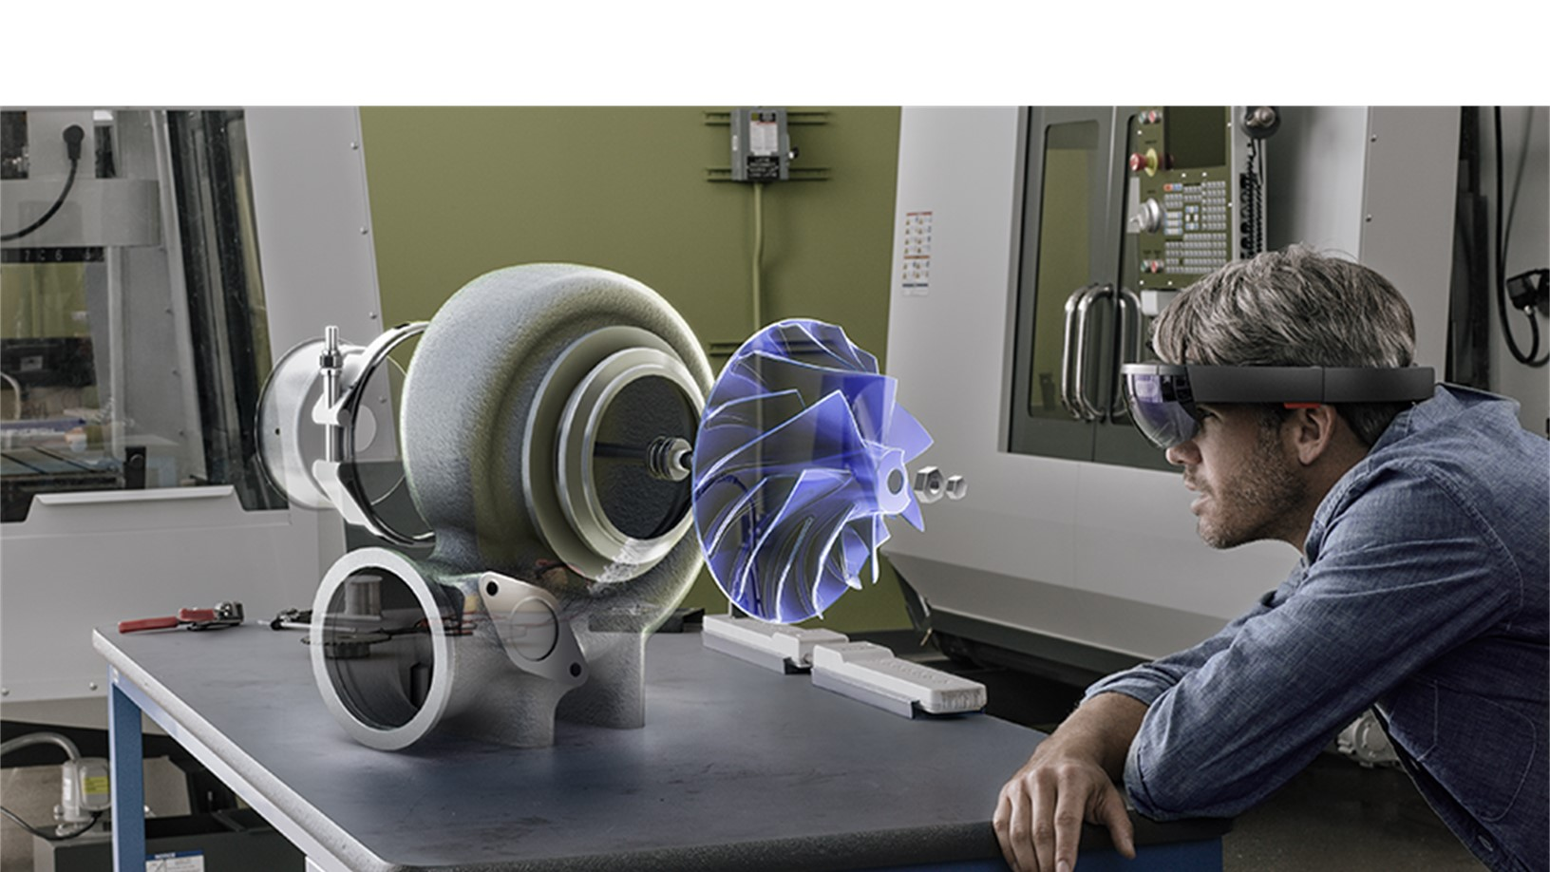
The most VERSITILE DEVICES
Notes:
Of course, it takes great devices to truly deliver the full Windows experience.

Slide 24
THE MOST VERSITILE DEVICES
Bring innovation to your current PCs
Chose devices that are right for you
Vertical industry and IoT solutions
Devices that redefine productivity
Windows 10 works great on Windows 7 PCs
Range of innovative devices across 2-in-1s, tablets, and phones
Find the right device for your Line of Business and IoT scenarios
Revolutionary new devices
In-place upgrade
Hardware compatibility
Surface
Lumia
3rd party devices
Windows 10 IoT
Granular UX control
Ruggedized devices
Surface Hub
HoloLens
Notes:
[Complete slide talk track below.]
Key points to land
Windows 10 works great on your existing machines, and with in-place upgrades it’s easy to get them there
Windows 10 runs on the widest array of hardware to meet your unique business needs
Windows 10 also supports IoT and other vertical industry solutions
Windows 10 enables the next generation of collaboration with devices like Surface Hub and the next generation of devices like HoloLens.
Talks Track
[Bring innovation to your current PCs]
Windows 10 is designed to work great on your existing devices. It works with what you have and brings the latest features to your existing hardware. You don’t have to wait until your next hardware refresh to start to take advantage of the value of Windows 10.
[Choose the devices that are right for you]
When you are ready for that hardware refresh, Windows 10 is also ready to light up today’s devices. In many cases, getting the most from the latest devices requires strong connections between the operating system and the hardware. The two must work in concert to deliver a seamless and powerful experience. Windows 10 lights up on the latest touch enabled tablets and laptops, phones, and 2 in 1 devices like no other.
[Vertical industry solutions]
Certain industries and scenarios require different types of devices. You might need a rugged device in a manufacturing plant, an embedded scanner in a retail environment, or a device optimized to run in a kiosk and print boarding passes in an airport – whatever the need, Windows devices can fill it.
From IOT solutions, to kiosks, to POS systems, to most other things you can think of, there is a hardware and software solution for you.
[Redefine productivity]
As we discussed, Windows 10 lights up on devices with touch and pen support. But Windows 10 is also looking forward and powering the next wave of entirely new, revolutionary, business devices.
Take Surface Hub. Surface Hub unlocks the power of group collaboration in ways that have never been done before. It uses the Windows 10 platform to power amazing large screen apps to create more engaging, productive, meetings – whether the team is in one location or many.
Microsoft HoloLens is truly something revolutionary. By augmenting reality, it opens up ways to create, learn, collaborate, and visualize that we have dreamed up, but was not possible before. You see your creations come to life in the world around you. And, it is powered by Windows 10.

Slide 25
THE MOST VERSITILE DEVICES
Bring innovation to your current PCs
Vertical industry and IoT solutions
Devices that redefine productivity
Windows 10 works great on Windows 7 PCs
Find the right device for your Line of Business and IoT scenarios
Revolutionary new devices
In-place upgrade
Hardware compatibility
Windows 10 IoT
Granular UX control
Ruggedized devices
Surface Hub
HoloLens
Notes:
[Complete slide talk track below.]
Key points to land
Windows 10 works great on your existing machines, and with in-place upgrades it’s easy to get them there
Windows 10 runs on the widest array of hardware to meet your unique business needs
Windows 10 also supports IoT and other vertical industry solutions
Windows 10 enables the next generation of collaboration with devices like Surface Hub and the next generation of devices like HoloLens.
Talks Track
[Bring innovation to your current PCs]
Windows 10 is designed to work great on your existing devices. It works with what you have and brings the latest features to your existing hardware. You don’t have to wait until your next hardware refresh to start to take advantage of the value of Windows 10.
[Vertical industry solutions]
Certain industries and scenarios require different types of devices. You might need a rugged device in a manufacturing plant, an embedded scanner in a retail environment, or a device optimized to run in a kiosk and print boarding passes in an airport – whatever the need, Windows devices can fill it.
From IOT solutions, to kiosks, to POS systems, to most other things you can think of, there is a hardware and software solution for you.
[Redefine productivity]
As we discussed, Windows 10 lights up on devices with touch and pen support. But Windows 10 is also looking forward and powering the next wave of entirely new, revolutionary, business devices.
Take Surface Hub. Surface Hub unlocks the power of group collaboration in ways that have never been done before. It uses the Windows 10 platform to power amazing large screen apps to create more engaging, productive, meetings – whether the team is in one location or many.
Microsoft HoloLens is truly something revolutionary. By augmenting reality, it opens up ways to create, learn, collaborate, and visualize that we have dreamed up, but was not possible before. You see your creations come to life in the world around you. And, it is powered by Windows 10.

Slide 26
DESIGNED FOR DIGITAL TRANSFORMATION
The most trusted platform
More productive
More personal
The most versatile devices
Notes:
I have talked about more personal computing, and how it is driving digital transformation in every sector of the economy, and how we’ve made investments in Windows to help you better navigate this digital revolution.

Slide 27
TRANSFORM YOUR BUSINESS with the
Microsoft enterprise cloud
Seamless user access to apps and data with Azure AD Join in Windows 10
Reduced deployment complexity with dynamic provisioning delivered via Azure AD Join and automatic MDM enrollment
Extended protection for your corporate data with Enterprise Data Protection and Azure Rights Management
Office is a key enabler of EDP and Azure Rights Management
Notes:
As we saw in every pillar, Windows 10 is cloud powered, on your terms and timelines. The Microsoft Enterprise cloud enables you to take advantage of these unique capabilities and I encourage you to learn more about Windows 10 and the Microsoft Cloud to get started today.

Slide 28
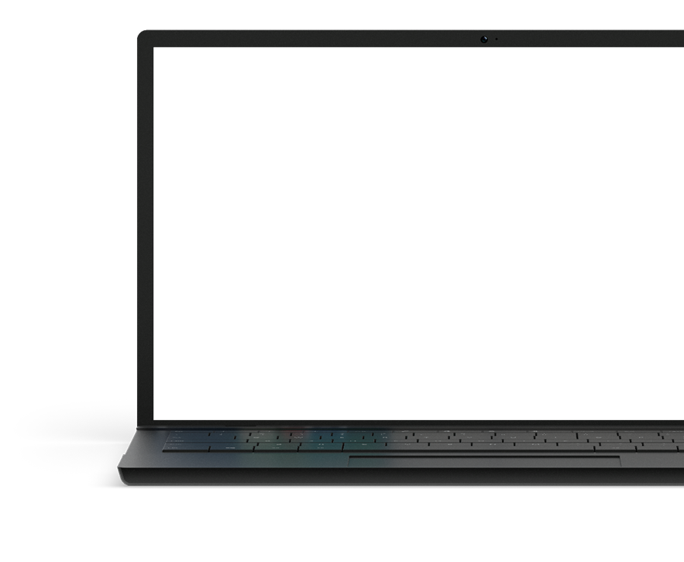
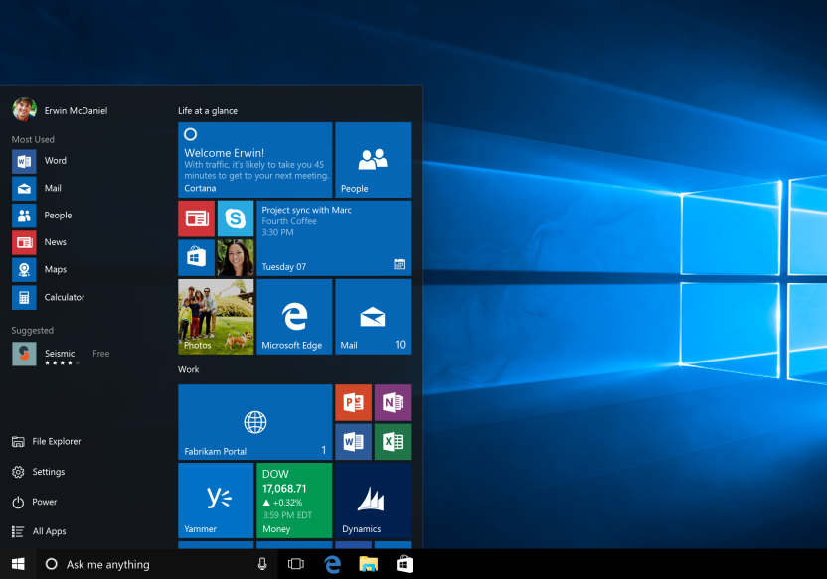
Getting VALUE from Windows 10
Accelerate your Windows 10 Deployments
Learn more about the Microsoft Enterprise Cloud
Join the Windows Insider program to see the latest innovations in Windows
Notes:
Accelerate your Windows 10 Deployments
Learn more about the Microsoft Enterprise Cloud
Join the Windows Insider program to see the latest innovations in Windows

Slide 29
Notes:
Thank you.

Slide 30
Windows 10
DEMO
name
Notes:
<insert if you are showing demos>

